Slide 1
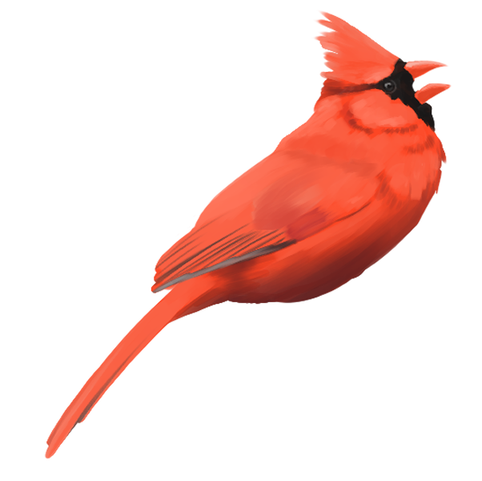
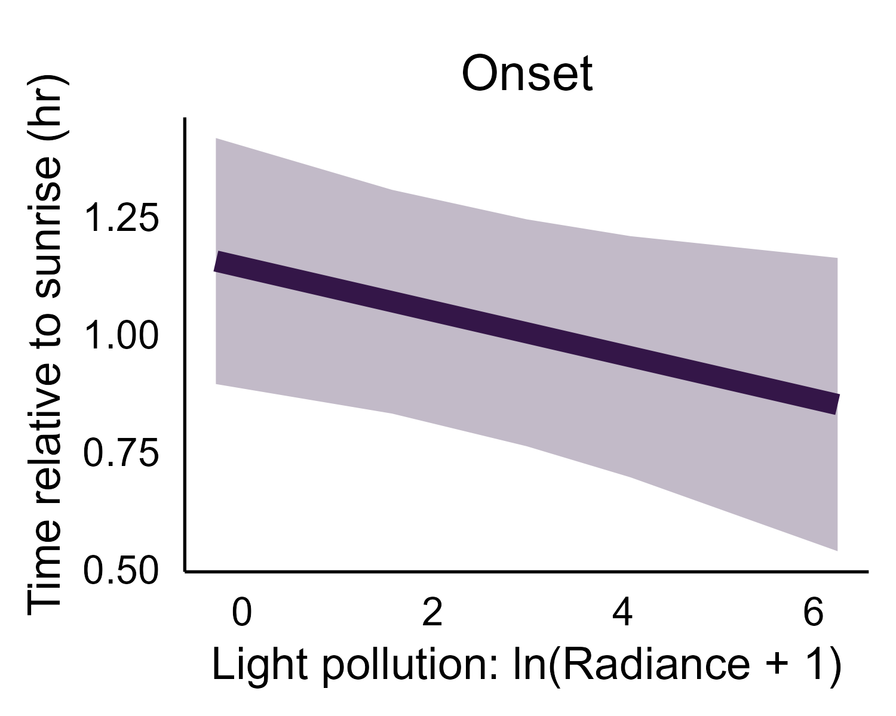
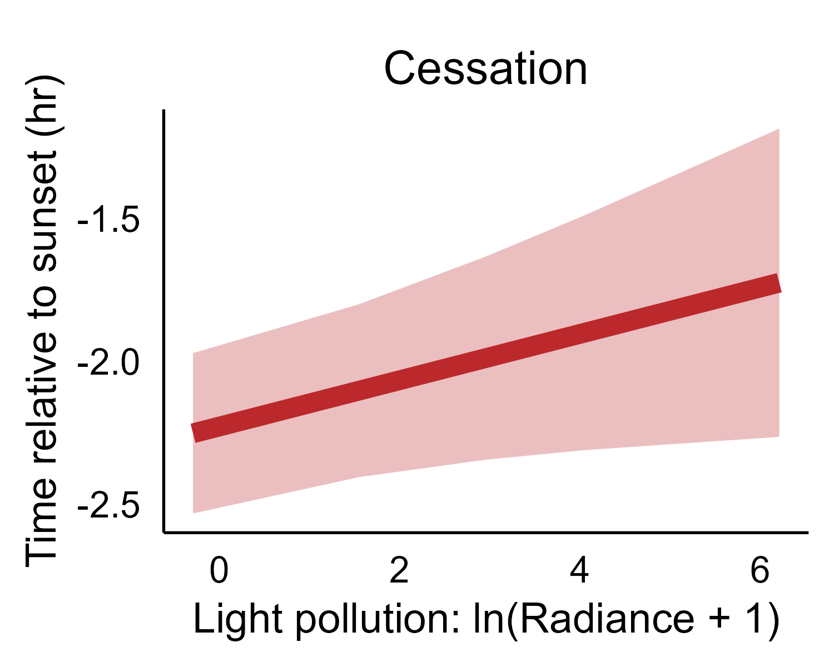
(A)
Amount of vocalization
cessation of vocalization extended 32 min
onset of vocalization advances 18 min
dark landscapes
bright landscapes
Time of day
(B)
(C)
Light: -0.05 ± 0.03, p = 0.06
Light: 0.09 ± 0.04, p = 0.03

