Slide 1
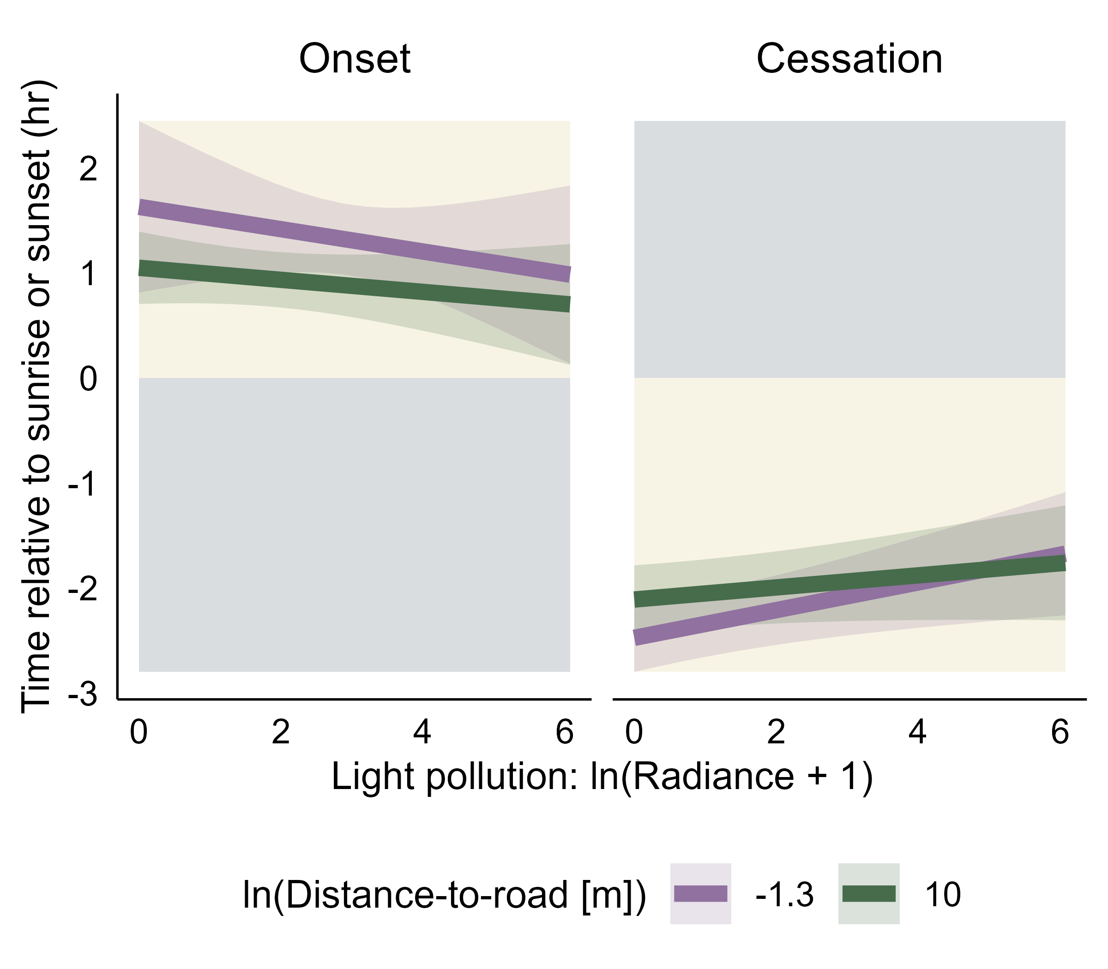
Close to road
Light: 0.09 ± 0.04, p = 0.03
Road: 0.03 ± 0.02, p = 0.06
Light x Road: -0.01 ± 0.03, p = 0.12
Far from road
Light: -0.08 ± 0.02, p = 0.001
Road: -0.07 ± 0.03, p = 0.03
Light x Road: 0.01 ± 0.03, p = 0.79
Far from road
Close to road

