Slide 1

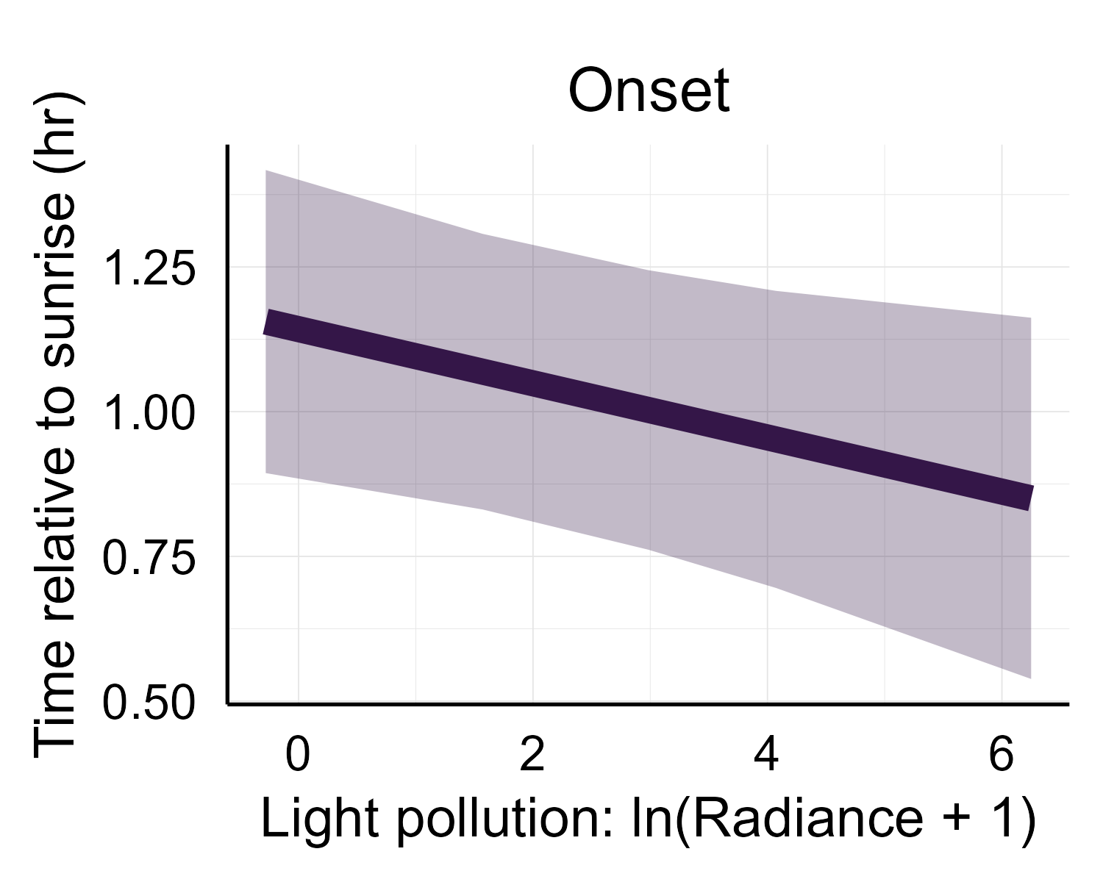
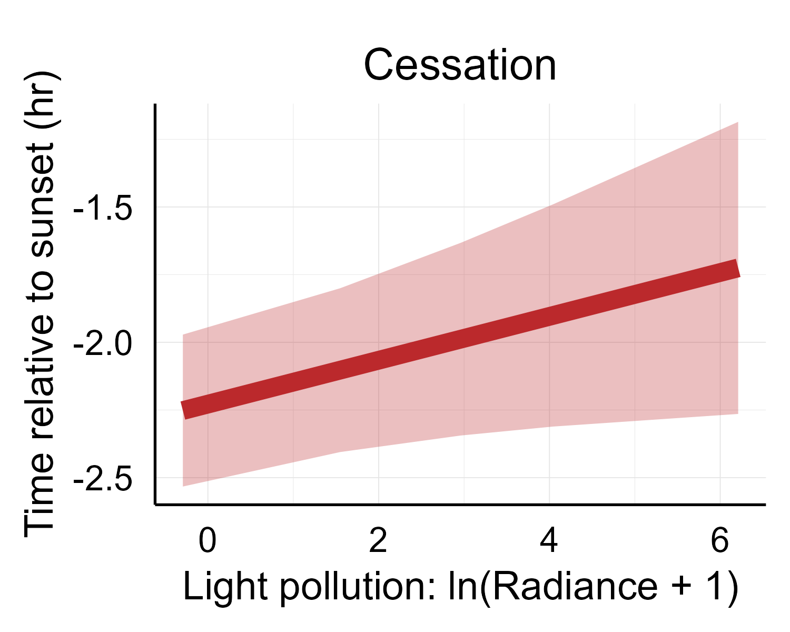
(A)
Amount of vocalization
cessation of vocalization extended 32 min
onset of vocalization advances 18 min
dark landscapes
bright landscapes
Time of day
(B)
(C)

