Slide 1
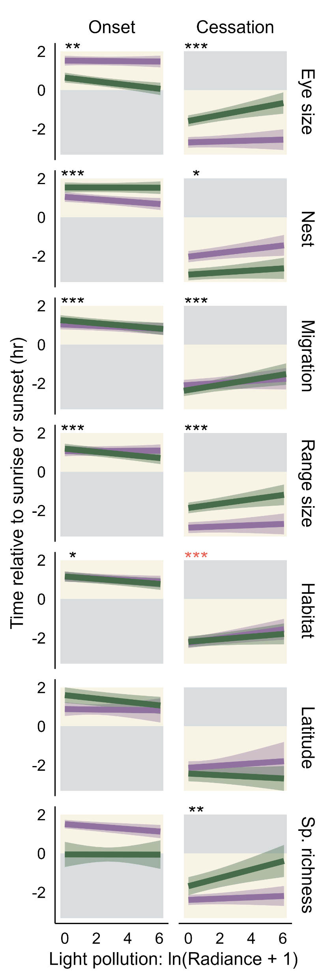
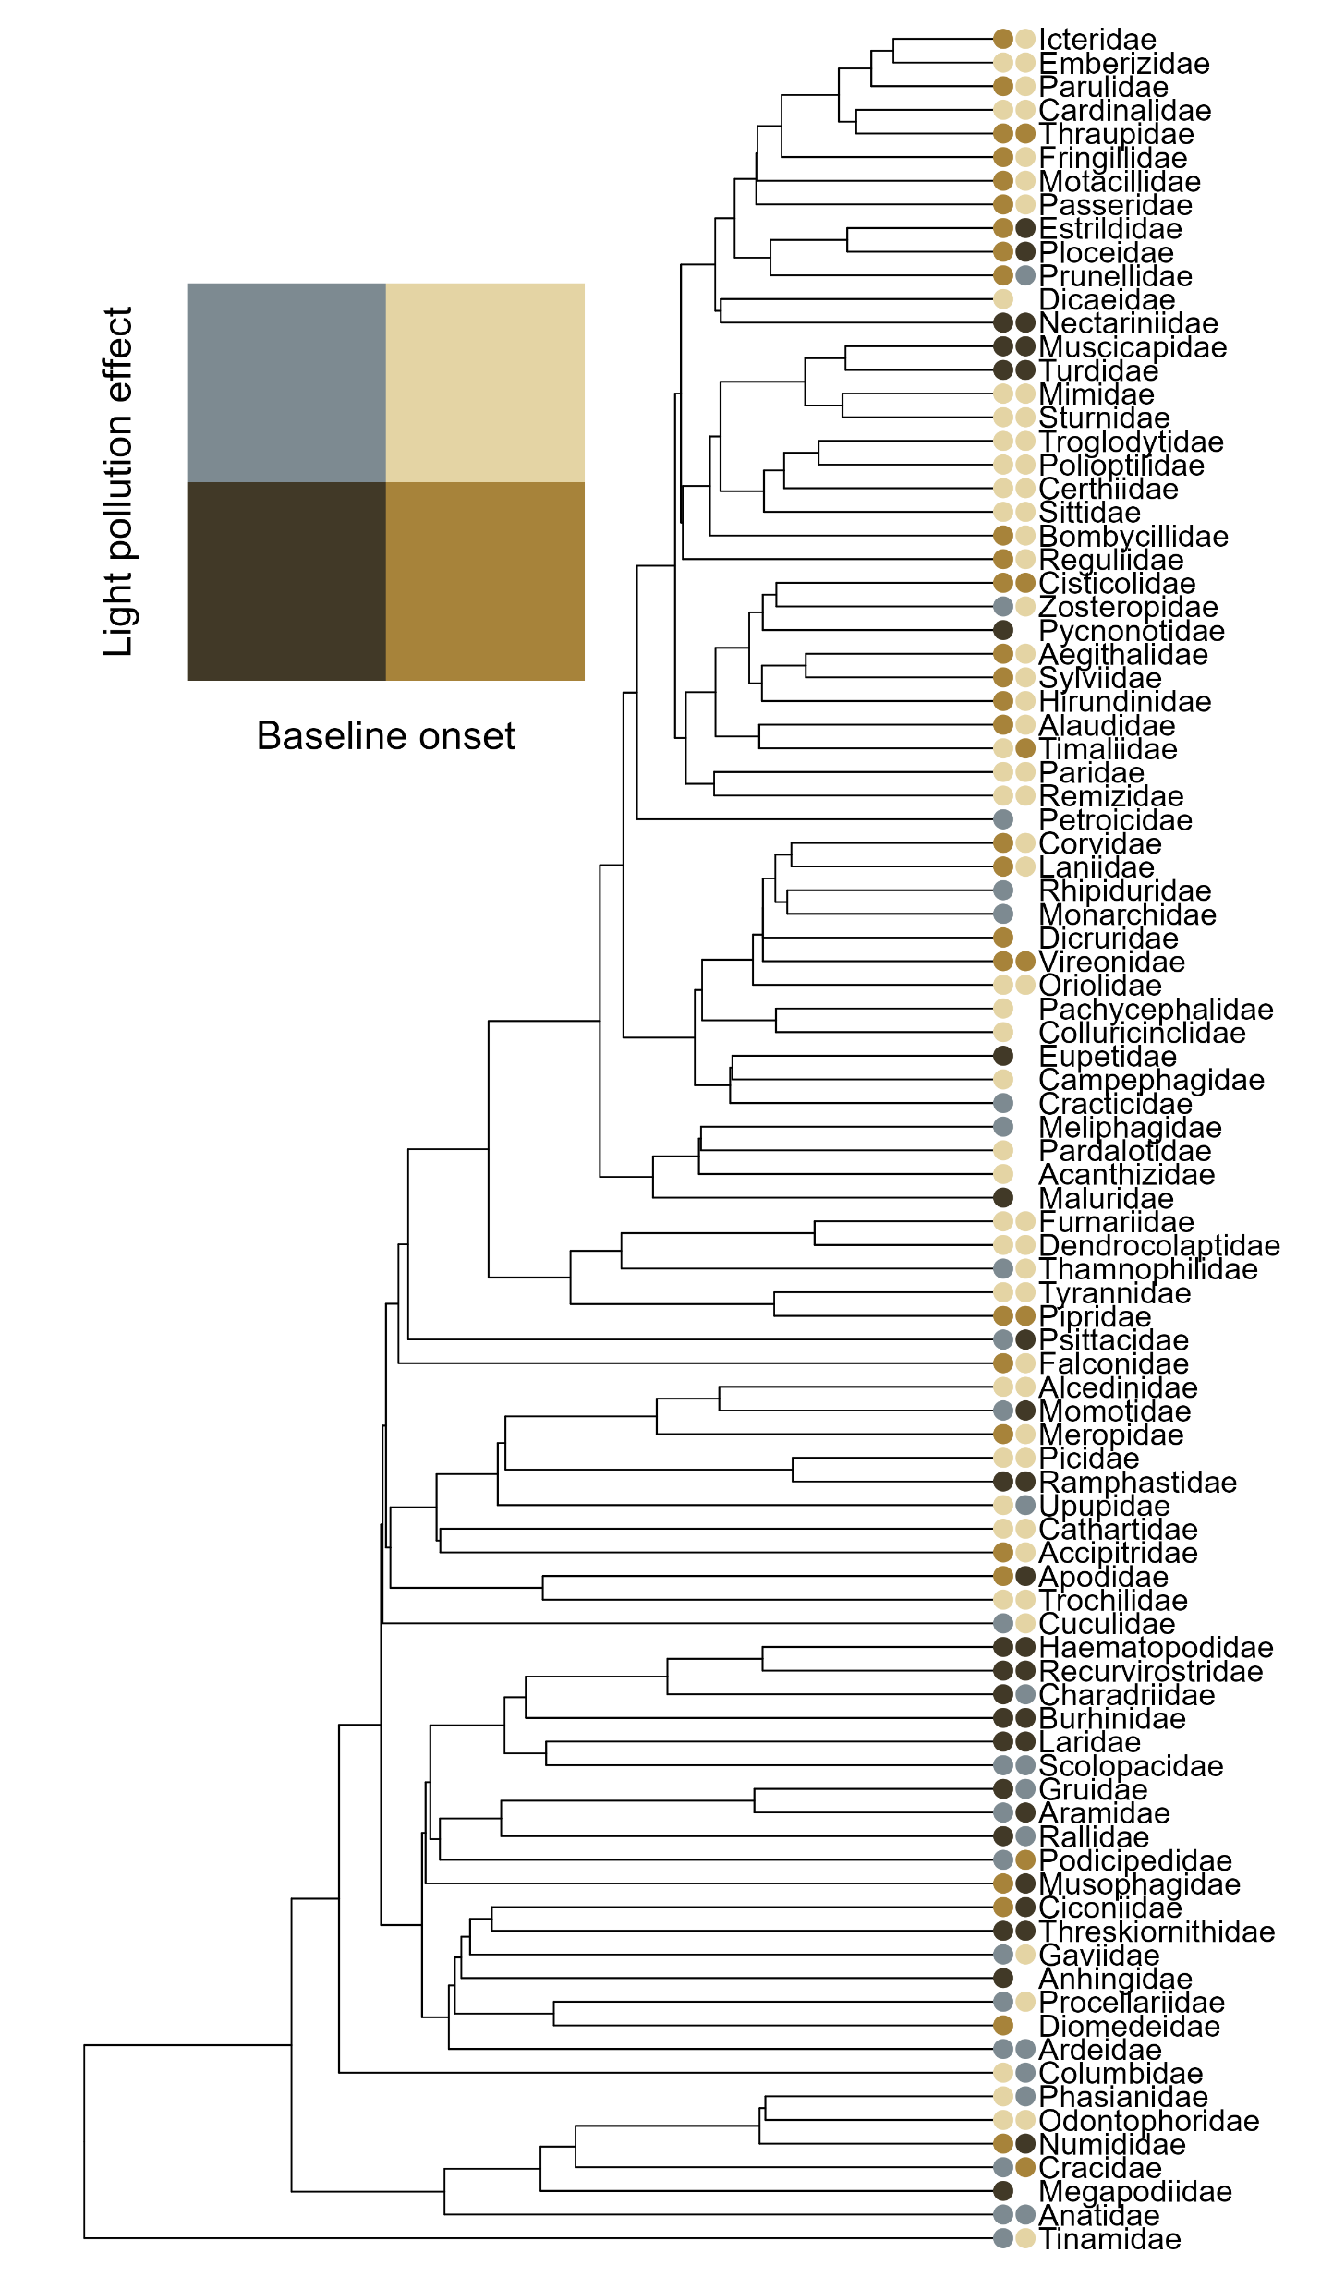
(A)
(B)
Cessation
small
Onset
large
large
small
cavity
shorten
open
Light pollution effect
open
prolong
cavity
migrant
before sunrise
after sunset
after sunrise
before sunset
sedentary
migrant
Baseline vocalization time
sedentary
small
large
large
small
dense
open
dense
open
60°
20°
20°
60°
low
high
high
low

