Slide 1
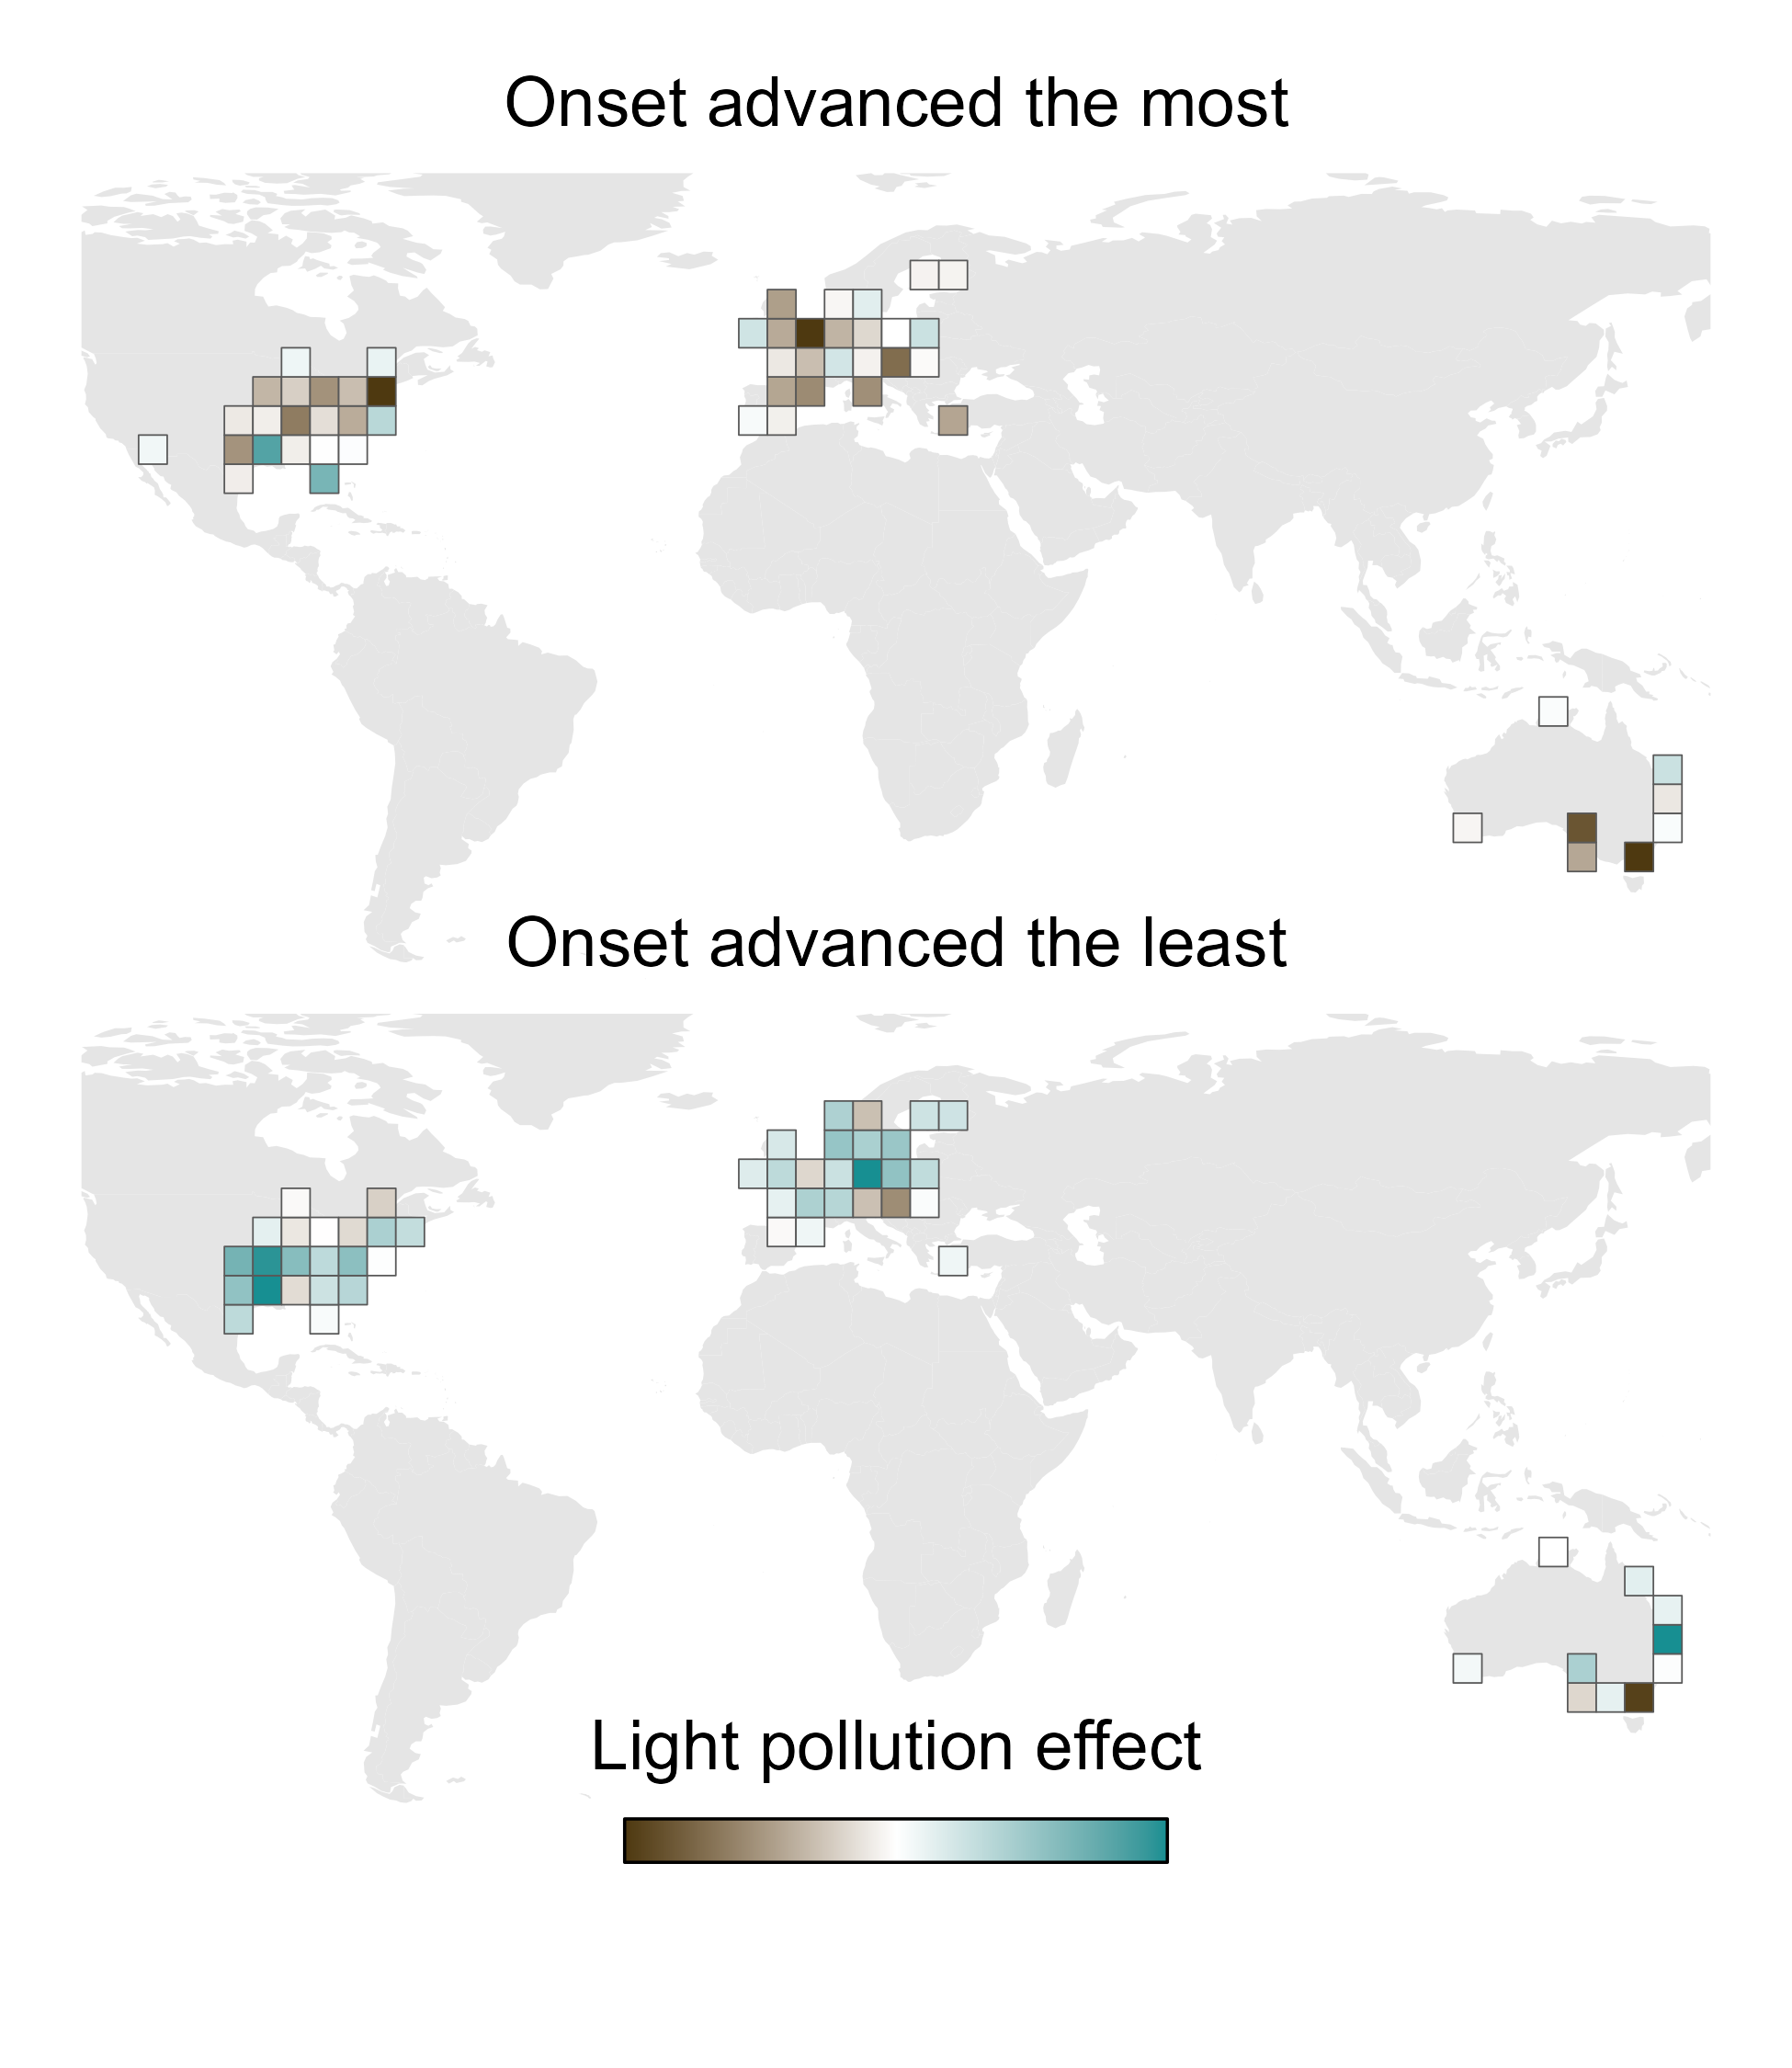
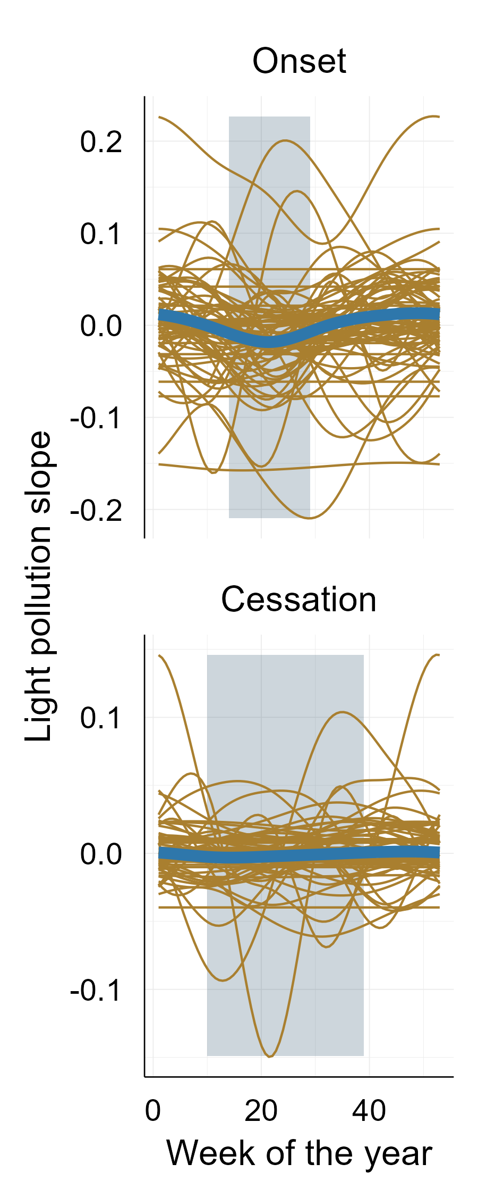
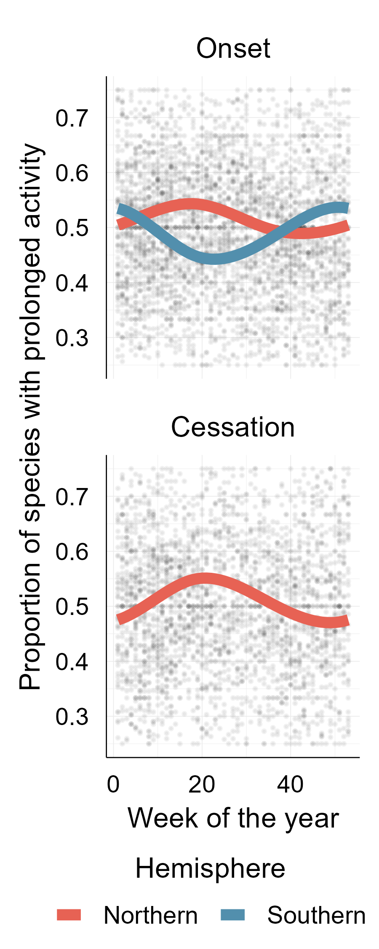

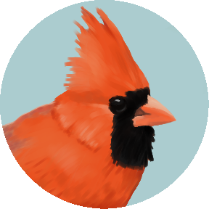

(A)
(B)
(C)
Strongest effects 50% of spp.
Jan 29
May 29
Sep 29
Strongest effects 50% of spp.
Jun 19
Sep 11
advance
delay
Nov 6

