Slide 1
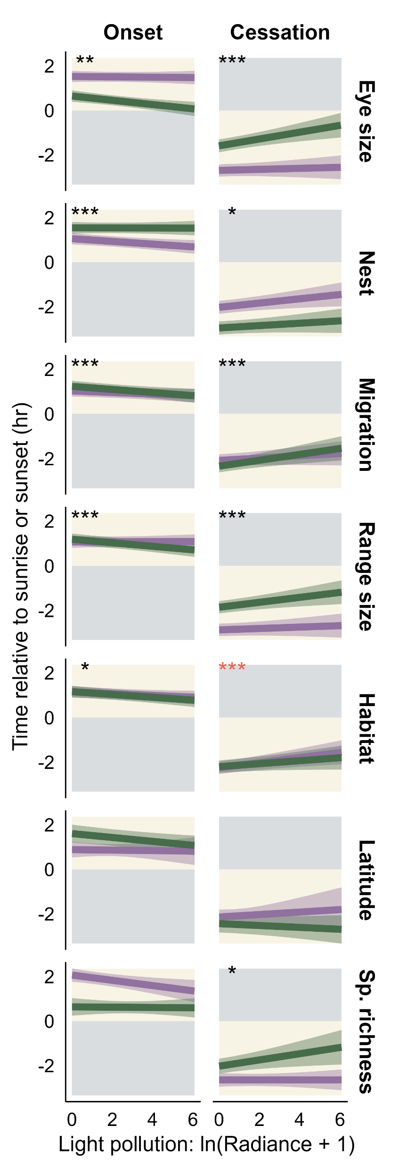
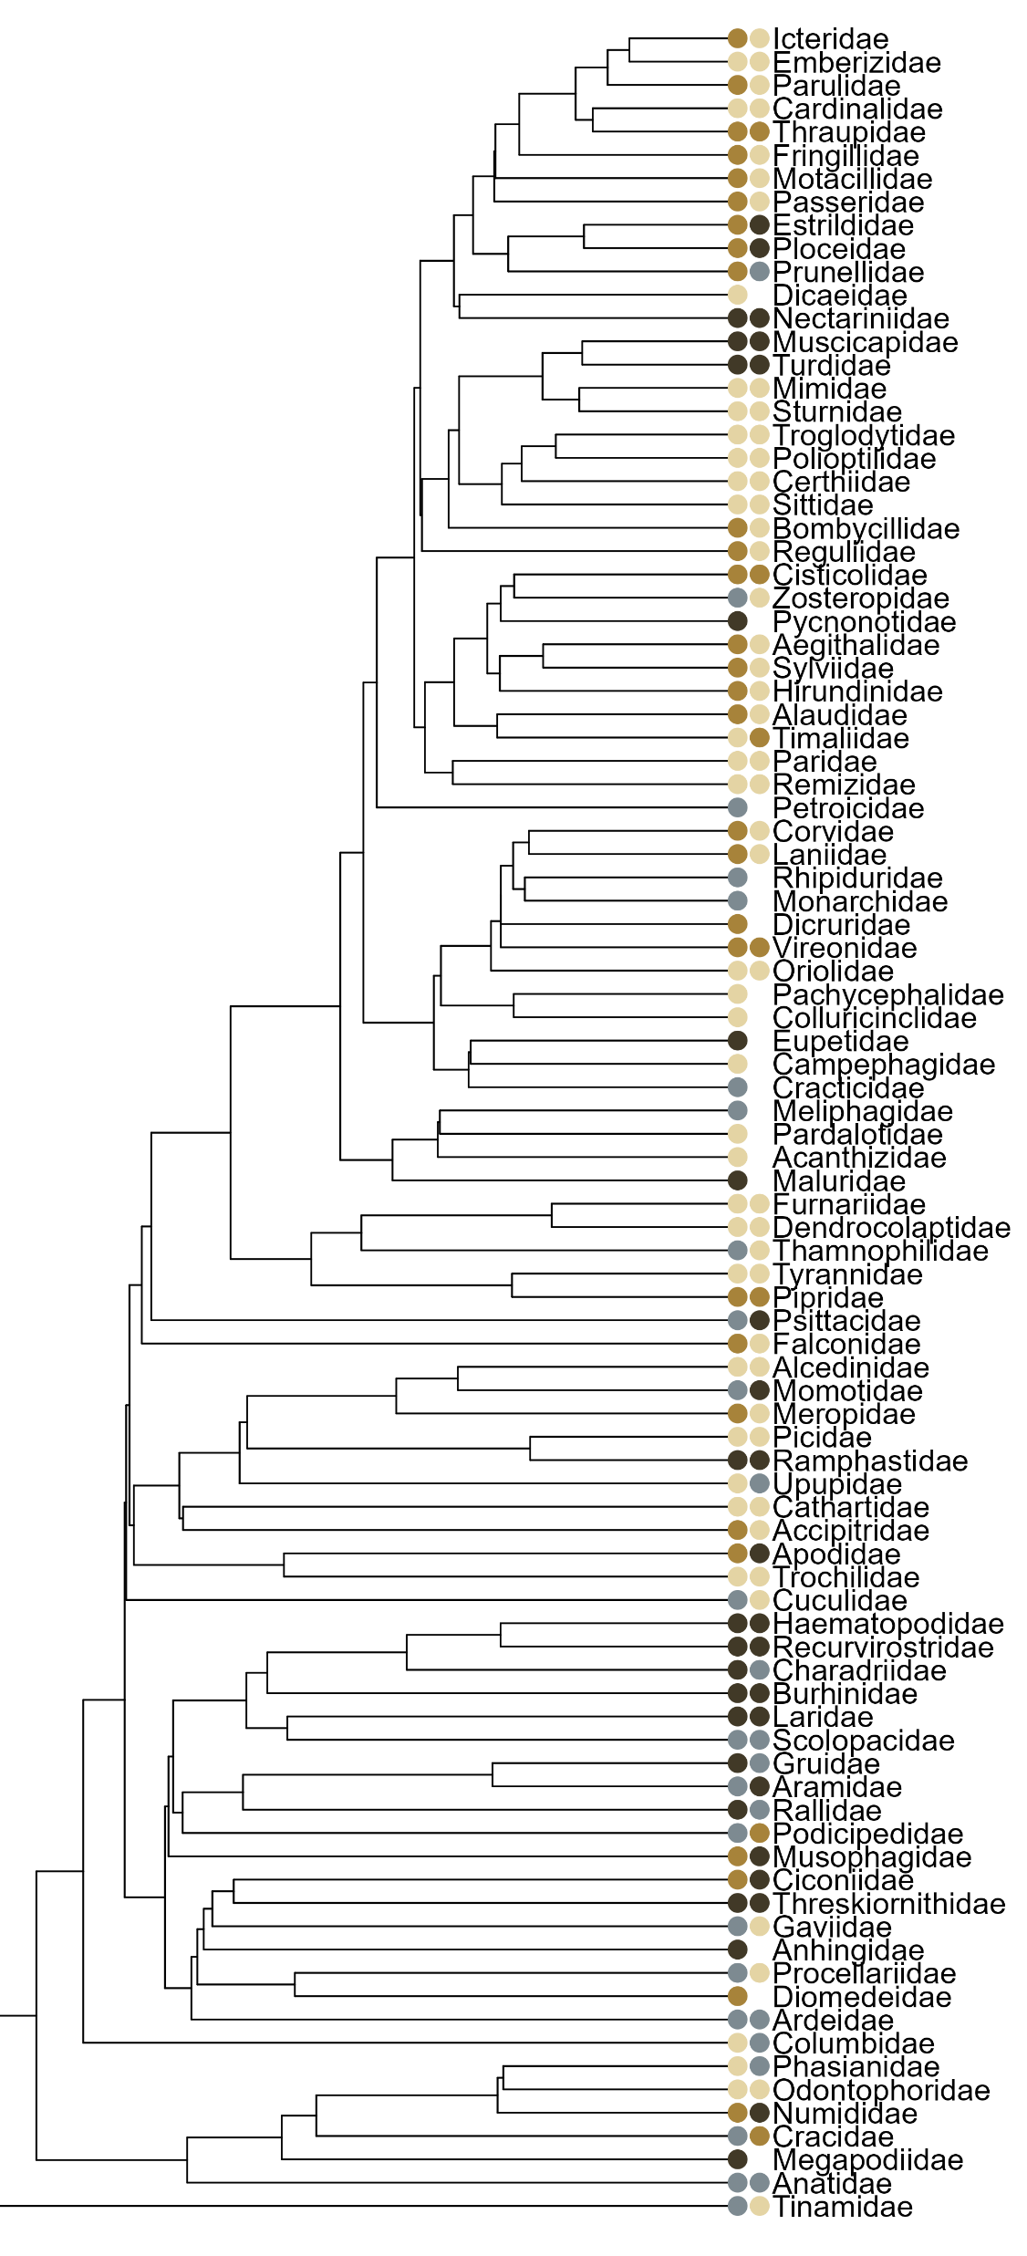
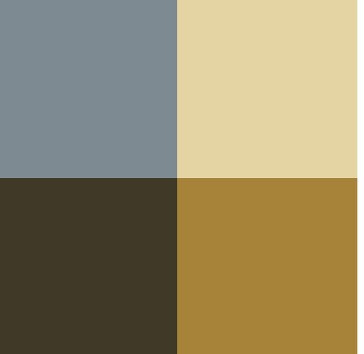
(A)
(B)
small
Cessation
large
large
Onset
small
cavity
shorten
open
Light pollution effect
open
prolong
night
day
cavity
Baseline vocalization time
migrant
sedentary
migrant
sedentary
small
large
large
small
dense
open
dense
open
60°
20°
20°
60°
low
high
high
low

