Slide 1
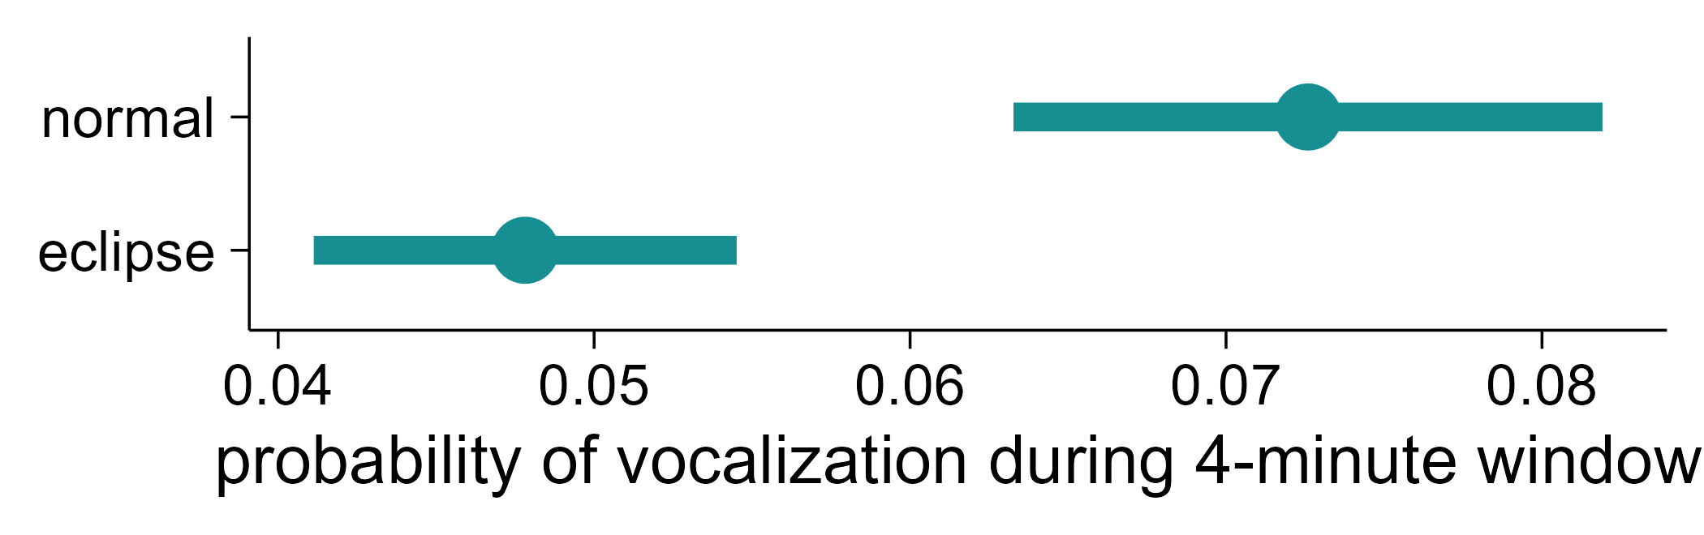
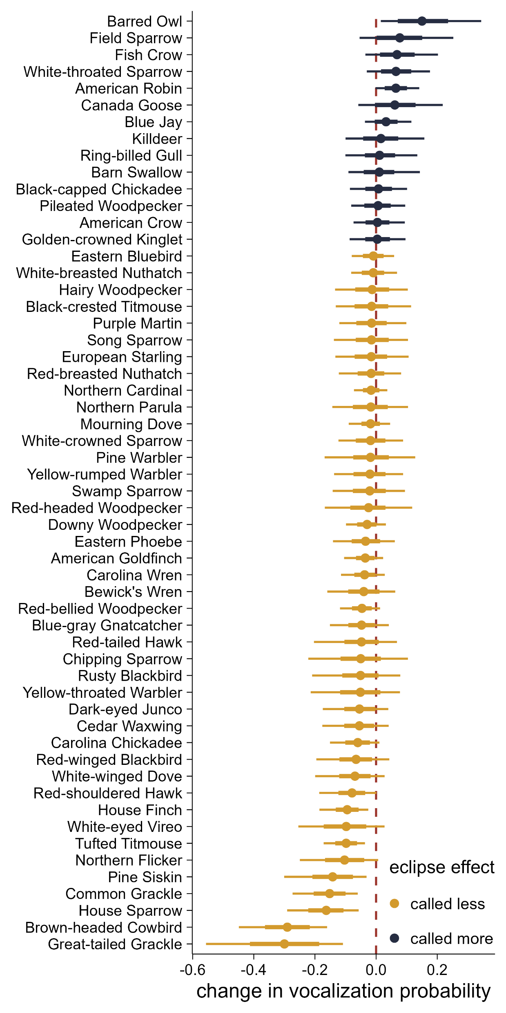
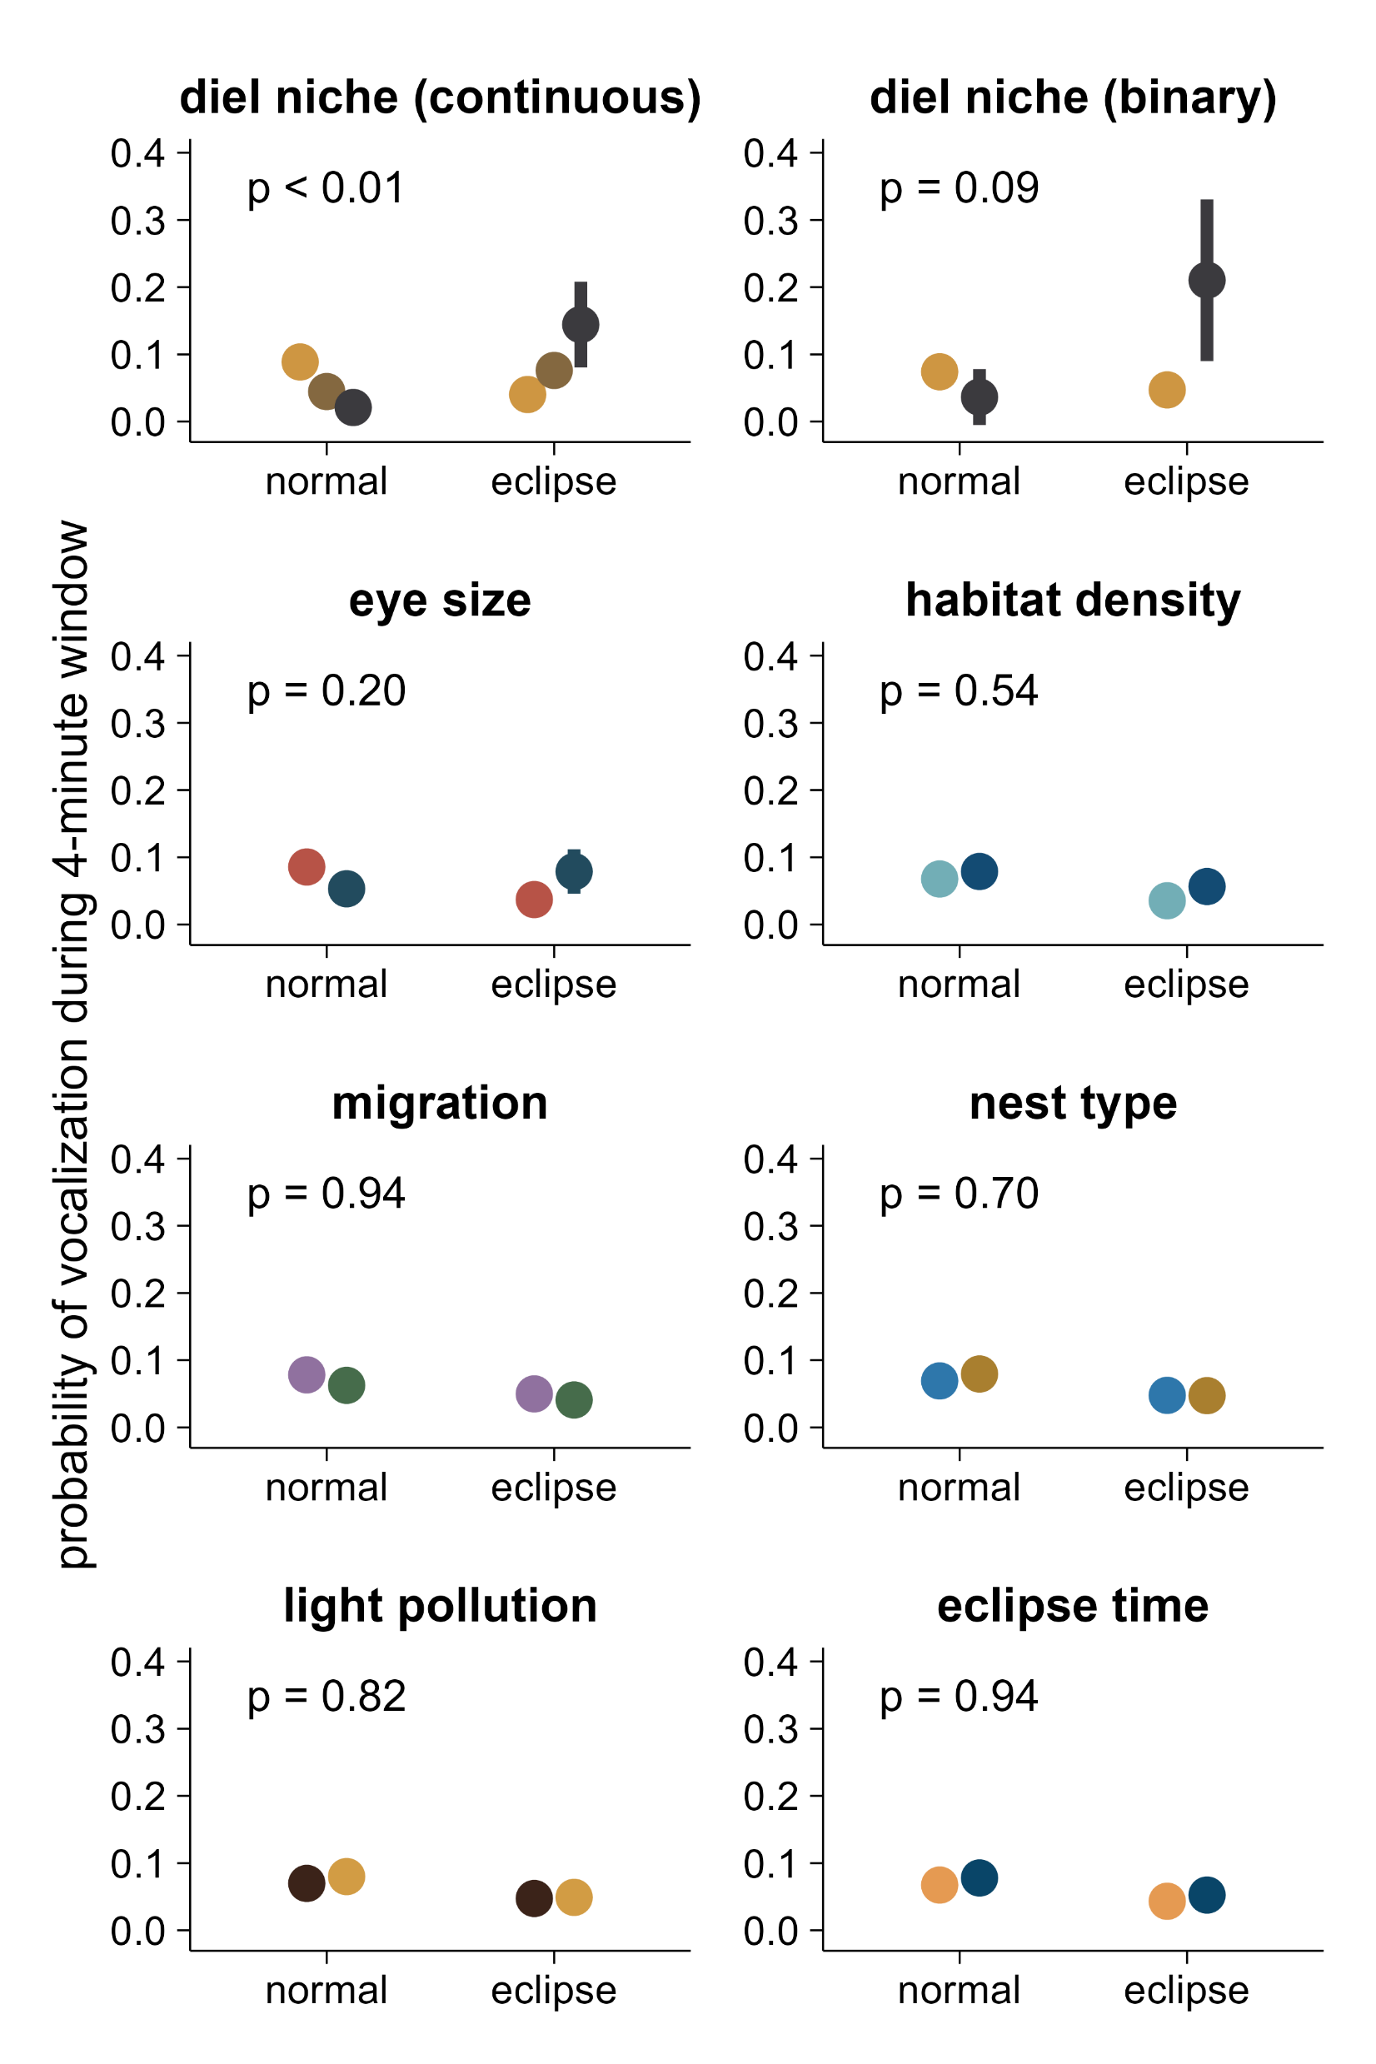
(a)
main effect of eclipse:
-0.44 ± 0.21, p = 0.03
(c)
(b)
100% diurnal
diurnal
nocturnal
50%
0%
small
large
dense
open
sedentary
migrant
open
cavity
dark
bright
5 hr from sunrise
10 hr from sunrise

