Slide 1
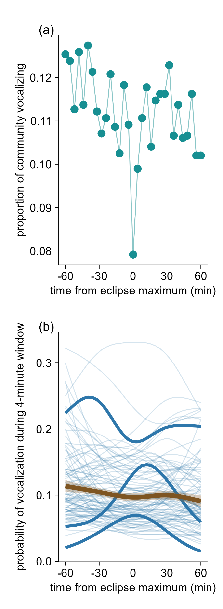
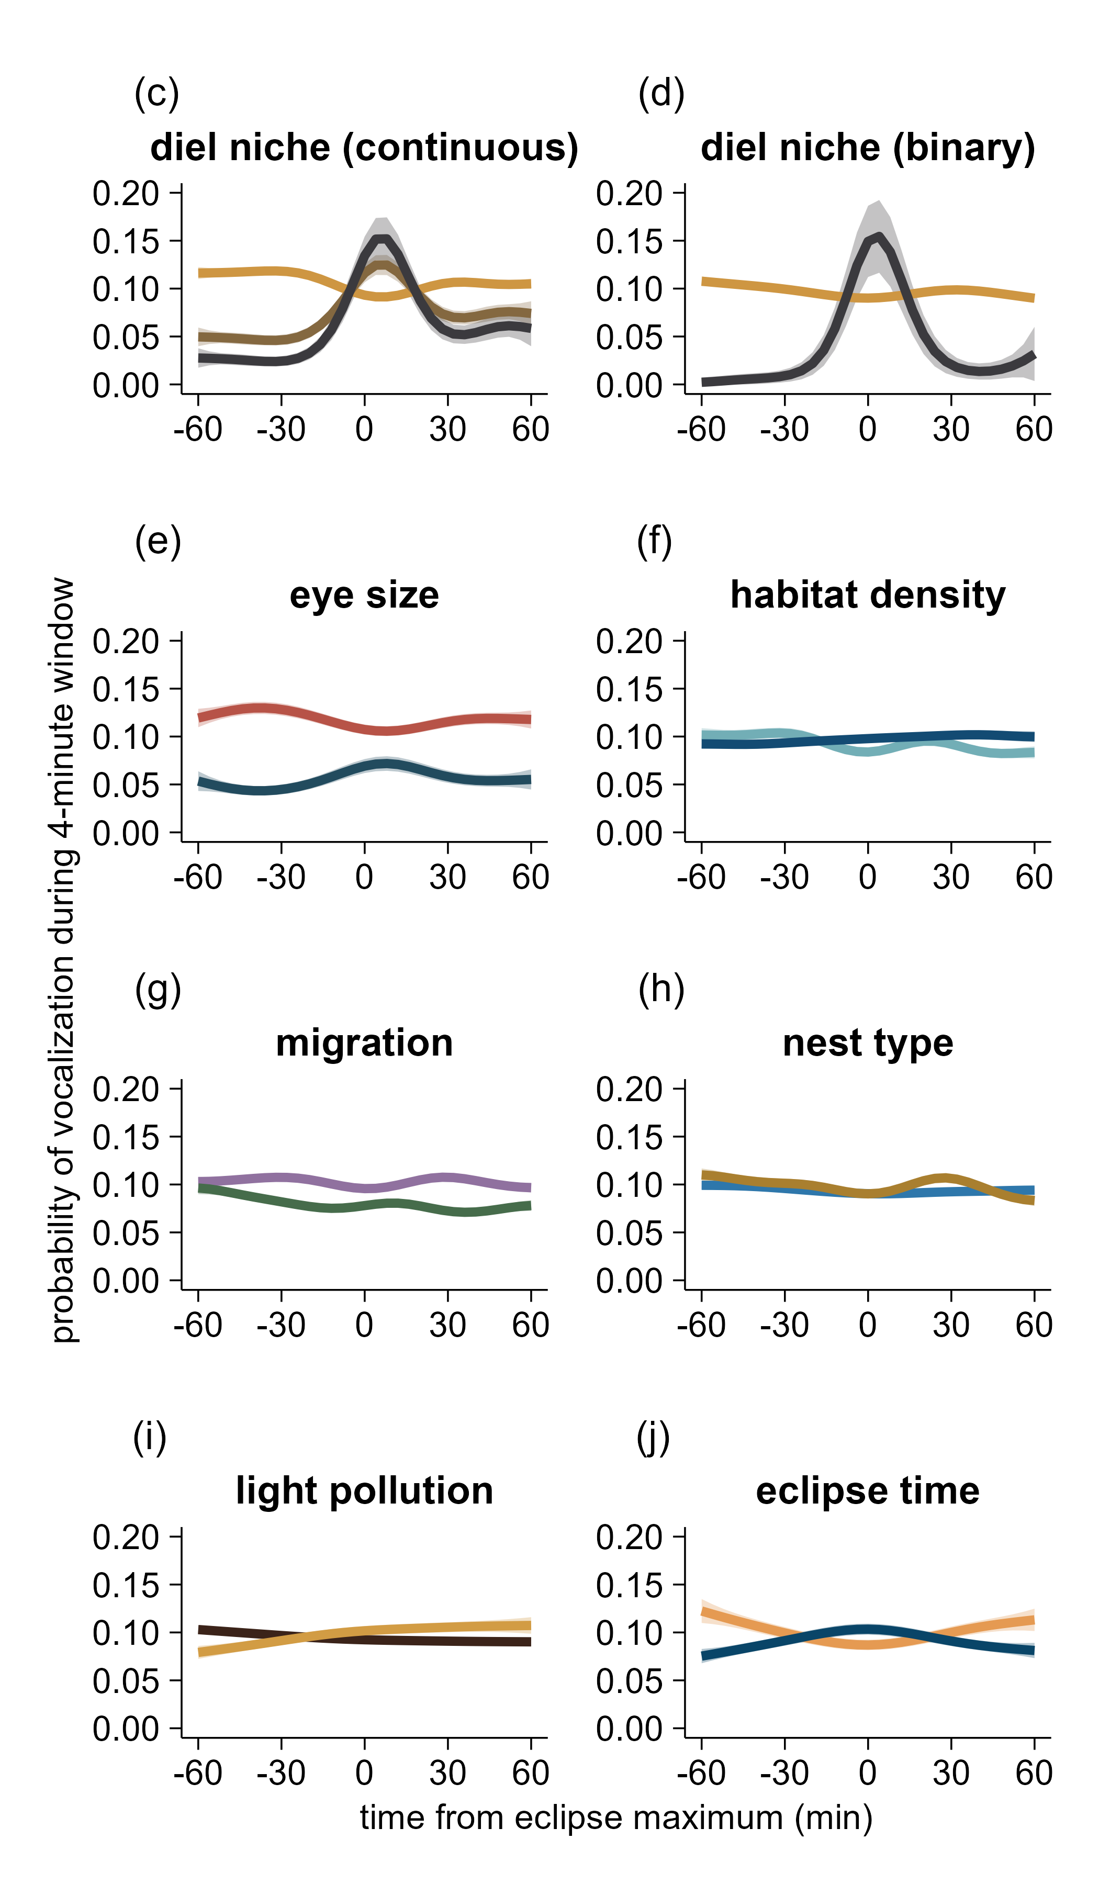
0%
nocturnal
p < 0.01
p < 0.01
p < 0.01
diurnal
nocturnal
60%
100% nocturnal
p < 0.01
p < 0.01
p = 0.06
small
dense
open
large
p = 0.08
tufted titmouse
p < 0.01
p = 0.02
p < 0.01
p = 0.04
p < 0.01
sedentary
cavity
american robin
migrant
open
time of eclipse maximum
p = 0.02
5 hours from sunrise
p = 0.02
dark
barred owl
bright
10 hours from sunrise

