Slide 1
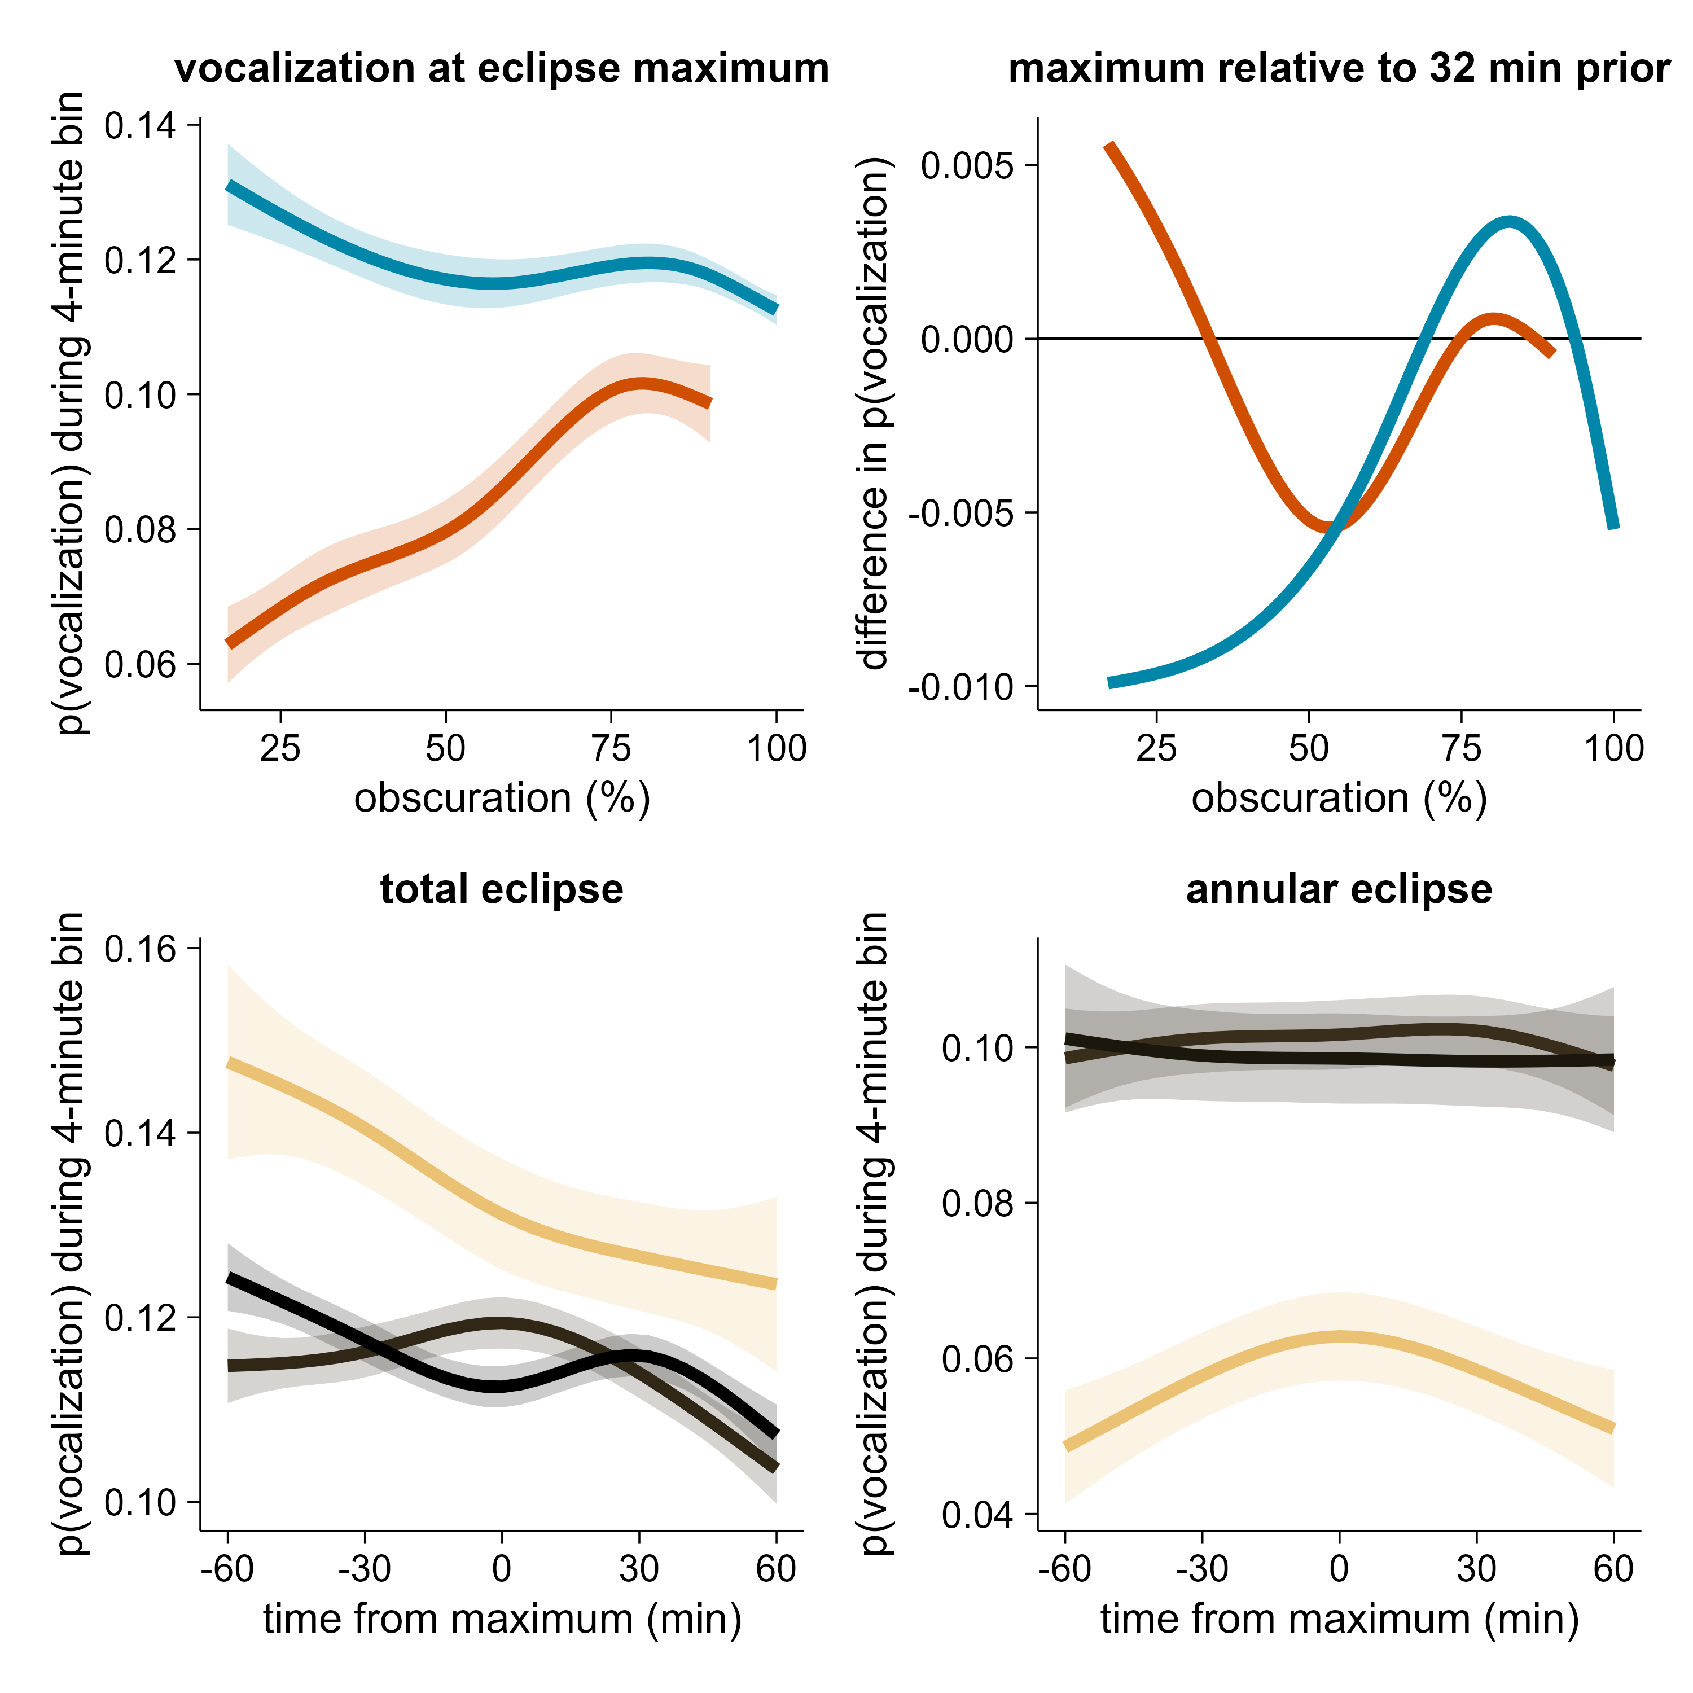
(a)
(b)
total eclipse
annular eclipse
p < 0.01
total eclipse
promote
annular eclipse
suppress
p < 0.01
(c)
(d)
80% obscuration
17%
obscuration
90% obscuration
17% obscuration
100% obscuration
83% obscuration

