Slide 1
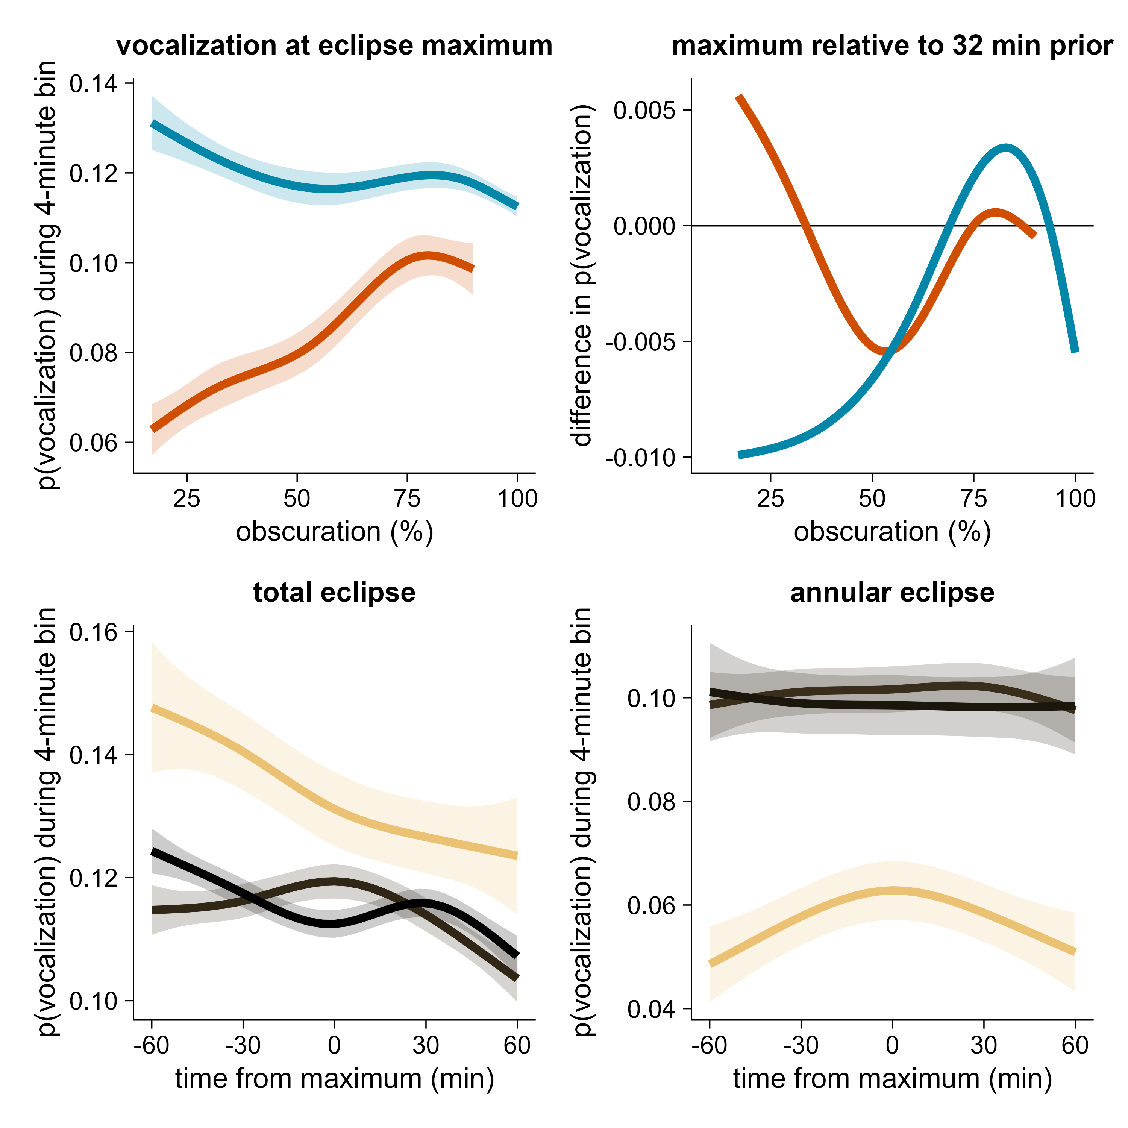
(a)
(b)
annular eclipse
total eclipse
total eclipse
promote
annular eclipse
suppress
(c)
(d)
80% obscuration
17%
obscuration
90% obscuration
17% obscuration
100% obscuration
83% obscuration

