Slide 1
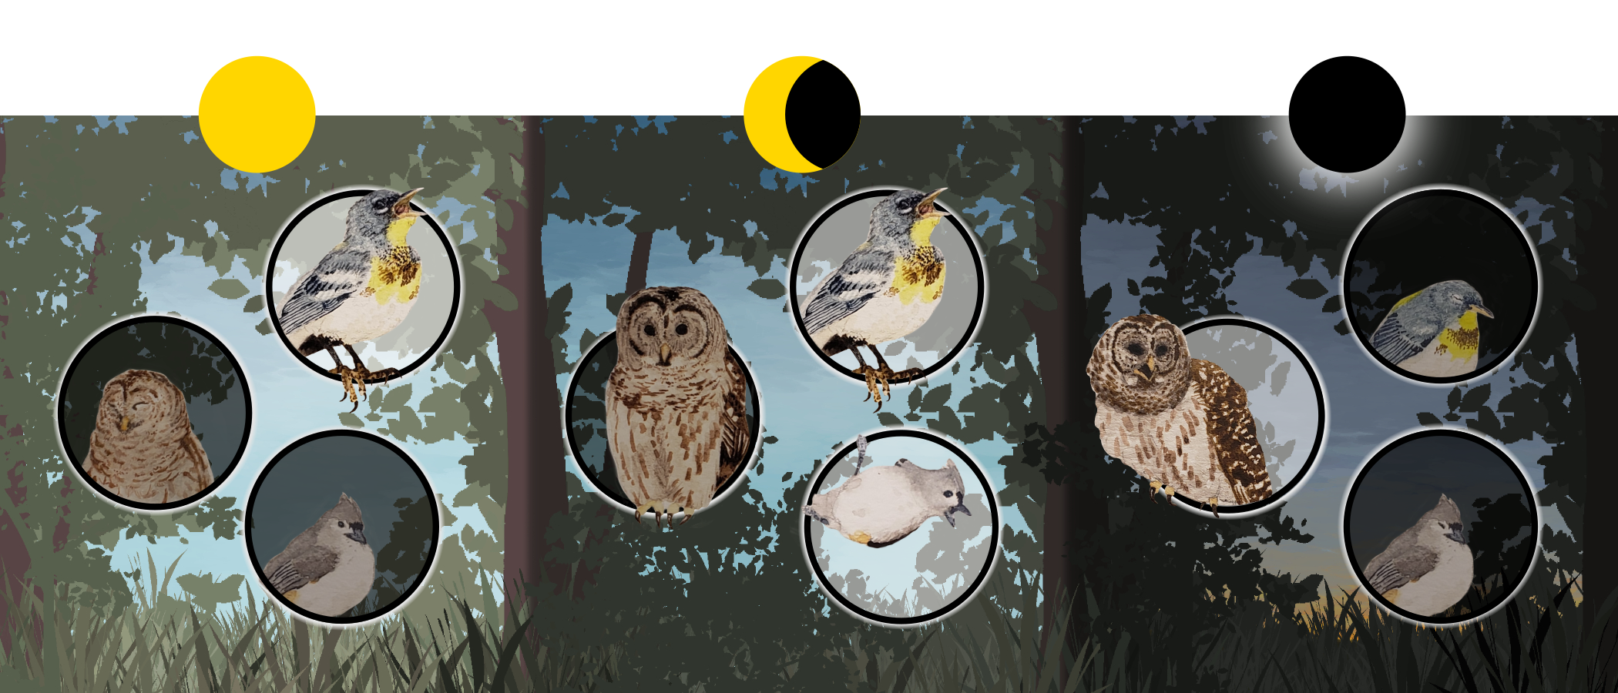
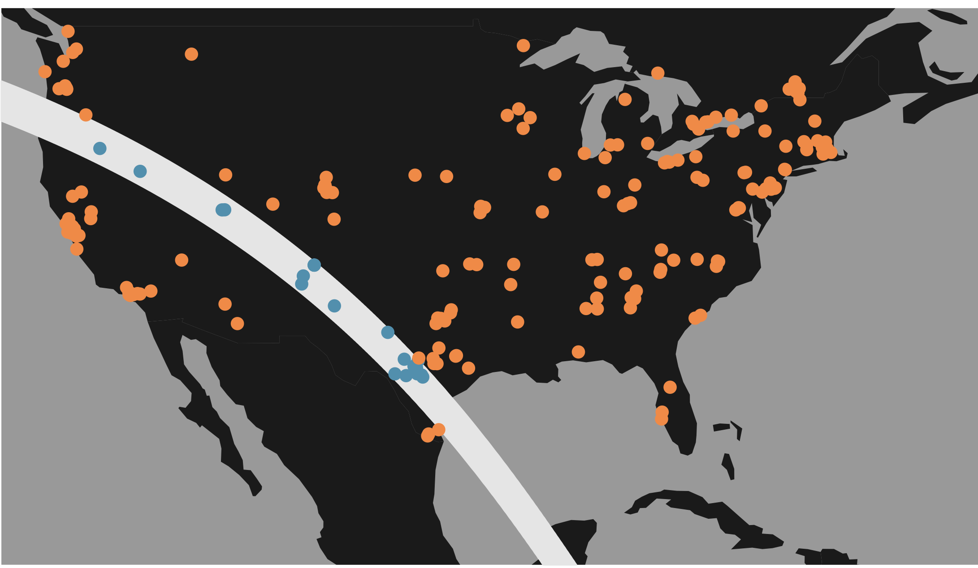
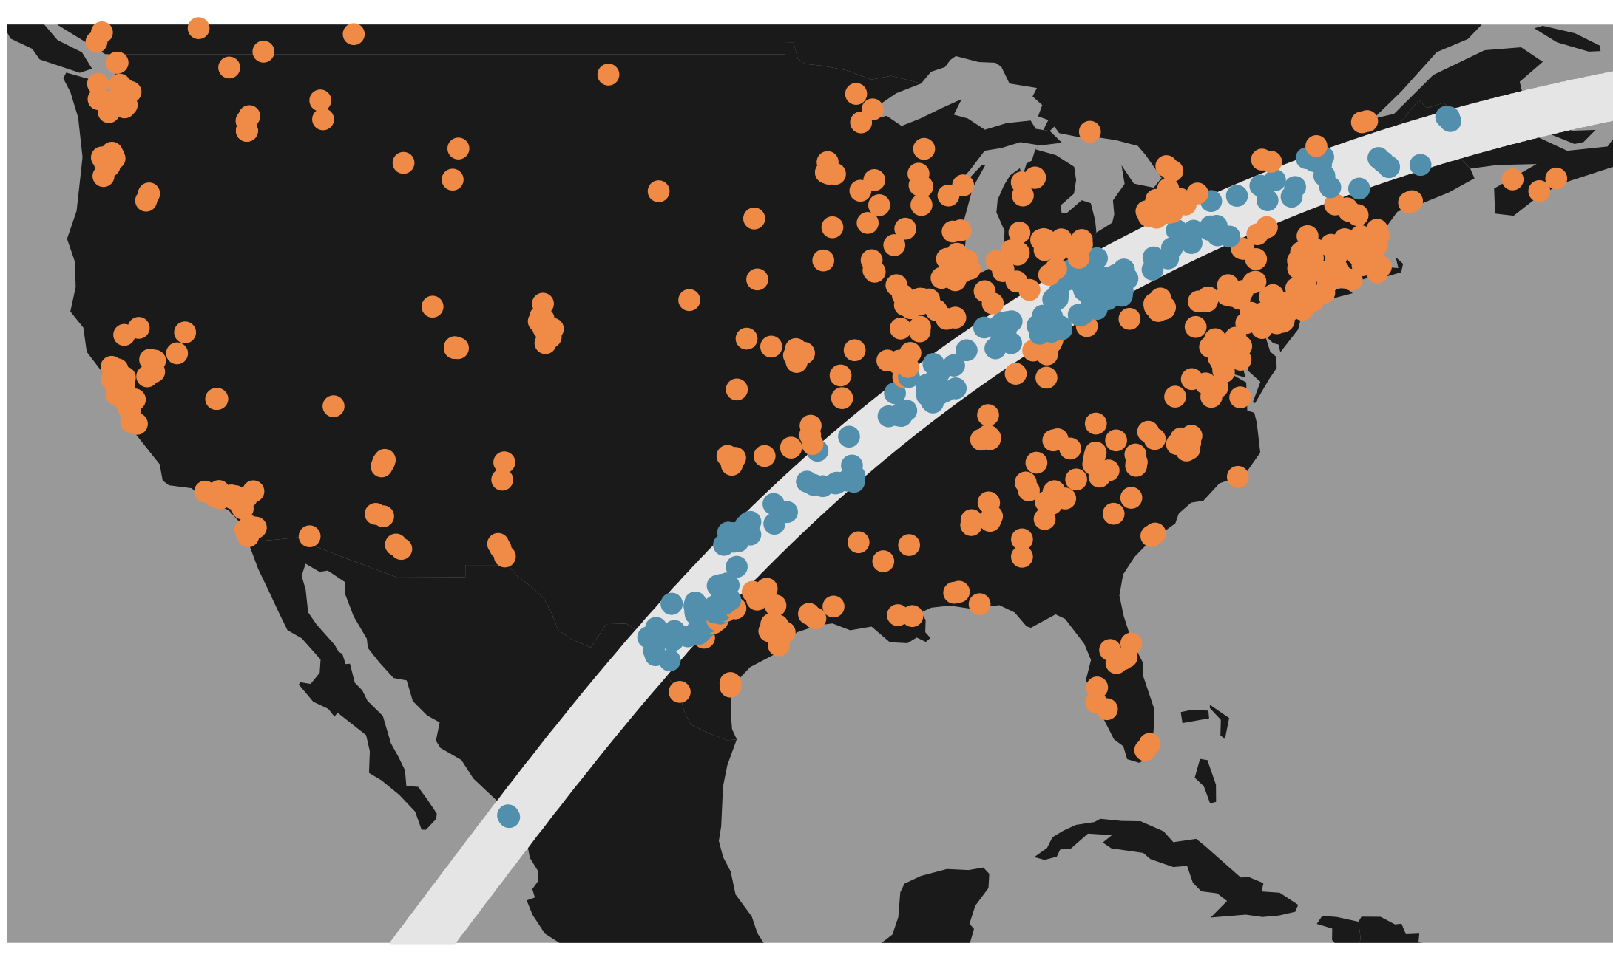
(a)
(b)
(c)
outside path
inside path
annular eclipse
14 october 2023
total eclipse
8 april 2024

