Slide 1
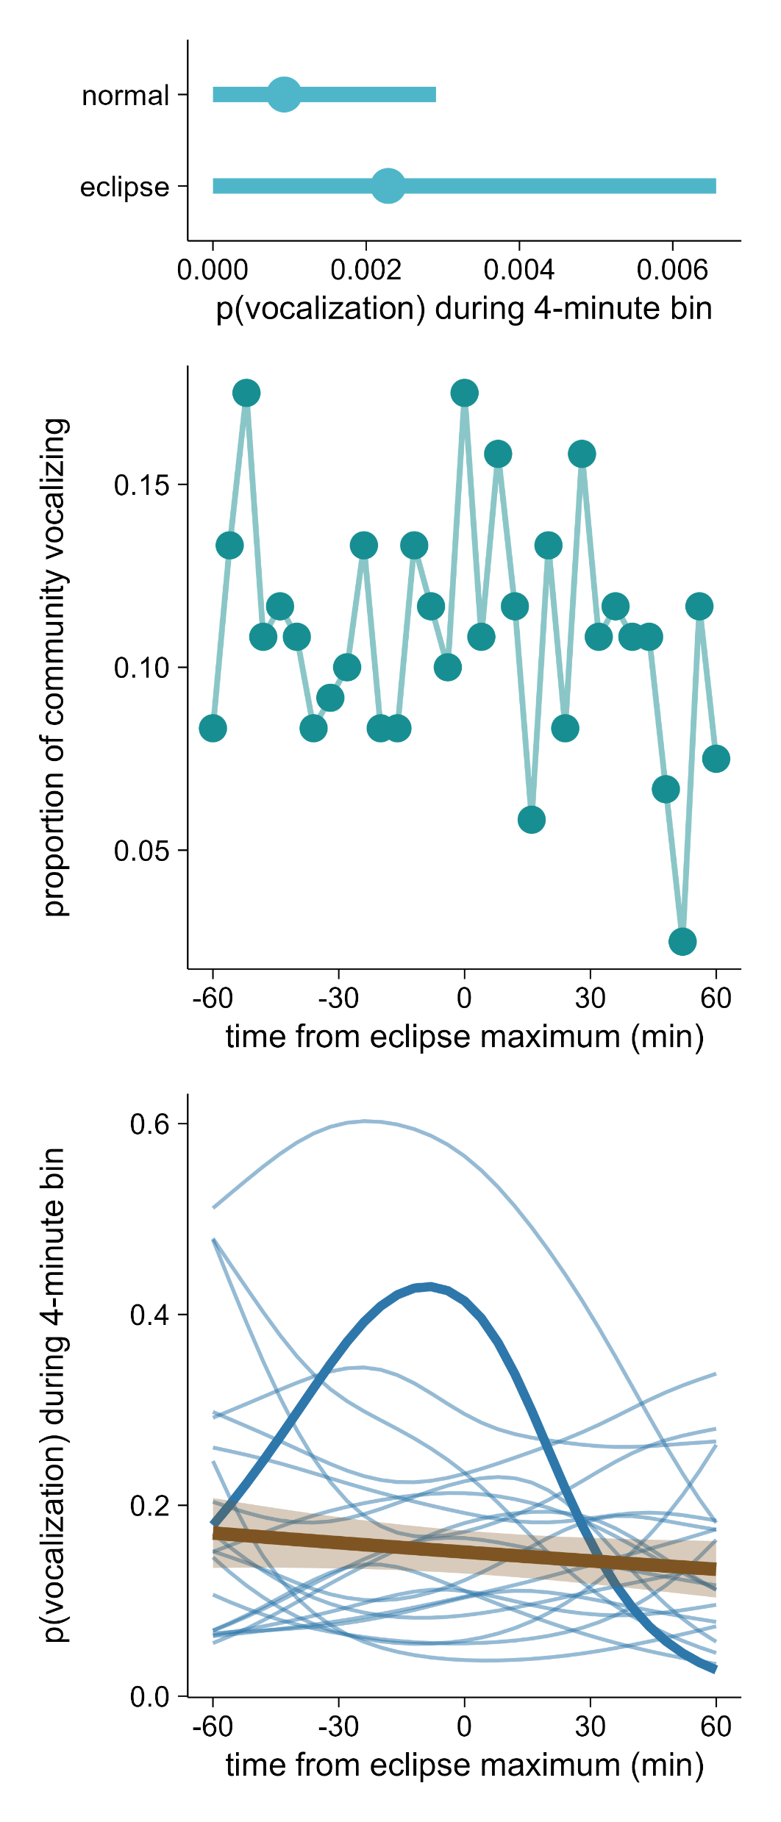
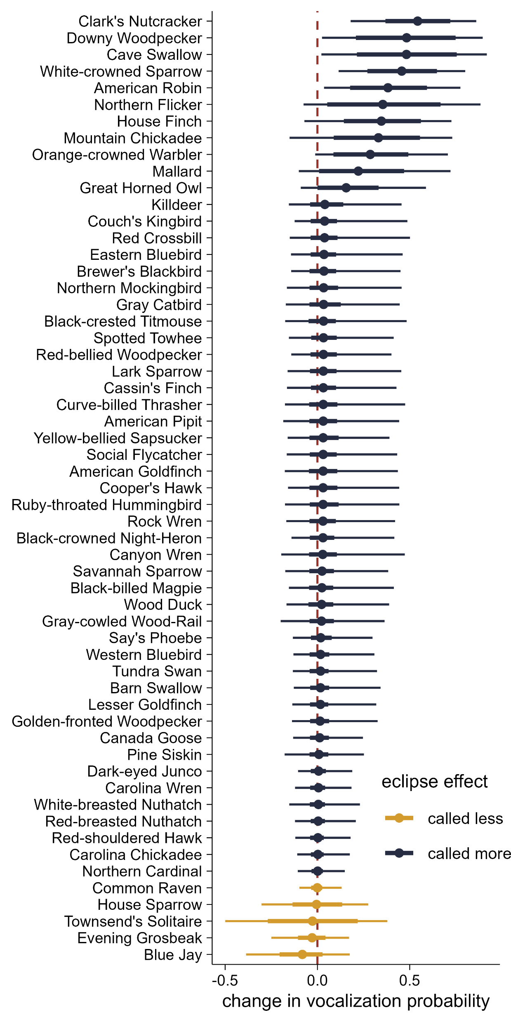
(a)
(b)
main effect of eclipse:
0.90 ± 2.80, p = 0.75
(c)
(d)
american robin

