Slide 1
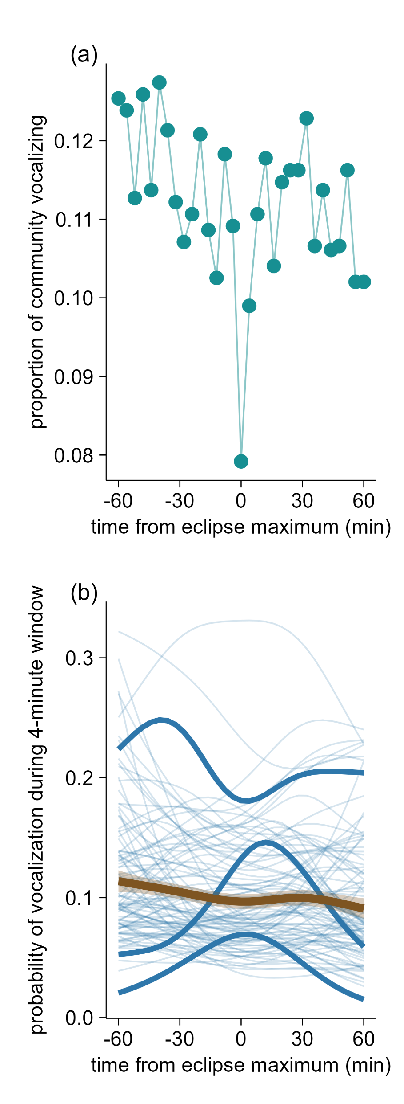
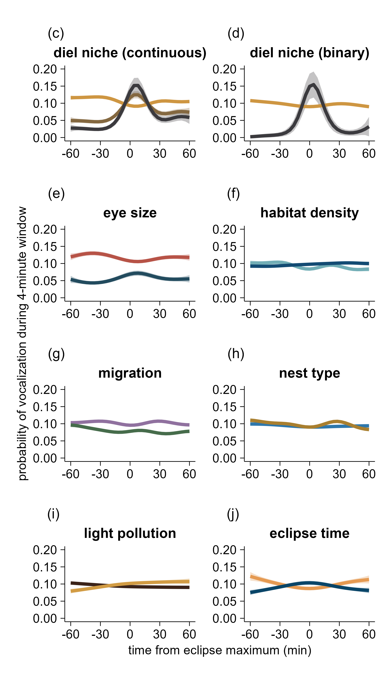
0%
nocturnal
nocturnal
diurnal
60%
100% nocturnal
small
dense
open
large
tufted titmouse
sedentary
cavity
american robin
migrant
open
time of eclipse maximum
dark
5 hours from sunrise
barred owl
bright
10 hours from sunrise

