Slide 1

Ear Train the Brain
Notes:
What NEEDS to be in this presentation?
GET LOGO

Slide 2
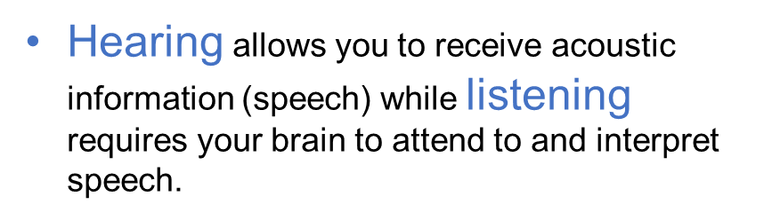
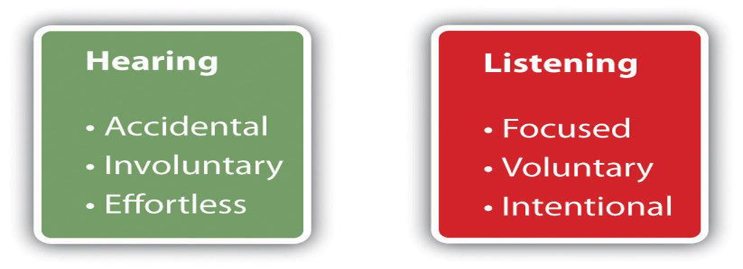
Are hearing and listening the same thing?
Notes:
Once a speech signal enters your ear, your brain must rapidly process each word and hold that string of words in memory long enough to comprehend and make sense of its meaning.
Not only must your brain distinguish each word from all other possible words, but it must invoke mental skills such as auditory memory, auditory attention, and auditory processing speed in order for you to engage successfully in conversation.

Slide 3
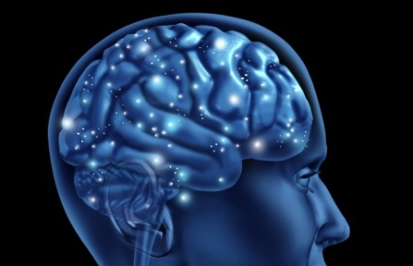
How does hearing loss change my brain?
Pathways in your brain designated for understanding speech begin to reorganized and rewire themselves.
You may lose mental tools that are necessary to process and comprehend speech.

Slide 4
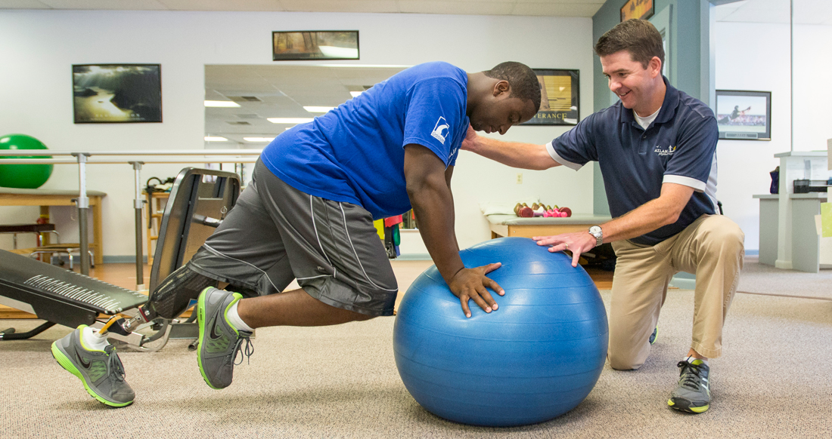
If I begin to use hearing aids, will my brain automatically regain those mental skills that I lost because of hearing loss?
Regaining those skills might take a long time.
You may never become the listener that you were before you acquired hearing loss.
Auditory brain training is like physical therapy for the brain. It trains the brain so you can better comprehend speech.
Notes:
Possibly, but if this does happen, regaining those skills might take a long time and you may never become the listener that you were before you acquired hearing loss. However, help is available. Auditory brain training triggers and accelerates your brain’s rebuilding process. When someone has difficulty walking because of a bum hip and then receives a hip replacement, they receive physical therapy. Auditory brain training is like physical therapy for the brain. It trains the brain so you can better comprehend speech.

Slide 5
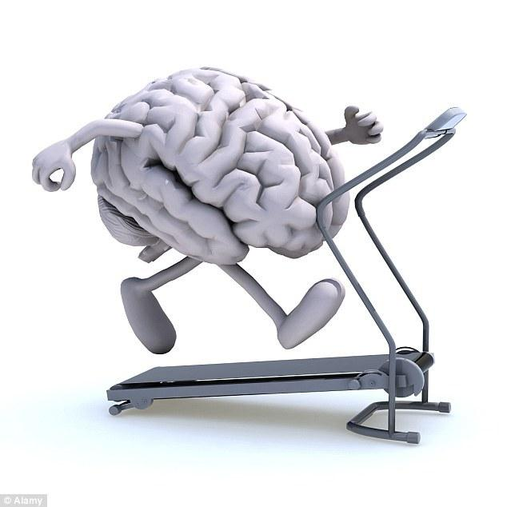
What is auditory brain training?
Trains you to recognize the most frequent words of the language (e.g., “chair”, “table”)
Teaches you to discriminate fine phonetic distinctions (e.g., “can” versus “can’t”)
Trains brain skills such as your auditory working memory, auditory processing speed, and auditory attention.

Slide 6
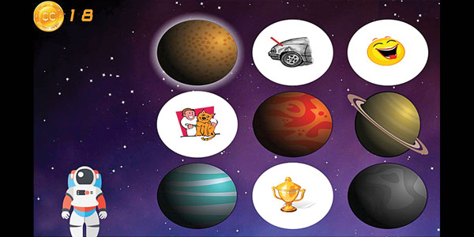
What is clEAR auditory brain training?
Computerized auditory brain training games that are fun to play.
Training that is customized to your specific listening needs.
Coaching and support that is provided by your audiologist.

Slide 7
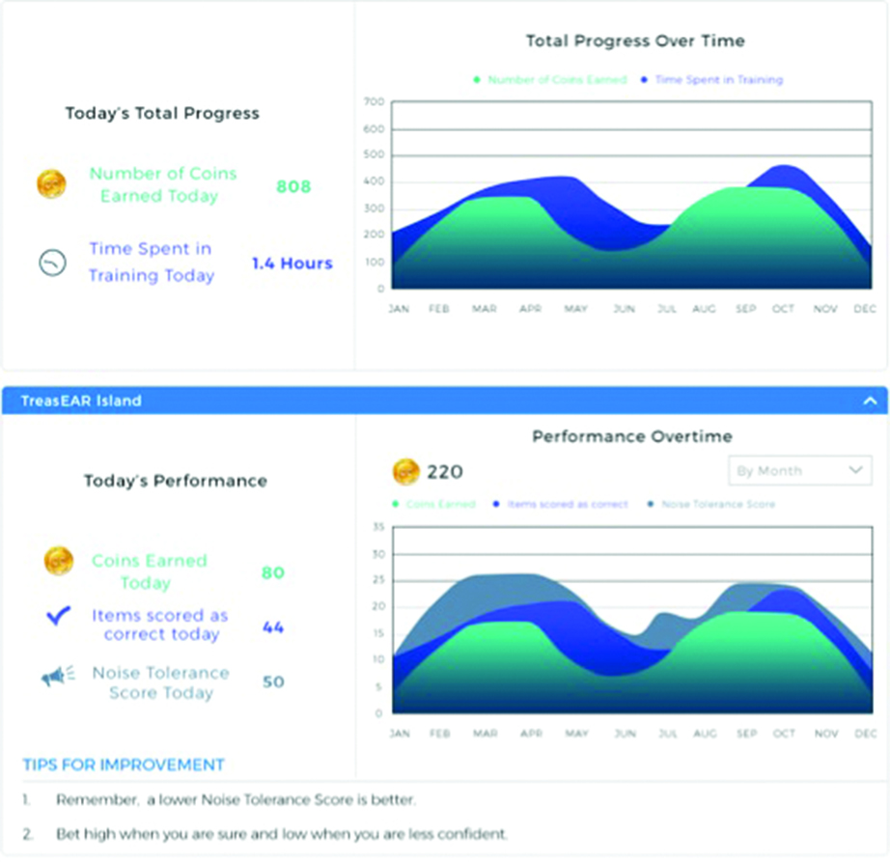
How does it work?
Your audiologist will give you a lesson plan that has been customized for your listening needs.
You’ll play the games for 20 minutes two to three times each week for 12 weeks on your IPad or home computer.
Your audiologist will be in regular contact with you each week with clEAR’s easy-to-use messaging system.
Every time you play, simple feedback graphs will inform you and your audiologist how well you are doing.

Slide 8

What kind of benefits can I receive from clEAR?
Research performed at Washington University in St. Louis shows that most people:
Improve their ability to recognize speech in the present of background noise.
Experience improved conversational confidence.
Find that it takes less effort to be actively engaged in conversations.
Experience reduced listening challenges

Slide 9
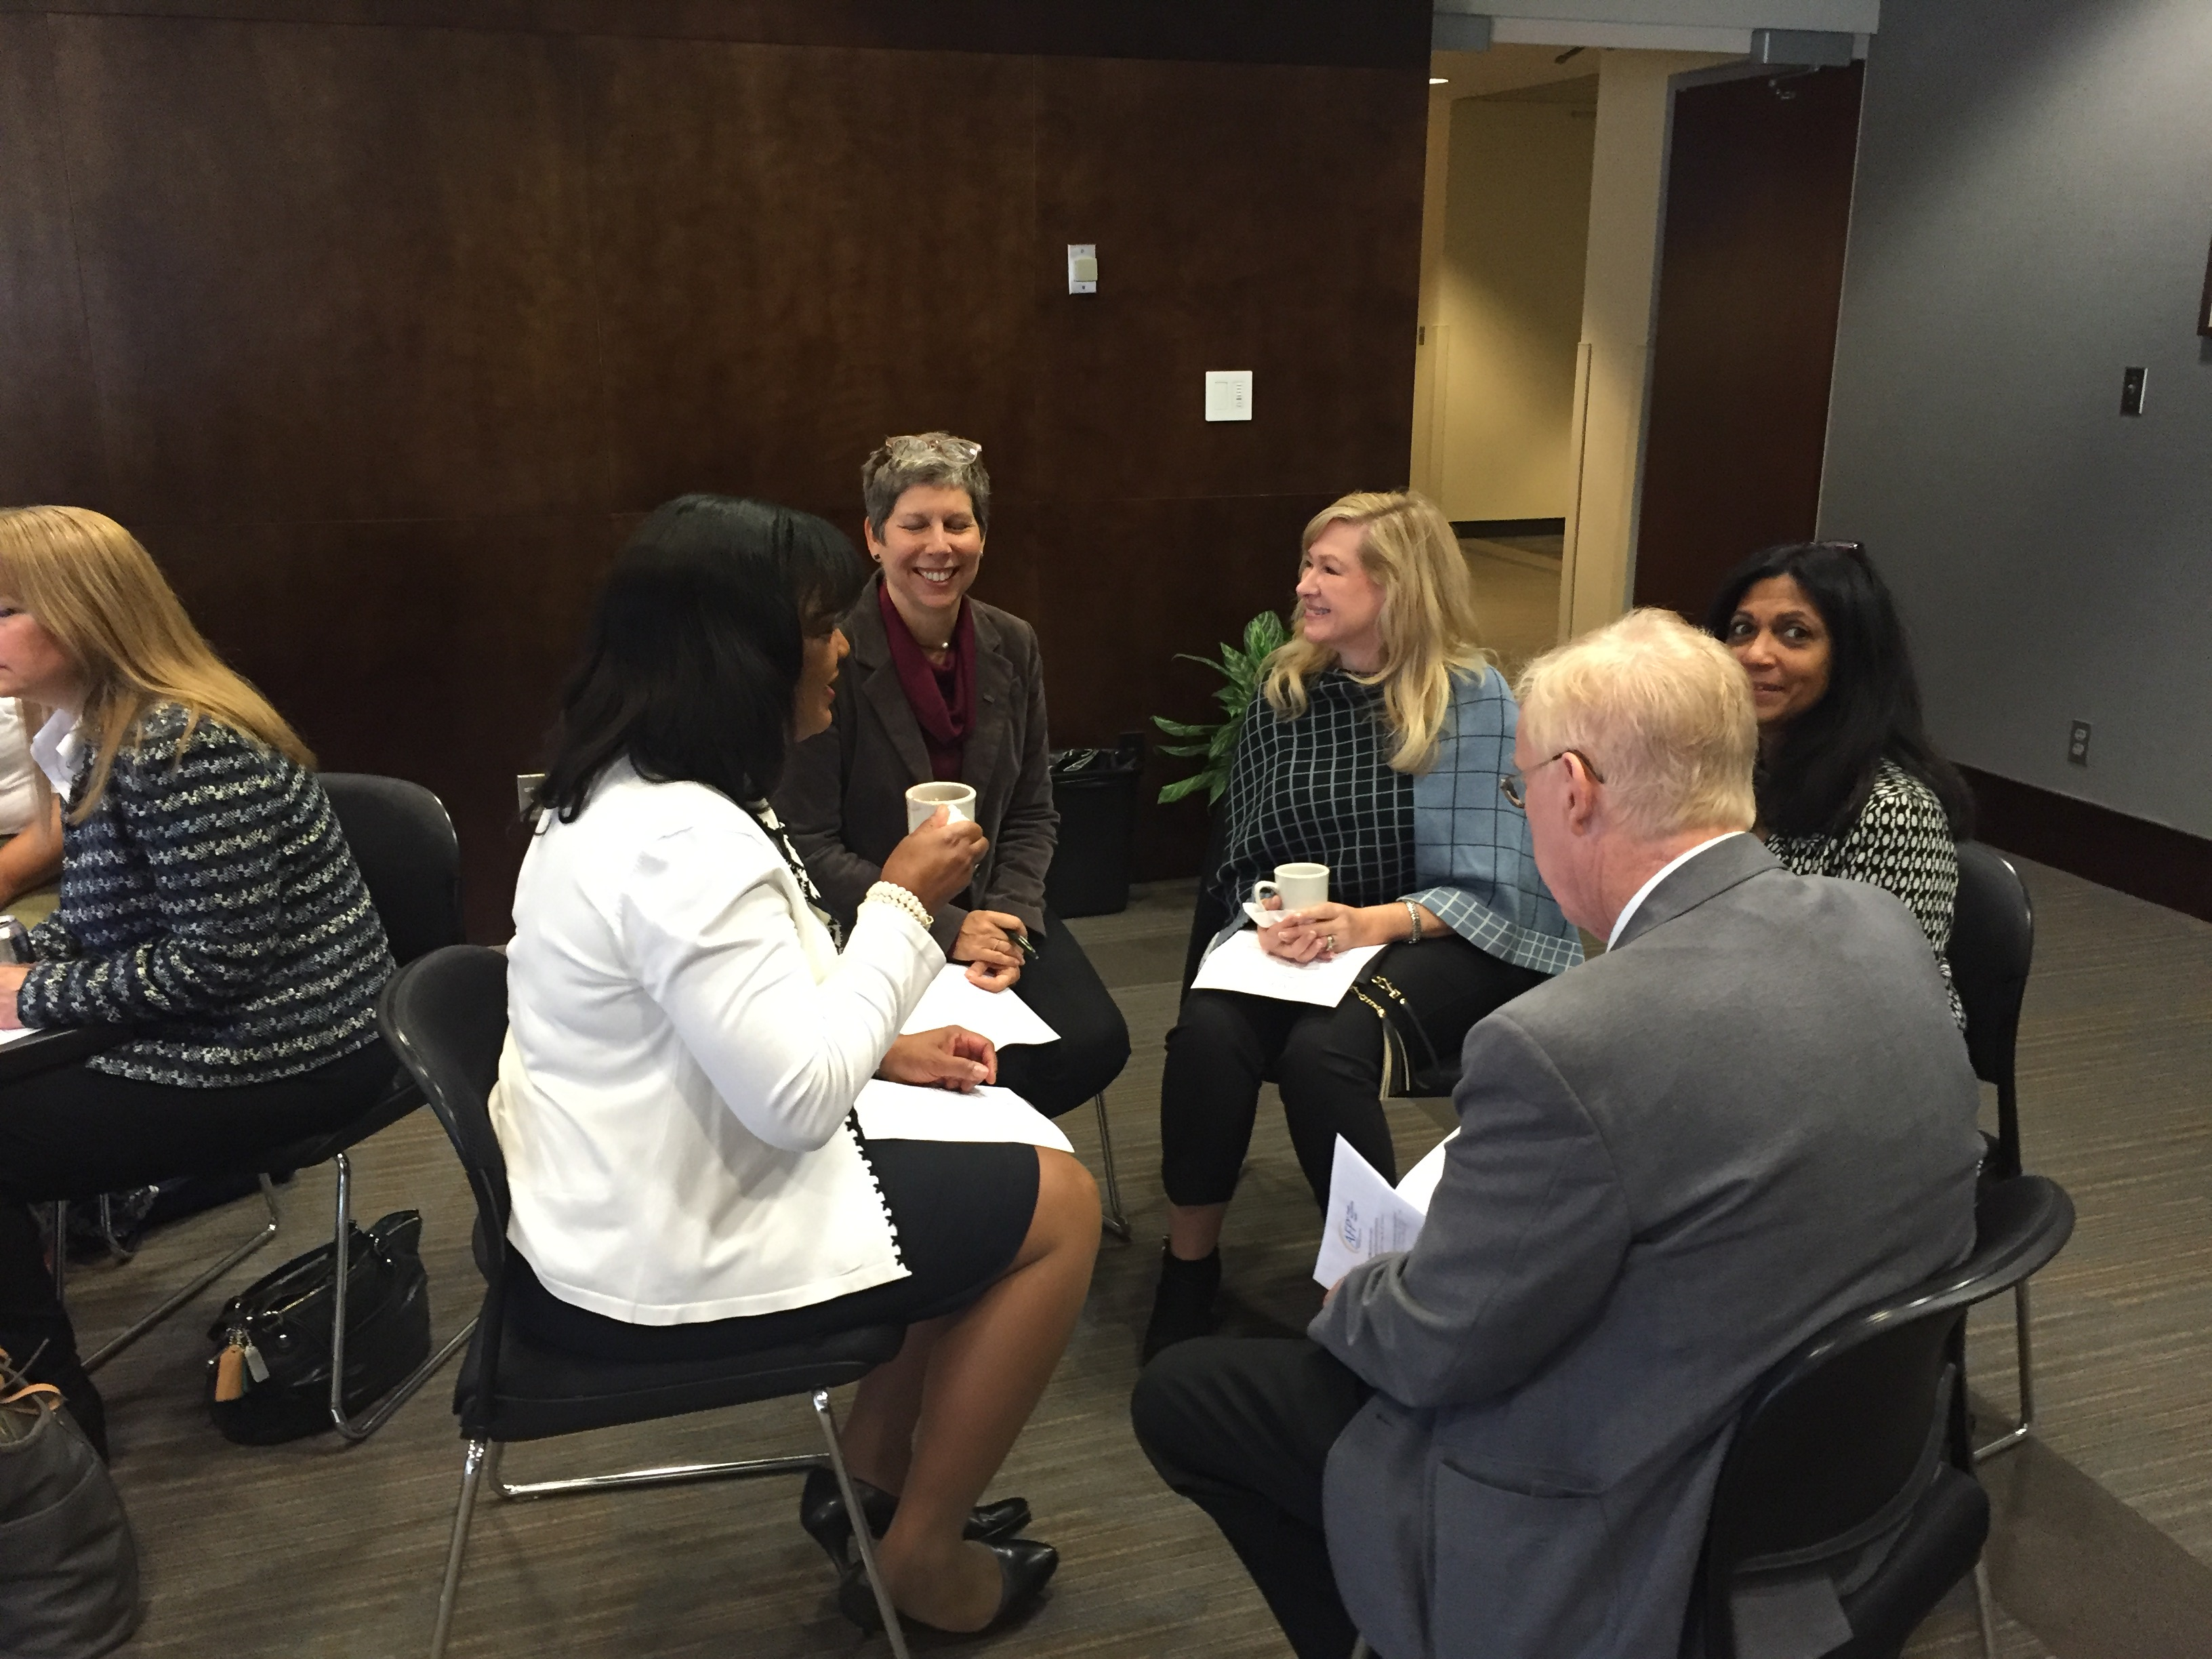
What are people saying about clEAR?
“I was at a wedding reception this past weekend where I was worried that I wouldn't be able to hear the others at my table. I focused intently when speaking to 2 men at the table and was able to hear about 90% of what they said, which was great…better than ever before.”
“Listening is easier now that I’ve trained with clEAR.”
“I loved receiving all of the attention from my audiologist. She really cares about how I’m doing.”
“I would definitely recommend this clEAR program to a friend or relative.”

Slide 10

How do I get started?
Getting started is easy!
Become a subscriber, either through your audiologist or directly from your home computer or IPad.
Simply log on and create an account.
Your audiologist will provide you with a weekly lesson plan.
You can start training and playing the games right away!
A subscription lasts for three months, and doesn’t start until you play for the first time.
Extended subscriptions are available and easy to obtain.

Slide 11
Ear Train the Brain
Notes:
What NEEDS to be in this presentation?
GET LOGO

