Slide 1
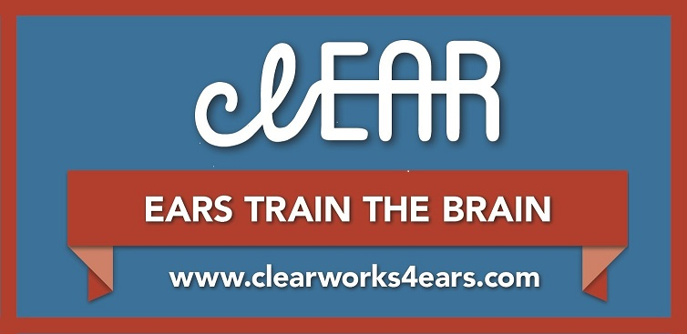
Auditory Brain Training
clEAR User Presentation

Slide 2
Hearing vs. Listening
Hearing allows you to receive acoustic information (speech)
Listening requires your brain to attend to and interpret speech
HEARING
Accidental
Involuntary
Effortless
LISTENING
Focused
Voluntary
Intentional

Slide 3
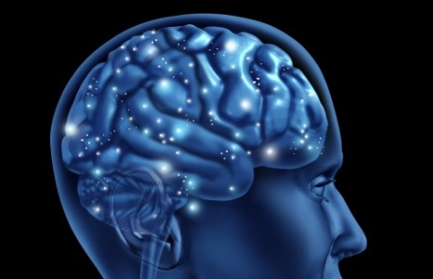
How does hearing loss change your brain?
Pathways in your brain designated for understanding speech begin to reorganize and rewire themselves.
You may lose mental tools that are necessary to process and comprehend speech.

Slide 4
Question
If I begin to use hearing aids, will my brain automatically regain those mental skills that I lost because of hearing loss?
Notes:
Answer: Possibly, but if this does happen, regaining those skills might take a long time and you may never become the listener that you were before you acquired hearing loss. However, help is available. See the next slide for more details.

Slide 5
Why Hearing Aids Are Not Enough
Regaining those skills might take a long time…
You may never become the listener that you were before you acquired hearing loss.
Auditory brain training is like physical therapy for the brain. It trains the brain so you can better comprehend speech.
Notes:
Additional notes:
ABT triggers and accelerates your brain’s rebuilding process
When someone has difficulty walking because of a bum hip and then receives a hip replacement – they receive physical therapy

Slide 6
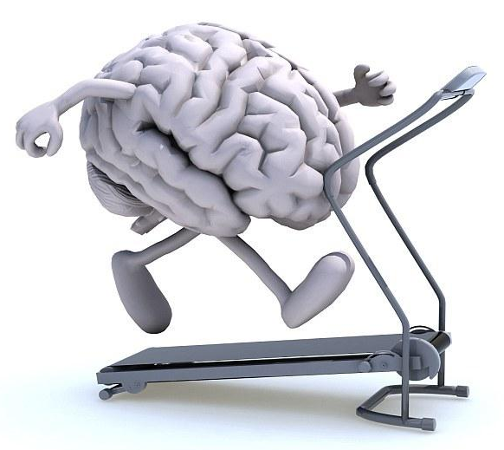
What is Auditory Brain Training?
Trains you to recognize the most frequent words of the language:
Chair
Table
Teaches you to discriminate fine phonetic distinctions:
Can versus Can’t
Trains brain skills such as:
Auditory working memory
Auditory processing speed
Auditory attention
Notes:
Auditory working memory: ability to keep words in short-term memory so meaning of the word and its linguistic context can be processed.
Auditory processing speed: ability to recognize speech quickly which is important during everyday conversation, where one word follows another in rapid succession.
Auditory attention: ability to extract meaningful speech from a background of competing speech babble, as might be required to do when listening in a noisy restaurant.

Slide 7

What is clEAR Auditory Brain Training?
Computerized auditory brain training games that are fun to play
Training that is customized to your specific listening needs
Coaching and support that is provided by your hearing healthcare professional (HHP)

Slide 8
How does it work?
Your HHP provides you with a customized lesson plan.
Play games 2-3 times per week for 20 minutes for a total of 12-weeks.
Your HHP provides regular contact with you each week.
Simple feedback graphs inform you and your HHP how well you are doing.

Slide 9
What benefits can I receive from clEAR?
Research performed at Washington University in St. Louis shows that most people:
Improve their ability to recognize speech in the present of background noise.
Experience improved conversational confidence.
Find that it takes less effort to be actively engaged in conversations.
Experience reduced listening challenges.

Slide 10
What are people saying about clEAR?
“I was at a wedding reception this past weekend where I was worried that I wouldn’t be able to hear the others at my table. I focused intently when speaking to two men at the table and was able to hear about 90% of what they said which was great…better than ever before.”
“Listening is easier now that I’ve trained with clEAR.”
“I loved receiving all of the attention from my audiologist. She really cares about how I am doing.”
“I would definitely recommended this clEAR program to a friend or relative.”

Slide 11
How do I get started?
Become a subscriber, either through your HHP or directly from home.
Your HHP will provide you with a customized lesson plan.
Start training and playing the games right away!
Log-on and create an account.
Subscriptions last for 3 months, beginning on the day that you play for the first time.
Extended subscriptions are available and easy to obtain.

Slide 12
Let’s Get Started!

