Slide 1
HTML 1
Professor Jianqing (Fisher) Wu

Slide 2
After This Lecture, You Should Be Able to...
Understand the basic concepts of HTML
Know how to create HTML documents
Know how to adjust style and formats of font and background
Know how to use css to control styles
Know how to create the following elements on websites and adjust their properties
Links
Images
Lists

Slide 3
HyperText Markup Language (HTML)
Hypertext markup language (HTML) – language you use to create a Web site
Contains markup elements purely procedural and purely descriptive
HTML document – file that contains your Web content and HTML formatting instructions

Slide 4
HTML Document Sections
HTML tag – specifies formatting and presentation of information in a Web site
Structure tags – HTML tags that set up sections and specify the document is an HTML document

Slide 5
HTML Tags
Come in pairs (typically)
begin with <atag>
end with </atag>
Can have properties
<atag property = property_value>
Tags must be nested
<aTag><anotherTag>content</anotherTag></aTag>

Slide 6
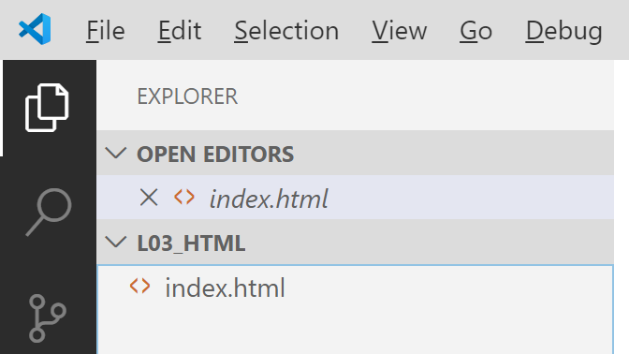
Create HTML Documents
Create a folder (e.g. “L03_HTML”) at somewhere you can find.
Open the folder in VSC
Create a new file with name “index.html”
Notes:
1st exercise: create a web page to display your name

Slide 7
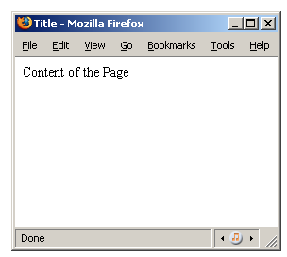
Basic Structure of an HTML Document
<html>
<head>
<title> Title </title>
</head>
<body>
Content of the Page
</body>
</html>
{
Notes:
1st exercise: create a web page to display your name

Slide 8
Basic Structure of HTML Documents
Paragraph <P> and Break <BR>
<P> … </P>
A common error is “not having an ending tag </p>”
<BR> creates line break, no corresponding ending tag
All of these tags have interesting optional parameters
bgcolor, align ...
Notes:
The <br> tag is essentially a carriage return.
<center> … </center>: Centers its enclosed text horizontally.

Slide 9
Style and Formats
Headings: <H1> through <H6>
Headings have different sizes
Formatting text
Align, Font Size, Bold, Italic, Underlined
Standard formats:
Strong, Em, u, Code, Cite, Dfn
HR for horizontal rule
Example:
Notes:
<em>Renders as emphasized text<strong>Renders as strong emphasized text<dfn>Defines a definition term<code>Defines computer code text
<cite>Defines a citation
Definition and Usage
The pre element defines preformatted text. The text enclosed in the pre element usually preserves spaces and line breaks. The text renders in a fixed-pitch font.

Slide 10

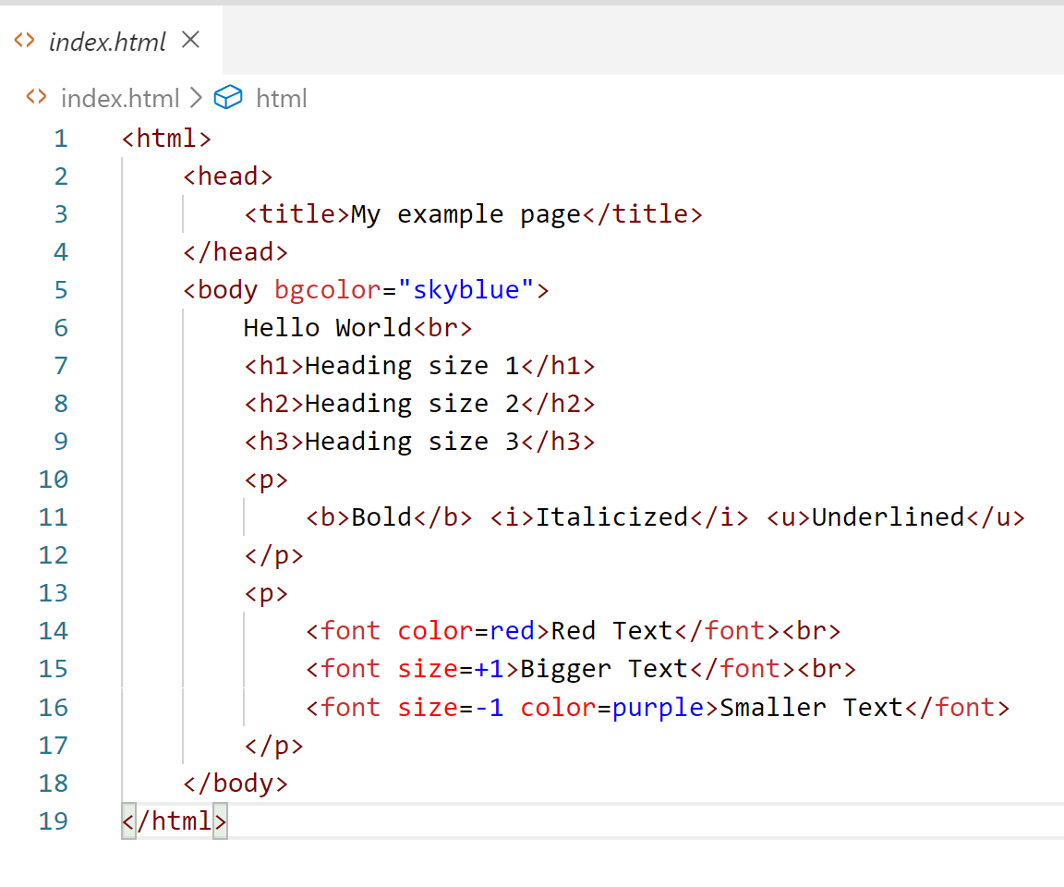
Text Formatting
Notes:
Put your name in H1 format
The course number in blue and underline format
The date in bold, italics and green
The larger the font size number, the larger the text. Default size is usually 3.

Slide 11
Text Size
Default text size is usually 3; can be changed
<font size=size number> and </font>
Example
<font size=10 color=blue>A</font>stronomy is fun.
Produces: Astronomy is fun.

Slide 12
Text Color
Default text color is black; can be changed
<font color=color name> and </font>
Example
I like the color <font color=blue>blue</font>.
Produces: I like the color blue.

Slide 13
Background Color
We typically have
<body>
</body>
Default background color is white; can be changed
<body bgcolor=color name>
Example
<body bgcolor=green>
</body>
Changes background color to green
Notes:
Change your background color to yellow.
Ask students to run the example
Heading tags – make certain information, such as titles, stand out
<hnumber> and </hnumber>, where number is from 1 to 6
<h1> and </h1> - largest
<h6> and </h6> - smallest

Slide 14
Using Number to Specify Colors
Hexadecimal number – to the base 16 (0,1,2,3,4,5,6,7,8,9,A,B,C,D,E,F)
A hex triplet is a six-digit, hexadecimal number used in HTML to represent colors.
The number of colors that can be represented by this system is
R
G
B
Color | Hexadecimal | Color | Hexadecimal | Color | Hexadecimal | Color | Hexadecimal
black | #000000 | silver | #c0c0c0 | maroon | #800000 | red | #ff0000
navy | #000080 | blue | #0000ff | purple | #800080 | fuchsia | #ff00ff
green | #008000 | lime | #00ff00 | olive | #808000 | yellow | #ffff00
teal | #008080 | aqua | #00ffff | gray | #808080 | white | #ffffff
Notes:
Each bytes (2 digits) represent the red, green and blue components of the color
http://www.w3schools.com/html/html_colors.asp

Slide 15
Using Number to Specify Colors
R
G
B
Color | Hexadecimal | Color | Hexadecimal | Color | Hexadecimal | Color | Hexadecimal
black | #000000 | silver | #c0c0c0 | maroon | #800000 | red | #ff0000
navy | #000080 | blue | #0000ff | purple | #800080 | fuchsia | #ff00ff
green | #008000 | lime | #00ff00 | olive | #808000 | yellow | #ffff00
teal | #008080 | aqua | #00ffff | gray | #808080 | white | #ffffff
Notes:
Each bytes (2 digits) represent the red, green and blue components of the color
http://www.w3schools.com/html/html_colors.asp

Slide 16
Background Picture
We typically have
<body>
</body>
Example
<body background=yellowhaze.jpg>
</body>
Uses a “yellow haze” as background
Notes:
Change your background color to yellow.
Ask students to run the example
Heading tags – make certain information, such as titles, stand out
<hnumber> and </hnumber>, where number is from 1 to 6
<h1> and </h1> - largest
<h6> and </h6> - smallest

Slide 17
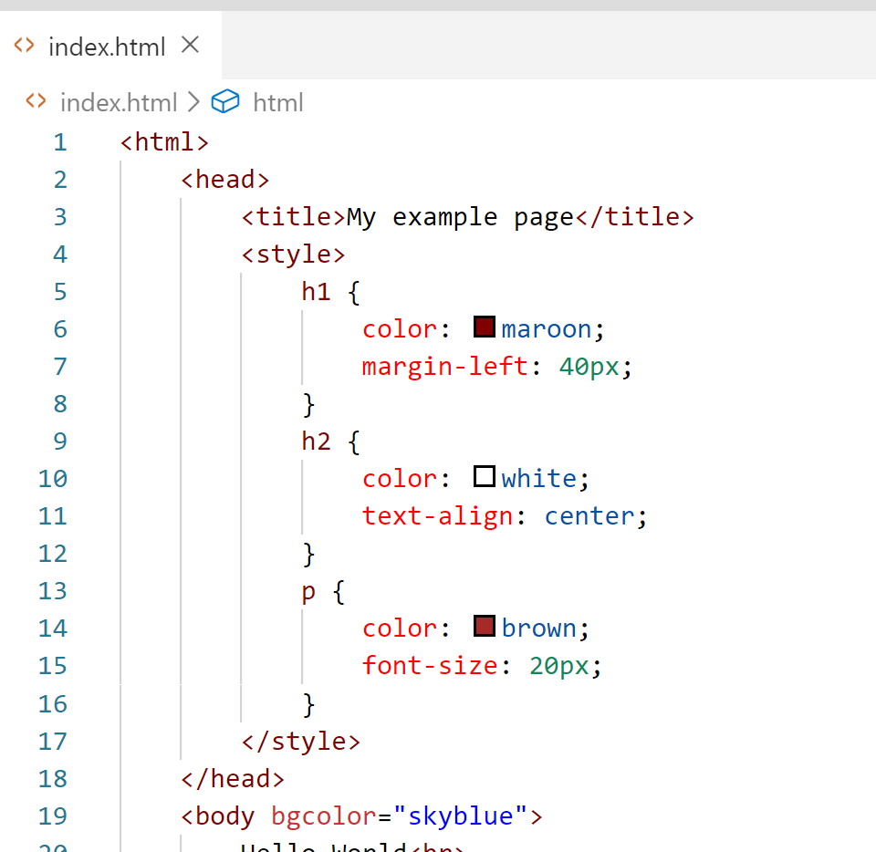
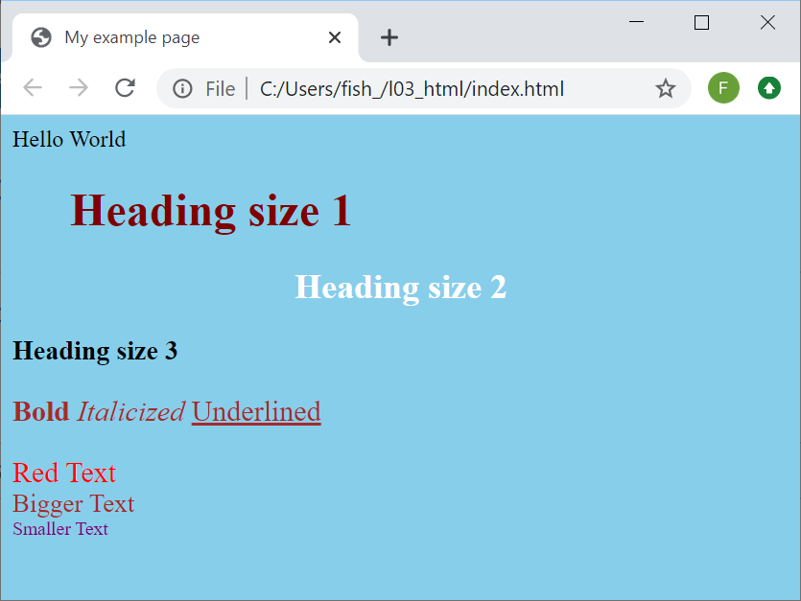
Use CSS to control styles

Slide 18
Links
Link (hyperlink) – clickable text or an image that takes you to another site or page
<A HREF=destination>stuff</A>
Stuff can be text, formatted text or images
Create “clickable” text “CSULB”
<a href=http://www.csulb.edu>CSULB</a>
Notes:
HTML uses the <a> (anchor) tag to create a link to another document.
An anchor can point to any resource on the Web: an HTML page, an image, a sound file, a movie, etc.
The syntax of creating an anchor:
<a href="url">Text to be displayed</a>

Slide 19
Three types of Links
Links to other Web pages or sites
Destination should be relative to the page
Any website/webpage on the internet: destination must be the URL of the website and include http://
Links to downloadable files (e.g., .pdf, .zip)
<a href=workbook1.xlsx>My Excel Work</a>
Links to e-mail
<a href=mailto:account@csulb.edu>account@csulb.edu </a>

Slide 20
Images
Most browsers handle
GIF; JPEG; PNG; several other types
IMG tag:
<img src=file.jpg>
ALT tag for image text
HEIGHT, WIDTH to help browser
BORDER is useful with hyperlinks
<img src=csulbpyr.jpg>
Notes:
Display the krannert logo on your page.
Is usually jpg or gif format
Cannot use bmp file formats
Alt text Defines a short description of the image
Border Defines a border around an image.

Slide 21
Adjusting Image Sizes
Can adjust size of images with height and width parameters
Provide sizing in pixel counts
Example
<img border=0 src= csulbpyr.jpg height=200 width=200>
Size would be 200x200 (approximately 3 inches square)
Notes:
If you provide different values for the height and width, that might skew the image one way or the other.

Slide 22
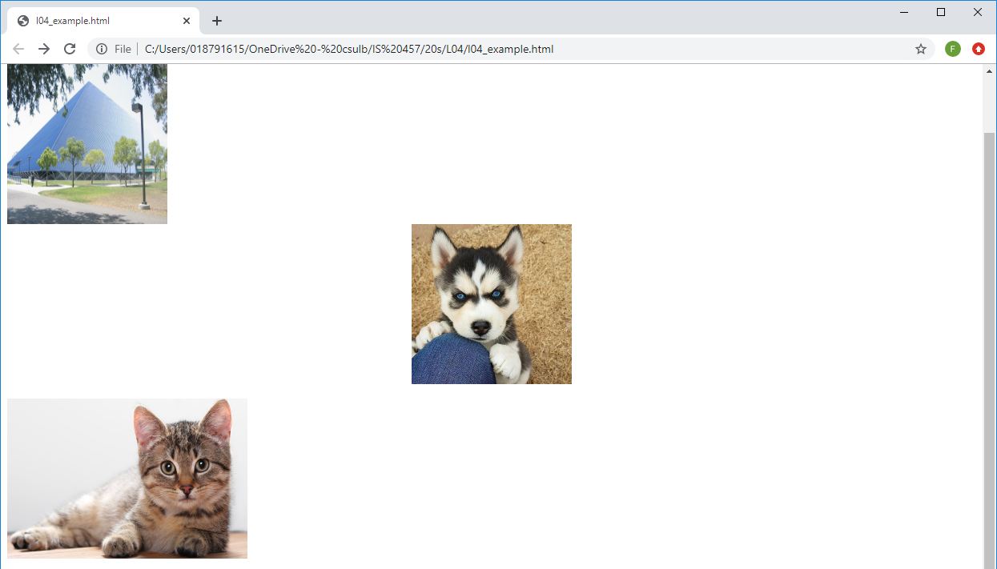
Adding Images
Notes:
Show examples

Slide 23
Lists
Ordered lists, unordered lists
<OL> -- Ordered lists
type = 1, a, A, i, I
elements bracketed by <LI>, </LI>
<UL> -- Unordered lists
type = disk, square, circle
elements bracketed by <LI>, </LI>
Notes:
No corresponding ending tag for <li>
The default numbering for numbered lists is Arabic. Can be changed.

Slide 24
Ordered Lists
Format is
<ol>
<li>list content</li>
<li>list content</li>
</ol>
Default is Arabic
<ol type=a> lower case letters
<ol type=A> upper case letters
<ol type=i> lowercase Roman numerals
<ol type=I> uppercase Roman numerals
Notes:
Show examples

Slide 25
Unordered Lists
Format is
<ul>
<li>list content</li>
<li>list content</li>
</ul>
<ul type=disc>
<ul type=square>
<ul type=circle>
Notes:
Show examples

Slide 26
Some Additional CSS Styling
ol {
color: blue;
font-size: 24px;
}
ul {
border: 1px solid;
padding: 40px;
}
Notes:
Show examples

Slide 27
Additional Hints
The Most Common Error: Forgetting the ending tag
Example: <body> and </body> is a pair, you need to have both
Explore more on HTML and CSS!
https://www.w3schools.com/html/default.asp

Slide 28
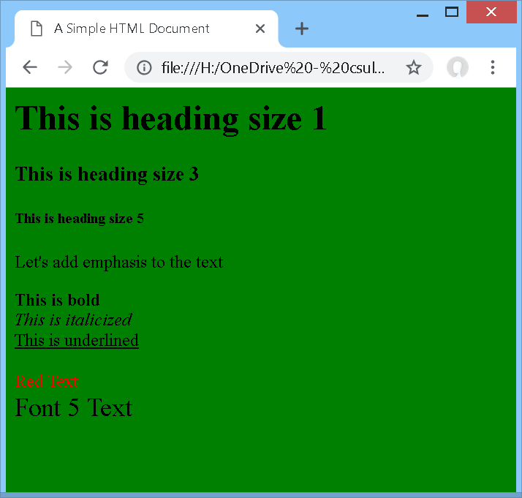
In Class Exercise 1
Try to create a HTML file that shows exactly the following
Name it simple.html
Hint: All the content except the three headings are within a paragraph (within a <p></p> tag)

Slide 29
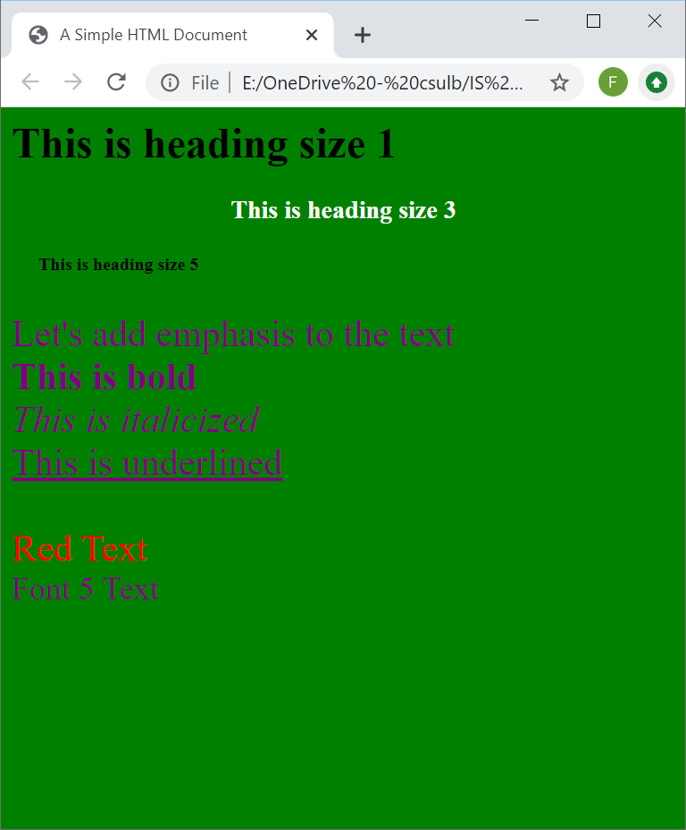
In Class Exercise 2
Use CSS to control the default style of
Heading size 3 has white color, text aligned to center
Heading size 5 has 20 pixels left margin
Paragraphs have purple color and 28 pixels font size

Slide 30
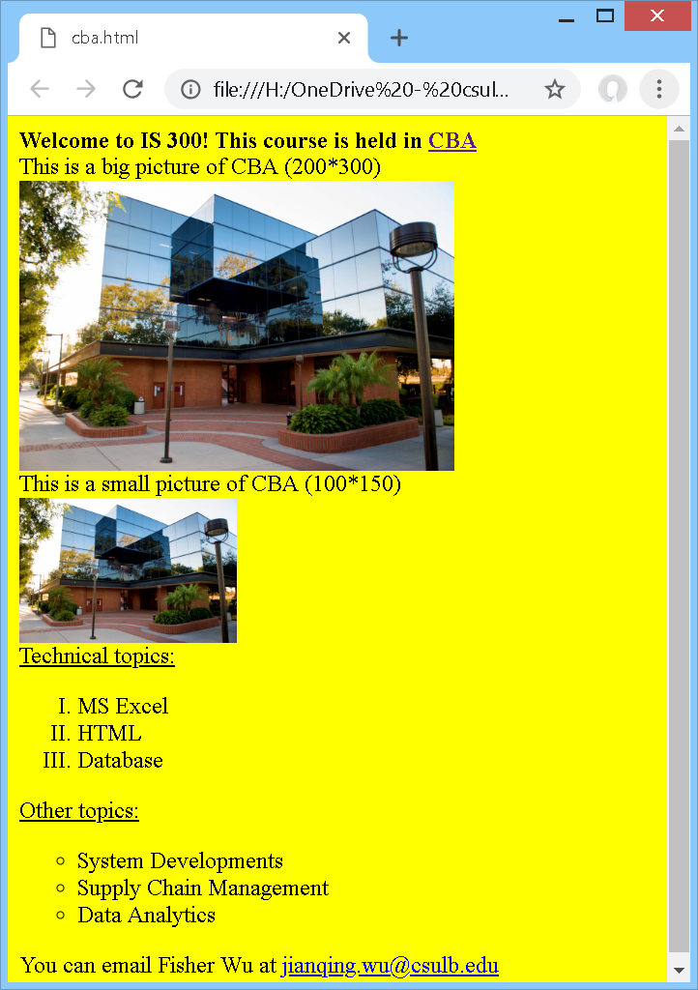
Exercise 3
Try to create a HTML file that shows exactly as the right webpage
CBA link is http://www.csulb.edu/college-of-business-administration
Use picture “cba.jpg” from Beachboard
Name it “cba_page.html”

Slide 31
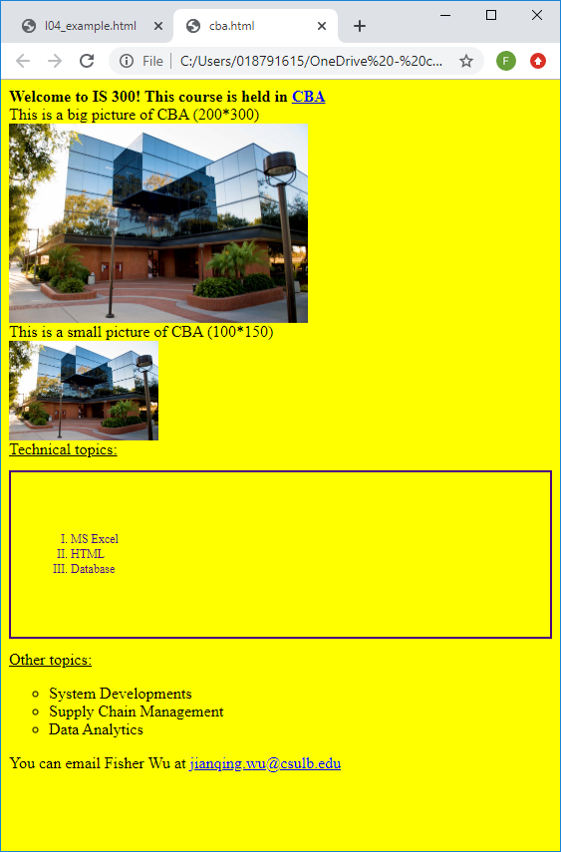
Exercise 4
Use CSS to control the default style of ordered lists as
Indigo font color;
12 pixels font size;
2 pixels solid board;
60 pixels padding.

