Slide 1
Prediction of Mortality from 12-Lead Electrocardiogram Voltage Data Using a Deep Neural Network
Raghunath, S., Ulloa Cerna, A.E., Jing, L. et al.
Nature Medicine 26, 886-891 (2020)
Paper Review by Brenton Graham

Slide 2
Background
The electrocardiogram (ECG) is a widely used medical test that measures the heart’s voltage over time
Despite widespread use, not well adopted as a prognostic tool
Can we use ECGs to predict clinical events?
Hypothesis
A deep neural network (specifically CNN) can predict an important future
clinical event (1-year all cause mortality) from ECG traces
Hypothesis

Slide 3
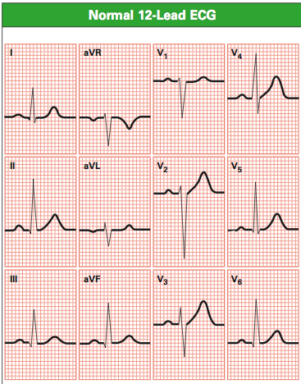
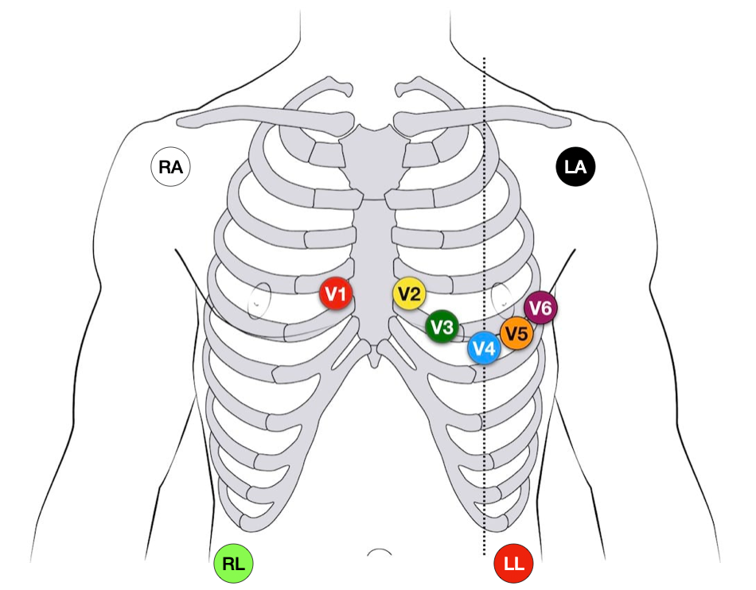
12-Lead ECGs
12-lead ECG measures the heart from 12 angles
6 Limb Leads – Look at the heart in a vertical plane
Leads I, II, III
Leads aVR, aVL, aVF
6 Chest Leads – Look at the heart in a horizontal plane
Leads V1, V2, V3
Leads V4, V5, V6
Electrode Placement

Slide 4
12-Lead ECGs
15 traces per ECG
All 12 leads have traces of 2.5s in duration (measured in groups of three)
Leads V1, II and V5 have additional traces of 10s in duration (long-reads)
12-Lead ECG
I, II, III
aVR, aVL, aVF
V1, V2, V3
V4, V5, V6
Short-Reads
2.5sec
2.5sec
2.5sec
2.5sec
10sec
Long-Reads
Leads V1, II, V5
10sec
10sec

Slide 5
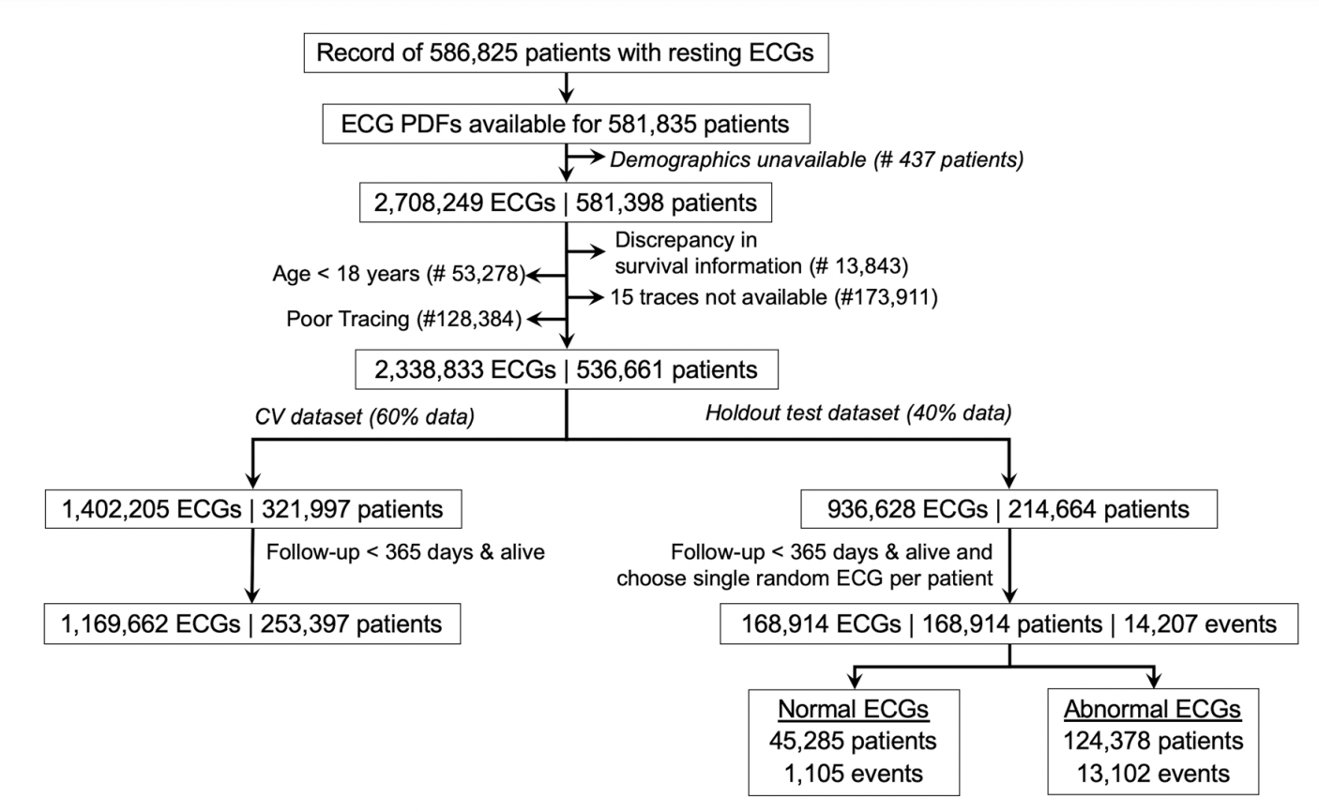
Data
Data from institutional clinical MUSE database (1984 – 2019)
Inclusion criteria
ECGs screened for data quality
ECGs associated with at least 1 year of follow-up or death within a year
Patients 18 years or older
Hold-out test set
Single random ECG was chosen for each patient to avoid overrepresenting sicker patients who undergo more ECGs

Slide 6
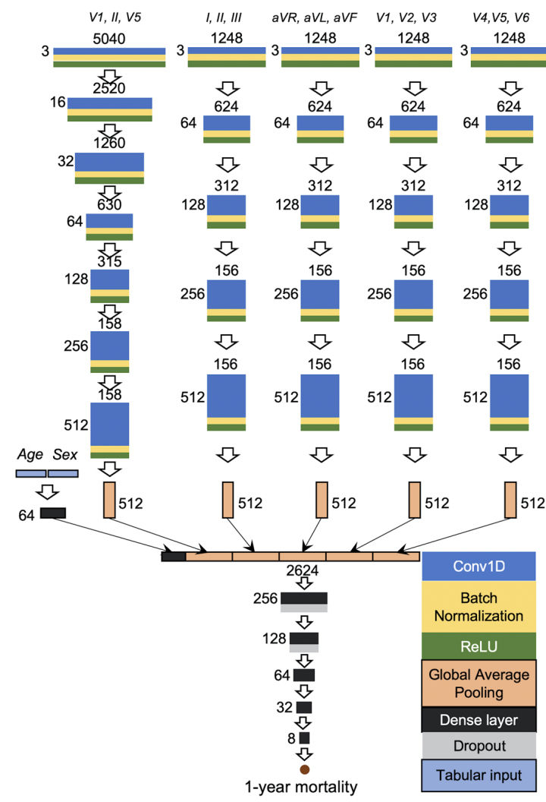
Long-Read Branch
Short-Read Branches
CNN Architecture
Convolutional neural network (CNN) using five branches
Each branch has input of three leads (as channels) that are concurrent in time (acquired during the same heartbeats)
Helps account for arrhythmias
A convolutional block consisted of…
One-dimensional convolution layer
Batch normalization
Rectified linear unit (ReLU) activation
‘Short-read’ branches (4) consisted of 4 convolutional blocks followed by a global average pooling (GAP) layer
‘Long-read’ branch consisted of 6 convolutional blocks followed by a global average pooling (GAP) layer
The outputs of all branches were concatenated and connected to a series of six dense layers
256 (with dropout), 128 (with dropout), 64, 32, 8 and 1 unit(s) with a sigmoid function as the final layer

Slide 7
CNN Hyperparameters
Adam optimizer
Learning rate: 1 x 10⁻⁵
Batch size set to 2,048
All other hyperparameters set to default

Slide 8
All Models
A collection of models/data sets were used to assess CNN model performance
Model Type | Test Data Sets
Model | All ECGs | Normal ECGs | Abnormal ECGs
CNN | ECG Traces ECG Traces + Age, Sex*
XGBoost (Baseline Models) | ECG Measures Age, Sex ECG Measures + Age, Sex

Slide 9
Various Feature Sets
12-Lead ECG Trace Images (Feature Set of Interest)
Modeled with CNN
These are the ‘novel’ models in the paper
Model Type | Test Data Sets
Model | All ECGs | Normal ECGs | Abnormal ECGs
CNN | ECG Traces ECG Traces + Age, Sex
XGBoost (Baseline Models) | ECG Measures Age, Sex ECG Measures + Age, Sex

Slide 10
Various Feature Sets
ECG Measures
Traditional quantitative ECG measures parsed from clinical reports
Includes 31 diagnostic pattern classes and 9 continuous measurements
Modeled using XGBoost framework
This feature set/classification results serve as a baseline to compare CNN to
Model Type | Test Data Sets
Model | All ECGs | Normal ECGs | Abnormal ECGs
CNN | ECG Traces ECG Traces + Age, Sex
XGBoost (Baseline Models) | ECG Measures ECG Measures + Age, Sex Age, Sex

Slide 11
Various Feature Sets
Age & Sex
Additive features
Modeled independently using XGBoost framework
Model Type | Test Data Sets
Model | All ECGs | Normal ECGs | Abnormal ECGs
CNN (Novel Models) | ECG Traces ECG Traces + Age, Sex
XGBoost | ECG Measures ECG Measures + Age, Sex Age, Sex

Slide 12
Performance on Normal ECGs
Results Reported for 3 Sets of ECGs
Can the CNN perform well on ECGs that are interpreted as normal by physicians?
Normal ECGs: ECGs without easily recognizable high-risk factors
All models trained on all ECGs (both normal and abnormal)
Model Type | Test Data Sets
Model | All ECGs | Normal ECGs | Abnormal ECGs
CNN (Novel Models) | ECG Traces ECG Traces + Age, Sex*
XGBoost (Baseline Models) | ECG Measures ECG Measures + Age, Sex Age, Sex

Slide 13
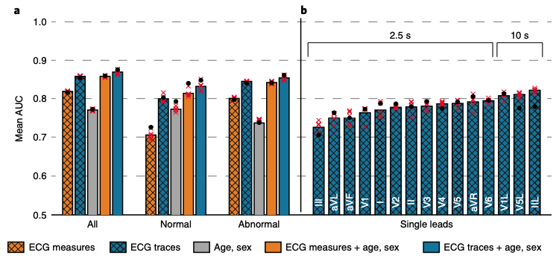
Model Comparisons
ROC-AUC for All ECGs
Common Risk Scoring Methods
Framingham Risk Score (FRS): AUC 0.648
Charlson Comorbidity Index (CCI): AUC 0.816
Model | Feature Set | AUC
CNN | ECG traces + Age, Sex | 0.870 + 0.006
XGB | ECG measures + Age, Sex | 0.859 + 0.002
CNN | ECG traces | 0.859 + 0.001
XGB | ECG measures | 0.820 + 0.002
XGB | Age, Sex | 0.772 + 0.002
*AUCs from 5-fold CV

Slide 14
Model Comparisons
ROC-AUC for Normal ECGs
AUC of CNN from 5-fold CV: 0.833 + 0.001
CNN vs XGBoost
“CNN generally outperformed XGB”
Confidence intervals of the mean AUCs overlapped when including age and sex

Slide 15
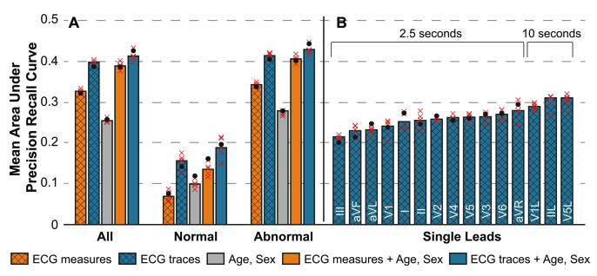
Model Comparisons
PR-AUC

Slide 16
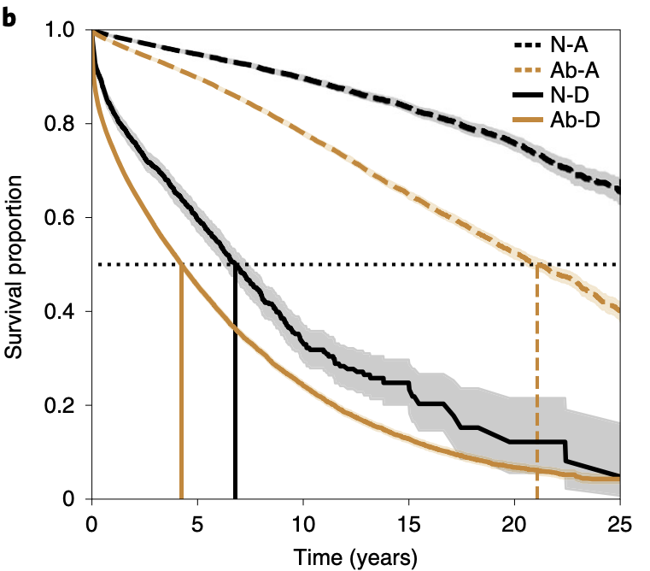
Survival Analysis
Kaplan-Meier Median Survival Times
Cox PH Regression Model
CNN prediction of 1-year mortality is a significant discriminator of long-term survival for up to 25yrs
ECG Type | Predicted Alive at 1-Yr | Predicted Dead at 1-Yr
Normal ECG | >25yr | 7
Abnormal ECG | 21 | 4
ECG Type | HR (95% CI) Predicted Dead vs Alive at 1-Yr
Normal ECG | 9.1 (7.3 – 11.0)*
Abnormal ECG | 6.8 (6.2 – 7.6)

Slide 17
Practical Applications
Mortality prediction is useful in numerous clinical contexts
Physicians and cardiologists use risk prediction tools to assess the safety of elective surgical procedures and guide therapy for prevention of cardiovascular disease
‘Normal’ ECGs may be giving false reassurance in clinical settings

Slide 18
Potential Weaknesses
Much improvement of the CNN compared to XGBoost?
Computational considerations
Perhaps some hyperparameter tuning could improve XGBoost results
Are traditional ECG measures more common/available in practice?
Model interpretability
Limited ability to define the basis for model predictions
Choosing 1-year all-cause mortality as the the outcome of interest
Could CVD-related mortality be more appropriate for potential applications?

Slide 19
Strengths
CNN architecture
Nice example of an architecture that accounts for biologically important data structures
Demonstrated that CNNs can use ECG traces effectively for prediction
Don’t need to rely on traditional quantitative measures being available
Traditional measures associated with some levels of missingness (up to 12% missing for some measures in this data set)

