Slide 1
10-Year Probability of Stroke from the Framingham Heart Study
Brenton Graham
11/23/22

Slide 2
Background & Research Questions
The Framingham Heart Study
A multigenerational prospective cohort study that was initiated in 1948 to characterize risk factors associated with cardiovascular disease (CVD)
Subjects were examined biennially for risk factors and followed for CVD-related health outcomes including incidence of stroke and heart attack
This Report
We focus on a subset of data from 4,434 participants from the Framingham Heart Study
Research aim: To estimate the 10-year probability of stroke incidence associated with different risk profiles, stratified by sex

Slide 3
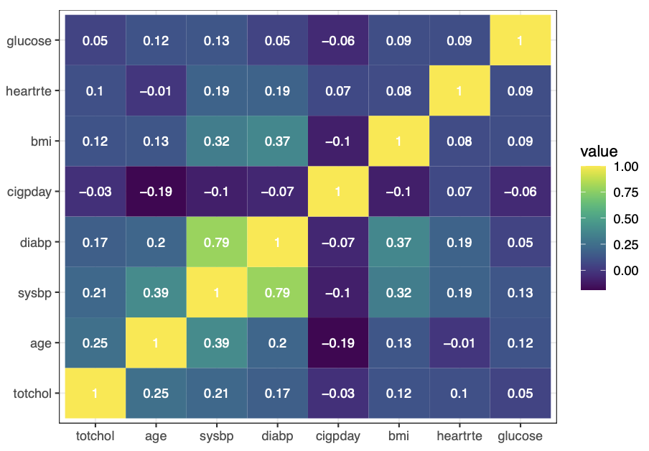
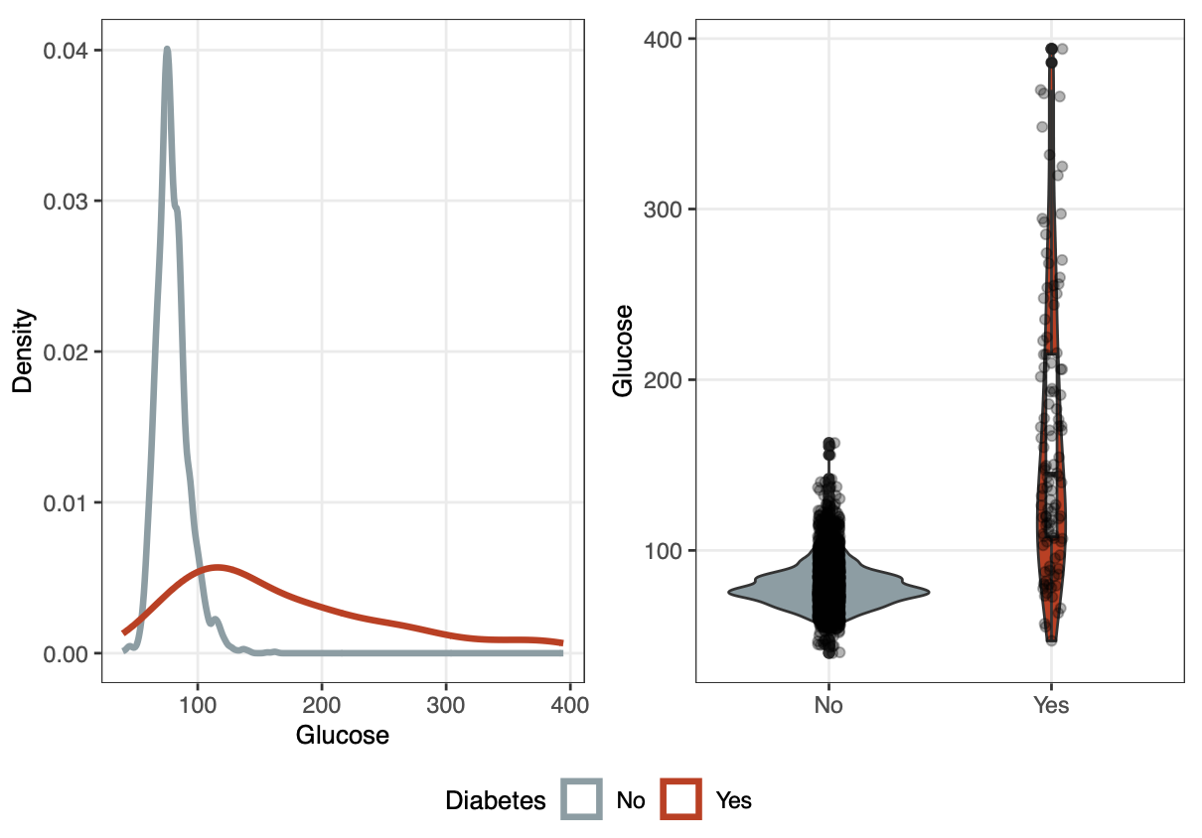
Data Preparation & Variable Screening
Data was transformed to reflect 10 years of follow-up and baseline risk factors
Original 24 years of follow-up in the data set
Stroke events occurring after 10 years of follow-up were censored and time-to-stroke measures were restricted to a maximum of 10 years
Death is treated as a censoring event
Variable Screening
Risk factors were screened for redundancy, collinearity, missingness, and biological relevance
Variable screening decisions:
Cigarette smoking (binary) over cigs/day (redundancy)
Systolic blood pressure over diastolic blood pressure (collinearity)
Cholesterol variables removed (missingness/relevance)
Diabetes as a measure of glucose (missingness/redundancy)
Prevalent CHD as indicator of Prevalent CHD, MI and AP

Slide 4
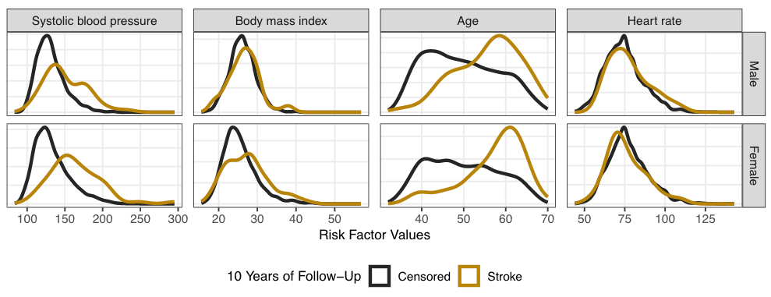
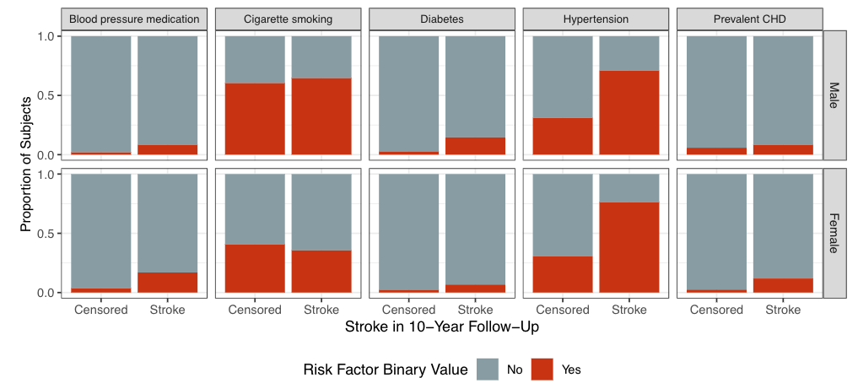
EDA

Slide 5
Statistical Methods
Proceeded with a Complete-Case Analysis (Limitation)
4.3% of subjects with missing data after variable screening process (4.3% of males and 4.2% of females)
7 stroke events undesirably dropped
LASSO-penalized Cox Proportional Hazards (CPH) Models
We fit sex-specific CPH models with LASSO regularization
Additional variable selection feature with this regression technique
K-fold cross-validation was used to determine the “optimal” lambda (λ) values for each model
5-fold CV; minimum λ value to achieve maximum Harrell’s C-index (AUC-like goodness-of-fit measurement)
λ_{male} = 0.00193; λ_{female} = 0.0024
Proportional hazards assumptions were checked for all models
Participants were Categorized into Risk Groups
Subject-specific risk scores were from LASSO CPH model fits
Risk scores were used to categorize participants into three equally-sized risk profile groups
Low-, medium-, and high-risk groups
Kaplan-Meier curves were then fit, stratifying by risk profile

Slide 6
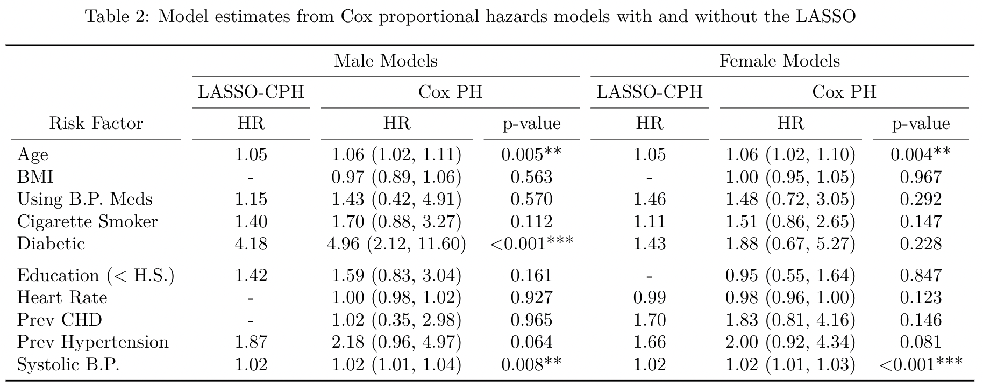
Results
LASSO-penalized Cox Proportional Hazards (CPH) Models
Note: Standard frequentist estimates (CIs and p-values) are not applicable to LASSO-based models
Non-regularized CPH models were fit for an exploratory comparison (to get perspective on shrinkage)
C-index results indicate reasonable prediction performance
Male model: 0.776
Female model: 0.799

Slide 7
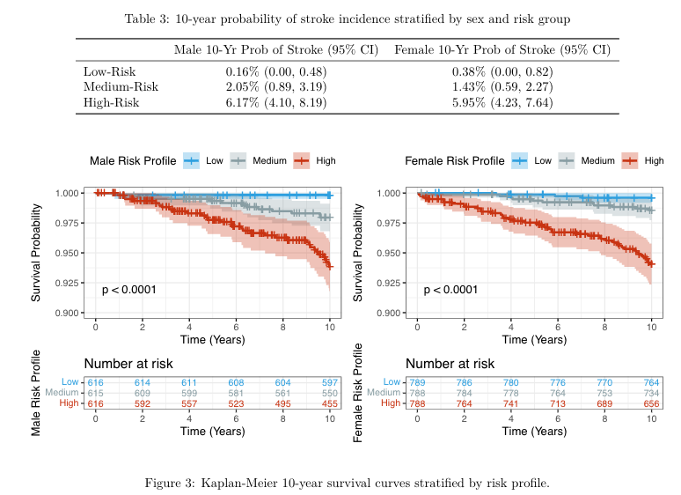
Results
10-Year Survival Curves Stratified by Risk Profiles
Subject-specific risk scores were from LASSO CPH model fits
Risk scores were used to categorize participants into three equally-sized risk profile groups
Low-, medium-, and high-risk groups
Kaplan-Meier curves were then fit, stratifying by risk profile

Slide 8
Discussion & Limitations
Complete-case analysis used
We should try multiple imputation/sensitivity analysis to check for bias
The LASSO is known to produce biased estimators
Limitations on statistical inference since our estimates are likely biased (shrunken)
The LASSO is known to produce unstable variable selection
Results are sensitive to the lambda value used
We should run a stability analysis (bootstrap approach) to assess which variables are consistently selected as predictors of 10-year stroke incidence
Risk score profiling was performed on the full data set
Generalizability of risk profile probabilities should be questioned
We should use a training/test cross-validation approach to assess generalizability
Time-varying risk factors would likely improve prediction capabilities
Future reports should explore mixed effects Cox regression models

