Slide 1
Exploring Longitudinal Pulmonary Exacerbation Outcome Trajectories in Cystic Fibrosis Patients
Brenton Graham
12/5/22

Slide 2
Cystic Fibrosis (CF)
Hereditary disease which involves production of abnormally viscous mucus
Early airway vulnerability to chronic bacterial infections
Most common life-threatening autosomal recessive disease in US
Affects 1 in 4000 newborns
No known cure

Slide 3
Pulmonary Exacerbations (PExs)
Significant life events ( “lung attacks”) in people with CF
Associated with declining lung function, reduced quality of life, hospitalizations, and decreased survival
A leading cause of morbidity in CF
Treatment response often suboptimal despite seemingly appropriate antimicrobial therapy
PEx-related outcomes (markers)
FEV-1: Measure of lung function
PEx Score: Self-evaluated score of PEx severity
CRP: Marker of inflammation
Neutrophil Elastase: Secreted during inflammation; destroys bacteria and host tissue

Slide 4
Study Design
Participants include CF patients hospitalized at the onset of a PEx
34 CF patients and 39 PExs (5 subjects with multiple PEx)
Subjects evaluated at three timepoints separated by 10-14 days
T1: Admission (PEx onset) – least healthy
T2: Hospital discharge – most healthy
T3: Follow-up – somewhere in between
At each time point subjects were evaluated for…
PEx-related clinical outcomes
CF pathogen detection (Culture and 16S)

Slide 5
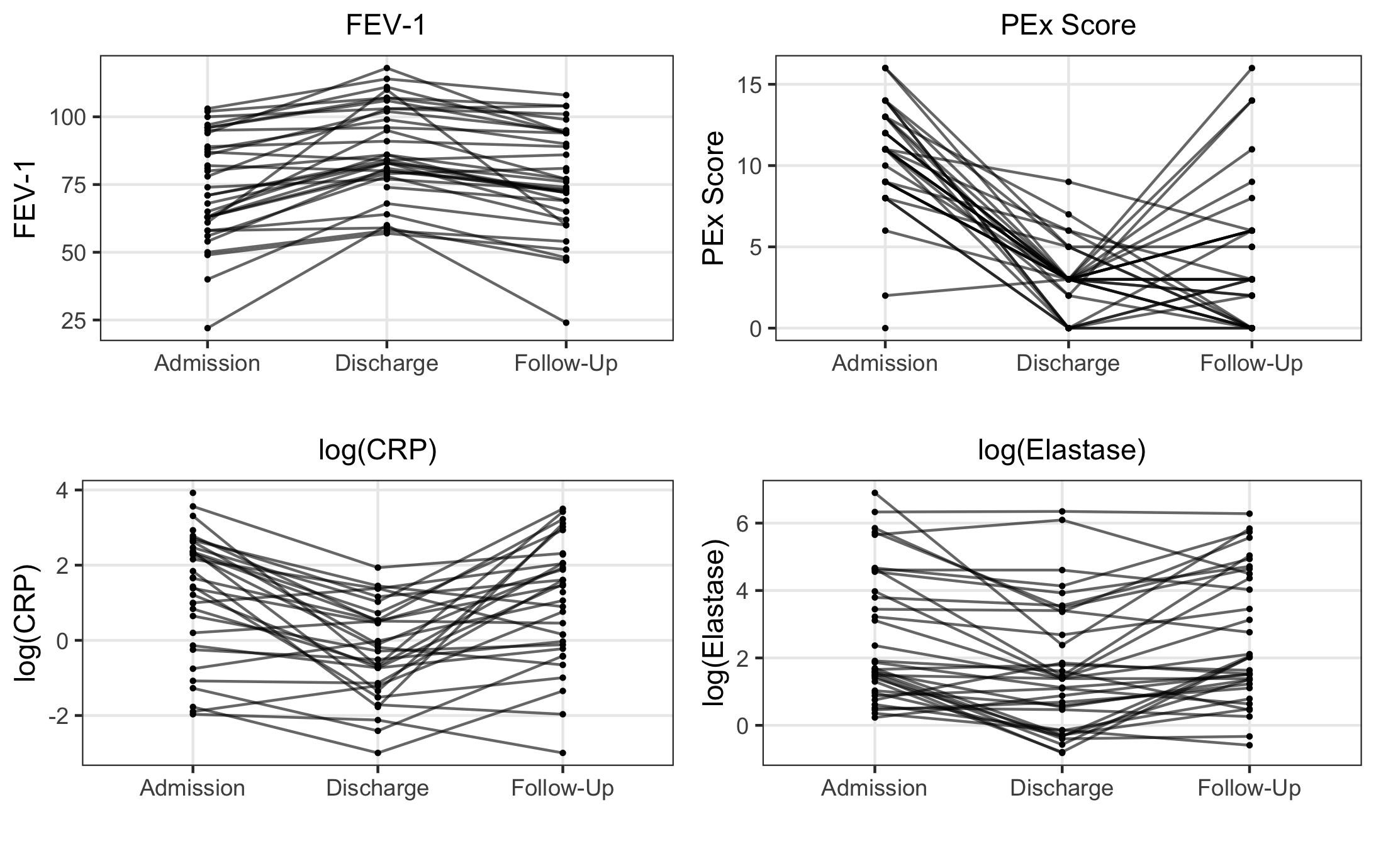
PEx-Related Outcomes

Slide 6
Project Aim
Outcome of Interest: Neutrophil elastase
Inflammatory marker that suggests lung disease
“If you can detect elastase, disease is in progression”
Question: Are there any baseline risk factors associated with outcome trajectory (treatment response)?
Hypotheses
Hypothesis 1: There exist sub-groups in our population that experience separable outcome trajectories (treatment response)
Hypothesis 2: There exist baseline risk factors that are associated with said sub-groups

Slide 7
Latent Class Analysis (LCA)
LCA is a longitudinal (LMM) framework that can be used for clustering repeated responses based on similar patterns
This project: we want to cluster subjects based on treatment response over time
Longitudinal piece
LMM framework
Can specify random effects and correlation structures that shape
Fitting a latent class mixed model
lcmm package in R
Must specify the number of latent classes
Model selection process used to determine the optimal # of classes

Slide 8
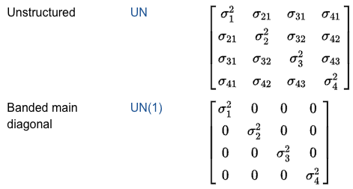
Latent Class Mixed Model
Model specifications
Fixed effects: Time (as class variable)
Random effects
Random intercept for subject
Random effect for time
Correlation structure
Tried both unstructured and UN(1) equivalent from SAS
Number of latent classes
Varied between 2-5 classes

Slide 9
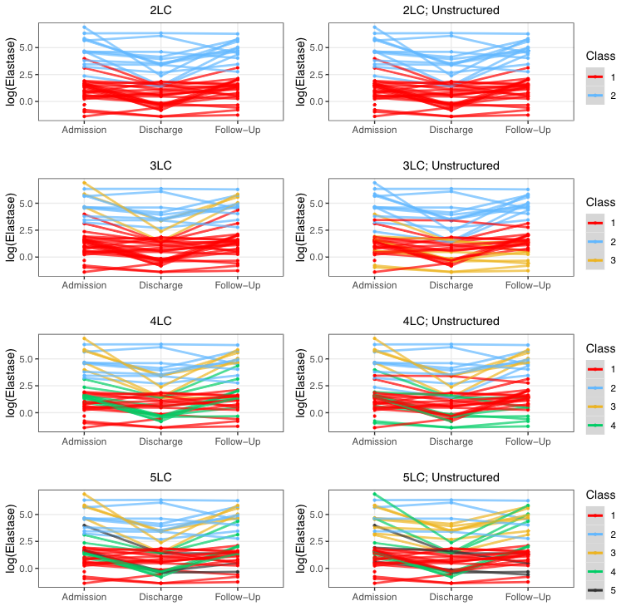
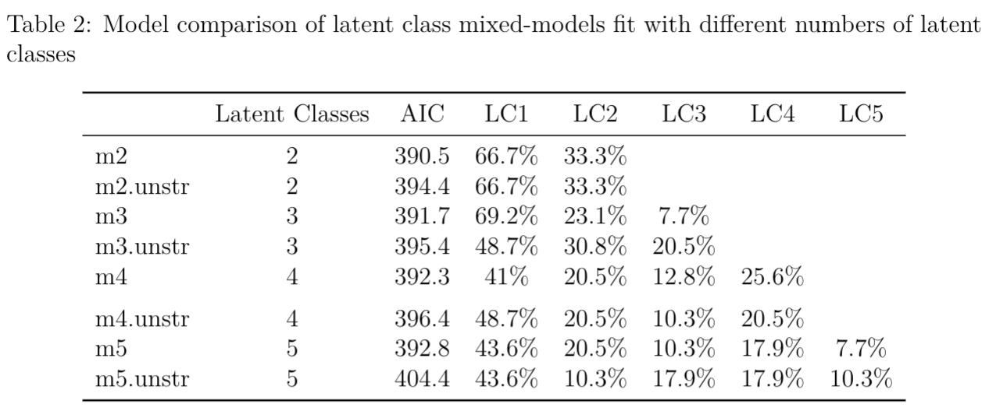
LCMM Model Selection
Model selection process
Considering a mixture of AIC, adjusted BIC, latent class balance, and visualizations to assess which model makes the most sense
Decision: 4 LC, diagonal variance-covariance structure for random effects

Slide 10
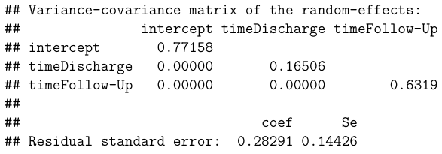
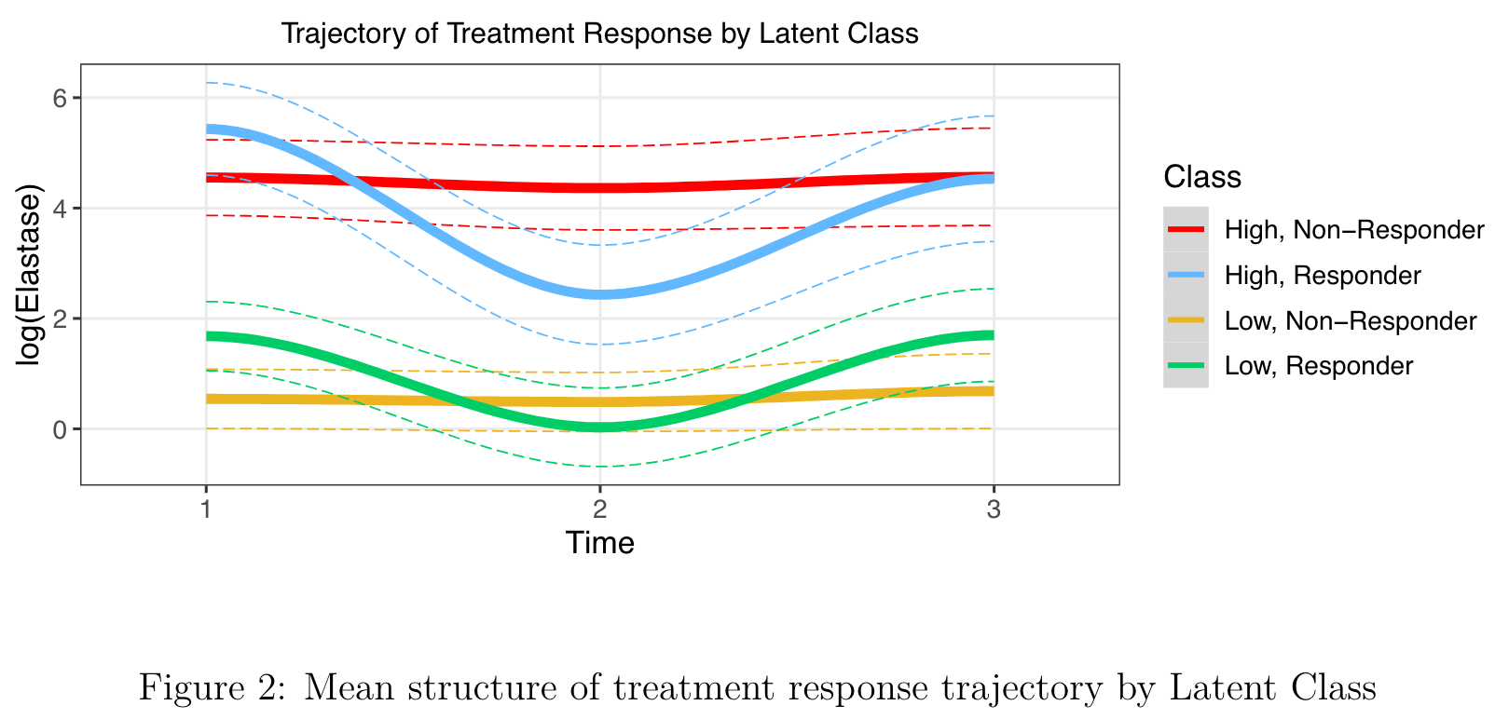
LCMM Selected Model
LC | Baseline Elastase | Treatment Response
1 | High | Non-Responder
2 | High | Responder
3 | Low | Non-Responder
4 | Low | Responder
LCMM model also reports the probability of an observation belonging to each latent class

Slide 11
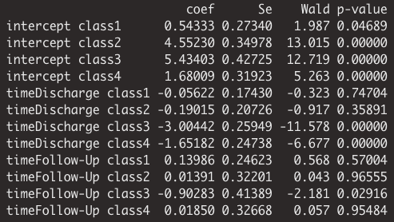
LCMM Selected Model Inference

Slide 12
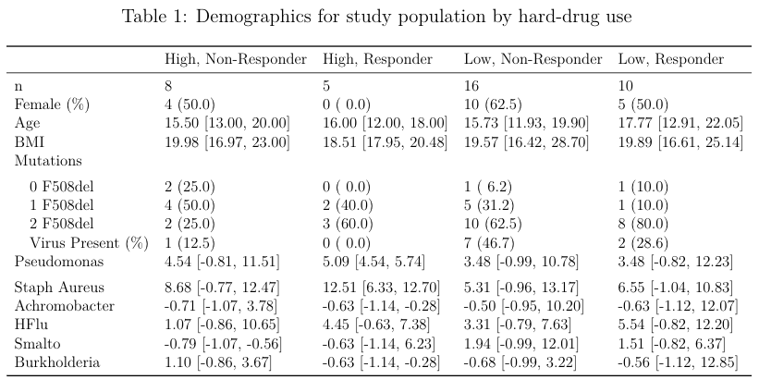
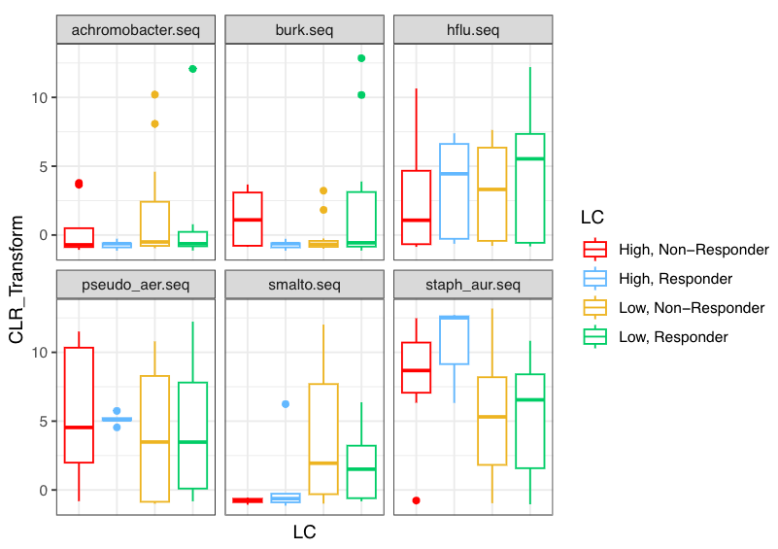
Post-Hoc Analysis
Final Step
Use something like multinomial regression or binomial regression to assess baseline risk factor differences between latent classes; can use table 1 and data visualizations also to guide comparisons

Slide 13
Limitations
In general, we should be careful about using latent class assignments as actual classes
Sample size is a serious limitation here
Results are exploratory; shouldn’t necessarily use the results for inference

