Slide 1

Web Science
Lecture 2
01/19/2017
CS 432/532 Spring 2017
Old Dominion University
Department of Computer Science
Sawood Alam <salam@cs.odu.edu>
Originally prepared by Hany SalahEldeen Khalil

Slide 2
Original Lectures
CS 495 Python and Web Mining
http://www.cs.odu.edu/~hany/teaching/cs495-f12/
By Hany SalahEldeen Khalil

Slide 3
Lecture Outline
Python Programming
We will learn how to:
program in Python
write high quality code
utilize numerous libraries and APIs

Slide 4
Python
Taming the beast!

Slide 5
Python
It’s an open source programming language.
Compiled and Interpreted.
Slower than C/C++ but with the difference in speed is negligible for most applications.
Developed in the late 1980s.

Slide 6
Why Python?
It is a scripting language.
Fast in development and prototyping.
Fast in testing functionality.
Pluggable to other C/C++/Java code.
Object oriented.
Has hundreds of libraries.
Automatically convert variable types.
Clean and easy to read as white space is part of the syntax!

Slide 7
Expression vs. Statement
Expression
Statement
Represents something.
Python Evaluates it.
Results in a value.
Example:
5.6
(5/3)+2.9
Does something.
Python Executes it.
Results in an action.
Example:
print "Barcelona FC is Awesome!"
import sys

Slide 8
Similarity with C Syntax
Mostly similar to C/C++ syntax but with several exceptions.
Differences:
White spaces for indentation
No “{}” for blocks
Blocks begin with “:”
NO type declaration
No ++, -- operators
Keywords
No && and ||
No switch/case

Slide 9
Starting & Exiting Python REPL
[user@host ~]$ python
Python 2.6.5 (r265:79063, Jan 21 2011, 12:09:23)
[GCC 4.4.4 20100726 (Red Hat 4.4.4-13)] on linux2
Type "help", "copyright", "credits" or "license" for more information.
>>>
>>> ctrl + D
[user@host ~]$

Slide 10
Our Hello World!
[user@host ~]$ python
Python 2.6.5 (r265:79063, Jan 21 2011, 12:09:23)
[GCC 4.4.4 20100726 (Red Hat 4.4.4-13)] on linux2
Type "help", "copyright", "credits" or "license" for more information.
>>> print "hello world"
hello world

Slide 11
Simple Data Types
Integer: 7
Float: 87.23
String: "abc", 'abc'
Boolean: False, True

Slide 12
Simple Data Types: String
Concatenation: "Python" + "Rocks" → "PythonRocks"
Repetition: "Python" * 2 → "PythonPython"
Slicing: "Python"[2:3] → "th"
Size: len("Python") → 6
Index: "Python"[2] → 't'
Search: "x" in "Python" → False
Comparison: "Python" < "ZOO" → True
(lexicographically)

Slide 13
Compound Data Types: List
The equivalent of array or vector in c++.
X = [0, 1, 2, 3, 4]
Creates a pre-populated array of size 5.
Y = [ ]
X.append(5)
X becomes [0, 1, 2, 3, 4, 5]
len(X)
Gets the length of X which is 6

Slide 14
Compound Data Types: List
>>> mylist = [0, 'a', "hello", 1, 2, ['b', 'c', 'd']]
>>> mylist [1]
a
>>> mylist [5][1]
c
>>> mylist[1:3]
['a', "hello", 1]
>>> mylist[:2]
[0, 'a', "hello"]

Slide 15
Compound Data Types: List
>>> mylist = [0, 'a', "hello", 1, 2, ['b', 'c', 'd']]
>>> mylist[3:]
[1, 2, ['b', 'c', 'd']]
>>> mylist.remove('a')
>>> mylist
[0, "hello", 1, 2, ['b', 'c', 'd']]

Slide 16
Compound Data Types: List
>>> mylist.reverse() → Reverse elements in list
>>> mylist.append(x) → Add element to end of list
>>> mylist.sort() → Sort elements in list ascending
>>> mylist.index('a') → Find first occurrence of 'a'
>>> mylist.pop() → Removes last element in list

Slide 17
Compound Data Types: Tuple
X = (0, 1, 2, 3, 4)
Creates a pre-populated array of fixed size 5.
print X[3] → prints 2

Slide 18
Compound Data Types: Tuple vs. List
Lists are mutable, tuples are immutable.
Lists can be resized, tuples can't.
Tuples are slightly faster than lists.

Slide 19
Compound Data Types: Dictionary
An array indexed by a string.
Denoted by { }
>>> marks = { "science": 90, "art": 25 }
>>> print(marks["art"])
25
>>> marks["chemistry"] = 75
>>> print(marks.keys())
["science", "art", "chemistry"]

Slide 20
Compound Data Types: Dictionary
dict = { "fish": 12, "cat": 7}
dict.has_key('dog') → False (To check if the dictionary has 'dog' as a key)
dict.keys() (Gets a list of all keys)
dict.values() (Gets a list of all values)
dict.items() (Gets a list of all key-value pairs)
dict["fish"] = 14 → Assignment

Slide 21
Variables
Everything is an object.
No need to declare.
No need to assign.
Not strongly typed.
Assignment = reference
Ex: >>> X = ['a', 'b', 'c']
>>> Y = X
>>> Y.append('d')
>>> print(X)
['a', 'b', 'c', 'd']

Slide 22
Input / Output
Input:
Without a Message:
>>> x = input()
3
>>> x
3
With a Message:
>>> x = input('Enter the number: ')
Enter the number: 3
>>> x
3

Slide 23
Input / Output
Input:
Without evaluation:
>>> x = input()
3+4
>>> x
"3+4"

Slide 24
File: Read
Input:
>>> f = open("input_file.txt", "r")
>>> line = f.readline()
>>> f.close()
File handle
Name of the file
Mode
Read one line at a time
Stop using this file and close

Slide 25
File: Write
Output:
>>> f = open ("output_file.txt", "w")
>>> line = f.write("Hello how are you?")
>>> f.close()
File handle
Name of the file
Mode
Write a string to the file
Stop using this file and close

Slide 26
Control Flow
Conditions:
if
if / else
if / elif / else
Loops:
while
for
for loop in file iterations

Slide 27
Conditions
The condition must be terminated with a colon ":"
Scope of the loop is the following indented section
>>> if score == 100:
print("You scored a hundred!")
elif score > 80:
print("You are an awesome student!")
else:
print("Go and study!")

Slide 28
Loops: while
>>> i = 0
>>> while i < 10:
print(i)
i = i + 1
Do not forget the : at the end of the condition line!

Slide 29
Loops: for
>>> for i in range(10):
print(i)
>>> myList = ['hany', 'john', 'smith', 'aly', 'max']
>>> for name in myList:
print(name)
Do not forget the : at the end of the condition line!

Slide 30
Loops: Inside vs. Outside
for i in range(3):
print("Iteration {}".format(i))
print("Done!")
Iteration 0
Done!
Iteration 1
Done!
Iteration 2
Done!
for i in range(3):
print("Iteration {}".format(i))
print("Done!")
Iteration 0
Iteration 1
Iteration 2
Done!

Slide 31
Loops: for in File Iterations
>>> f = open ("my_ file.txt", "r")
>>> for line in f:
print(line)

Slide 32
Control Flow Keywords: pass
It means do nothing
>>> if x > 80:
pass
else:
print("You are less than 80!")

Slide 33
Control Flow Keywords: break
It means quit the loop
>>> for name in myList:
if name == "aly":
break
else:
print(name)
→This will print all names before “aly”

Slide 34
Control Flow Keywords: continue
It means skip this iteration of the loop
>>> for name in myList:
if name == "aly":
continue
else:
print(name)
→This will print all names except “aly”

Slide 35
Now, let’s dig some more into Python …

Slide 36
Functions
So far you have learned how to write regular small code in python.
Code for finding the biggest number in a list:
mylist = [2,5,3,7,1,8,12,4]
maxnum = 0
for num in mylist:
if (num>maxnum):
maxnum = num
print "The biggest number is: {}".format(maxnum)

Slide 37
Functions
But what if the code is a bit more complicated and long?
Writing the code as one blob is bad!
Harder to read and comprehend
Harder to debug
Rigid
Non-reusable

Slide 38
Functions
def my_funtion(parameters):
do stuff
My main program
Give parameters
to work with….
Magic box
Return results

Slide 39
Functions
Back to our example:
mylist = [2,5,3,7,1,8,12,4]
maxnum = getMaxNumber(mylist)
print "The biggest number is: {}".format(maxnum)

Slide 40
Functions
While you can make the function getMaxNumber as you wish
def getMaxNumber(list_x):
maxnum = 0
for num in list_x:
if (num>maxnum):
maxnum = num
return maxnum

Slide 41
Testing
def getMaxNumber(list_x):
"""
Returns the maximum number from the supplied list
>>> getMaxNumber([4, 7, 2, 5])
7
>>> getMaxNumber([-3, 9, 2])
9
>>> getMaxNumber([-3, -7, -1])
-1
"""
maxnum = 0
for num in list_x:
if (num>maxnum):
maxnum = num
return maxnum
if __name__ == '__main__':
import doctest
doctest.testmod()

Slide 42
Testing
def getMaxNumber(list_x):
"""
Returns the maximum number from the supplied list
>>> getMaxNumber([4, 7, 2, 5])
7
>>> getMaxNumber([-3, 9, 2])
9
>>> getMaxNumber([-3, -7, -1])
-1
"""
maxnum = 0
for num in list_x:
if (num>maxnum):
maxnum = num
return maxnum
if __name__ == '__main__':
import doctest
doctest.testmod()
$ python max_num.py
**********************************************************************
File "max_num.py", line 8, in __main__.getMaxNumber
Failed example:
getMaxNumber([-3, -7, -1])
Expected:
-1
Got:
0
**********************************************************************
1 items had failures:
1 of 3 in __main__.getMaxNumber
***Test Failed*** 1 failures.

Slide 43

Functions
Or…
def getMaxNumber(list_x):
return max(list_x)

Slide 44
Functions
Remember:
All arguments are passed by value
All variables are local unless specified as global
Functions in python can have several arguments or none
Functions in python can return several results or none

Slide 45
Functions
Remember:
All arguments are passed by value
All variables are local unless specified as global
Functions in python can have several arguments or none
Functions in python can return several results or none
This is AWESOME!

Slide 46
Functions
Example of returning several values
def getMaxNumberAndIndex(list_x):
maxnum = 0
index = -1
i = 0
for num in list_x :
if (num>maxnum):
maxnum = num
index = i
i = i + 1
return maxnum, index

Slide 47
Functions
And you call it like this:
mylist = [2,5,3,7,1,8,12,4]
maxnum, idx = getMaxNumberAndIndex(mylist)
print("The biggest number is: {}".format(maxnum))
print("It’s index is: {}".format(idx))

Slide 48
Class
class Student:
count = 0 # class variable
def __init__(self, name): # Initializer
self.name = name
self.grade = None
Student.count += 1
def updateGrade(self, grade): # Instance method
self.grade = grade
if __name__ == "__main__": # Execute only if script
s = Student("John Doe")
s.updateGrade("A+")
s.grade #=> "A+"
Student.count #=> 1

Slide 49
Writing Clean Code
Programmers have a terrible short term memory

Slide 50
Writing Clean Code
Programmers have a terrible short term memory
You will have to learn to live with it!

Slide 51
Writing Clean Code
To fix that we need to write clean readable code with a lot of comments.

Slide 52

Writing Clean Code
To fix that we need to write clean readable code with a lot of comments.
You are the narrator of your own code, so make it interesting!
Ex: Morgan freeman
http://www.youtube.com/watch?v=lbIqL-lN1B4&feature=player_detailpage#t=77s

Slide 53
Writing Clean Code
Comments start with a # and end at the end of the line.
mylist = [2,5,3,7,1,8,12,4]
# The function getMaxNumberAndIndex will be called next to retrieve
# the biggest number in list "mylist" and the index of that number.
maxnum, idx = getMaxNumberAndIndex(mylist)
print "The biggest number is: " + str(maxnum)
print "It’s index is: " + str(idx)

Slide 54
Creating Python Files
Python files end with ".py"
To execute a python file you write:
>>> python myprogram.py

Slide 55
Creating Python Files
To make the file “a script”, set the file permission to be executable and add this shebang in the beginning:
#!/usr/bin/python
or better yet
#!/usr/bin/env python
The path to Python installation

Slide 56

Building on the Shoulders of Giants!
You don’t have to reinvent the wheel….. someone has already done it better!

Slide 57
Modules
Let's say you have this awesome idea for a program, will you spend all your time trying to figure out the square root and how it could be implemented and utilized?

Slide 58
Modules
Let's say you have this awesome idea for a program, will you spend all your time trying to figure out the square root and how it could be implemented and utilized?
No!

Slide 59
Modules
We just call the math library that has the perfect implementation of square root.
>>> import math
>>> x = math.sqrt(9.0)
Or
>>> from math import sqrt
>>> x = sqrt(9.0)

Slide 60
Modules
To import all functions in a library we use the wildcard: *
>>> from string import *
Note: Be careful upon importing "from" several files, there might be two modules named the same in different libraries.

Slide 61

Your Programs are Your Butlers!
You are Batman! Your programs are your Alfreds!
Send them work:

Slide 62
Command-Line Arguments
To get the command line arguments:
>>> import sys
The arguments are in sys.argv as a list

Slide 63
What Happens When Your Program Goes
Kabooom!?

Slide 64
Bad Scenario
>>> sum_grades = 300
>>> number_of_students = input()
>>> average = sum_grades / number_of_students
→ What if the user wrote 0?

Slide 65
Bad Scenario
>>> sum_grades = 300
>>> number_of_students = input()
0
>>> average = sum_grades / number_of_students
→ Error! Divide by Zero

Slide 66
Bad Scenario
>>> sum_grades = 300
>>> number_of_students = input()
0
>>> average = sum_grades / number_of_students
→ Error! Divide by Zero
Remember: User input is evil!

Slide 67
Precautions: Exception Handling
You can just say:
try:
average = sum_grades / number_of_students
except:
# this catches if something wrong happens
print "Something wrong happened, please check it!"
average = 0

Slide 68
Precautions: Exception Handling
Or if you have an idea what exception could it be:
try:
average = sum_grades / number_of_students
except ZeroDivisionError:
# this catches if a number was divided by zero
print "You Evil User!.....you inserted a zero!"
average = 0

Slide 69
Precautions: Exception Handling
Or several exceptions you are afraid of:
try:
average = sum_grades / number_of_students
except ZeroDivisionError:
# this catches if a number was divided by zero
print "You Evil User!.....you inserted a zero!"
average = 0
except IOError:
# this catches errors happening in the input process
print "Something went wrong with how you enter words"
average = 0

Slide 70
Generators
def fib():
a = b = 1
while True:
yield a
a, b = b, a + b
f = fib()
print(next(f)) #=> 1
print(next(f)) #=> 1
print(next(f)) #=> 2
print(next(f)) #=> 3
print(next(f)) #=> 5

Slide 71
Python Tips and Tricks
range(start, end, increment)
You can design a specific loop with that
Swap variable values using multiple assignment
a, b = b, a

Slide 72
Python Tips and Tricks
“in” and “not in” operators
In loops
for line in lines
for line not in lines
In conditions
if item in list
if item not in list

Slide 73
Python Tips and Tricks
List comprehensions
squares = []
for x in range(10):
squares.append(x**2)
# Can be written like this
squares = [x**2 for x in range(10)]
# A more complex example
[(x, y) for x in [1,2,3] for y in [3,1,4] if x != y]

Slide 74
Python Tips and Tricks
Manipulating files:
readline() → reads a line from file
readlines() → reads all the file as a list of lines
read() → reads all the file as one string.
seek(offset, start) → start could be:
0 → beginning
1 → current location
2 → end of file

Slide 75
Python Libraries: urllib
urllib is a Python module that can be used for interacting with remote resources
import urllib.request
with urllib.request.urlopen('http://www.cs.odu.edu/') as res:
html = res.read()
# do something

Slide 76
urllib Response Headers
import urllib.request
with urllib.request.urlopen('http://python.org/') as res:
print("URL: {}".format(res.geturl())
print("Response code: {}".format(res.code)
print("Date: {}".format(res.info()['date'])
print("Server: {}".format(res.info()['server'])
print("Headers: {}".format(res.info())

Slide 77
urllib Requests
import urllib.request
url = 'http://www.cs.odu.edu/'
# This puts the request together
req = urllib.request.Request(url)
# Sends the request and catches the response
with urllib.request.urlopen(req) as res:
# Extracts the response
html = res.read()

Slide 78
urllib Request Parameters
import urllib.request
import urllib.parse
url = 'http://www.cs.odu.edu/'
query_args = {'q': 'query string', 'foo':'bar'}
data = urllib.parse.urlencode(query_args).encode('ascii')
req = urllib.request.Request(url, data)
with urllib.request.urlopen(req) as res:
# Extracts the response
html = res.read()

Slide 79

What Happens When the Server Tells, “You Can't Get This Page!”

Slide 80
URLlib2 Request Headers
import urllib.request
import urllib.parse
url = 'http://www.cs.odu.edu/'
query_args = {'q': 'query string', 'foo':'bar'}
headers = {'User-Agent': 'Mozilla 5.10'}
data = urllib.parse.urlencode(query_args).encode('ascii')
req = urllib.request.Request(url, data, headers)
with urllib.request.urlopen(req) as res:
# Extracts the response
html = res.read()
# Try a nicer third-party HTTP library named ‘requests’

Slide 81
Beautiful Soup: HTML/XML Parser
# Installation is needed before you could use any third-party library
$ pip install beautifulsoup4
from bs4 import BeautifulSoup
import urllib.request
with urllib.request.urlopen('http://www.reddit.com') as res:
redditHtml = res.read()
soup = BeautifulSoup(redditHtml)
for links in soup.find_all('a'):
print(links.get('href'))

Slide 82
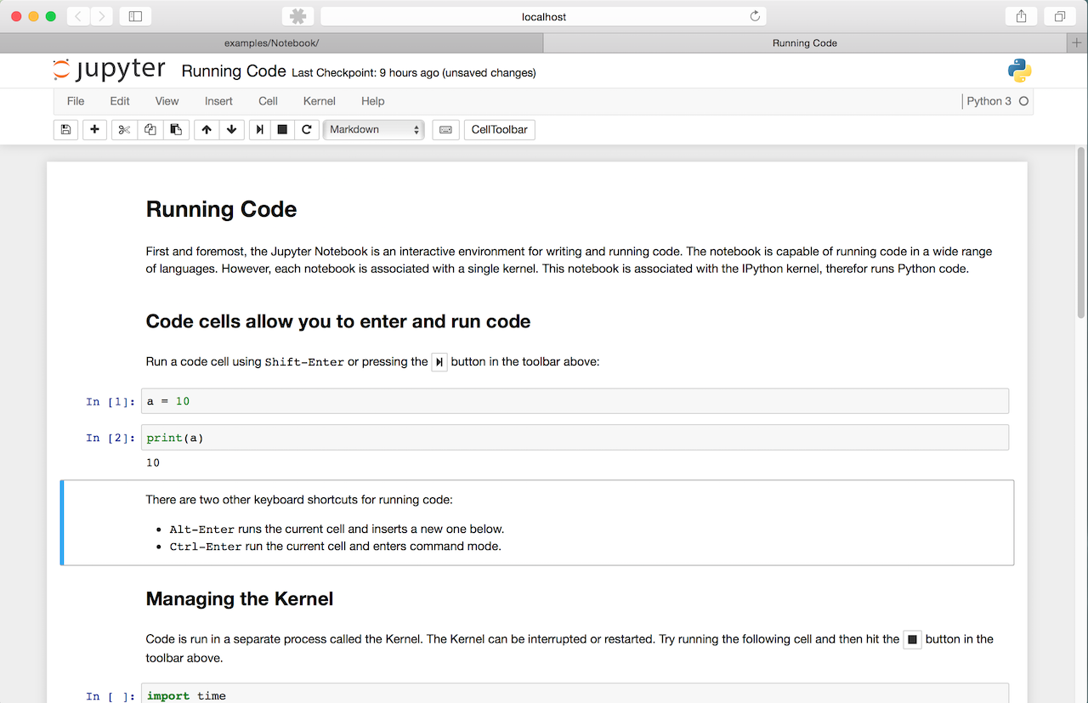
Jupyter Notebook

Slide 83
References
http://introtopython.org/
http://www.cs.cornell.edu/courses/cs1110/2012fa/
http://ocw.mit.edu/courses/electrical-engineering-and-computer-science/6-189-a-gentle-introduction-to-programming-using-python-january-iap-2011/lectures/
http://courses.cms.caltech.edu/cs11/material/python/index.html
http://www.cs.cornell.edu/courses/cs2043/2012sp/
http://www-cs-faculty.stanford.edu/~nick/python-in-one-easy-lesson/
http://www.pythonforbeginners.com/python-on-the-web/how-to-use-urllib2-in-python/
http://www.pythonforbeginners.com/python-on-the-web/beautifulsoup-4-python/
Python in a Nutshell, 2nd Edition By Alex Martelli

