Slide 1
Maksimukv-football
EPAM Java CRUD project

Slide 2
Used technologies
Tools
IntelliJ IDEA
Java 15
Apache Maven
Apache Tomcat
Language
Spring Boot
Thymeleaf
Bootstrap CSS
HTML
JUnit 4/5
Mockito
Markdown
SQL
Swagger
SLF4J

Slide 3
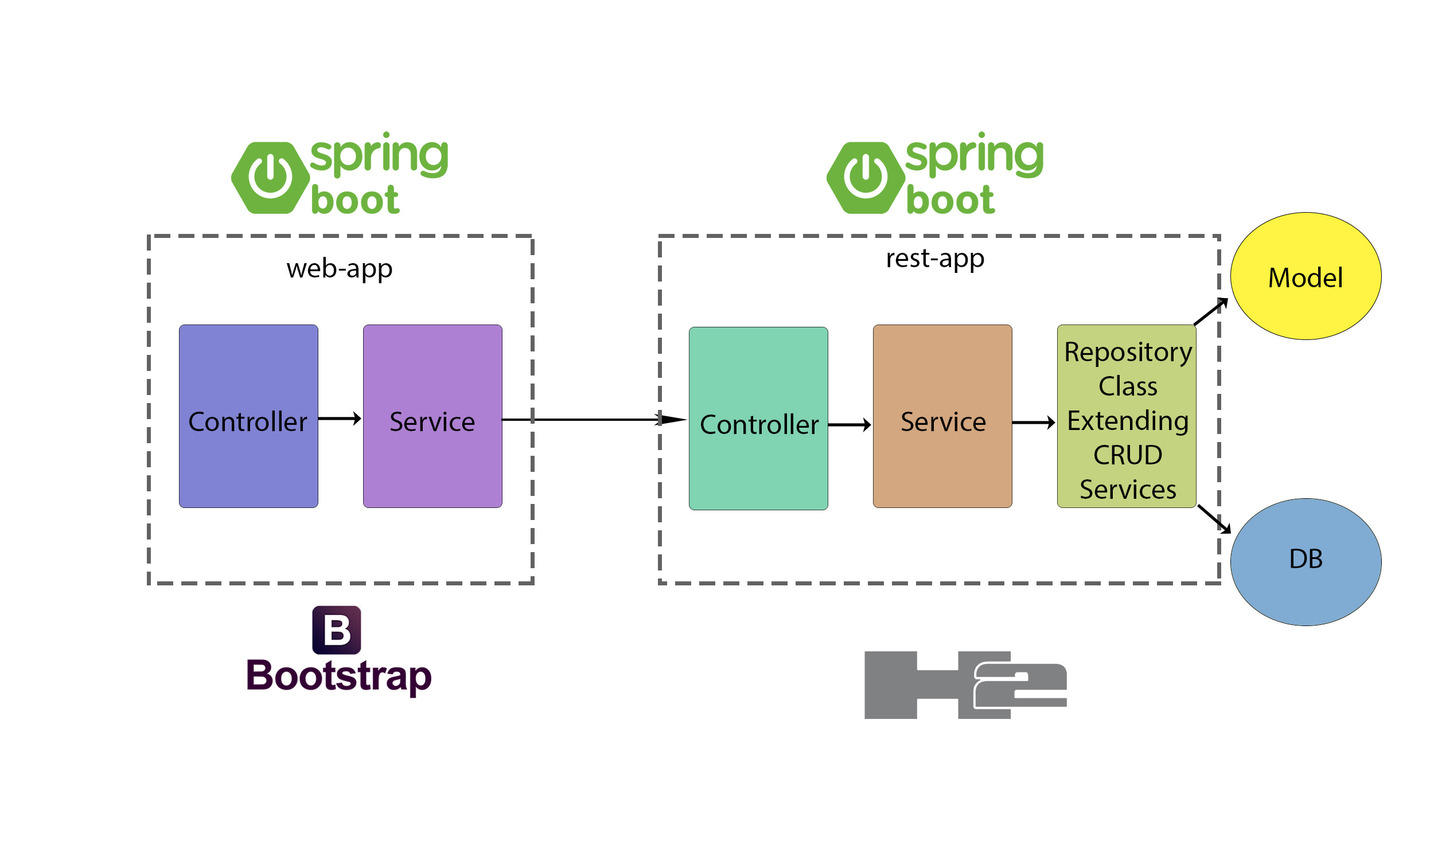
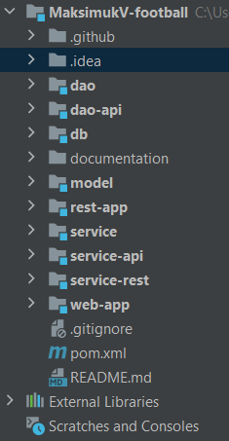
Project structure and architecture

Slide 4
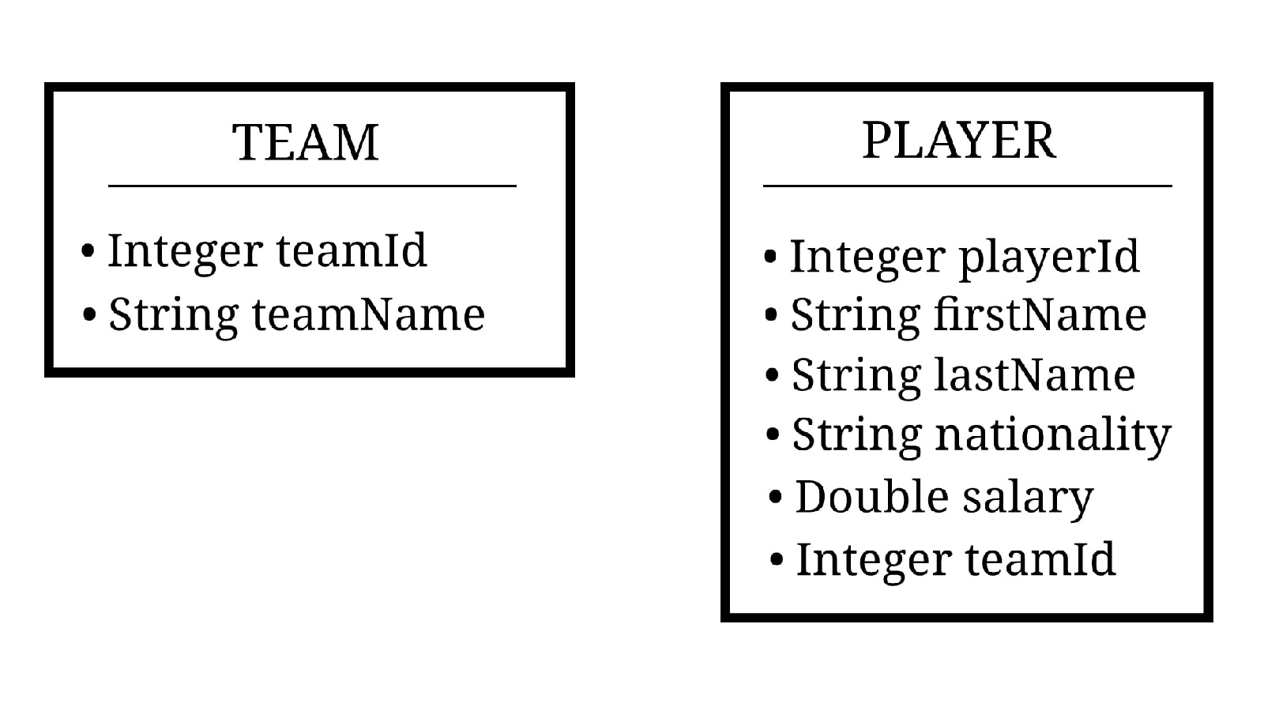
Database structure
1:n

Slide 5
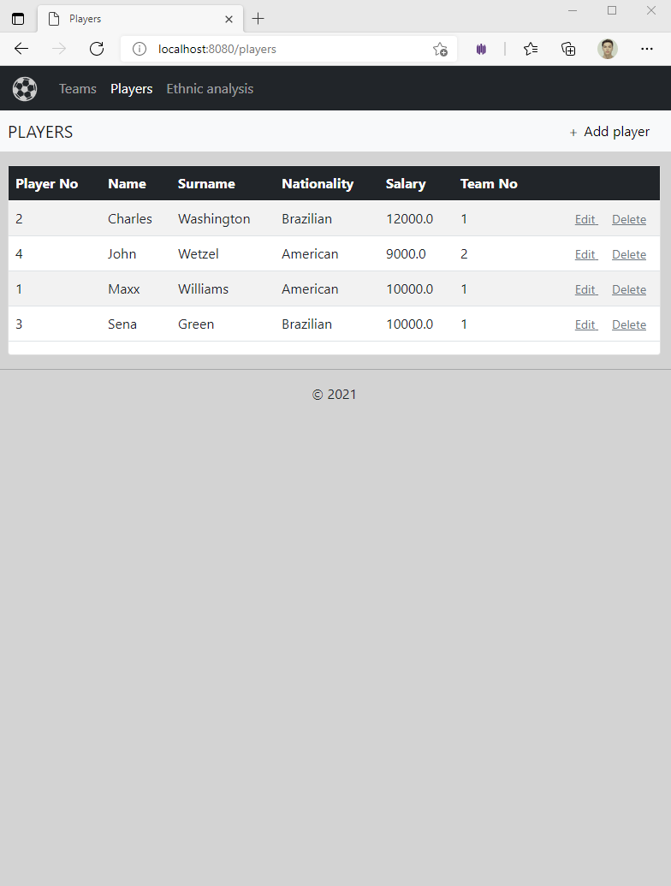
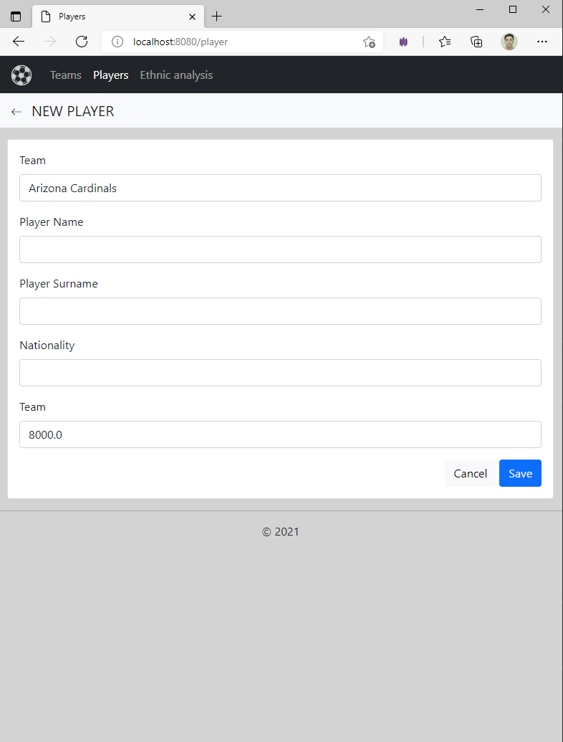
WEB-app

Slide 6
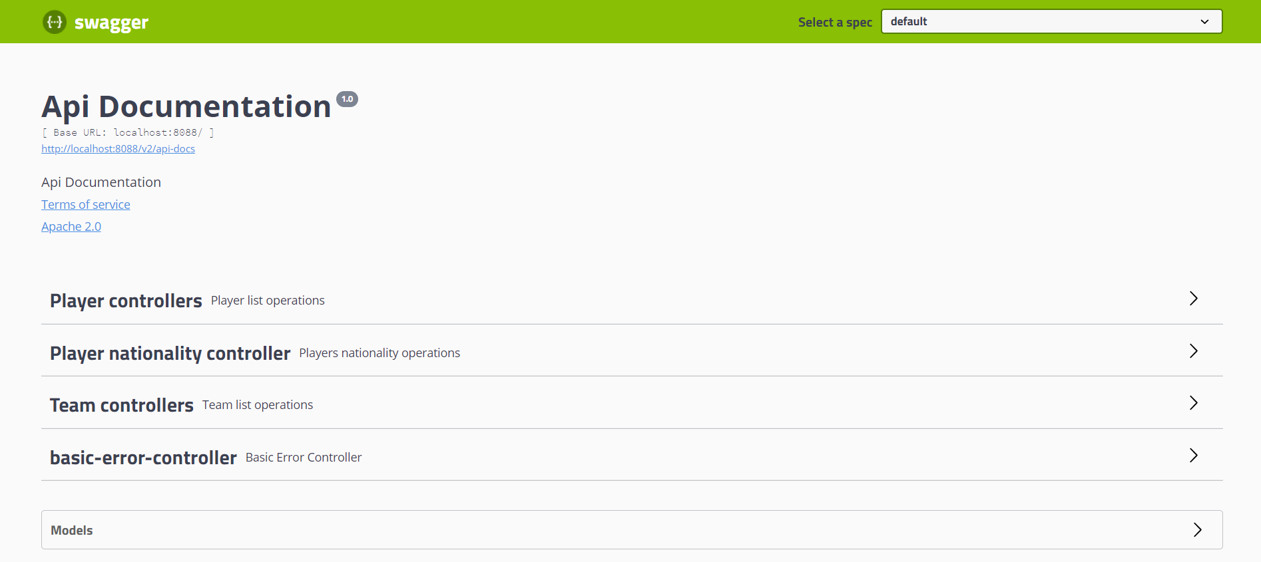
Rest-app and its API

Slide 7
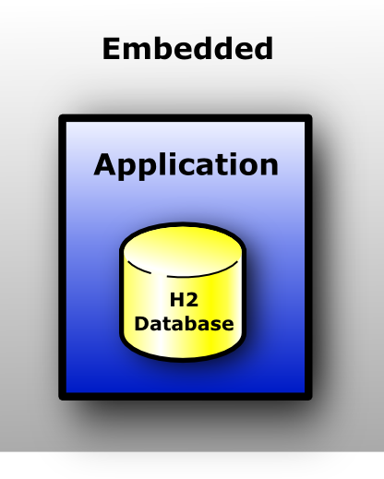
DAO and database
SQL queries used
DAO goals:
Teams CRUD
Player CRUD
Find the most popular player nationality in each team where the number of players above 0

