Slide 1
Maksimukv-football
EPAM Java CRUD project

Slide 2
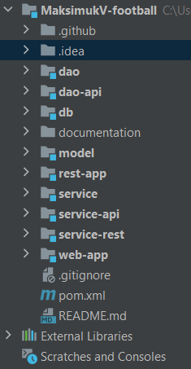
Project structure
Data Access Object part. Implemented through dao-api module to provide unique universal interface for all DAO implementations regardless of what DB it is referred to.
Database handle part, includes its creation/initialization SQL scripts and a configuration class that connects DB to Spring Boot application.
Model part. Contains several Java-classes that are used to describe instances, used in application.
“Server” module handle part. Consists of configuration class that is used to start REST-application (this is where “void main” is placed) and REST-controllers.
Service modules part. Those modules are capable of coordinating web-app/rest-app modules and rest-app controllers/DAO modules interaction.
“Client” module handle part. This module is responsible for deploying operations results through user-friendly UI. It refers directly to rest-app module to perform any kind of transactions, as it lacks business logics itself. As well as rest-app, this module contains configuration class.

Slide 3
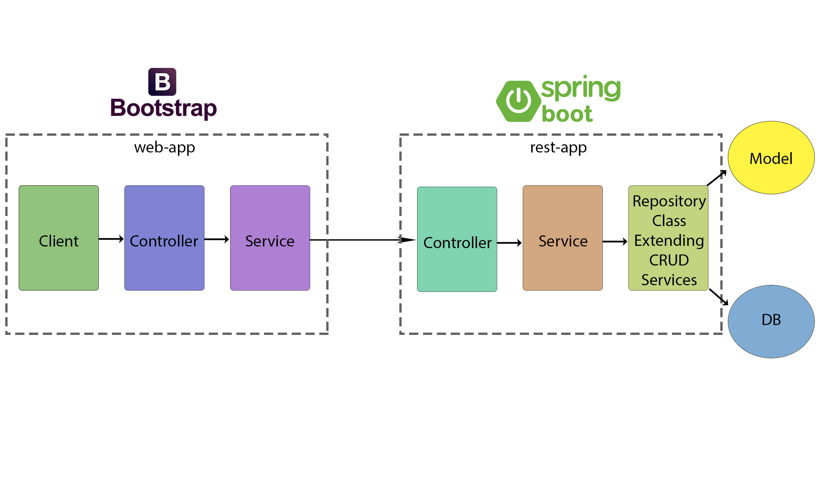
Project architecture

Slide 4
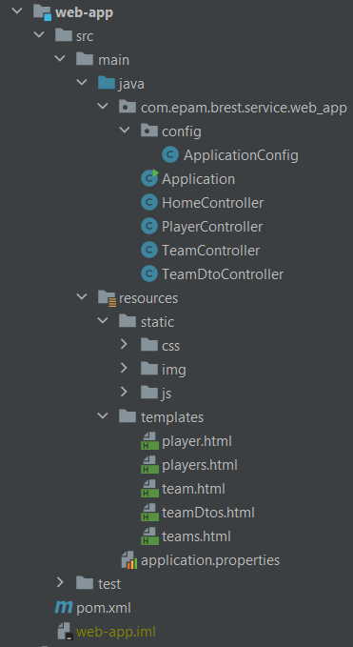
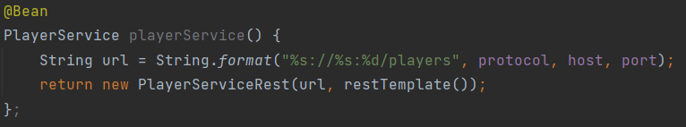
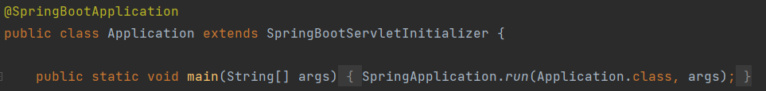
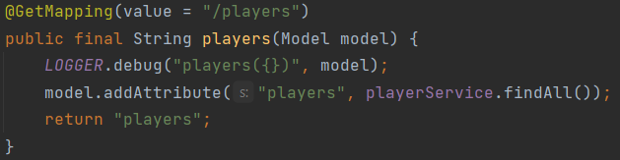
WEB-app
Special configurational java-class, providing connection between web- and rest-app. There some beans are created to be used for receiving data through rest-services.
An example of a bean.
Web-app entry point.
Application class with its main method.
Front-end controllers. Those are used to define which services to trigger to get data and put this data to a model. The model will be used later to deploy information into UI by Thymeleaf.
An example of a controller.
Some front-end resources, such as CSS for HTML templates, static vector SVG images, JavaScript.
HTML templates, used to vusualise received info. Data is taken from models and inserted directly into HTML components by Thymeleaf.

Slide 5
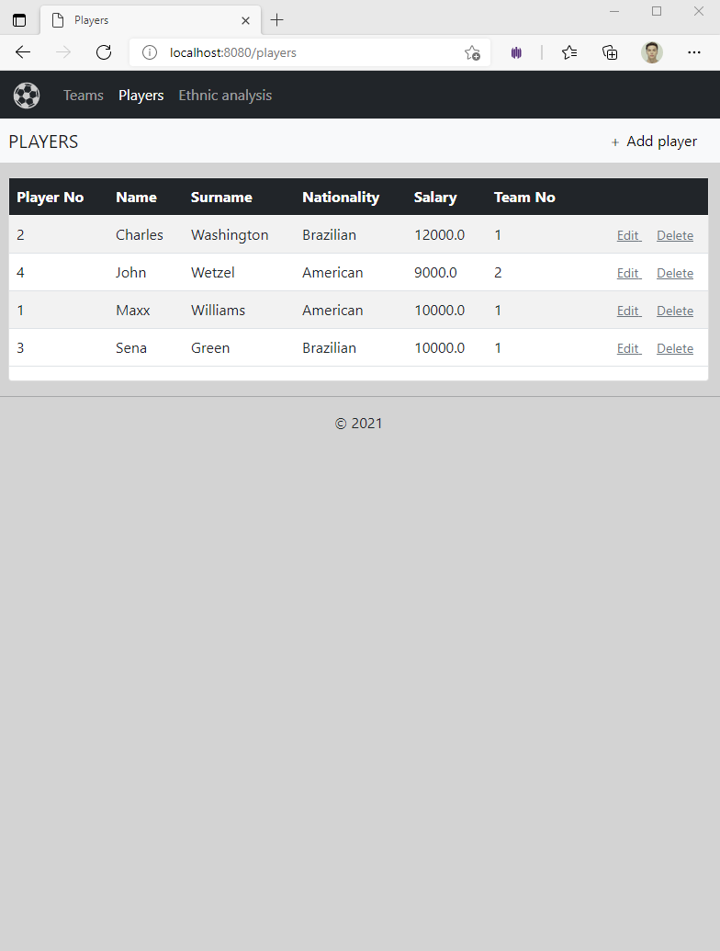
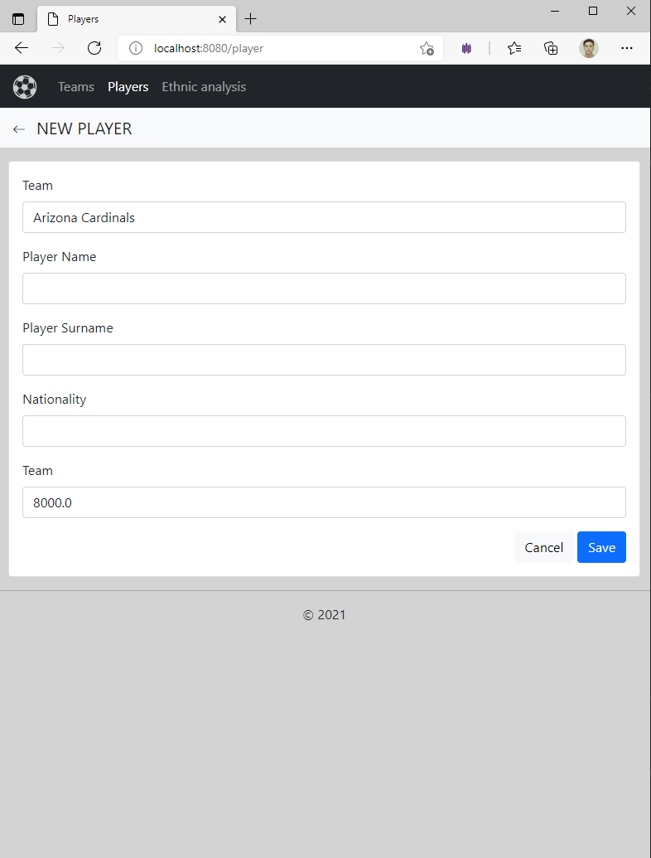
WEB-app
Navigation bar
Current form unique name
Triggers edit form, just like “Add player”
Calls deletion confirmation dialogue
Submit form and send new/updated data

Slide 6
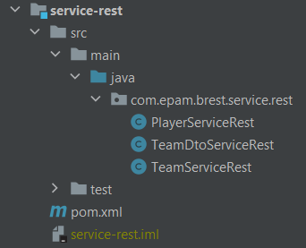
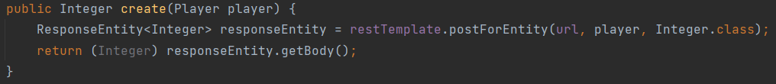
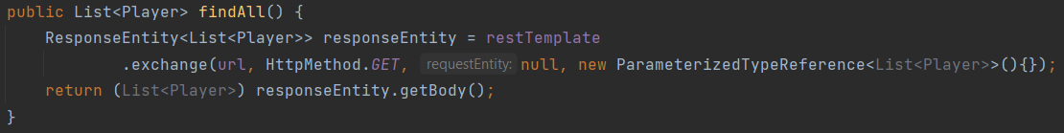
Service-rest
This module is an implementation of service-api module. Its main role is to send data entities, given by web-app and return entity list taken from database. In other words, this module is responsible for receiving data from rest-app module, that is deployed on other port and functions as “server”.
Example of posting data:
Example of receiving data:

Slide 7
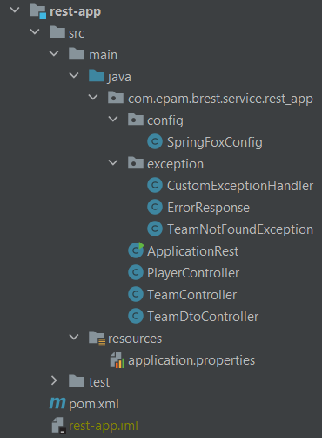
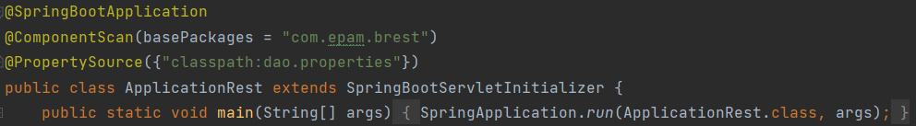
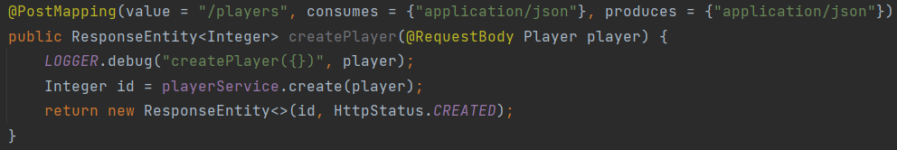
Rest-app
Swagger configuration class. Sets up swagger dependencies.
Exception handlers. Triggered when a controller meets an exceptional situation in sending/receiving data.
Rest-app entry point.
ApplicationRest class with its main method.
Back-end controllers. Just like web-app ones, those are used to define which services to trigger to get/send data. Response entities are deployed on defined mapping.
An example of a controller.
Property file with REST-server configuration (server port).

Slide 8
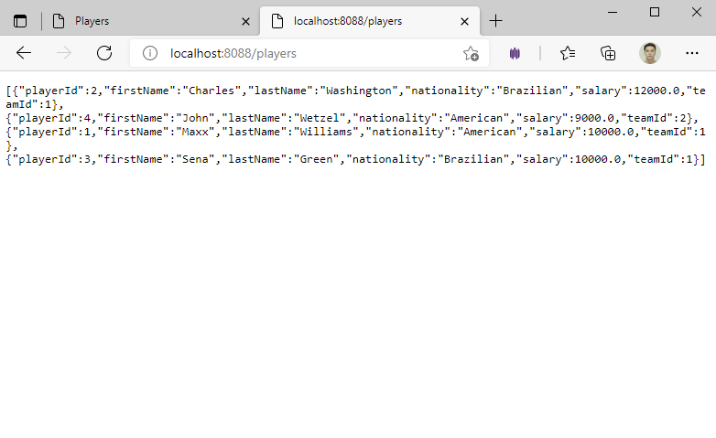
Rest-app

Slide 9
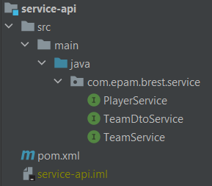
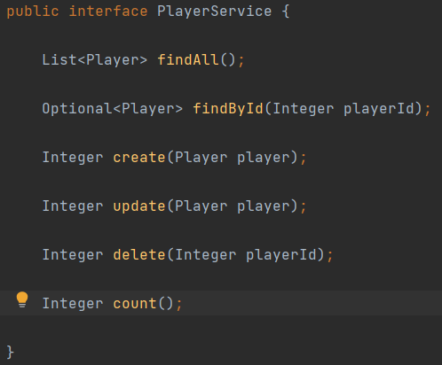
Service-api
This module is just a collection of interfaces that define services structure. This is important, because it is better for developer to know what methods he should be implemented for the app to work properly and exclude upcoming errors.
An example of interface:

Slide 10
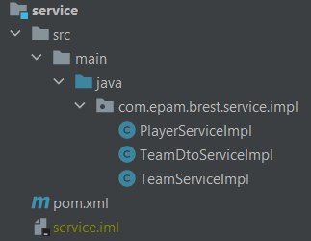
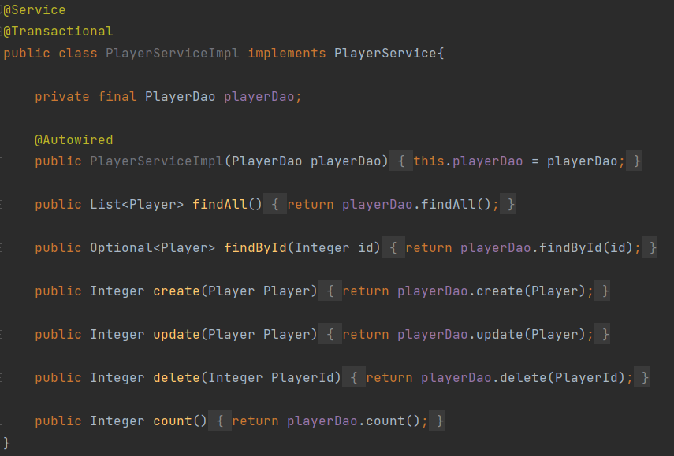
Service
Rest-controllers refer to this module. The module itself contain a set of classes that connect DAO and controllers. As soon as no logics needed to be used in services, this is just a “bridge” between modules.
Example of a service:

Slide 11
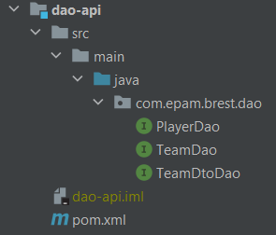
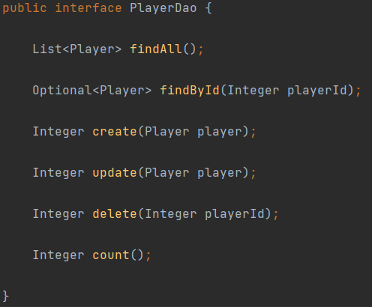
DAO-api
Just like any other api module in the project, this module is just a collection of interfaces that define DAOs structure. This is important, because the implementation must perform same functions regardless of database it is working with.
An example of interface:

Slide 12
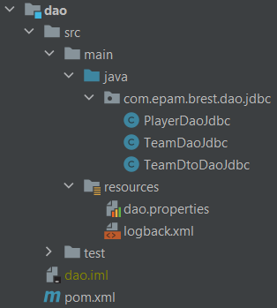
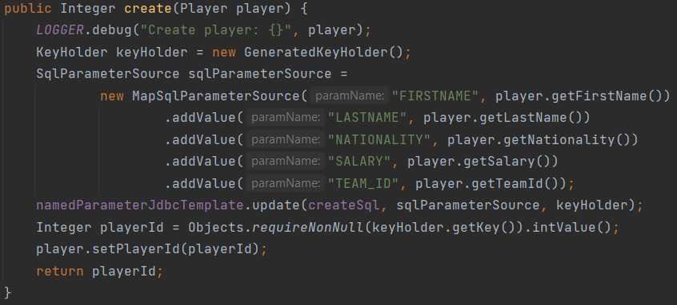
DAO
A set of DAO classes that implement dao-api module. They are responsible for database and project connection.
An example of DAO function.
Property file in which all SQL scripts are written.
Logger file.

Slide 13
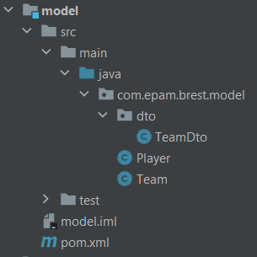
Model
The module is used to describe instances, used in project. Data transfer object is created in purpose of providing additional functionality, such as finding out which player nationality is the most popular in each team.
Each model includes named fields, getters/setters, constructor, override on equals/hash code.

Slide 14
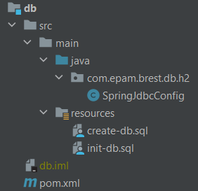
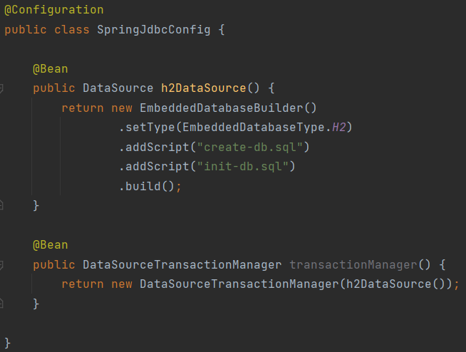
db
Database configuration file. Sets up all needed dependencies, points scripts, creates beans.
SQL files.

Slide 15
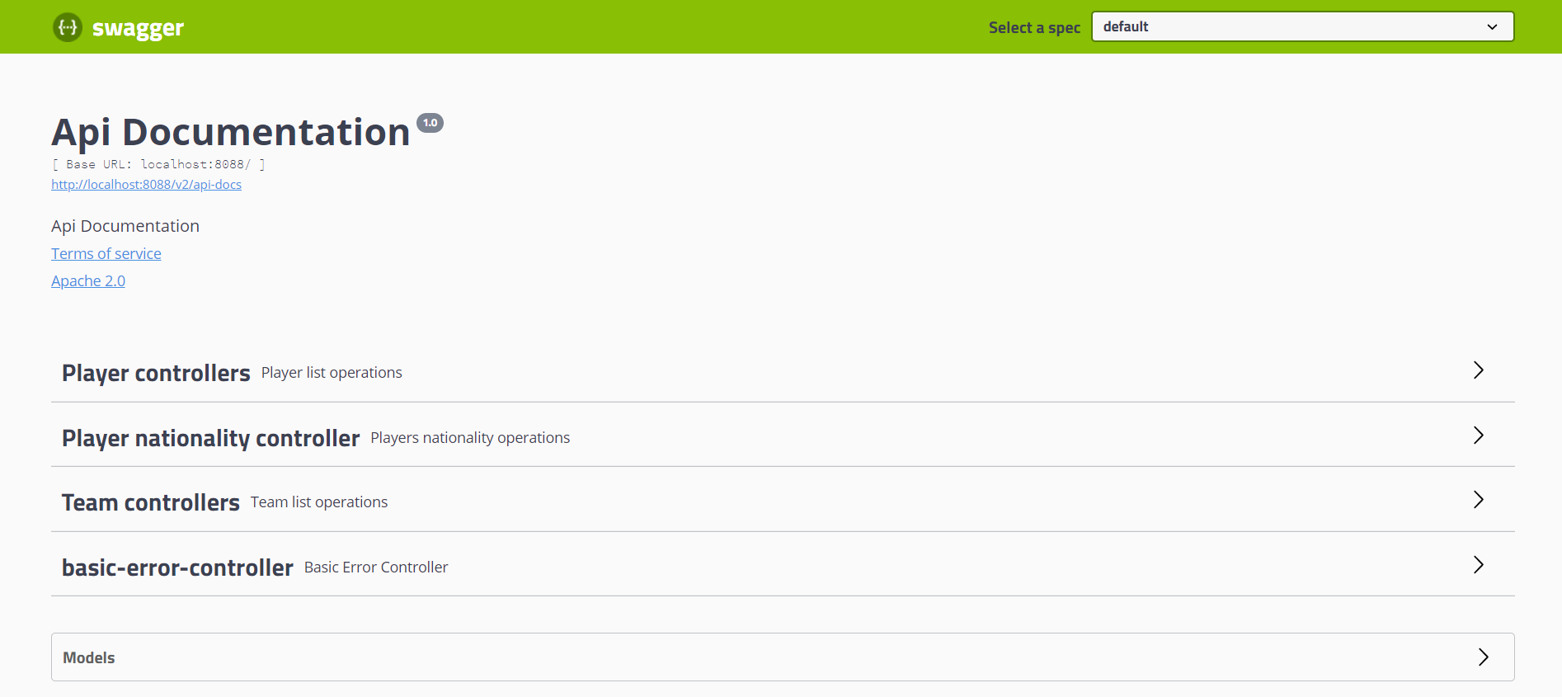
API

