Slide 1
My project Online Store
For Epam

Slide 2

Description of the project
The project is an Online Store of goods with great functionality

Slide 3

Online Store features
All the possibilities of an Online Store are divided into two main categories:
Client part
Administrative part

Slide 4
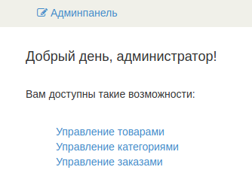
Online Store from the Administrator's side
Administrator's cabinet

Slide 5
Online Store complies with the principles of SOLID
S - Single-responsiblity Principle
O - Open-closed Principle
L - Liskov Substitution Principle
I - Interface Segregation Principle
D - Dependency Inversion Principle

Slide 6
Architectural templates for Online Store
Layered template
MVC template
Client-server template

Slide 7
Layered template
REST-APP
WEB-APP
SERVICE-API
SERVICE-REST
SERVICE
DAO-API
MODEL
DAO
TEST-DB

Slide 8
MVC template
MODEL
VIEW
CONTROLLER
Response
Request
USER

Slide 9
Client-server template
REST-APP
Request (Get,POST...)
WEB-APP
Respons(JSON Format)

Slide 10
Object Oriented Programming Principle
INVERSION OF CONTROL
SPRING implementation
DEPENDENCY INJECTION

Slide 11
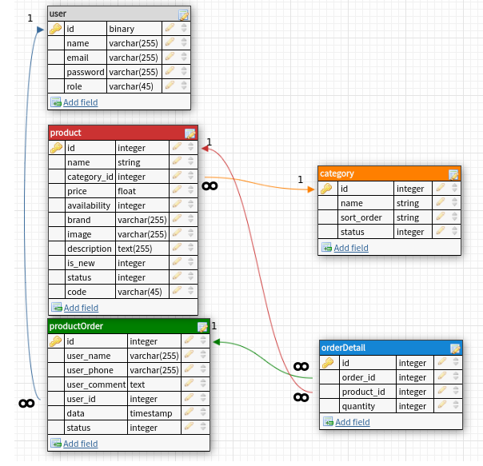
Database structure

Slide 12
List of technologies used
Java Core
Spring Core
Spring MVC
Spring Rest API
Spring Boot
Hibernate and HQL requests
JSTL
Spring MVC Form Tag Library
H2 DB in memory
Mockito and JUnit

Slide 13

Thanks for attention!!!

