Slide 1
Criminal Activity in Chicago, Illinois
Bret Finley

Slide 2
Problem
Crime is an ever-present issue
Dozens of crimes committed everyday are just added on top of a giant “pile” of data
Much of this data is textual in nature
Location values
Date/Time data
Need a way to visualize this data

Slide 3
Audience
Targeted a general audience
Wanted views to be plain and easy to understand
Also wanted users to be able to dive into and explore the data
Can be used by other people

Slide 4
Dataset
Consists of reported criminal activity within the city limits of Chicago, Illinois
Each data element represents a single reported crime
Except homicides which are divided in to crimes/victim
Each row value consists of several column values
Crime type
Latitude/Longitude where crime occurred
Chicago community area
Date/Time when crime occurred

Slide 5
Project Stack
Frontend: AngularJS with JavaScript and HTML
Controller provides layer between view and data
Directives provide frontend templating and modularization
Services allow for reusable library modules
HTML with Angular templating allow for two-way data binding between view and controller

Slide 6
Project Stack Cont.
Third Party Software
Google Maps for showing geographical data
D3 allows for rendering graphical representations
Backend: Node JavaScript server
ExpressJS provides routing facilities
Node file system library along with CSV library deserializes data on startup

Slide 7
Misc. Software
Lodash – JavaScript data structure utility library
dateFormat() – Library for JavaScript date formatting
MarkerClusterer – Utility for grouping Google Map markers
SortTable – Tool for making sortable HTML table headers

Slide 8
Project Architecture

Slide 9
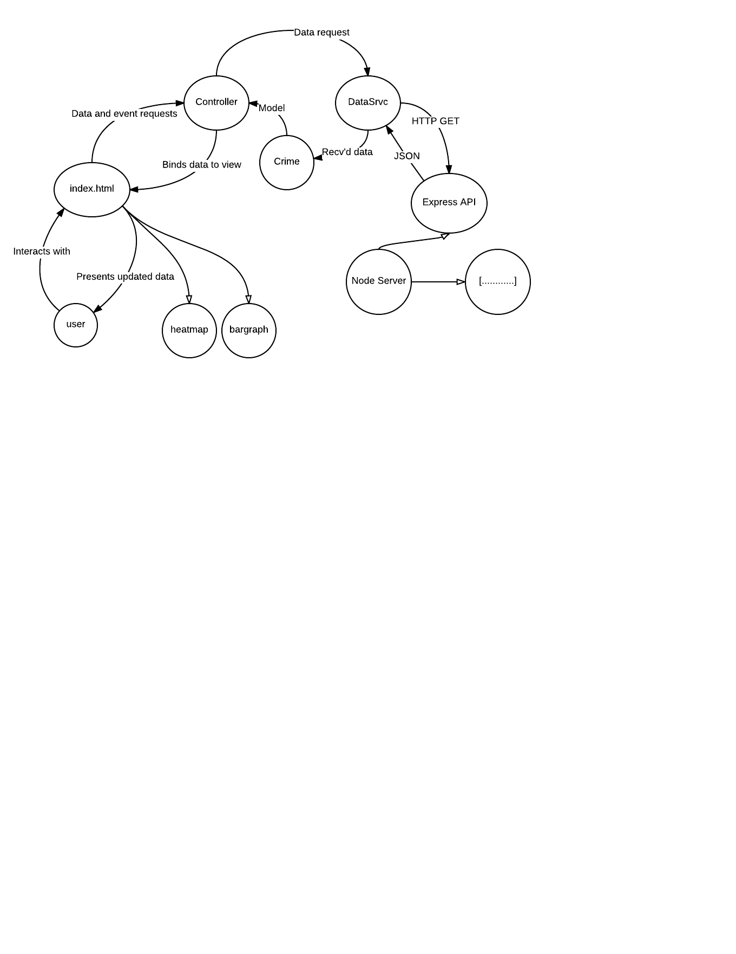
/

Slide 10
Application Layout
Consists of four separate views
Can filter the dataset to be resented by all views
Able to sift through this data within the individual views

Slide 11
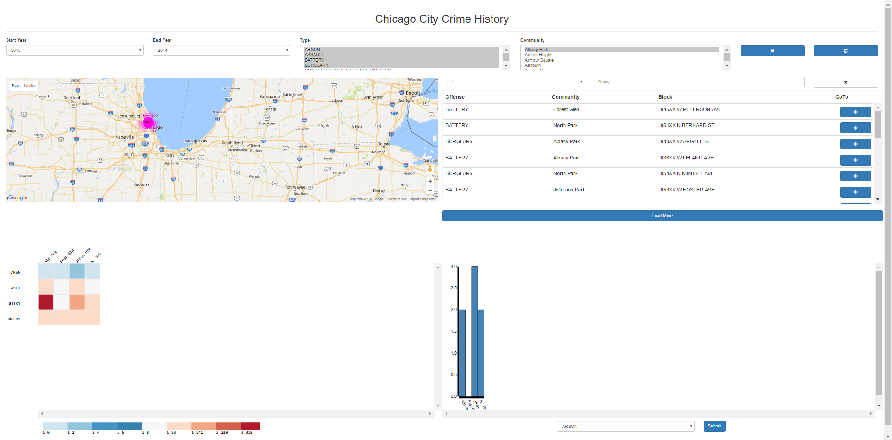

Slide 12
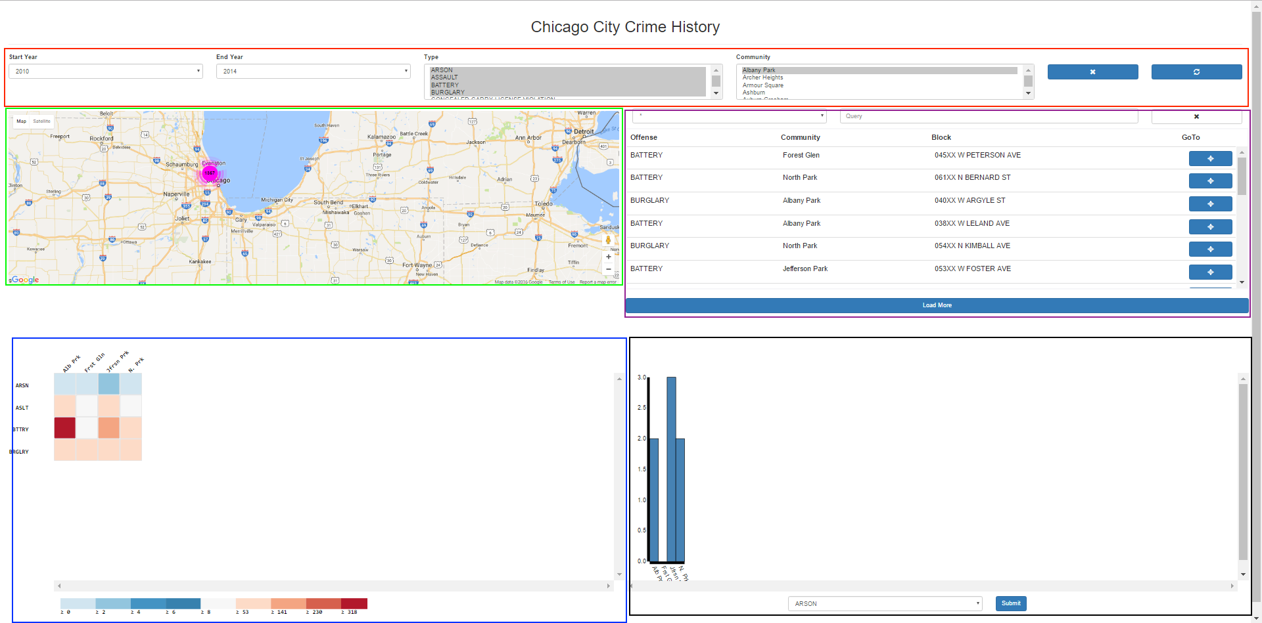

Slide 13
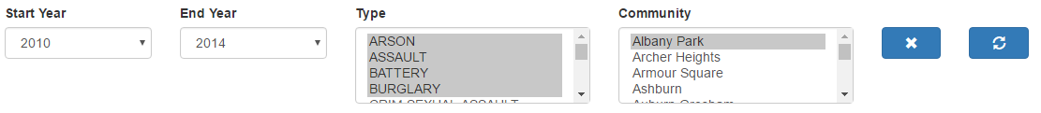
Filter Bar

Slide 14
View 1: Map

Slide 15
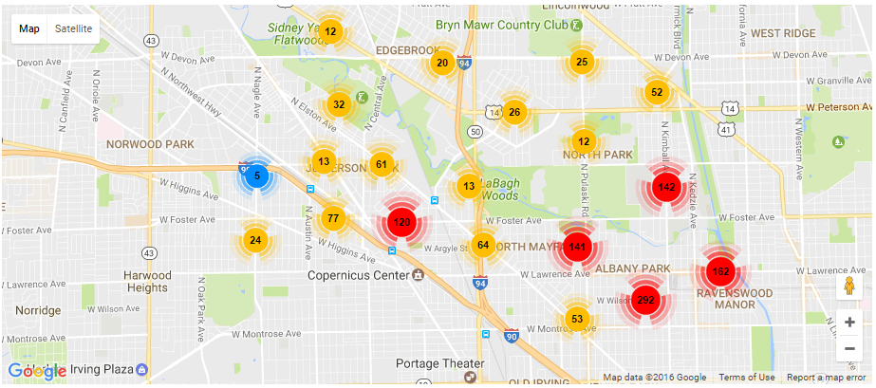

Slide 16
View 2: Table

Slide 17
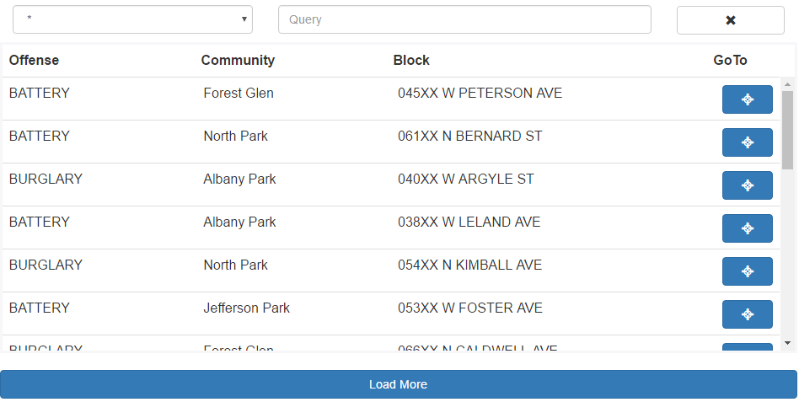

Slide 18
View 3: Heatmap

Slide 19
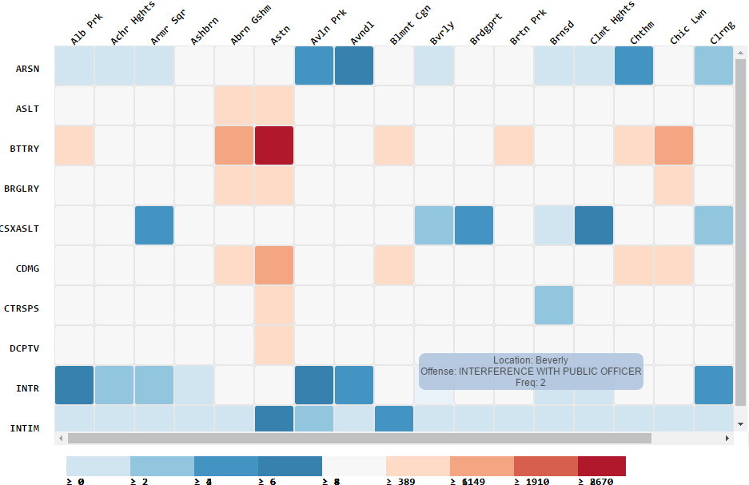

Slide 20
View 4: Bargraph

Slide 21
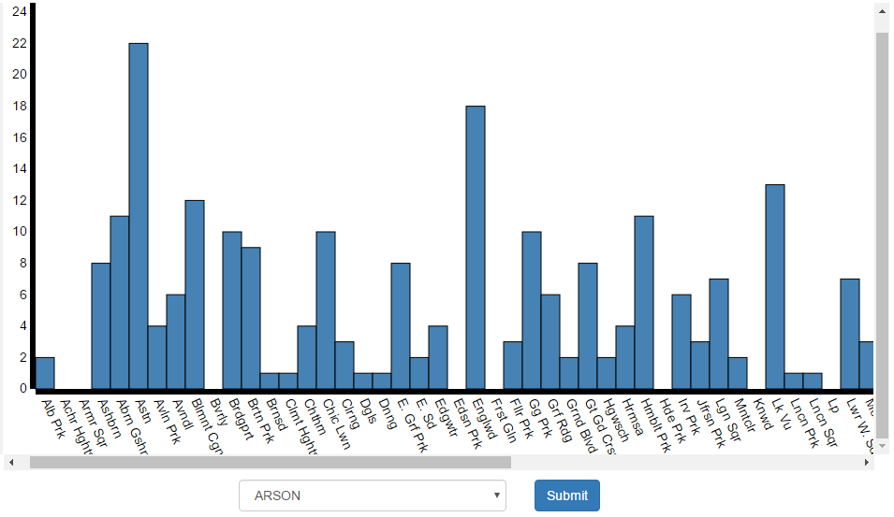

Slide 22
Challenges
Deciding the purpose and scope of the project
Many different dimensions of data allows for almost limitless inquiry
Dataset was very large, performance was always a concern
Memory consumption
Computational performance
Diverse software stack complicated communication between modules

Slide 23
Future Work
Warn user when requesting a large number of API results
Differentiate clustered markers with same location
Add a view which organizes crimes according to when they occurred
Qualitative user study

Slide 24
Conclusions
Many different pieces went into building this application
Server is key to performance when working with lots of data
Must be judicious with what pieces of the data you want to visualize
Different views are useful for focusing what you want to show

Slide 25
Questions?

