Slide 1
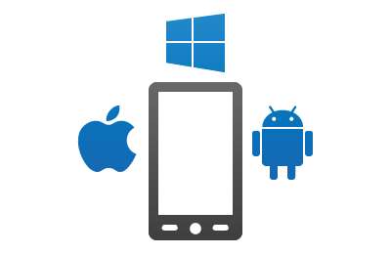
LUX – a better way to develop app UI and full apps
Empowering developers, designers, and really anyone to more easily turn an app vision into a cross platform app reality

Slide 2
The Problem
Customer problem: It should be easier to build apps
It should be easier to do for experienced folks (dev productivity)
It should be easier to learn & do for less technical folks (broaden reach)
The solution: LUX
How better client UI tooling, help Microsoft achieve its business goals?
Microsoft goal—service attach (monetize on the server)
Build service support in by default—a great (and easy) service experience starts on the client

Slide 3
Overall goals
Make it as easy as possible to build mobile apps, esp. those that use MS services
Easy = more apps = greater service use = $$ (plus a better world)
Remove complexity & cruft whenever possible
UI in XML + extensions lang hybrid
UI via simpler but more powerful, purpose built declarative lang
Install GBs of SDKs, slow compile inner loop, Mac/PC compatibility woes
Inner loop interpreted with as you type live update;
fast and intuitive
Write from scratch;
pro dev skills required
Templates + low code;
pro dev skills optional

Slide 4
LUX is…
A general purpose functional, reactive, declarative language
Think better XML, useful for any declarative configuration
A better way to build UI
Think better XAML (or better HTML, if we want to go there)
A better way to build full blown, simpler apps, with service connections
Think low code or think PowerApps but in VS with native Xamarin Forms controls
For pro devs (and motivated citizen devs)
Makes the easy stuff easy but the hard stuff possible
Can write code in C# (or JavaScript, if we want to go there) when needed; think XAML but more of the app is declarative
Uses Visual Studio (or VSCode)
Pro devs loves easy too; and motivated non-pro devs like the flexibility to use code if needed—not two silo’ed dev stacks

Slide 5
Declarative UI construction approaches
Enhance general purpose markup language: XML -> XAML
The seams show through
Extra syntax ceremony and complexity
Enhance general purpose programming language: JavaScript -> JSX
The seams show through
Extra syntax ceremony and complexity
Custom drag & drop UI design GUI
Limited in power—and complexity when trying to remove those limits
Often a textual language is the clearest, most concise way to express the UI
It’s why humans communicate primarily with words
Pictures supplement the words, but don’t replace them

Slide 6
LUX is declarative…
YAML/JSON like syntax Product Name: Chai UnitsInStock: 12
Supports text markup, with power equivalent to XML Product Name: Chai Description: In the Middle East the drink is commonly called bold{karak chai}, which literally means italics{strong tea}. Learn more at link{https://en.wikipedia.org/wiki/Masala_chai label:Wikipedia}

Slide 7
LUX is functional…
LabelColor=#777777 LabeledField{Label:UIText Value:Text} =
Label Grid.Row:0 Grid.Column:0 Text:{Label} ForegroundColor:{LabelColor} Label Grid.Row:0 Grid.Column:1 Text:{Value} ForegroundColor:Black
Functions can be simple constants or take parameters and return any object tree.
Note that calling a function and instantiating an object are syntactically identical. Instantiating can be thought of as calling the “constructor function” (which maps to a C# constructor or sets frozen properties on a C# object).

Slide 8
LUX is functional…
StudentDetails{Students:StudentList MinAge:Integer} = ItemsList Students .where Age > MinAge .sort Name .as Item LabeledField Label:Student name Value:{Name} LabeledField Label:Student age Value:{Age}
LUX LINQ allows using LINQ operators for data transformation. Since LUX is reactive, LUX LINQ is also RX-like: As input changes are pushed, the output updates Typical application: Transform business data into UI—and an app

Slide 9
LUX is functional…
LUX if statements support conditionals, case functionality, and pattern matching. LetterGrade{score: Integer} = if | score >= 95: UIText{A, great job!} | score >= 90: UIText{A, good work!} | score >= 80: UIText{B} | score >= 70: UIText{C, be sure to study} | score >= 60: UIText{D, please see me} | else: UIText{F, please see me!!} LetterGrade{score: Integer} = if score is | >= 95: UIText{A, great job!} | >= 90: UIText{A, good work!} | >= 80: UIText{B} | >= 70: UIText{C, be sure to study} | >= 60: UIText{D, please see me} | else: UIText{F, please see me!!}
Support for localization is part of the language—localizable text is a separate type. It’s green above. The tooling knows about localizable strings and can extract them.

Slide 10
LUX is reactive…
if enableLogging.checked: Label Text:Logging directory Entry { value: loggingDirectorySetting }

Slide 11
LUX supports localization…
StackPanel Label Text:Student name Entry Placeholder:enter name Name:nameControl
Support for localization is part of the language—localizable text is a separate type (UIText). It’s green above. The tooling knows about localizable strings and can extract them.

Slide 12
Naming conventions--fuzzy match to make everyone happy
Want to appeal to 3 constituencies
Microsoft .Net devs (use PascalCase)
JavaScript/Java/Swift devs (use camelCase)
Web/CSS devs and designers (use dash-delimiters)
LUX supports all 3 naming conventions
Calling code (e.g. LUX) and callee code (e.g. C#) do NOT have to use the same convention; LUX will do fuzzy match and convert
Matching rules:
Matching is case insensitive, with any “-” characters removed
LUX encourages consistent naming conventions in a code base
Declare in project settings what naming convention want to use
LUX warns if you deviate from that in your LUX code (both in what it defines and calls)

Slide 13
Supporting slides

Slide 14
Moving to more declarative app building
Declarative dev is easier, for both pro & citizen devs
That means moving more to low code
Still, having a textual, not only GUI, representation of the app is desirable
Pro devs prefer, even require, this
Useful for citizen devs too, as it’s the most concise way to view the app
Declarative language (with associated tooling) is the core of the declarative app building experience
Thus
A better, easier declarative app building experience needs a better declarative language (plus associated tooling)
That’s LUX

Slide 15
LUX is…
A general purpose functional, reactive, declarative language
Think better XML, useful for any declarative configuration
A better way to build UI
Think better XAML (or better HTML, if we want to go there)
A better way to build full blown, simpler apps, with service connections
Think low code or think PowerApps but in VS with native Xamarin Forms controls
For pro devs (and motivated citizen devs)
Makes the easy stuff easy but the hard stuff possible
Can write code in C# (or JavaScript, if we want to go there) when needed; think XAML but more of the app is declarative
Uses Visual Studio (or VSCode)
Pro devs loves easy too; and motivated non-pro devs like the flexibility to use code if needed—not two silo’ed dev stacks

Slide 16
Value prop: LUX addresses customer needs
Slow UI inner loop was main pain point we heard from both Xamarin and Android Native devs; GUI UI designers (both Android Native and XAML) frequently described as unreliable and not used in practice
LUX as you type live update of the real app means no inner loop delays
Addresses several XAML pain points
More concise, intuitive, and powerful syntax (verbosity is frequent XAML complaint)
Supports conditionals (highly ranked user voice request, see here)
Better localization experience (addressing several of the pain points here)
Supports expressions, better data binding, less MVVM boilerplate code behind (several customer requests around these things)
Many (e.g. Gartner) believe low code is the future, esp. for enterprise apps
LUX can help us move more into that space, with Xamarin-backed native controls and in way that makes life better for pro devs too
Complements PowerApps and can use (potentially) same connectors
This especially can drive service attach

Slide 17
Suggested next steps
Get customer feedback, both from existing XAML devs and others

Slide 18
Motivation
Moneyball learnings
Xamarin devs
#1 feature related pain point we heard is lack of Xamarin Forms designer / immediate UI feedback
Android native devs
Many complained about slow UI dev inner loop, with long waits to see UI updates
Google’s Android Studio 2.0 (currently preview) Instant Run feature helps address this, but it doesn’t do anything for our customers
In general
UI dev is a core part of all app construction
It’s the only part of UI prototype construction
So it’s worth some effort to find innovative ways to make it easier

Slide 19
LUX does this
It’s:
A declarative markup language first & foremost
Functional—Turing complete, think a simplified version of Haskell
Functional reactive—when data changes, stuff updates automatically
General purpose but optimized for UI
Strongly typed, with type inference
Ease of use is a primary goal

Slide 20
LUX is…
LUX = Logical UI and Transformation language
It’s:
A declarative markup language first & foremost
Functional—Turing complete, think a simplified version of Haskell
Functional reactive—when data changes, stuff updates automatically
General purpose but optimized for UI
Strongly typed, with type inference
Ease of use is a primary goal

Slide 21
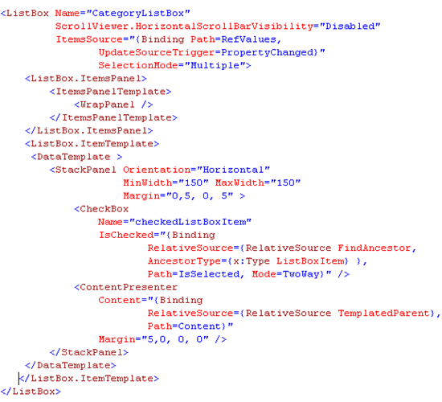
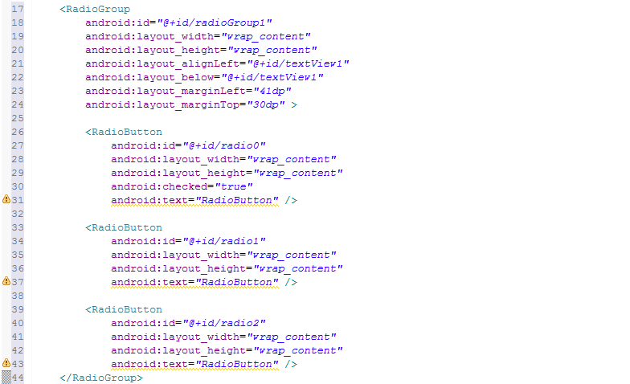
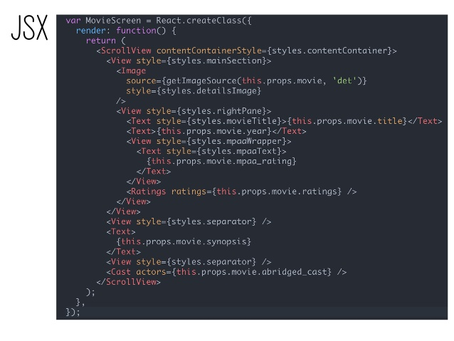
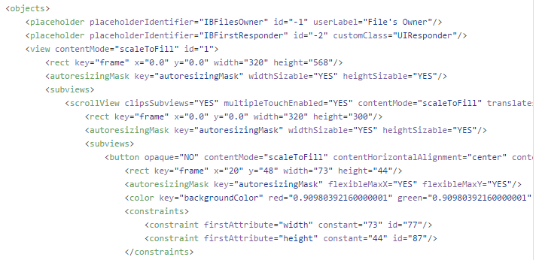
Current “state of the art”
Android XML with Java
iOS XIB XML with Objective-C / Swift; rarely created by hand
XAML with C# - Windows Xamarin
React Native / Angular with JavaScript + declarative language extensions
Primarily declarative, but every platform is different & coupled to the platform preferred programming language
85% of mobile app devs look first to build native; good native support is key
Existing markup languages have room for improvement: poor support for abstraction, poor tooling support for localization, etc.

Slide 22

The Value Proposition
Creating multi platform, native mobile apps today is much harder than it has to be.
Making it easier would be great for the industry & great for Microsoft.
LUX…
Let’s you build native mobile UIs
On all platforms
Easy for semi-technical users, building concept prototypes
Powerful and performant enough for all production apps; no compromises
Blends seamlessly with current platform technology, as is transpiled to Java/C#/Swift/JavaScript; low barrier to adoption

Slide 23
Synergy, from owning UI Layer
Code Push to devices—deploy enterprise apps (if LUX only) with no need to install SDK, sign, etc.
Hockey App analytics of what screens users visit
Live Reload as primary UI design tool

