Slide 1
Dev and Test on Windows Azure
Speaker Name
Speaker Title
Speaker Company
Email:
Twitter:

Slide 2
Why consider the cloud?
Speed
Scale
Economics
Notes:
Ask yourself the process to provision dev and test environments in your organization today.
Speed. Its not uncommon to wait weeks or more to get a virtual machine provisioned.
Scale. What if you asked IT to have your own development environment of three servers? What if everyone on your team wanted their own environment? What if QA did as well? And, what if you wanted to do some load testing, so in addition to the application environment, you also need several beefy machines to simulate user load.
Economics. Your organization may implement departmental chargebacks or something similar, so you know roughly what it costs to assemble and maintain the environments above. The cloud puts this capability in your control and your budget – and Microsoft will give you amazing value.

Slide 3
Develop, test, run your apps
Developers
Use VMs
Provision VMs
Develop and test using Windows Azure
Dev & Test is the #1 workload in the cloud
Cost-effective (pay for what you use)
Improved developer agility with platform services
Ready to use gallery of images
Ship-tested in realistic scale scenarios
Use existing development tools & languages
Access on-premise resources if necessary
Manage environment
IT Admin
Notes:
(2 minutes)
Why should I care about dev/test? Development & test is the #1 and most important workload in the cloud. One of two things happen after they introduced to dev/test in the cloud: 1) go to production on-premises or 2) go to production in the cloud. Either way, they have a better understanding of the cloud which is the right road we want to lead our customers down.
Here’s an easy way to do this - an IT administrator or a developer can use the Windows Azure Management Portal to create VMs in the cloud (step 1). Those VMs are created using Windows Azure Virtual Machines, the platform’s Infrastructure as a Service (IaaS) offering. Developers can supply their own VM images as ordinary VHDs or use VHDs provided by Windows Azure, with support for both Windows Server and Linux. Once the VMs exist, developers and testers can use them to build and test a new application, customizing the VMs as they see fit (step 2).
Why would you want to do this? Two main reasons - low cost and speed. Windows Azure VMs are available to their users in a few minutes, while deploying VMs in an organization’s own datacenter can take days or weeks. Also, an organization pays for public cloud VMs by the hour, at prices ranging from $0.02 to $1.10 per hour. This is relatively inexpensive, and the VMs can be shut down when they’re not in use, making them even cheaper.
Furthermore, with a gallery of images to readily choose from - like Windows Server, SQL Server, and various Linux distributions - your developers can quickly grab the images and start building or testing applications.
In addition to using VMs in Azure to build a test and dev environment, your developers can rapidly create apps using the various other services that would usually require time to set up on-premises. For example, there are ready- to-use-services in Windows Azure such as caching or NoSQL databases or SQL Database which are offered as services. Typically, if you had to setup a development environment on-premises, you’d need up servers for all of these and you’d need licenses. With Azure, you eliminate all of this and give your developers a developer friendly environment.
Benefits:
Deliver Faster. Agile development with no waiting for IT, new hardware, or availability of existing dev/test boxes.
Cost. Eliminate cap-ex expense and yet build test environments that scale better than ever.
Use Existing Tools. Continue using the development languages, tools and lifecycle technologies you are using today.
Test Better. Build bigger test environments that simulate real customer load including spikes without resource contention on the cloud’s “infinite” resources.
Leave Production Alone. Prevent dev/test apps from affecting on-premise production performance. Even virtualized on-premise test workloads can on-premise production on shared machines.
Access Existing Resources - Securely network from the cloud to on-premise to test against systems of record if necessary.
Deploy Anywhere with No Lock-in. Once testing deploy either in the cloud or on-premise

Slide 4
Customer Stories
Telenor
Uses Windows Azure Virtual Machines for Fast, Efficient Cost-Saving Development and Testing of Company-Wide SharePoint 2013 Platform
http://www.Microsoft.com/casestudies/Case_Study_Detail.aspx?CaseStudyID=710000002349
Blackbaud
Using Windows Azure Infrastructure Services to support non-profits around the world
http://go.microsoft.com/fwlink/?linkid=288785&clcid=0x409
Webzen
Korean gaming company scales globally using Windows Azure
http://azurevideos.com/webzen/technical-webzen/

Slide 5





System Center : “Single pane of glass” management experience
Visual Studio Services Cloud
Azure
production cloud
On-premises
Azure dev and test cloud
App Lifecycle Services
(Cloud & On Prem)
Project management tools
Version & Source Control
Build
Testing
Services
Monitoring
Diagnostics
Cloud
Continuous Delivery
Analytics
Lab Mgmt Automation
Azure PaaS Cloud
Mobile services
Web sites
Storage and caching
Data / Big Data
Modern
app dev
services
Developer and test tools
Media services
Internet service bus
Identity federation
Azure IaaS Cloud
Dev & Test
Lab
environments
Infrastructure and Apps
Production servers
Notes:
(5 minutes)
Integrated & Comprehensive Solution from Microsoft from developer & testing tools to a first-class cloud platform for Dev/Test & Production Environments.
Visual Studio provides ALM as a Service through the Team Foundation Service offers tooling for version control, project management, bug tracking, testing, elastic build automation, and more.
One of the differentiators between Microsoft’s end to end solution and Amazon EC2 is that teams don’t have to setup, manage, or administer their ALM tooling on just base IaaS images.
Comprehensive - Azure has a full set of capabilities for development teams to harness
Hybrid Compatibility – Dev/Test in the Cloud but allowing for production in your private cloud on-premises.

Slide 6
Azure MSDN benefits improved!
Up to $150 in Azure credit per month
Use credits on any Windows Azure service you want for dev/test incl. Virtual Machines (VMs), Web Sites, Cloud Services, Mobile Services, Storage, SQL Database, Content Delivery Network, HDInsight, Media Services, and more.
Discounted rates
MSDN subscribers receive:
Visual Studio Professional with MSDN OR Visual Studio Test Professional: $50 per month
Visual Studio Premium with MSDN OR MSDN Platforms: $100 per month
Visual Studio Ultimate with MSDN: $150 per month – Example: Three live dev/test machines every day!
33% discount on Windows Virtual Machines
25% discounts on Cloud Services, HDInsight, and Reserved Websites.
Access to preconfigured virtual machine images
Dev/Test usage
SQL Server, BizTalk Server and other software over time included with MSDN subscription
Or upload your own virtual machine with their MSDN software.
Benefit is for dev/test scenarios (no production usage)
Notes:
(5 minutes)

Slide 7
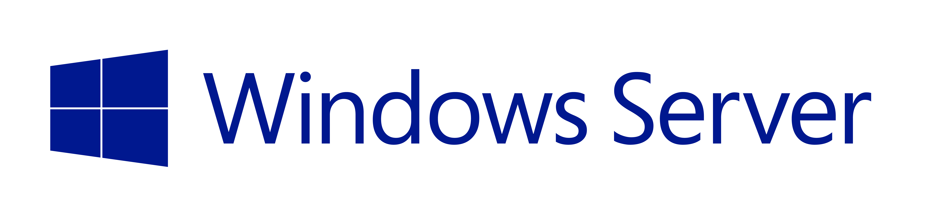
Cloud innovation presents challenges for IT
How do I integrate with my existing IT investments?
What about my heterogeneous, complex IT landscape?
What about security and compliance?
Notes:
But as you think about using the public cloud, there are some top-of-mind issues you have to reckon with.
If you’re like most organizations, you have your existing servers and IT infrastructure (either on-premises in your own datacenters or in 3rd party co-location facilities). You also have an IT staff to manage these assets. So as you think about using the public cloud, you’re not thinking of it in a silo – ideally where possible you’d want to integrate the public cloud with existing IT, manage it no differently, and even have applications with parts running on and off-premises. Latest IDC findings show 40% of enterprises are already adopting hybrid clouds today (source - http://www.infosys.com/newsroom/press-releases/Pages/cloud-ecosystem-integrator.aspx).
You’re also probably running a variety of OSs, databases, middleware and toolsets from multiple IT vendors. Your developers are proficient in multiple languages and your apps are written in multiple languages and frameworks. In other words, your IT environment is complex and heterogeneous. And you want to make sure the cloud you choose is able to handle your heterogeneous needs.
Next you have to abide by a bunch of security and compliance initiatives. The rest of the business trusts your IT org to run apps in a secure and reliable manner. So you want to make sure the public cloud platform and the vendor who provides the service is using is trustworthy, i.e. has the right experience and expertise, and has necessary SLAs, and security controls in place.

Slide 8

Windows Azure delivers.
Integration
Heterogeneity
Security
On-premises
AND cloud
Open, Broad, Flexible
Trustworthy
On-premises and Cloud
Broad and flexible
Secure and reliable
Enterprise ready by design.
Notes:
Let’s pause and summarize the design principles that make Windows Azure a true enterprise-ready platform.
FIND EXAMPLES on security

Slide 9








Getting Started with Virtual Machines
Multiple options to get started…
Windows Server 2012 DataCenter
Windows Server 2012 R2 Preview
Windows Server 2008 R2 SP1
BizTalk Server 2013
Management Portal
SharePoint Server 2013 Trial
>_
OpenLogic CentOS
SUSE Linux Enterprise Server 11
Scripting
(Windows, Linux and Mac)
openSUSE 12.3
SQL Server 2008, 2012
Ubuntu Server 12.04 LTS
REST API
Visual Studio Ultimate 2013 Preview
Notes:
How do you start? That is the first question we will address for you.
For those of you who are new to Virtual Machines and who need an easy and quick way to get started, Windows Azure Management portal, the web interface, offers the desired experience. Simply provision Virtual Machines from the Image Gallery in minutes . Virtual Machines Image Gallery contains pre-built images of Linux – CentOS, Ubuntu and Suse Enterprise Linux (SLES), Windows Server, SQL Server, SharePoint (evaluation copy) and BizTalk Server. These images have hourly rates, where you pay for what you use. We are continuously working on expanding the images in the gallery – both for most popular Microsoft workloads but also for prebuilt Linux images from commercial distributors.
On the other hand, some of you will be familiar with Virtual Machines having used it since the preview. And, you might be looking for ways to automate tasks like provisioning virtual machines or building workflows for your organization where you upload a large number of custom images into your storage account. REST based service management APIs and PowerShell commands are the tools you use in that case.

Slide 10


How it Works – Option #1 Select from Image Gallery
Log in to
Windows Azure
Management Portal
Create new VM from image gallery
The image is copied to
your blob storage account
Virtual Machine booted. Changes direct-write to blob storage
Notes:
We talked about getting started from the Virtual Machines Image Gallery. What happens when you select an image from the gallery? The image is copied to your blob storage account and then your virtual machine is booted with that image. From there on, any changes you make to the image are directly written into the blob storage and persisted. This is also where the storage element we talked about in infrastructure services come into play.
Microsoft will maintain and keep the images fresh and up to date when you choose an image from the Image Gallery.

Slide 11

How it Works – Option #2 Bring your own custom VHD
Create your own VHD
Upload image to blob storage
Create a Virtual Machine by attaching to disk
Virtual Machine booted. Changes direct-write to blob storage
Notes:
You have more options than using just the images in the Virtual Machine Image Gallery. When you have custom images created in VHD format using Hyper-V, you can easily bring them into Windows Azure as well. These images can simply be your favorite Linux stacks obtained from VM Depot, images for existing applications running on-premises or images with Microsoft server workloads such as SharePoint that you need to build your collaboration environments. Simply upload to blob storage – you can do that using PowerShell commands and then create your disks using the image in the management portal. Voila, your Virtual Machine is booted with the right pieces in it.
In this case, you have the full option and control of maintaining and updating your image as it fits your needs.

Slide 12
Develop, test, run your apps
Start VMs and app development in Azure
Deploy anywhere with no lock-in
Your Datacenter,
or Your Hoster
Easy VM portability
If it runs on Hyper-V, it runs in Windows Azure
Production environment
Notes:
Once everything is developed and tested, you, of course, have the choice of running in Azure or bringing it back to production environment on your premises.
If that’s the case, moving the deployment is easy. Because Windows Azure VMs use the exact same format as the Windows Server Hyper-V i.e. VHD. So if it runs on Hyper-V it runs in Azure and vice-versa. In fact, Windows Azure is built on the same foundation as Windows Server 2012!
This is unique for us. Other public cloud vendors will convert the image into proprietary formats and it becomes hard to convert back.
If you have your on-premises environment on a different platform other than Hyper-V, the Microsoft Virtual Machine Converter (MVMC) Solution Accelerator is a Microsoft-supported, stand-alone solution to convert VMware-based virtual machines and disks to Hyper-V®-based virtual machines and disks.
How about management? While you can use the Windows Azure management portal, you can also use the familiar System Center 2012 management console. System Center 2012 introduced the App Controller component to enable organizations to optimize resource usage across their private cloud and Windows Azure resources from a single pane of glass. In SP1, we’ve extended App Controller’s capabilities to integrate with Windows Azure Virtual Machines enabling you to migrate on-premises Virtual Machines to run in Windows Azure and manage them from your on-premises System Center installation.

Slide 13
Extend your infrastructure
Windows Azure Infrastructure Services
<subnet 1>
<subnet 2>
<subnet 3>
Windows Azure Virtual Network
Logical isolation with control over network
Create Subnets, Private IP addresses
Bring your own DNS
Domain join your VMs
DNS Server
Virtual Network
Notes:
Extend your Datacenter
Own the base, rent the rest! Extend your datacenter by building capacity on-demand.
With Windows Azure, you can literally create a virtual “datacenter” in the Cloud. You can do this by leveraging a feature called Virtual Network (VNET) which allows you to create a logically isolated section of Azure and treat it like your own network. You can customize the network configuration for a VNET - create subnets, assign private IP addresses and bring your own DNS server if you wish. Within a virtual network for example, you can create a public-facing subnet for your webservers that has access to the Internet, and place your backend systems such as databases or application servers in a private-facing subnet with no Internet access.

Slide 14
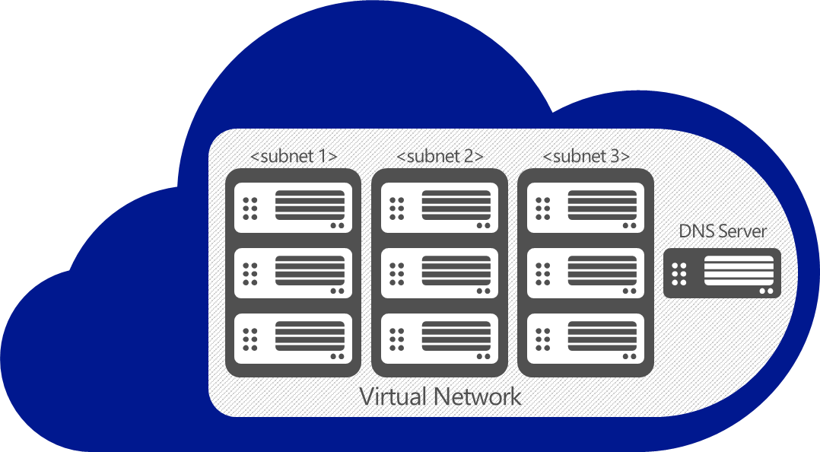
Extend your infrastructure
Windows Azure Infrastructure Services
VPN
On-premises
VPN
Notes:
Of course, once you set up VPN connectivity, you’re treating the virtual network in Azure almost as if it were an extension of your on-prem datacenter. You can domain join your VMs with an AD running on-premises or an AD running inside of the virtual network. You can have hybrid multi-tier apps with perhaps the presentation and logic tiers running in Azure, and the database tier running on-premises for compliance reasons.
A good example is SharePoint that uses all of the features we outlined (cross-premises VPN connectivity, Active Directory, VMs).
Windows Azure provides first-party tested Windows Server images for easily deploying SharePoint, SQL and Active Directory.
<From IaaS scenario for Sharepoint>
When you need more from your collaboration infrastructure vs. Office 365 and the ability scale in real time, count on Windows Azure. Start with dev & test work and maintain control as you grow. You can deeply customize with full trust custom code on top of Windows Azure infrastructure services. Support provided directly by Microsoft.
Internet sites with SharePoint: When you need to roll-out customized public or anonymous internet sites, count on Windows Azure. You can closely manage your infrastructure versus Office 365 and get real time scalable resources vs. on-premises datacenters. Get started quickly with direct Microsoft supported images.
<From IaaS scenario for AD>
Identity with AD in Virtual Machines
Hybrid apps and hybrid IT: When apps live both in the cloud and on-premises, and need to synch with on-premises directory, simply bring DirSync into Virtual Machines.
Specific AD capabilities in the cloud: When applications in need of on-premises optimized AD capabilities are moving to cloud and Windows Azure Active Directory is not the solution, bring your AD into Virtual Machines. Same AD, same skill sets and same trustworthy capabilities.
Identity synch with Office 365: When you need to synch identity with O365 and want to minimize your on premise identity infrastructure, rely on running AD in Virtual Machines. Even when you have an on-premises identity infrastructure synching with Office 365, simply build your high availability copy in Virtual Machines and keep working when internet connectivity is down.
<From IaaS scenario for Scalable, On-Demand Infrastructure For .NET apps>
When you need to accommodate variable and increasing needs of .NET and Windows Server apps, spin up trustworthy infrastructure with no code changes required. And, it is more than just infrastructure. Use Windows Azure building blocks – such as Service Bus or Media Services and many more from partners in Windows Azure Store – to boost your existing app.
When you want to participate in software as a service business model as an app vendor and host all or part of an existing .NET or Windows Server app in the cloud with no changes, build your offer on scalable, trustworthy Windows Azure infrastructure.

Slide 15

PowerShell for Automation and Advanced Management
Automation
➔ Query, manage and configure:
Virtual Machines
Storage across multiple subscriptions & storage accounts
Tiered deployment workflows
Virtual Machines
Configure storage and networking
Domain join to AD on-premises
Bring your own machine images or disks
Use remote PowerShell
Virtual Network
Configure Virtual Network
Manage configuration and gateway
Connect to on-premises networks
Storage
➔ Upload & download VHDs from storage accounts to on-premises
➔ Copy VHDs between storage accounts and subscriptions
Notes:
For many customers and partners, scripting and automation is the key to efficient operations. Fear not! Microsoft’s popular task automation framework PowerShell is available for use with Windows Azure as well. Whether you want to automate provisioning of lots and lots of Virtual Machines or configure your Virtual Network settings through scripts, PowerShell cmdlets are ready for you. You can download PowerShell cmdlets from http://www.windowsazure.com/en-us/downloads/ to get started.
You can configure and manage all 3 elements of infrastructure services (IaaS) with PowerShell: Virtual Machines, Virtual Network and Storage. When you want to upload custom VHDs into Windows Azure or bring your images back to on-premises, at scale, use PowerShell. When you are working across many Windows Azure subscriptions and need to copy VHDs in between, use PowerShell. Or when you want to convert images virtualized with VMware (VMDK format) into VHD to run in Virtual Machines, use the Microsoft Virtual Machine Converter (MVMC Toolkit) first and then upload the converted images using PowerShell cmdlets.
PowerShell is here to help increase your productivity, and to give you advanced management options.

Slide 16



Customize.
Collaborate.
Maintain.
SharePoint Server on Windows Azure
Design, implement, and develop on SharePoint 2010/2013 without upfront hardware costs
Develop custom internet sites and collaboration apps not supported in software as a service model
Burst compute, storage, and database for your SharePoint farm when you need it
Custom Collaboration Site
Virtual Machines
Virtual Network
Windows Server Active Directory
SharePoint Server
Internet
Windows Server Active Directory
Remote Workers
On-premises
Windows Azure
Remote Workers
Notes:
Customize. Collaborate. Maintain. - SharePoint on Windows Azure Infrastructure Services.
Let’s move on to another scenario: SharePoint on Windows Azure Infrastructure Services. This one has been in high demand since Virtual Machines became available in preview and began offering a robust infrastructure for SharePoint Server.
Windows Azure Virtual Machines is one of the deployment options for SharePoint. Some of the other options include Office 365 and on-premises deployment. We’ll go over the situations where SharePoint 2010 and SharePoint 2013 deployments on Windows Azure Virtual Machines have distinct advantages.
One is Web Content Management (or SharePoint for Internet Sites - FIS), when customers want to minimize on-premises infrastructure and need real-time scale. These public-facing, anonymous sites are often highly customized so they can scale and contract on demand according to traffic and load needs. FIS is unsupported in Office 365. Windows Azure infrastructure Services offers the right, robust foundation for complex designs like these that need to support memory intensive instances.
The second scenario is for collaboration sites, where we keep documents, and list and share content with coworkers. Windows Azure Virtual Machines is ideal for these sites, especially when they need deep customization, typically with full-trust custom code. Many of our customers start dev and test work for full-trust custom code environments on Windows Azure Virtual Machines connected to on-premises via Virtual Network and Active Directory Federation Services running in Virtual Machines. When they complete their development cycles, the farm either continues to live in Windows Azure or moves to on-premises. Office 365 does not support full-trust custom code.
When you choose SharePoint to power your file sharing and collaboration workloads, Windows Azure Infrastructure Services is a robust platform option. Through the 180-day evaluation image in our gallery, you can get started quickly and then upgrade to a full edition by bringing your own licenses under License Mobility rights that come with Volume Licensing programs. [might have to remove if the eval image does not come through]
Microsoft provides end-to-end, direct support for SharePoint Server running in Windows Azure. Pick up the phone and call us using your Windows Azure support plan. There’s no hand- offs to another organization and no additional charges. You can call a single support organization for your cloud and non-cloud questions when you work with Windows Azure and Microsoft.

Slide 17
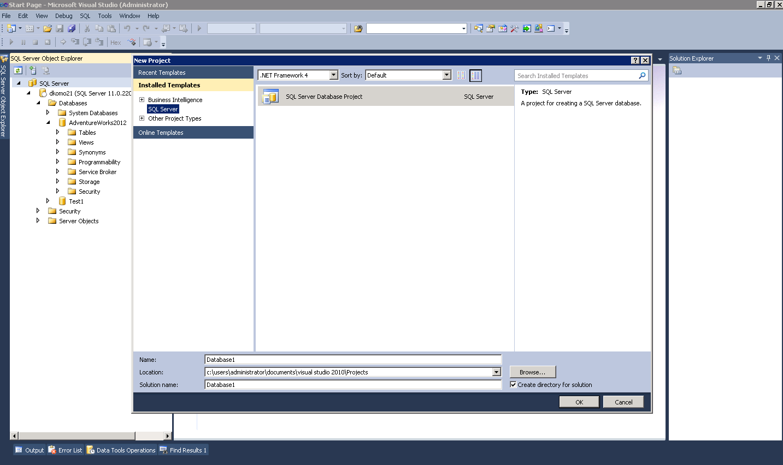
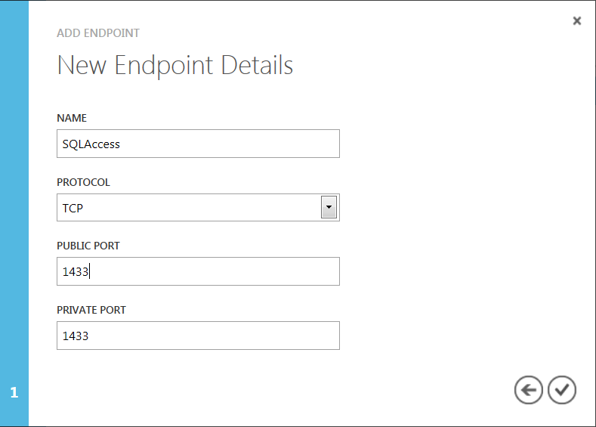
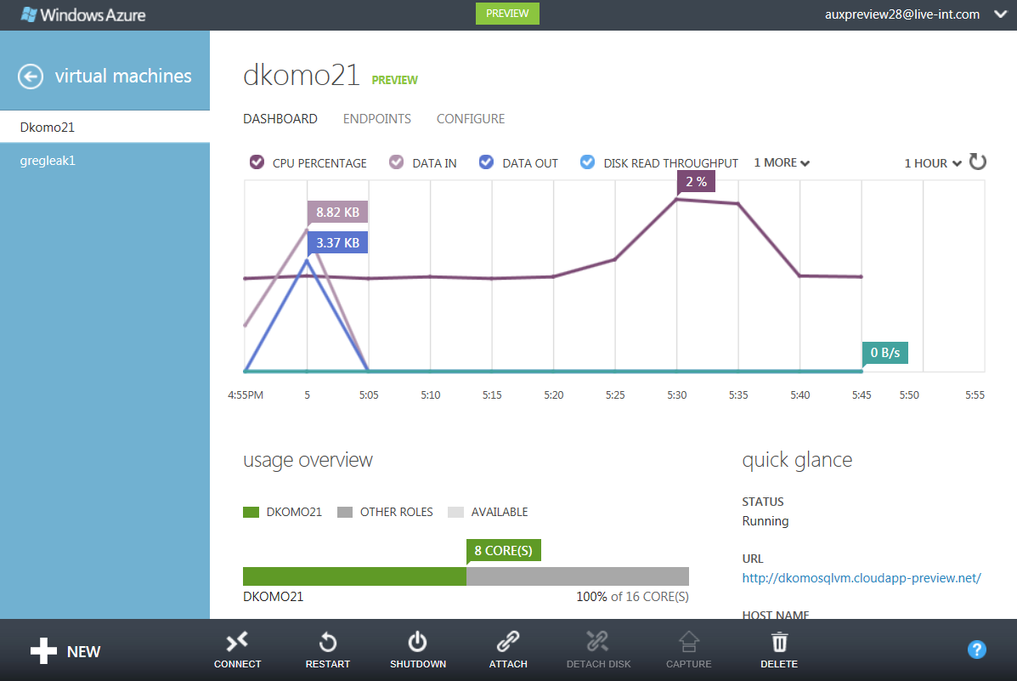
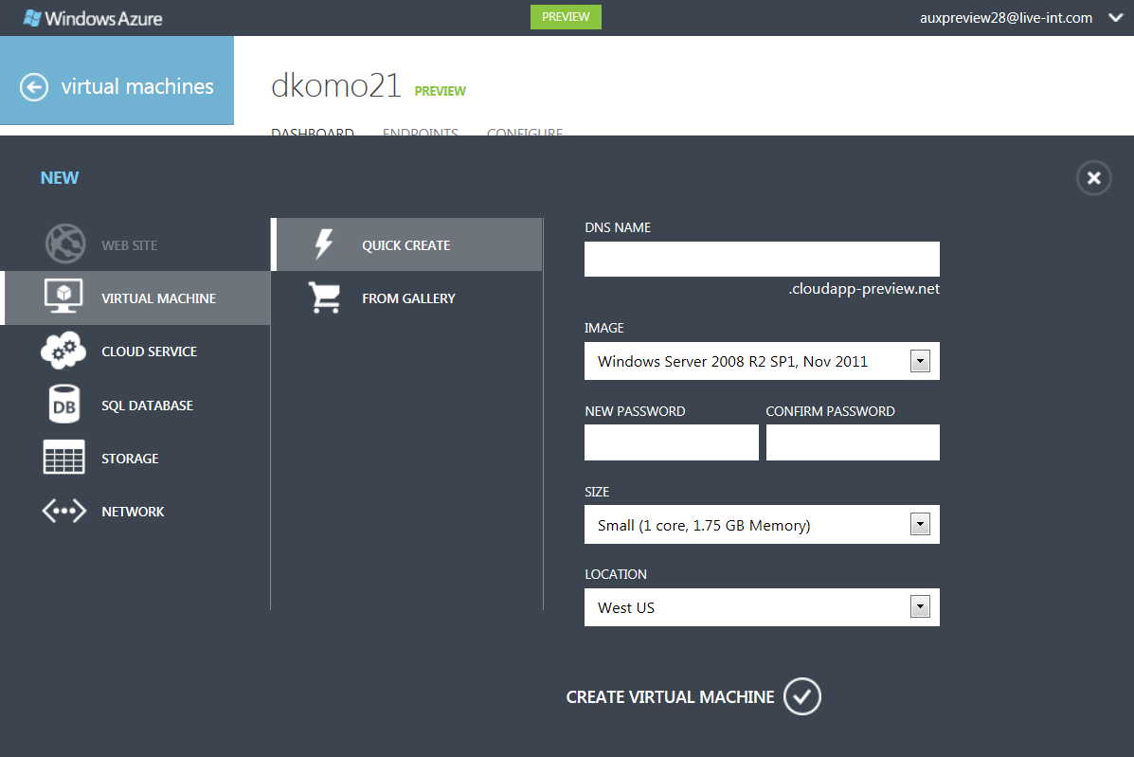
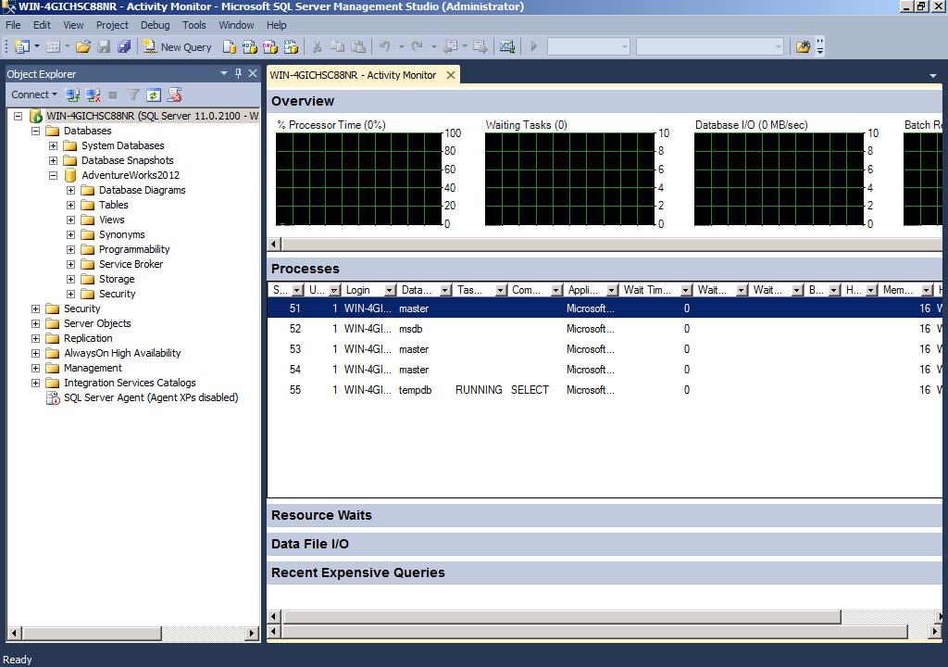
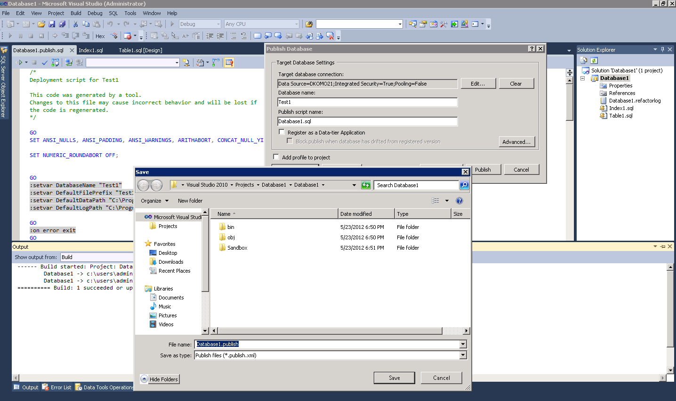
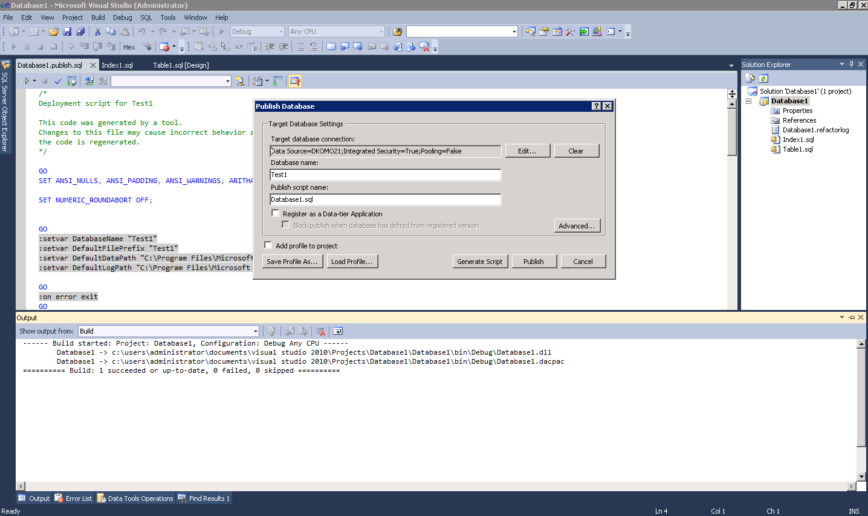
Develop & test new apps using Windows Azure and SQL Server
PROVISION
DEVELOP
DEPLOY
MANAGE
Provision new Windows Azure VM based on SQL Server template using Windows Azure Portal:
Develop new applications using SQL Server Data Tools and Visual Studio
Configure access using Windows Azure Portal and Windows Firewall in the VM
Monitor application over time using Windows Azure Portal and SQL Server Management Studio
Create deployment scripts using SQL Server Data Tools and Visual Studio
Deploy and test package to Windows Azure VM using SQL Server Data Tools and Visual Studio

Slide 18
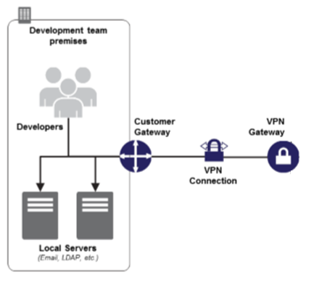

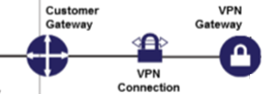
the customer experience
5
Setup projects and SCM
3
Configure build servers, test labs, and BDT workflows
1
The Tailspin Corp.
Azure Dev and Test cloud
6
Dev and Test
Management Portal
Configure load testing
Dev and Test – Visual Studio Services
Tailspin
on-premise
TFS in the cloud
Testing Services
APM and Analytics
Cloud
CD
Dev and Test
workstations
2
Dev and Test PaaS
Modern App Dev Services for Dev and Test
5
4
On-premise TFS
Configure BDT workflows with build and test servers in the cloud
Dev and Test IaaS
Tailspin Corp’s
Dev and Test
Machine Image Gallery
Build and Test rigs
Load testing rig
Get Productive!
7
Provision dev sandboxes
4
Notes:
(4 minutes)

Slide 19
DEMO
DevTest on Windows Azure
Notes:
Slide Objective:
DEMO
Notes:
Essentially this is quick run through of the hands on lab, minus unit testing and load testing
Create a TFS project
Create a Windows Azure Web Site
Link the Web Site to the TFS Project
Use VS to update the Web Site and check in
Show continuous deployment in TFS and Windows Azure management portals

