Slide 1

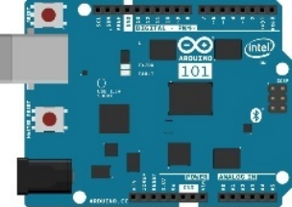


Microsoft Azure
Storage Account ingenustorage
Power BI Report TemperatureChart
Web App ingenuweb
Function IntellectRest2IoTHubJs
QUERY
SQL Db
ingenudb
Stream Analytics
ingenujob
Event Hub ingenualerts
IoT Hub ingenuhub
OUTPUT
OUTPUT
SEND / RECEIVE
UPLINK / DOWNLINK
INPUT
Ingenu Intellect Platform
Intellect HTTP REST API / AMQP
rACM

