Slide 1
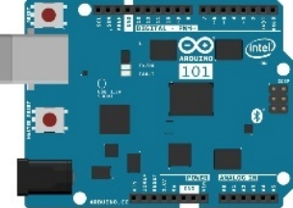
Lab Architecture
Resource Group ingenugroup
Development Workstation (Windows / OSx / Linux)
PowerBI Embedded Workspace Collection ingenucollection
PowerBI Embedded Workspace
Dynamically generated guid
Storage Account ingenustorage
Report TemperatureChart
Router w/ Internet Access
LOCAL RESOURCES
AZURE RESOURCES
READ / WRITE
RENDER
App Service Plan ingenuplan
Function App
ingenufunctions
DIRECT QUERY
Intel NUC / IoT Gateway
Function TempAlert
Arduino 101 & Grove Base Shield
Web App ingenuweb
Buzzer
QUERY
RECEIVE
SQL Server
ingenusql
IoT Hub ingenuhub
Service Bus
ingenubus
Temperature Sensor
SQL Db
ingenudb
SEND CLOUD-TO-DEVICE-MESSAGES
SEND CLOUD-TO-DEVICE MESSAGES
Event Hub ingenualerts
Rotary Angle Sensor
OUTPUT
Stream Analytics
ingenujob
OUTPUT
2 Row LCD Display
GET / POST
INPUT
SEND / RECEIVE
SEND / RECEIVE

Slide 2

Lab Architecture
Microsoft Azure
Storage Account ingenustorage
Development Workstation (Windows / OSx / Linux)
Power BI Report TemperatureChart
Web App ingenuweb
Function IntellectRest2IoTHubJs
QUERY
SQL Db
ingenudb
Stream Analytics
ingenujob
Event Hub ingenualerts
IoT Hub ingenuhub
Router w/ Internet Access
OUTPUT
OUTPUT
LOCAL RESOURCES
SEND / RECEIVE
AZURE RESOURCES
UPLINK / DOWNLINK
INPUT
Intel NUC / IoT Gateway
Ingenu Intellect Platform
Arduino 101 & Grove Base Shield
Intellect HTTP REST API / AMQP
Buzzer
Temperature Sensor
SEND CLOUD-TO-DEVICE MESSAGES
Rotary Angle Sensor
2 Row LCD Display
GET / POST

Slide 3
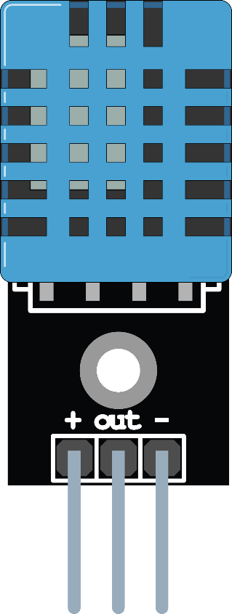

Microsoft Azure
Storage Account ingenustorage
Power BI Report TemperatureChart
Web App ingenuweb
Function IntellectRest2IoTHubJs
QUERY
SQL Db
ingenudb
Stream Analytics
ingenujob
Event Hub ingenualerts
IoT Hub ingenuhub
OUTPUT
OUTPUT
SEND / RECEIVE
UPLINK / DOWNLINK
INPUT
Ingenu Intellect Platform
Intellect HTTP REST API / AMQP
rACM

