Slide 1
Web Services and Windows Azure
Bruno Terkaly | Technical Evangelist
Bret Stateham | Technical Evangelist

Slide 2
Meet Bruno Terkaly | ‏@BrunoTerkaly
Monthly Columnist MSDN Magazine
Expertise in Windows Azure / Windows 8
Principal Technical Evangelist – Silicon Valley
Find him on the web at blogs.msdn.com/brunoterkaly

Slide 3
Meet BretStateham | @BretStateham‏
Find me on the Web at BretStateham.com
Working with the web since before IIS
Working with .NET since before .NET
In love with SQL Server (don’t tell my wife)

Slide 4


Course Topics
Developing SharePoint Server Core Solutions Jump Start
01 | WCF Services | 05 | Entity Framework
02 | Hosting Services in Windows Azure | 06 | Web API
03 | Data Storage | 07 | Advanced WCF Topics
04 | Data Access Technologies

Slide 5
Setting Expectations
Target Audience
Developers looking to host WCF or Web API services in Windows Azure, with data stored in Azure Storage or Azure SQL Database
Considering taking the 70-487 Exam
Additional Material
Microsoft Official Course 20487
Developing Windows Azure and Web Services

Slide 6
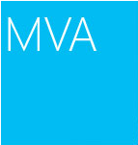
Join the MVA Community!
Microsoft Virtual Academy
Free online learning tailored for IT Pros and Developers
Over 1M registered users
Up-to-date, relevant training on variety of Microsoft products
“Earn while you learn!”
Get 50 MVA Points for this event!
Visit http://aka.ms/MVA-Voucher
Enter this code: AzWebSvc (expires 12/13/2013)

Slide 7
01 | WCF Services
Bret Stateham | Technical Evangelist
Bruno Terkaly | Technical Evangelist

Slide 8
Course Introduction

Slide 9
Module Overview
WCF Overview
Configuring Services
Consuming Services
Hosting WCF Services

Slide 10
WCF Overview

Slide 11
Windows Communication Foundation (WCF)
The Windows Communication Foundation (or WCF) is a runtime and a set of APIs in the .NET Framework for building connected, service-oriented applications.

Slide 12
Windows Communication Foundation (WCF)
Common Tasks For A Web Service
Perform read write operations on back end databases.
Perform operations by calling other web services.
Abstract blocking I/O operations affects performance and scalability.

Slide 13


Windows Communication Foundation (WCF)
Other Web Service
Incident Client UX
Customer Web Service Demo Scenarios
Customer Web Service
Customer Databases

Slide 14
Windows Communication Foundation (WCF)
Messages are typically sent in text encoded SOAP messages using is the HyperText Transfer Protocol (HTTP)
SOAP, originally defined as Simple Object Access Protocol, is a protocol specification for exchanging structured information in the implementation of Web Services in computer networks.
It relies on XML Information Set for its message format.

Slide 15

Windows Communication Foundation (WCF)
SOAP calls
REST calls
REST is an abbreviation for:
Representational State Transfer

Slide 16
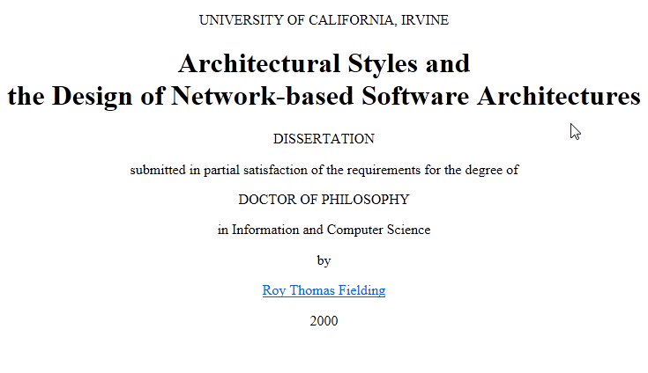
Windows Communication Foundation (WCF)
But REST is coming along….

Slide 17
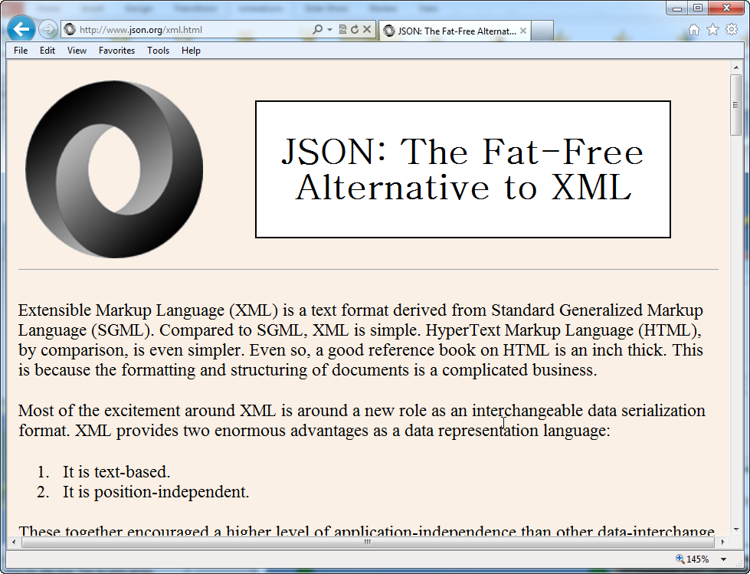
Windows Communication Foundation (WCF)
Advantages of REST
Automatic support - native http
Lightweight, Efficient
Secure - Supports https
Modern - Twitter, Yahoo, etc
No toolkits needed, XML format

Slide 18
Windows Communication Foundation (WCF)
Advantages of WCF + SOAP: Provides a lot of support for many bindings
BasicHttpBinding | Interoperability with Web services and clients supporting the WS-BasicProfile 1.1 and Basic Security Profile 1.0.
WSHttpBinding | Interoperability with Web services and clients that support the WS-* protocols over HTTP.
WSDualHttpBinding | Duplex HTTP communication, by which the receiver of an initial message does not reply directly to the initial sender, but may transmit any number of responses over a period of time by using HTTP in conformity with WS-* protocols.
WSFederationBinding | HTTP communication, in which access to the resources of a service can be controlled based on credentials issued by an explicitly-identified credential provider.
NetTcpBinding | Secure, reliable, high-performance communication between WCF software entities across a network.
NetNamedPipeBinding | Secure, reliable, high-performance communication between WCF software entities on the same

Slide 19
Creating a New WCF Service Library

Slide 20
Configuring A WCF Service
Data Contracts

Slide 21
Defining the Data Contracts
A data contract is a formal agreement between a service and a client.
It describes the data to be exchanged.
To communicate, the client and the service do not have to share the same types, only the same data contracts.
A data contract precisely defines, for each parameter or return type, what data is serialized (turned into XML) to be exchanged.

Slide 22
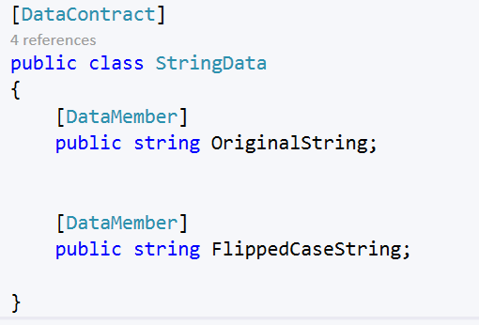
Defining the Data Contracts

Slide 23
Configuring A WCF Service
Using Interfaces

Slide 24
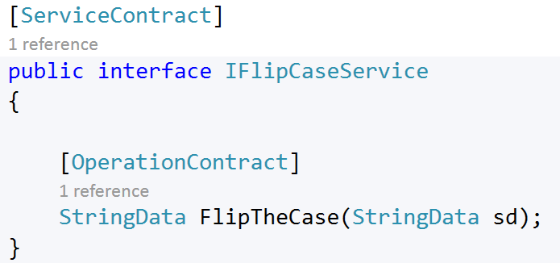
Why use Interfaces?

Slide 25
Why use Interfaces?
Interface-based programming is popular among many developers
It makes code better, by increasing reusability, maintainability, and extensibility
An interface defines what must a client know about a class in order to benefit from using it
Developers often put the interfaces into a separate assembly
This is useful because the interface can be used by any piece of code that needs to know about the interface, but not necessarily about the implementation
It is common practice to have one class implement more than one interface

Slide 26
Why use Interfaces?
The benefit is that you can expose the same implemented class in different ways using different interfaces in the WCF endpoints.
WCF Service
Customer
Manager

Slide 27
Why use Interfaces?
In Windows Communication Foundation (WCF) applications, you define the operations by creating a class and marking it with the [ServiceContract] attribute in the interface file.
For each method in the class you can mark each method with OperationAttribute.

Slide 28
Configuring A WCF Service
Endpoints

Slide 29
WCF and Endpoints
All communication with a Windows Communication Foundation (WCF) service occurs through the endpoints of the service
Endpoints provide clients access to the functionality offered by a WCF service
WCF Service
Client

Slide 30
Each endpoint consists of four properties:
An address that indicates where the endpoint can be found
A binding that specifies how a client can communicate with the endpoint
A contract that identifies the operations available
A set of behaviors that specify local implementation details of the endpoint.
Know your ABCs

Slide 31
FlipCaseService has 3 endpoints
FlipCaseService
Endpoint 1
Address | http://localhost:8080/flipcase/ws
Binding | wsHttpBinding
Contract | FlipCaseService.FlipCaseService
Client
Endpoint 2
Address | http://localhost:8080/flipcase/basic
Binding | basicHttpBinding
Contract | FlipCaseService.FlipCaseService
Endpoint 3
Address | Net.tcp://localhost:8081/flipcase
Binding | netTcpBinding
Contract | FlipCaseService.FlipCaseService

Slide 32
Bindings – Q & A
What should you know about Bindings? | Transport Encoding Protocol details
What does the client need to know about the endpoint, beside the bindings? | When connecting to endpoints, the client not only needs to know the address and contract, not just the binding specified by the endpoint.

Slide 33
Configuring A WCF Service
Bindings

Slide 34
Your ABCs
Address
Binding
Contract
Understanding Endpoints
Hosting Environment
What you should know about Bindings
Transport
Encoding
Protocol details
WCF Service

Slide 35
Your ABCs
Transport protocol
A transport protocol defines how information travels from endpoint to endpoint
There are 4 options:
Address
Binding
Contract
What you should know about Bindings
Transport
Encoding
Protocol details
Hypertext Transfer Protocol (HTTP)
Transmission Control Protocol (TCP)
Message Queuing (also known as MSMQ)
Named pipes

Slide 36
Binding - Transport Protocols
Hypertext Transfer Protocol (HTTP)
Transmission Control Protocol (TCP)
HTTP leverages the traditional request/response pattern.
HTTP is stateless, so if there is any multi page transactions, the application (server and client) needs to maintain state.
The main value of HTTP is interoperability with non-WCF clients.
A duplex service contract is a message exchange pattern in which both endpoints can send messages to the other independently
TCP is connection based and provides end-to-end error detection and correction.
TCP is a great choice because it provides reliable data delivery.
It handles lost packets and duplicate packets.
The TCP transport is optimized for scenarios where both ends are using WCF.
It is the fastest of all the bindings.
TCP provides duplex communication and so can be used to implement duplex contracts, even if the client is behind network address translation (NAT).

Slide 37
Binding - Transport Protocols – continued from http and tcp
Named Pipes
MSMQ
Named Pipes is ideal for two or more WCF applications on a single computer, and you want to prevent any communication from another machine.
Named pipes are efficient because they tie into the Windows operating system kernel, leveraging a section of shared memory that processes can use for communication.
MSMQ is allows applications to communicate in a failsafe manner.
A queue is a temporary storage location from which messages can be sent and received reliably.
This enables communication across networks and between computers, running Windows, which may not always be connected

Slide 38
Your ABCs
Encoding
Encoding types represents how the data is structured across the wire
There are 3 options:
Address
Binding
Contract
What you should know about Bindings
Transport
Encoding
Protocol details
Text
Binary
MTOM

Slide 39
Bindings - Encoding
Text
Binary
MTOM
Uses base64 encoding, which can make messages up to 30% bigger.
If you are sending binary data, this can introduce a large amount of overhead.
This is the fastest encoding.
Unless you are sending very large messages, the binary format is ideal (with the assumption that text isn’t needed for interoperability)
Is for large objects
MTOM is the W3C Message Transmission Optimization Mechanism, a method of efficiently sending binary data to and from Web services.
MTOM doesn't use base64 encoding for binary attachments keeping the overall size small.
MTOM is based on open specifications & hence is largely interoperable.

Slide 40
Your ABCs
Protocol Details
WCF leverages SOAP for its network messaging protocol.
SOAP, aka Simple Object Access Protocol, specifies how structured information is exchanged in the implementation of Web Services in computer networks.
It relies on XML for its message format.
One big advantage is that SOAP can tunnel easily over existing firewalls and proxies, without modification.
The disadvantage of SOAP is that it has a verbose XML format and can be slow.
Address
Binding
Contract
What you should know about Bindings
Transport
Encoding
Protocol details

Slide 41
Bindings – Protocol Details – WS-* Specifications
Messaging Specifications | WS-Addressing, WS-Enumeration, WS-Eventing, WS-Transfer
Security Specifications | WS-Security, SOAP Message Security, WS-Security: UsernameToken Profile, WS-Security: X.509 Certificate Token Profile, WS-SecureConversation, WS-SecurityPolicy, WS-Trust, WS-Federation, WS-Federation Active Requestor Profile, WS-Federation Passive Requestor Profile, WS-Security: Kerberos Binding
Reliable Messaging Specifications | WS-ReliableMessaging
Transaction Specifications | WS-Coordination, WS-AtomicTransaction, WS-BusinessActivity
Metadata Specifications | WS-Policy, WS-PolicyAssertions, WS-PolicyAttachment, WS-Discover, WS-MetadataExchange, WS-MTOMPolicy
Management Specifications | WS-Management, WS-Management Catalog, WS-ResourceTransfer
Specification Profiles | WS-I Basic Profile
With respect to SOAP, there are a number of WS-* specifications. These WS-* specifications can be broken into various categories.

Slide 42
Consuming A WCF Service
A console client

Slide 43
Writing the client app
Understanding Endpoints
Hosting Environment
Client App
Console App
Windows Presentation Foundation
Winforms
Web Page
Windows 8
Cloud App
WCF Service

Slide 44
Consuming a WCF Service Library

Slide 45
Hosting a WCF Service
Data Contracts

Slide 46
Hosting WCF
Option 1
Option 2
Option 3
IIS
Windows Service
Managed .NET App
WCF Service
WCF Service
WCF Service

Slide 47
Hosting WCF
WCF service that runs in the IIS environment takes full advantage of IIS features:
Based on Http
Option 1
IIS
Process recycling
Idle shutdown
Process health monitoring
Message-based activation
WCF Service

Slide 48
Hosting WCF
Option 2
The lifetime of the service is controlled instead by the operating system as a Windows Service
This hosting option is available in all server-based versions of Windows
Can be configured to start up automatically when the system boots up
Process lifetime of the service is controlled by the Service Control Manager (SCM)
Windows Service
WCF Service

Slide 49
Hosting WCF
Option 3
Hosting a service in a managed application is the most flexible option
It requires the least infrastructure to deploy
It is also the least robust hosting option
Managed applications do not provide the advanced hosting and management features of other hosting options in WCF
Managed .NET App
WCF Service

Slide 50
Hosting a WCF Service Library

