Slide 1
04 | Hosting Services in Windows Azure
Bruno Terkaly | Technical Evangelist
Bret Stateham | Technical Evangelist

Slide 2
Module Overview
Windows Azure Overview
Windows Azure Web Sites
Windows Azure Cloud Service Web Roles
Windows Azure Cloud Service Worker Roles

Slide 3
Azure Overview

Slide 4
Windows Azure Overview
For me, “the cloud”, at it’s heart is about
running your code,
and storing your data
in somebody else's data center
and leveraging their platform and services

Slide 5
Windows Azure Overview

Slide 6
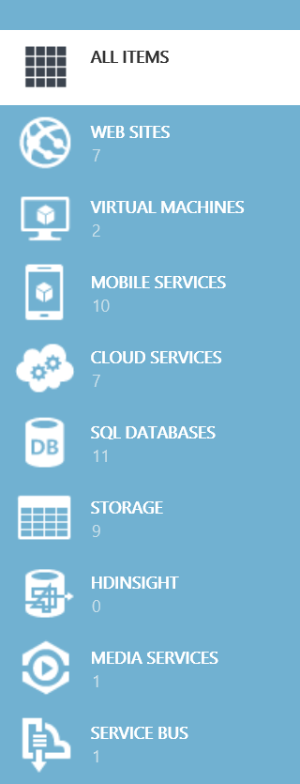
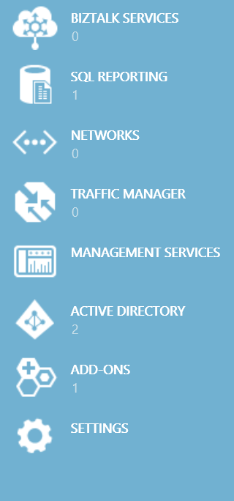
Software as a Services (SaaS)
Applications
ALL ITEMS
WEB SITES
VIRTUAL MACHINES
Data
MOBILE SERVICES
CLOUD SERVICES
Platform as a Services (PaaS)
Runtime
SQL DATABASES
STORAGE
Middleware
HDINSIGHT
MEDIA SERVICES
O/S
SERVICE BUS
BIZTALK SERVICES
Infrastructure as a Services (IaaS)
Virtualization
SQL REPORTING
NETWORKS
Servers
TRAFFIC MANAGER
MANAGEMENT SERVICES
Storage
ACTIVE DIRECTORY
ADD-ONS2
SETTINGS
Networking

Slide 7
Azure from a Web Services Perspective….
Virtual Machines
Cloud Services
Web Sites
Storage Services
SQL Database
Service Bus
Persistent Windows or Linux Virtual Machines
Scalable, Configurable Windows Server Instances
Scalable Web Sites. No OS config needed
File (blob) storage, No-SQL Tables and Queues
Convenient, scalable SQL Databases
Expand your services reach beyond the firewall

Slide 8
Web Services in Azure Web Sites

Slide 9
Windows Azure Web Sites
powerful web sites in seconds
start simple
code smart
go live
start free, scale up and out as you go, friction-free and without the headaches
with classic asp, asp.net, php or node.js, develop on Windows, OSX or Linux
deploy live in seconds, easily monitor performance, rapidly diagnose and fix issues
Notes:
Slide Objectives:
Explain how Windows Azure websites are simple, easy, and open.
Notes:

Slide 10

Supported Publishing Methods
FTP://
TFS
WebDeploy
DropBox
Notes:
Git Deployment is Native, or through a Service hook from CodePlex, GitHub or BitBucket

Slide 11
Deploying a Web Service to a Windows Azure Web Site

Slide 12
Windows Azure Cloud Services

Slide 13
What is a Cloud Service?
A collection of related service roles
Web Role
Worker Role

Slide 14
Compute Web / Worker Role VMs
A “Platform as a Service” (PaaS) solution
Preconfigured Virtual Machines (VMs)
Running Windows Server 2012 R2, 2012, or 2008
You DO NOT need to install the OS
You DO NOT need to maintain the OS
They are STATELESS
When a VM is recycled, no data is preserved
Data in local storage (local to the VM) will be lost
Persist data in Table or Blob Storage or SQL Azure
Role Virtual Machines

Slide 15
Azure Fabric Controller & VM Recovery
Fabric Controller
Server Rack
Server Rack
Server Rack
Server Rack
Physical Servers
Physical Servers
Physical Servers
Physical Servers
VM
VM
VM
VM
VM
VM
VM
VM
VM
VM
VM
VM
VM
VM
VM
VM
VM
VM
VM
VM
VM
VM
VM
VM
VM
VM
VM
VM
VM
VM
VM
VM
VM
VM
VM
VM
VM
VM
VM
VM
VM
VM
VM
VM
VM
Tables / Queues/ Blobs / Azure SQL Database
Data
Data

Slide 16
Cloud Services
Windows Azure Data Center
Cloud Service (cloudservicename.cloudapp.net)
Storage (accountname.*.core.windows.net)
Web Role
Web Role
80
Load Bal.
SQL Database (server.database.windows.net)
Firewall
Worker Role
8081
Worker Role
Lot’s of other cool stuff they can use….
Virtual Machine
1433

Slide 17
Web Roles
Pre-configured Windows Server
IIS Pre-Installed
Firewall open for port 80
Default Endpoint for port 80
You can run pretty much any IIS workload on it
Customizable with startup scripts
Run hybrid workloads with WebRole.cs

Slide 18
WCF Web Services in Web Roles
Pretty Easy!
You write the web service the same
IIS deals with hosting it
Unless you ports other than 80, they are setup
WCF Service / code has access to Azure runtime

Slide 19
Running and Deploying a WCF Service to a Web Role

Slide 20
Worker Roles
Pre-configured Windows Server
Nothing else installed
No default Azure endpoints
Run custom workloads that don’t require IIS
Install additional software, etc. using scripts
Implement Logic in the WorkerRole.cs class

Slide 21
WCF Web Services in Worker Roles
Not “Hard”, but not as easy as Web Roles
You need to write code for the Service Host
You need to create Azure Endpoints
You can create the WCF endpoints in code
Can also create WCF endpoints in config
Again, WorkerRole.cs is where you code

Slide 22
Running and Deploying a WCF Service to a Worker Role

