Slide 1
06 | HTTP Services with Web API
Bruno Terkaly | Technical Evangelist
Bret Stateham | Technical Evangelist

Slide 2
Module Overview
Service Frameworks Review
Creating Web API Services
Consuming Web API Services
Configuring Routes

Slide 3
Service Frameworks Review

Slide 4
Web Services “Through the Years”
WCF “Brand”
WCF “Classic”
WCF Data Services
WCF RIA Services
WCF Web HTTP
ASP.NET “Brand”
ASP.NET Web Services (ASMX)
ASP.NET MVC
ASP.NET Web API
ASP.NET Web API Odata
ASP.NET SignalR
Blatantly stolen from Daniel Roth’s Tech Ed 2013 “Serious Web Services” Session

Slide 5
SOAP vs. REST
SOAP
REST
?
XML Based Messaging
Contains Envelopes, Headers, Body
Can be sent over any transport
WS* added Security, Reliability, Transactions…
WCF is a full SOAP/WS* Framework
REpresenation State Transfer
Matches Architecture of the web
REST Service =<usually>= HTTP Service
Leverage HTTP methods (GET,POST,DELETE…)
Web API is a way to create an HTTP Service

Slide 6
SOAP Client Support
SOAP SVC
Proxy Generator
No Simple Proxy Generator

Slide 7
REST Client Support
REST SVC
HTTP Client

Slide 8
Creating Web API Services

Slide 9
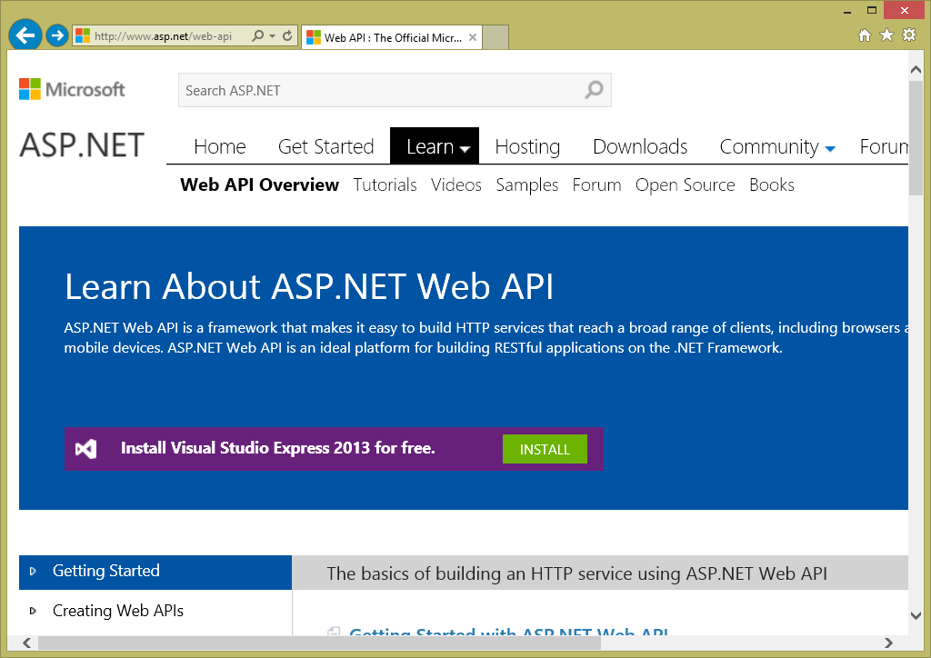
ASP.NET Web API
Open source: aspnetwebstack.codeplex.com
Nightly builds
Web API 2 shipped with VS2013
Learn more at asp.net/web-api

Slide 10
Creating a Web API
Derive from ApiController
Implement Actions
Actions map to HTTP methods (GET, POST, PUT, DELETE)
Either prefix your action method name with HTTP verb: GetCustomer
Use Attributes if you want to name your action methods differently
[HttpGet]
[HttpPost]
[HttpPut]
[HttpDelete]

Slide 11
Creating Web API Services

Slide 12
Consuming Web API Services

Slide 13
Consuming HTTP Clients
Build your client side models (optional)
Use the HttpClient to call REST Service URLs
Set headers
Query String
Body (for POST and PUT)
Use a JSON Serializer / Deserializer (Like Json.NET)
Map objects to JSON (Serializer)
Map JSON to Objects (Deserializer)

Slide 14
Consuming Web API Services

Slide 15
Configuring Web API Services

Slide 16
Configuring Routes
Routes map URI templates to ApiControllers
Default Route: api/{controller}/id
{controller} + “Controller” = ApiContoller type name
HTTP Verb (Get, Post, Put, Delete) is used to determine action
{id} is passed as an argument to the action method
For example:
An HTTP GET to http://mysite.com/api/customer/1
{controller} = “customer” => CustomerController class
HTTP GET implies method that starts with the word “Get”
{id} value looks for a Get(object id) method and passes {id} as arg

Slide 17
Configuring Routes

