Slide 1
01 | Hosting Services in Windows Azure
Bret Stateham | Technical Evangelist
Bruno Terkaly | Technical Evangelist

Slide 2
Module Overview
WCF Introduction
Creating a WCF Web Service
Configuring WCF Services
Consuming WCF Services

Slide 3
Course Introduction

Slide 4
Windows Communication Foundation (WCF)
The Windows Communication Foundation (or WCF) is a runtime and a set of APIs in the .NET Framework for building connected, service-oriented applications.

Slide 5
Windows Communication Foundation (WCF)
Common Tasks For A Web Service
Perform read write operations on back end databases.
Perform operations by calling other web services.
Abstract blocking I/O operations affects performance and scalability.

Slide 6


Windows Communication Foundation (WCF)
Other Web Service
Incident Client UX
Customer Web Service Demo Scenarios
Customer Web Service
Customer Databases

Slide 7
Windows Communication Foundation (WCF)
Messages are typically sent in text encoded SOAP messages using is the HyperText Transfer Protocol (HTTP)
SOAP, originally defined as Simple Object Access Protocol, is a protocol specification for exchanging structured information in the implementation of Web Services in computer networks.
It relies on XML Information Set for its message format.

Slide 8

Windows Communication Foundation (WCF)
SOAP calls
REST calls
REST is an abbreviation for:
Representational State Transfer

Slide 9
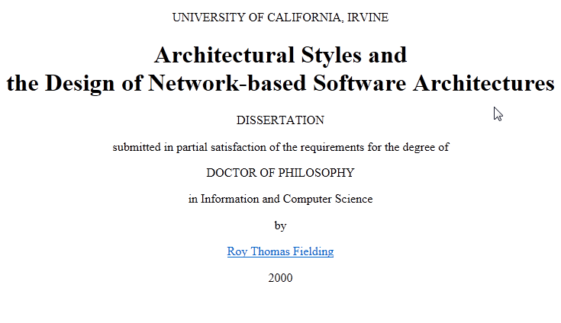
Windows Communication Foundation (WCF)
But REST has coming along….

Slide 10
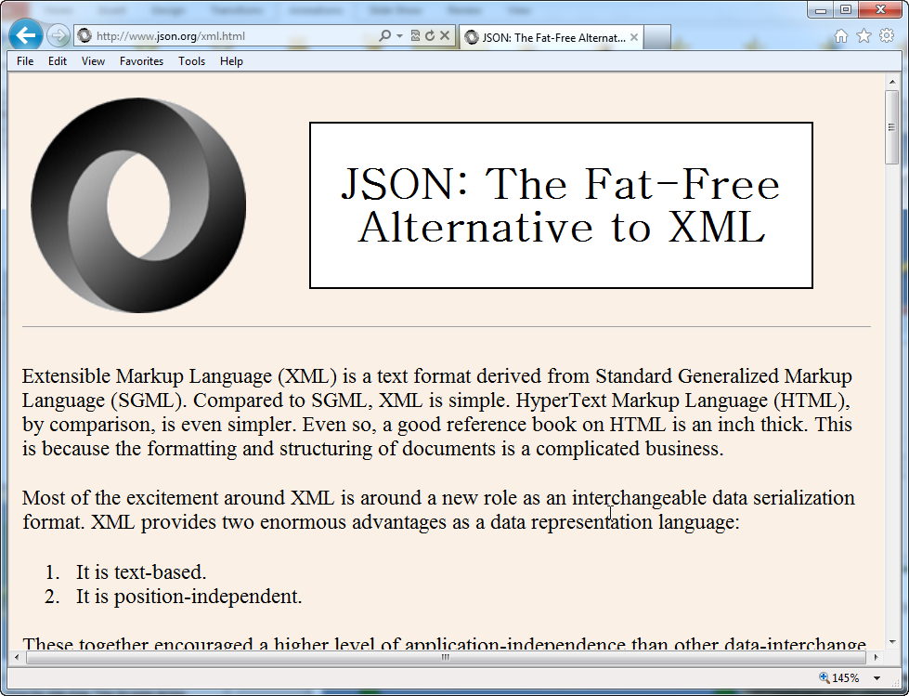
Windows Communication Foundation (WCF)
Advantages of REST
Automatic support - native http
Lightweight, Efficient
Secure - Supports https
Modern - Twitter, Yahoo, etc
No toolkits needed, XML format

Slide 11
Windows Communication Foundation (WCF)
Advantages of WCF + SOAP: Provides a lot of support for many bindings
BasicHttpBinding | Interoperability with Web services and clients supporting the WS-BasicProfile 1.1 and Basic Security Profile 1.0.
WSHttpBinding | Interoperability with Web services and clients that support the WS-* protocols over HTTP.
WSDualHttpBinding | Duplex HTTP communication, by which the receiver of an initial message does not reply directly to the initial sender, but may transmit any number of responses over a period of time by using HTTP in conformity with WS-* protocols.
WSFederationBinding | HTTP communication, in which access to the resources of a service can be controlled based on credentials issued by an explicitly-identified credential provider.
NetTcpBinding | Secure, reliable, high-performance communication between WCF software entities across a network.
NetNamedPipeBinding | Secure, reliable, high-performance communication between WCF software entities on the same

Slide 12
Creating a New WCF Service Library

