Slide 1
Web Services and Windows Azure
Bruno Terkaly | Technical Evangelist
Bret Stateham | Technical Evangelist

Slide 2
Meet Bruno Terkaly | ‏@BrunoTerkaly
Taller than Bret
Has hair
Doesn’t live in Redmond
Wears shoes (sometimes)
Find him on the web at blogs.msdn.com/brunoterkaly

Slide 3
Meet BretStateham | @BretStateham‏
Find me on the Web at BretStateham.com
Working with the web since before IIS
Working with .NET since before .NET
In love with SQL Server (don’t tell my wife)

Slide 4


Course Topics
Developing SharePoint Server Core Solutions Jump Start
01 | Introduction to the SharePoint Developer Landscape | 05 | Cloud Hosted Apps
02 | Lists and Sites | 06 | Deploying Apps
03 | Client Side SharePoint Development | 07 | Workflows
04 | Apps and SharePoint

Slide 5
Setting Expectations
Target Audience
Developing solutions for SharePoint products and technologies in a team-based, medium-sized to large development environment
Considering taking the 70-488 Exam
Additional Material
Microsoft Official Course 20488
Developing Microsoft SharePoint® Core Solutions

Slide 6
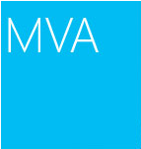
Join the MVA Community!
Microsoft Virtual Academy
Free online learning tailored for IT Pros and Developers
Over 1M registered users
Up-to-date, relevant training on variety of Microsoft products
“Earn while you learn!”
Get 50 MVA Points for this event!
Visit http://aka.ms/MVA-Voucher
Enter this code: DevSPS (expires 11/25/2013)

Slide 7
01 | WCF Services
Bret Stateham | Technical Evangelist
Bruno Terkaly | Technical Evangelist

Slide 8
Module Overview
WCF Overview
SOAP vs. REST

Slide 9
Course Introduction

Slide 10
WCF Overview

Slide 11
Windows Communication Foundation (WCF)
The Windows Communication Foundation (or WCF) is a runtime and a set of APIs in the .NET Framework for building connected, service-oriented applications.

Slide 12
Windows Communication Foundation (WCF)
Common Tasks For A Web Service
Perform read write operations on back end databases.
Perform operations by calling other web services.
Abstract blocking I/O operations affects performance and scalability.

Slide 13


Windows Communication Foundation (WCF)
Other Web Service
Incident Client UX
Customer Web Service Demo Scenarios
Customer Web Service
Customer Databases

Slide 14
Windows Communication Foundation (WCF)
Messages are typically sent in text encoded SOAP messages using is the HyperText Transfer Protocol (HTTP)
SOAP, originally defined as Simple Object Access Protocol, is a protocol specification for exchanging structured information in the implementation of Web Services in computer networks.
It relies on XML Information Set for its message format.

Slide 15
SOAP vs. REST

Slide 16

Windows Communication Foundation (WCF)
SOAP calls
REST calls
REST is an abbreviation for:
Representational State Transfer

Slide 17
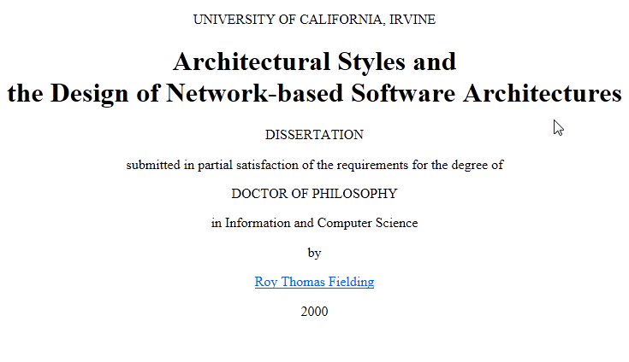
Windows Communication Foundation (WCF)
But REST is coming along….

Slide 18
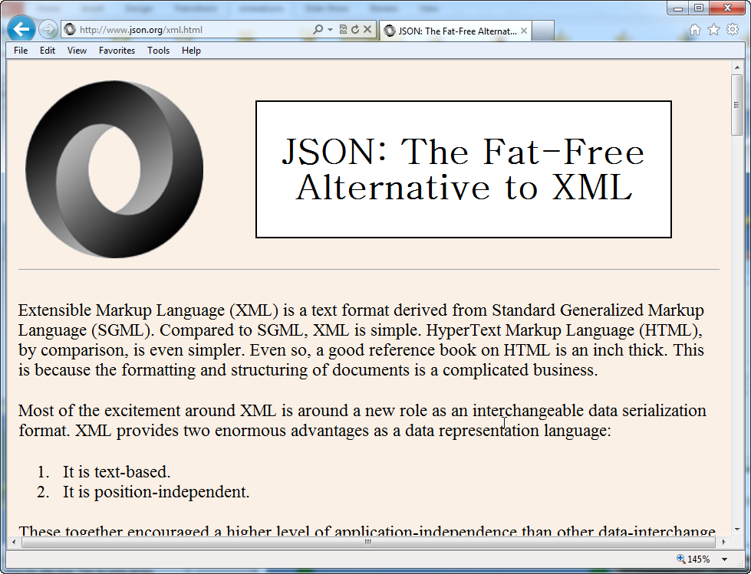
Windows Communication Foundation (WCF)
Advantages of REST
Automatic support - native http
Lightweight, Efficient
Secure - Supports https
Modern - Twitter, Yahoo, etc
No toolkits needed, XML format

Slide 19
Windows Communication Foundation (WCF)
Advantages of WCF + SOAP: Provides a lot of support for many bindings
BasicHttpBinding | Interoperability with Web services and clients supporting the WS-BasicProfile 1.1 and Basic Security Profile 1.0.
WSHttpBinding | Interoperability with Web services and clients that support the WS-* protocols over HTTP.
WSDualHttpBinding | Duplex HTTP communication, by which the receiver of an initial message does not reply directly to the initial sender, but may transmit any number of responses over a period of time by using HTTP in conformity with WS-* protocols.
WSFederationBinding | HTTP communication, in which access to the resources of a service can be controlled based on credentials issued by an explicitly-identified credential provider.
NetTcpBinding | Secure, reliable, high-performance communication between WCF software entities across a network.
NetNamedPipeBinding | Secure, reliable, high-performance communication between WCF software entities on the same

Slide 20
Creating a New WCF Service Library

