Slide 1


Join the MVA Community!
Microsoft Virtual Academy—Free online training!
Tailored for IT Pros and Developers
Over 1M registered users
Earn while you learn!
50 MVA Points for this event!
Visit http://aka.ms/MVA-Voucher
Code: Bing (expires 7/5/2013)
Leave area blank for clock. Remove this section before saving final break slide

Slide 2
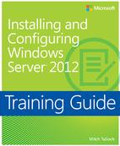
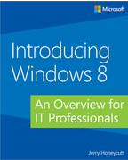
Great MSPress Books
Introducing Windows® 8: An Overview for IT Professionals
http://aka.ms/Win8Intro_ITPro
Training Guide: Installing and Configuring Windows Server® 2012
http://aka.ms/InstConf-WinSv2012
Leave area blank for clock. Remove this section before saving final break slide

Slide 3
Suggested Resources
Course 55021A: Configuring and Administering Hyper-V in Windows Server 2012
http://aka.ms/HyperV-WinSvr
Course 20410B: Installing and Configuring Windows Server 2012
http://aka.ms/ConfigWinSvr2012
Leave area blank for clock. Remove this section before saving final break slide

Slide 4
Know your stuff? Get Certified!
Microsoft Certified Solutions Expert (MCSE)
http://aka.ms/MCSE-Svr-Infr
Microsoft Certified Solutions Associate (MCSA)
http://aka.ms/MCSA-WinSvr2012
Microsoft Learning Partners—Learn from the Pros!
http://aka.ms/CPLS
Find a Class: http://aka.ms/ClassLocator
Leave area blank for clock. Remove this section before saving final break slide

