Slide 1
Windows Azure Web Sites

Slide 2
Introduction to Windows Azure

Slide 3



Windows Azure
Flexible
Open
Solid

Slide 4
Global Footprint

Slide 5
Run Your Code In Azure
Virtual Machines
Cloud Services
Web Sites
Mobile Services

Slide 6
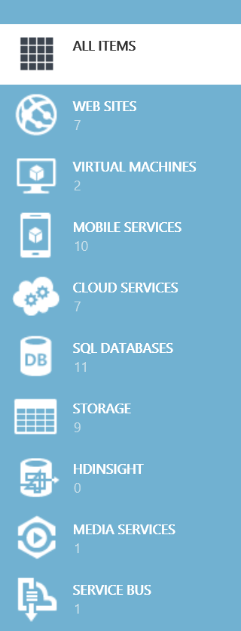
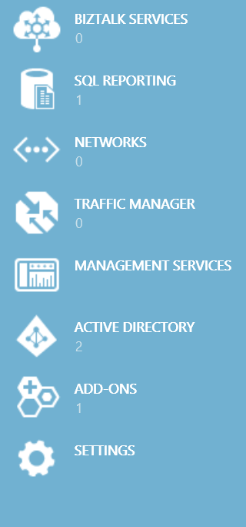
ALL ITEMS
Additional Services
WEB SITES
VIRTUAL MACHINES
MOBILE SERVICES
SQL Database, Reporting, Data Sync, HDInsight
Table, Blob & Queue Storage
Service Bus & BizTalk Services
Networks & Traffic Manager
Media Services
Active Directory
Management Services
Add-ons (MongoDB, SendGrid, MySql, …)
CLOUD SERVICES
SQL DATABASES
STORAGE
HDINSIGHT
MEDIA SERVICES
SERVICE BUS
BIZTALK SERVICES
SQL REPORTING
NETWORKS
TRAFFIC MANAGER
MANAGEMENT SERVICES
ACTIVE DIRECTORY
ADD-ONS
SETTINGS

Slide 7
How to get Azure
Free Trial: 30 days / $200 - http://aka.ms/az30
MSDN – http://msdn.com
BizSpark – http://bizspark.com
Pay-as-you go subscriptions – http://aka.msazpay
Six and Twelve month plan subscriptions

Slide 8
Windows Azure Web Sites

Slide 9



Windows Azure
Your Datacenter
Virtual Machines
Cloud Services
Web Sites
Applications
Applications
Applications
Applications
Data
Data
Data
Data
Firewall
Firewall Rules
Firewall Rules
Network
Virtual Network
Virtual Network
O/S
O/S
Virtualization
Hardware
Focus on the Application
Notes:
Slide Objectives:
Explain the differences between traditional self-hosting and the three options of Windows Azure hosting.
Notes:
In a traditional environment you must manage the full stack. With Windows Azure you can choose a variety of options depending on your needs.

Slide 10

Windows Azure Web Sites
powerful web sites in seconds
start simple
code smart
go live
start free, scale up and out as you go, friction-free and without the headaches
with classic asp, asp.net, php or node.js, develop on Windows, OSX or Linux
deploy live in seconds, easily monitor performance, rapidly diagnose and fix issues
Notes:
Slide Objectives:
Explain how Windows Azure websites are simple, easy, and open.
Notes:

Slide 11
Hello World

Slide 12
Entity Framework

Slide 13

Supported Publishing Methods
FTP://
TFS
WebDeploy
DropBox
Notes:
Git Deployment is Native, or through a Service hook from CodePlex, GitHub or BitBucket

Slide 14
Deployment

Slide 15




Supported Web Frameworks
Or any custom FastCGI Handler
Notes:
Slide Objectives:
Explain that Windows Azure Web Sites supports Classic ASP, ASP.NET, PHP, and Node.js out of the box and that you can also host any custom FastCGI handler.
Notes:

Slide 16
WordPress & WebMatrix
Notes:
Demo
Length: 10 minutes
Create Wordpress Blog in Web Gallery
Download Publish File
Open in WebMatrix
Edit Theme
Save/Deploy
Show site with changes
Run locally
Add theme -> Can we find an enterprise theme, team status or something similar
Deploy to cloud
Show running in cloud

Slide 17

scale
Free
Multi-tenant. Daily quotas
Shared
Multi-tenant. Daily quotas
Standard
Dedicated VMs. No quotas
Notes:
Slide Objectives:
Explain the three scale choices on Windows Azure Web Sites.
Notes:
Both free and shared are the same architecture. With standard you isolate your application to your own virtual machines that you can use and pay for whatever resources you choose.
Online Resources:
If you’d like more details on Web Site pricing and quota, see the Windows Azure pricing page here: http://www.windowsazure.com/en-us/pricing/details/web-sites/

Slide 18


web sites
shared
standard
1
shared
Shared instances
:-)
Notes:
Slide Objectives:
Explain how you can start with a small site hosted for free.
Notes:

Slide 19
web sites
shared
standard
2
shared
Shared instances
:-)
:-)
Notes:
Slide Objectives:
Explain how you can scale your site to multiple shared instances.
Notes:

Slide 20

web sites
shared
standard
1
0
standard
Shared instances
Standard instance
:-)
:-)
:-)
Notes:
Slide Objectives:
Explain how you can move to standard instances for additional scale.
Notes:

Slide 21
web sites
shared
standard
2
standard
Standard instance
Standard instance
:-)
:-)
Notes:
Slide Objectives:
Explain how you can scale up standard instances to multiple instances as needed.
Notes:

Slide 22


web sites
shared
standard
2
standard
Standard instance
Standard instance
:-)
:-)
:-)
:-)
:-)
:-)
:-)
:-)
Notes:
Slide Objectives:
Explain how you can host multiple sites that you own on a your standard instances.
Notes:

Slide 23
Scaling
Notes:
Demo

Slide 24
auto-scaling
standard
cpu utilization
Standard instance
Standard instance
Standard instance
:-)
:-)
:-)
Notes:
Slide Objectives:
Explain how you can host multiple sites that you own on a your standard instances.
Notes:

Slide 25
Auto-scaling
Notes:
Demo

Slide 26
Diagnostics & Monitoring
HTTP Logs
Error Logs
Portal Monitoring
Log Streaming
New Relic
Notes:
Git Deployment is Native, or through a Service hook from CodePlex, GitHub or BitBucket

Slide 27
Diagnostics & Log Streaming

Slide 28
















Windows Azure Web App Gallery
Ready-to-Go Open Source
Web Applications,
Frameworks,
and Templates
Notes:
Slide Objectives:
Highlight the ability to get started quickly with the Windows Azure Web App Gallery
Speaking Points:
Along-side the publishing capabilities, Windows Azure Web Sites also offers the Web App Gallery which provides many turn key solutions based off of well known open source web applications.
Notes:

Slide 29












Windows Azure Store
Discover, Purchase & Provision Premium
Services
Notes:
Slide Objectives:
Highlight the benefits of the Windows Azure Store
Speaking Points:
Much like the Windows Azure Web App Gallery brings a turn key solution to Web Applications, the Windows Azure Store quickly exposes Application and Data Services for use in your applications.
Notes:

Slide 30
Monitoring with New Relic

Slide 31



Windows Azure Web Sites
start simple
code smart
go live

Slide 32
Start Simple
Get started with 10 free web sites
Create new sites in seconds
Easily manage and scale your sites
Automatic load balancing and shared storage across instances
Scale out or up to reserved instances for improved performance and scale

Slide 33
Code Smart
Use ASP.NET, ASP, PHP, or Node.js
SQL Azure or MySQL databases
Start with open source apps and frameworks
Develop with VS and WebMatrix
Supports any Web development tool on any platform (Windows, OSX, Linux)

Slide 34
Go Live
Rapid deployment for quick iteration
Integrated source control with Team Foundation Server (TFS) and Git
Built-in monitoring of perf and usage data
Quick access to request logs, failed requests diagnostics and diagnostics

Slide 35
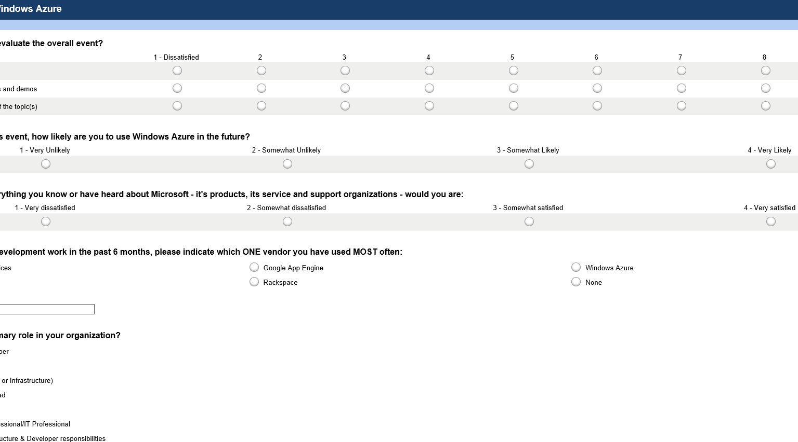

Take the DevUnleashed Windows Azure Survey
Your feedback, helps us make these events available to your community, please fill it out sometime today.
www.surveymonkey.com/s/azureunleashed

Slide 36
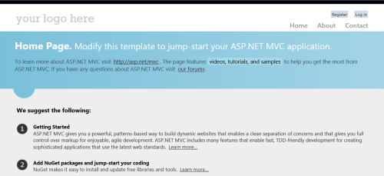
HANDS ON LAB
Building and Publishing ASP.NET Applications with Windows Azure Web Sites and Visual Studio 2012
Getting Started: Creating an MVC 4 Application using Entity Framework Code First
Exercise 1: Publishing an MVC 4 Application using Web Deploy
Exercise 2: Publishing an MVC 4 Application using Git

Slide 37
Thank You!

Slide 38
Application Scenarios
Web Sites
Cloud Services
Virtual Machines
Modern web apps
Perfect if your app consists of client side markup and scripting, server side scripting and a database. Powerful capability to scale out and up as needed.
Multi-tier applications
Cloud-based applications that separate application logic into multiple tiers (i.e. caching middle tier, asynchronous background processes like order processing) using both Web and Worker Roles
Enterprise server applications
Run your existing enterprise applications in the cloud, such as SQL Server, SharePoint Server or Active Directory.
Continuous development
Deploy directly from your source code repository, using Git or Team Foundation Service.
Apps that require advanced administration
Cloud-based applications that require admin access, remote desktop access or elevated permissions
Porting existing line of business apps
Choose an image from the library or upload your own VHD.
Popular open source apps
Launch a professional looking site with a few clicks using apps like WordPress, Joomla!, Drupal, DotNetNuke and Umbraco
Apps that require advanced networking
Cloud-based applications that require network isolation for use with Windows Azure Connect or Windows Azure Virtual Network
Windows or Linux operating system
Support for Windows Server, along with community and commercial versions of Linux. Connect virtual machines with cloud services to take full advantage of PaaS services.

