Slide 1
Windows Azure Web Sites

Slide 2
Introduction to Windows Azure
Notes:
Before we dive into Windows Azure Web Sites, I want to give you a brief, high level introduction to Windows Azure.

Slide 3



Windows Azure
Flexible
Open
Solid
Notes:
What is Windows Azure?
Windows Azure is Microsoft’s cloud computing platform. It is a comprehensive set of services that enable you to quickly build, deploy and manage applications across a global network of Microsoft managed datacenters.
There are three core tenants that drive Windows Azure:
Flexible
The first is to make it Windows Azure really flexible and able to handle pretty much any workload on top of it.
When we introduced Windows Azure a few years ago, we pioneered the concept of Platform as a Service, by providing a set of scalable, managed services that you can take advantage of as a developer [to compose applications]
We continue to push that forward with a bunch of great features that you will see in a few minutes
This past year we have also enabled a concept called infrastructure as a service, which is the ability to host and scale durable virtual machines in the cloud as well.
With Windows Azure’s support for infrastructure as a service, you can install Windows or Linux and more easily migrate existing applications and workloads.
This combination of the ability to run both platform as a service and infrastructure as a service together ends up being a really powerful combination and makes Windows Azure super flexible.
Open
We also focused a lot this year on making Windows Azure even more open.
With Windows Azure you can use your choice of operating systems, your choice of frameworks, and your choice of tools.
This really opens up the most possibilities in terms of building on the platform
Another aspect of this openness is to use open protocols whenever possible.
For example, we use the memcachD protocol for our Caching service, we now support the AMQP protocol for our Service Bus messaging service, and all of the managed services are exposed through simple REST-based APIs that can be called from any framework or language.
This enables you to interoperate very easily with our services and integrate with what you already have
We’ve also taken all of our SDKs for Windows Azure and released them under an Apache 2 open source license and hosted them on GitHub.
Solid
Lastly, we’ve focused a lot during the last year on making Windows Azure a really solid platform. One that you can bet your business on and that you know will be reliable.
Built in across the platform is support for redundancy and across our managed services we provide guaranteed SLAs that you can bet on and know that your applications will scale and scale reliably.

Slide 4
Global Footprint
Notes:
Speaking Points:
Windows Azure itself is deployed around the world
With Windows Azure, we have a concept of regions, which is where you choose to place your code and run.
In each of the regions, we have a Microsoft datacenter.
These datacenters are massive facilities that host 10s or in some cases hundreds of thousands of servers
We have currently four regions in North America, two regions in Europe, and two in Aisa
As you can see on this slide we also have a number of CDN edge points, which we can use to cache your content and deliver it even faster for customers. %
What you’re going to see in the next couple months and years is that we will rapidly expand our datacenter footprint around the world, so you will have more options for running your applications.
Once you build an application, you can choose where you want to run in the world and you can move your workloads from region to region.
You can also run your application in multiple regions simultaneously and just direct traffic and customers to whichever version of the app is closest to them.
That gives you a global footprint and a chance to reach a bigger customer base or audience in new markets

Slide 5
Run Your Code In Azure
Virtual Machines
Cloud Services
Web Sites
Mobile Services

Slide 6
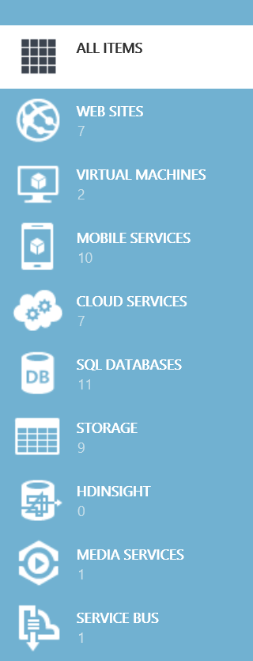
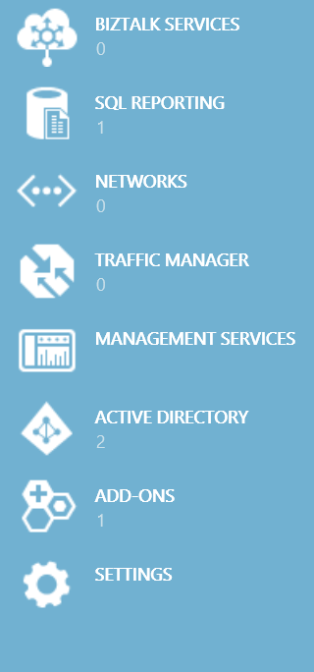
ALL ITEMS
Additional Services
WEB SITES
VIRTUAL MACHINES
MOBILE SERVICES
SQL Database, Reporting, Data Sync, HDInsight
Table, Blob & Queue Storage
Service Bus & BizTalk Services
Networks & Traffic Manager
Media Services
Active Directory
Management Services
Add-ons (MongoDB, SendGrid, MySql, …)
CLOUD SERVICES
SQL DATABASES
STORAGE
HDINSIGHT
MEDIA SERVICES
SERVICE BUS
BIZTALK SERVICES
SQL REPORTING
NETWORKS
TRAFFIC MANAGER
MANAGEMENT SERVICES
ACTIVE DIRECTORY
ADD-ONS
SETTINGS
Notes:
There are a number of services that you can leverage in Windows Azure
For structured data storage you can use SQL database. We also offer SQL reporting services in Windows Azure. If you need to sync SQL server data between Windows Azure and an on-premise database you can use data sync. If you work with big data, you can leverage HDInsight in Windows Azure for your processing needs.
Windows Azure also offers additional ways to store data. Windows Azure tables provides a NoSQL/non-relational way to store data. Blobs allow you to store files, and queues make it easy to implement a messaging infrastructure for your apps.
If your applications have sophisticated messaging requirements we also offer Windows Azure Service Bus and BizTalk Services to address your needs.
Processing audio and video content can be resource intensive. Windows Azure Media Services enables you to offload this workload to the cloud and create custom media workflows for your specific scenarios.
Windows Azure Active Directory allows your cloud applications to leverage the identity management features of Active Directory.
Windows Azure exposes management services through a REST API. You can either call these REST services directly, or you can use the Windows Azure Cross Platform command line tool to manage your Windows Azure Services.
Last, a number of third parties have created add-ons that allow you to use their products in Windows Azure. For example, SendGrid allows you to easily send email from your Windows Azure services.

Slide 7
How to get Azure
Free Trial: 30 days / $200 - http://aka.ms/az30
MSDN – http://msdn.com
BizSpark – http://bizspark.com
Pay-as-you go subscriptions – http://aka.msazpay
Six and Twelve month plan subscriptions

Slide 8
Windows Azure Web Sites

Slide 9



Windows Azure
Your Datacenter
Virtual Machines
Cloud Services
Web Sites
Applications
Applications
Applications
Applications
Data
Data
Data
Data
Firewall
Firewall Rules
Firewall Rules
Network
Virtual Network
Virtual Network
O/S
O/S
Virtualization
Hardware
Focus on the Application
Notes:
Slide Objectives:
Explain the differences between traditional self-hosting and the three options of Windows Azure hosting.
Notes:
In a traditional environment you must manage the full stack. With Windows Azure you can choose a variety of options depending on your needs.

Slide 10

Windows Azure Web Sites
powerful web sites in seconds
start simple
code smart
go live
start free, scale up and out as you go, friction-free and without the headaches
with classic asp, asp.net, php or node.js, develop on Windows, OSX or Linux
deploy live in seconds, easily monitor performance, rapidly diagnose and fix issues
Notes:
Slide Objectives:
Explain how Windows Azure websites are simple, easy, and open.
Notes:

Slide 11
Hello World

Slide 12
Entity Framework

Slide 13

Supported Publishing Methods
FTP://
TFS
WebDeploy
DropBox
Notes:
Git Deployment is Native, or through a Service hook from CodePlex, GitHub or BitBucket

Slide 14
Deployment

Slide 15




Supported Web Frameworks
Or any custom FastCGI Handler
Notes:
Slide Objectives:
Explain that Windows Azure Web Sites supports Classic ASP, ASP.NET, PHP, and Node.js out of the box and that you can also host any custom FastCGI handler.
Notes:

Slide 16
WordPress & WebMatrix
Notes:
Demo
Length: 10 minutes
Create Wordpress Blog in Web Gallery
Download Publish File
Open in WebMatrix
Edit Theme
Save/Deploy
Show site with changes
Run locally
Add theme -> Can we find an enterprise theme, team status or something similar
Deploy to cloud
Show running in cloud

Slide 17

scale
Free
Multi-tenant. Daily quotas
Shared
Multi-tenant. Daily quotas
Standard
Dedicated VMs. No quotas
Notes:
Slide Objectives:
Explain the three scale choices on Windows Azure Web Sites.
Notes:
Both free and shared are the same architecture. With standard you isolate your application to your own virtual machines that you can use and pay for whatever resources you choose.
Windows Azure offers three modes for you to run your web sites: Free, Shared (PREVIEW), and Standard. In the Free and Shared modes, all web sites run in a multi-tenant environment and have quotas for usage of CPU, memory, and network resources. The maximum number of sites you can run in Free mode may vary with your plan. Shared mode is a preview feature that employs less stringent resource usage quotas than Free mode, but provides a reduced SLA when compared to the Standard mode. When you choose Standard mode, you choose which sites run on dedicated virtual machines that correspond to standard Windows Azure compute resources.
Online Resources:
If you’d like more details on Web Site pricing and quota, see the Windows Azure pricing page here: http://www.windowsazure.com/en-us/pricing/details/web-sites/

Slide 18


web sites
shared
standard
1
shared
Shared instances
:-)
Notes:
Slide Objectives:
Explain how you can start with a small site hosted for free.
Notes:

Slide 19
web sites
shared
standard
2
shared
Shared instances
:-)
:-)
Notes:
Slide Objectives:
Explain how you can scale your site to multiple shared instances.
Notes:

Slide 20

web sites
shared
standard
1
0
standard
Shared instances
Standard instance
:-)
:-)
:-)
Notes:
Slide Objectives:
Explain how you can move to standard instances for additional scale.
Notes:

Slide 21
web sites
shared
standard
2
standard
Standard instance
Standard instance
:-)
:-)
Notes:
Slide Objectives:
Explain how you can scale up standard instances to multiple instances as needed.
Notes:

Slide 22


web sites
shared
standard
2
standard
Standard instance
Standard instance
:-)
:-)
:-)
:-)
:-)
:-)
:-)
:-)
Notes:
Slide Objectives:
Explain how you can host multiple sites that you own on a your standard instances.
Notes:

Slide 23
Scaling
Notes:
Demo

Slide 24
auto-scaling
standard
cpu utilization
Standard instance
Standard instance
Standard instance
:-)
:-)
:-)
Notes:
Slide Objectives:
Explain how you can host multiple sites that you own on a your standard instances.
Notes:

Slide 25
Auto-scaling
Notes:
Demo

Slide 26
Diagnostics & Monitoring
HTTP Logs
Error Logs
Portal Monitoring
Log Streaming
New Relic

Slide 27
Diagnostics & Log Streaming

Slide 28
















Windows Azure Web App Gallery
Ready-to-Go Open Source
Web Applications,
Frameworks,
and Templates
Notes:
Slide Objectives:
Highlight the ability to get started quickly with the Windows Azure Web App Gallery
Speaking Points:
Along-side the publishing capabilities, Windows Azure Web Sites also offers the Web App Gallery which provides many turn key solutions based off of well known open source web applications.
Notes:

Slide 29












Windows Azure Store
Discover, Purchase & Provision Premium
Services
Notes:
Slide Objectives:
Highlight the benefits of the Windows Azure Store
Speaking Points:
Much like the Windows Azure Web App Gallery brings a turn key solution to Web Applications, the Windows Azure Store quickly exposes Application and Data Services for use in your applications.
Notes:

Slide 30
Monitoring with New Relic

Slide 31



Windows Azure Web Sites
start simple
code smart
go live

Slide 32
Start Simple
Get started with 10 free web sites
Create new sites in seconds
Easily manage and scale your sites
Automatic load balancing and shared storage across instances
Scale out or up to reserved instances for improved performance and scale

Slide 33
Code Smart
Use ASP.NET, ASP, PHP, or Node.js
SQL Azure or MySQL databases
Start with open source apps and frameworks
Develop with VS and WebMatrix
Supports any Web development tool on any platform (Windows, OSX, Linux)

Slide 34
Go Live
Rapid deployment for quick iteration
Integrated source control with Team Foundation Server (TFS) and Git
Built-in monitoring of perf and usage data
Quick access to request logs, failed requests diagnostics and diagnostics

Slide 35
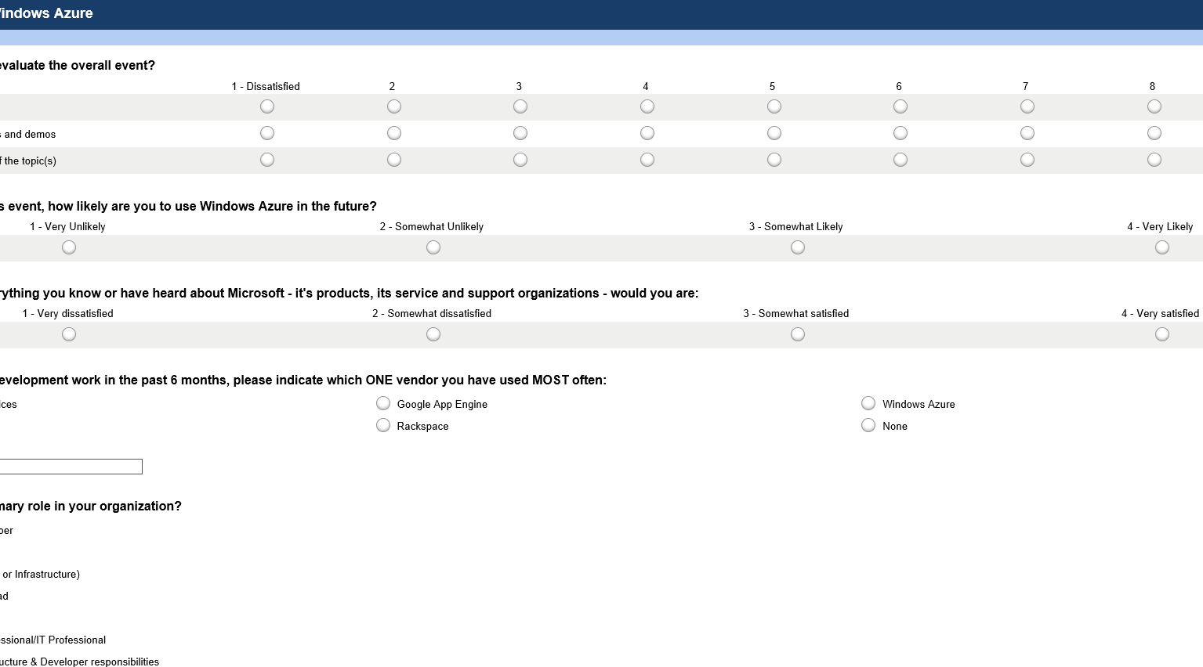

Take the DevUnleashed Windows Azure Survey
Your feedback, helps us make these events available to your community, please fill it out sometime today.
www.surveymonkey.com/s/azureunleashed

Slide 36
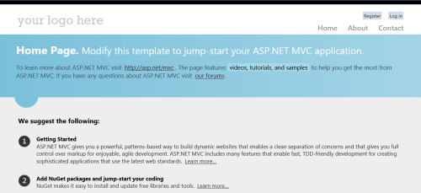
HANDS ON LAB
Building and Publishing ASP.NET Applications with Windows Azure Web Sites and Visual Studio 2012
Getting Started: Creating an MVC 4 Application using Entity Framework Code First
Exercise 1: Publishing an MVC 4 Application using Web Deploy
Exercise 2: Publishing an MVC 4 Application using Git

Slide 37
Thank You!

Slide 38
Application Scenarios
Web Sites
Cloud Services
Virtual Machines
Modern web apps
Perfect if your app consists of client side markup and scripting, server side scripting and a database. Powerful capability to scale out and up as needed.
Multi-tier applications
Cloud-based applications that separate application logic into multiple tiers (i.e. caching middle tier, asynchronous background processes like order processing) using both Web and Worker Roles
Enterprise server applications
Run your existing enterprise applications in the cloud, such as SQL Server, SharePoint Server or Active Directory.
Continuous development
Deploy directly from your source code repository, using Git or Team Foundation Service.
Apps that require advanced administration
Cloud-based applications that require admin access, remote desktop access or elevated permissions
Porting existing line of business apps
Choose an image from the library or upload your own VHD.
Popular open source apps
Launch a professional looking site with a few clicks using apps like WordPress, Joomla!, Drupal, DotNetNuke and Umbraco
Apps that require advanced networking
Cloud-based applications that require network isolation for use with Windows Azure Connect or Windows Azure Virtual Network
Windows or Linux operating system
Support for Windows Server, along with community and commercial versions of Linux. Connect virtual machines with cloud services to take full advantage of PaaS services.

