Slide 1
Building Windows Store Apps with Windows Azure Mobile Services
Notes:
Notes:
You can see a recorded version of this deck here http://go.microsoft.com/fwlink/?LinkID=267130&clcid=0x409

Slide 2
Demo Scripts
Demo scripts are contained within /DEMO-WindowsAzureMobileServices
At the time of writing they are also available at https://github.com/WindowsAzure-TrainingKit/Demo-Windows8AndMobileServices

Slide 3
Agenda
Windows Azure Mobile Services
Data
Push Notifications
Auth
Scheduler
Diagnostics & Scale

Slide 4

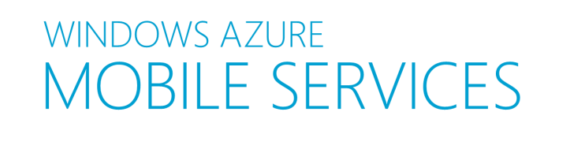

What is Windows Azure Mobile Services?
Auth
Server Logic
Notifications
Logging & Diag
Data
Scheduler
Scale
Notes:
Slide Objectives:
Provide broad overview of WA Mobile Services features
Speaking Points:
WAMS
Build a cloud backend in minutes with no hassles, no deployments, no fear
Supports Windows 8 client SDK, Windows Phone 8 SDK, iOS SDK
Android coming soon
Data
Structured Storage with SQL Database
Automatic service api generated for storage
Rich querying capability
Server Logic
Automatic CRUD service api generated
Ability to author server logic that intercepts CRUD operation pipeline
Auth
Authenticate against Windows Live
Table level authorization with no code
More granular control with server side scripts
Notifications
Integrates with WNS to provide Toast, Tile, Badge and Raw notifications
Clean object model to compose notifications
Scheduler
Scheduler allows you to run Scripts to perform tasks at a scheduled basis minutes, hrly, daily, monthly or on demand.
Example – aggregate News RSS feeds and send a tile update every 15 minutes
Logging and Diagnostics for monitoring
Scale out and Scale up

Slide 5
Key Scenarios
Windows Azure Mobile Services are ideal for:
Modern mobile apps
Windows Store Apps, Windows Phone, iOS, Android
Common Scenarios
Reduces the friction associated with repeating common tasks such as user authentication, push notifications and structured storage
Rapid Development
Time is money. Get your app up and running sooner when you use Mobile Services to configure a straightforward and secure backend in less than five minutes.
Notes:
Slide Objectives:
Outline the Key Scenarios Mobile Services can be used for

Slide 6
Getting Started a backend for your mobile app in minutes
Notes:
Slide Objectives:
Jump to VS and Demo the New Mobile Service Create a new Windows 8 application experience in the portal

Slide 7
Structured Storage
Structured Storage with SQL Database
If using single database apps are partitioned by schema
AppX.Todoitem
AppY.Todoitem
Manage data in
Portal, SQL Portal
SQL Management Studio
REST API
CLI Tools
Notes:
Slide Objectives:
Detail the structured storage feature
Speaking Points:
Structured storage provided by WAMS is backed by a Windows Azure SQL Database
DB can be Multi-tenant i.e 10 Mobile services can all use the one SQL Database. In this scenario each DB is partitioned by Schema
Multiple ways admins can access the raw data being stored.

Slide 8
Server Scripts
Automatic service REST API generated for storage
Dynamic Schema on/off
Ability to author server logic that intercepts CRUD operation pipeline
Rich querying capability
Notes:
Slide Objectives:
Detail the Server Logic capability
Speaking Points:
On creating of a Mobile Service a dynamic REST API is generated that sits on top of your structured storage
Dynamic Schema
When Dynamic Schema is enabled, your Mobile Service will automatically add columns to tables as necessary to store incoming data. When Dynamic Schema is disabled, your Mobile Service will only accept data whose properties correspond to existing columns on your tables.

Slide 9
Server Logic
Supported Modules + Globals
mssql
request
console
push.*
tables
xml2js
statusCodes
Windows Azure Node SDK
Windows Store Partners (Sengrid, Twillio, Pusher)
mssql.query(‘exec sprocDoStuff()', { success: function(results) { console.log(results);
}
}
);
Notes:
Slide Objectives:
Detail the Modules and Globals available to server side scripts.
Speaking Points:
Talk through the slide
Push.* currently supports push notifications for W8 (push.wns), WP8 (push.mpns), iOS (push.apns), Android coming soon
A subset of Node.js modules are also supported
Performing SQL queries is something that some people are not aware of. Instead of tables if you want to use mssql you can execute sql directly. One useful example of this would be to execute a store procedure
Latest full list here: http://msdn.microsoft.com/en-us/library/windowsazure/jj554226.aspx

Slide 10
REST API to SQL type mappings
JSON Value | T-SQL Type
Numeric values (integer, decimal, floating point) | Float
Boolean | Bit
DateTime | DateTimeOffset(3)
String | Nvarchar(max)
Notes:
Slide Objectives:
Detail the current REST API JSON value to T-SQL type mappings
Speaking Points:
Table shows the current JSON type mapping to T-SQL mapping used when columns are dynamically generated.
As we iterate on mobile services you will see the list of type mappings grow

Slide 11
Server Scripts adding server scripts on CRUD operations
Notes:
Slide Objectives:
Builds on the getting started application to Demonstrate how to add some simple server logic to an operation like the Insert operation. See example in video here http://go.microsoft.com/fwlink/?LinkID=267130&clcid=0x409
if(item.text.length < 5)
{request.respond(statusCodes.BAD_REQUEST, ‘too short’);}
Else
{request.execute();}

Slide 12
Push Notification Lifecycle Overview
Windows 8
Mobile Services
Request Channel URI
Register with your Cloud Service
Authenticate & Push Notification
App
(2)
(3)
(1)
Notification
Client Platform
Windows Push Notification Service
(3)
Notes:
Slide Objectives:
Detail the push notification lifecycle to give context for the demo coming up
WNS is free
Speaking Points:
Show the start screen and talk about how push notifications can be used to lightup the start screen
Green components are those FREE services Microsoft provides
Blue components are those components that the application developer must write.
Step 1 – using the WinRT API request a channel. A channel uniquely identifies an app and its tile.
Step 2 – channel is then registered and stored in your Mobile service
Step 3 – When your application specific logic determines that it is time to send a notification you can retrieve the channel and compose a notification to be sent. This is a two step process that first requires your service to auth against WNS and then compose and send a notification. Mobile Services makes this step incredibly easy.
Step 3 - part 2 – WNS will take care of delivering the notification and the Notification client platform will deal with surfacing that notification for you and rendering the tile/toast/badge etc

Slide 13
Push Notifications
Integrates with WNS to provide Toast, Tile, Badge and Raw notifications
Portal captures your WNS client secret and package SID
push.wns.* provides:
clean easy object model to compose notifications
Performs auth against WNS for you
Notes:
Slide Objectives:
Detail the types of notifications available with WNS
Detail how WNS Auth credentails are captured
Detail the API namespace for push
Speaking Points:
Talk through slide
Raw notification support coming soon.
Notes:

Slide 14
Push Notifications
Notes:
Slide Objectives:
Continue building out the Getting Started sample by adding Push Notifications to send a toast or tile
Notes:
Full demo script and snippets available in the links on slide 2.

Slide 15
Auth*
Authenticate against Microsoft Account, Twitter, Facebook, Google
Table level permissions for each CRUD operation
Everyone
Anyone with the Application Key
Only Authenticated Users
Only Scripts and Admins
More granular control with server side scripts
user.level: {admin, authenticated, anonymous}
user.userId: id or undefined if not authenticated
Notes:
Slide Objectives:
Detail Auth options
Speaking Points:
Windows Azure Mobile Services enables you to set the following permissions on table operations:
Everyone: This means that any request for the operation against the table is accepted. This option leaves your data wide-open for everyone to access. Anybody with the Application Key: Only the correct application key is required to perform the operation. The application key is distributed with the application. Because this key is not securely distributed, it cannot be considered a security token. To secure access to you mobile service data, you must implement authentication. Only Authenticated Users: Only authenticated users are permitted to perform the operation. In this preview release, clients are authenticated by Live Connect services. Scripts can be used to further restrict access to tables based on an authenticated user. Only Scripts and Admins: The operation requires the service master key, which limits the operation only to registered scripts or to administrator accounts.
The user parameter is available in all server side scripts methods and can be used to add more granular auth polices on you CRUD operations
Notes:

Slide 16
Adding Authentication hooking up Twitter in minutes
Notes:
Slide Objectives:
Continue building out the Getting started application by adding auth.
Notes:
Demo script with full code snippets available in link on slide 2

Slide 17
Scheduler
Execute scripts on a Schedule
by Minutes
by Hours
by Days
By Months
Execute scripts on Demand
Examples
Periodic purge of old data
Poll and aggregate from 3rd party (Twitter, RSS, others) Process/resize images
Schedule sending push notifications for a given time of day
Notes:
Slide Objectives:
Detail Auth options
Speaking Points:
Support for additional auth providers such as Facebook are coming soon
Windows Azure Mobile Services enables you to set the following permissions on table operations:
Everyone: This means that any request for the operation against the table is accepted. This option leaves your data wide-open for everyone to access. Anybody with the Application Key: Only the correct application key is required to perform the operation. The application key is distributed with the application. Because this key is not securely distributed, it cannot be considered a security token. To secure access to you mobile service data, you must implement authentication. Only Authenticated Users: Only authenticated users are permitted to perform the operation. In this preview release, clients are authenticated by Live Connect services. Scripts can be used to further restrict access to tables based on an authenticated user. Only Scripts and Admins: The operation requires the service master key, which limits the operation only to registered scripts or to administrator accounts.
The user parameter is available in all server side scripts methods and can be used to add more granular auth polices on you CRUD operations
Notes:

Slide 18
Purge data on a schedule
Notes:
Slide Objectives:
Continue building out the Getting started Mobile Service adding a Schedule
Notes:
Create a scheduled job named deleteall modify the script to the following:
function deleteall() {
var sql = "DELETE FROM todoitem";
mssql.query(sql, {
success: function(results) {
console.log('all todos deleted');
}
})
}

Slide 19
Diagnostics, Logging and Scale
Diagnostics
API calls
CPU Time
Data Out
Logging
console.error(…)
console.log(…)
console.warn(…)
Scaling Compute
Scale out instance count
Scale up VM Size
Scaling Storage
Scale out mobile service to dedicated SQL DB
Scale up SQL DB Capacity
Notes:
Slide Objectives:
Detail what Mobile Services provides as far as Diagnostics, Logging and Scale is concerned
Speaking Points:
Note when moving a Mobile Service from a multi-tenant DB to its own. Currently data is not automatically migrated.

Slide 20
Diagnostics, Logging, Scale
Notes:
Slide Objectives:
Show diagnostics graphs provided by portal
Show logging that has been performed by the sever side script snippets
Show scale out functionality. i.e move increase shared instances, then move to reserved mode.
Speaking Points:
when scaling out note speed with which your service is scaled out across multiple instances and/or from shared to reserved

Slide 21
Summary
Auth
Server Logic
Notifications
Logging & Diag
Data
Scheduler
Scale
Notes:
Slide Objectives:
Provide broad overview of WA Mobile Services features
Speaking Points:
WAMS
Build a cloud backend in minutes with no hassles, no deployments, no fear
Supports Windows 8 client SDK, Windows Phone 8 SDK, iOS SDK
Android coming soon
Data
Structured Storage with SQL Database
Automatic service api generated for storage
Rich querying capability
Server Logic
Automatic CRUD service api generated
Ability to author server logic that intercepts CRUD operation pipeline
Auth
Authenticate against Windows Live
Table level authorization with no code
More granular control with server side scripts
Notifications
Integrates with WNS to provide Toast, Tile, Badge and Raw notifications
Clean object model to compose notifications
Scheduler
Scheduler allows you to run Scripts to perform tasks at a scheduled basis minutes, hrly, daily, monthly or on demand.
Example – aggregate News RSS feeds and send a tile update every 15 minutes
Logging and Diagnostics for monitoring
Scale out and Scale up

Slide 22
Useful Resources
Get a Windows Azure Free Trial Account
http://www.windowsazure.com/
Learn more & try tutorials
Tutorials, Samples, Reference Docs: http://www.windowsazure.com/mobile
Help with Mobile Services
Q&A Forum: Windows Azure Mobile Services Forum
Feature Rqst: Windows Azure Mobile Services UserVoice
Feedback: mobileservices@microsoft.com
Twitter: @cloudnick (Windows 8, Windows Phone 8), @chrisrisner (iOS, Android)
Presentations, demos, hands on labs
Windows Azure Training Kit: Download here

Slide 23
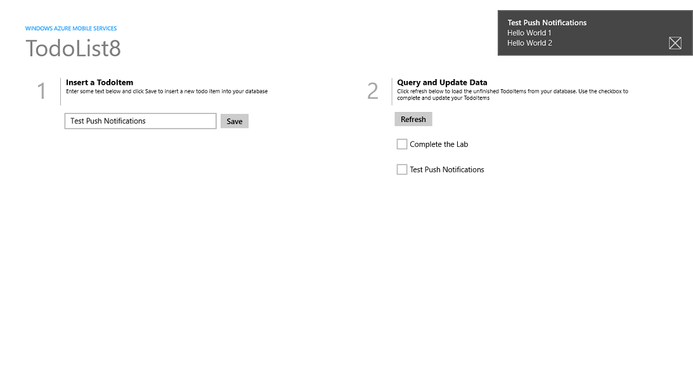

Slide 24
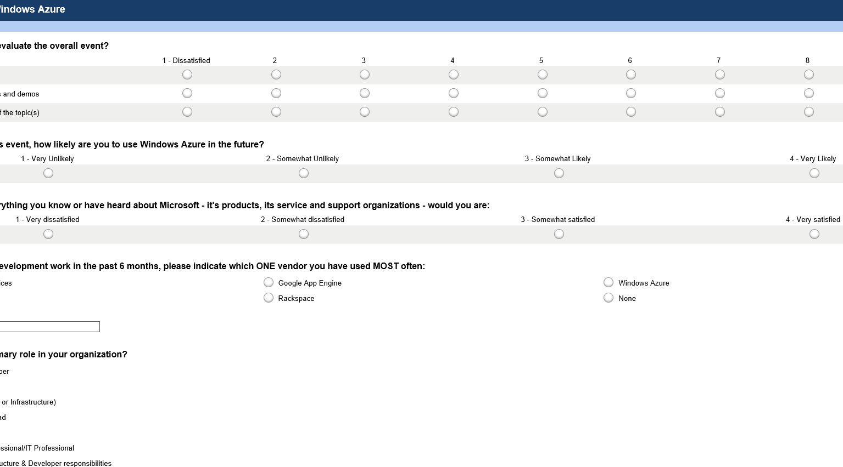
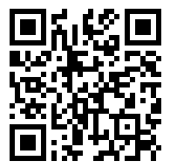
Take the DevUnleashed Windows Azure Survey
Your feedback, helps us make these events available to your community, please fill it out sometime today.
www.surveymonkey.com/s/azureunleashed

Slide 25
HANDS ON LAB
Introduction to Building Windows Store Apps with Windows Azure Mobile Services (C#/XAML or JS/HTML5)
Creating your first Mobile Service
Adding Push Notifications to your app
Adding Auth to Your App and Services
Adding a Scheduled Job to your Mobile Service

Slide 26
Thank You!

