Slide 1
Connect the Dots Sample Web Site
Web App
<name>-ns Service Bus Namespace
LISTEN
LISTEN
SEND
“ehdevices”
Event Hub
“ehalerts”
Event Hub
SEND
LISTEN
SEND
LISTEN
SEND
“<name>Aggregates”
Stream Analytics Job
“<name>Alert”
“<name>LightSensor”
“<name>cg4pbi” Stream Analytics Jobs
LOGGING
LOGGING
“<name>storage”
Storage Account

Slide 2
Connect the Dots Sample Web Site
Web App
<name>-ns Service Bus Namespace
LISTEN
LISTEN
SEND
“ehdevices”
Event Hub
“ehalerts”
Event Hub
SEND
LISTEN
SEND
LISTEN
SEND
“<name>Aggregates”
Stream Analytics Job
“<name>Alert”
“<name>LightSensor”
“<name>cg4pbi” Stream Analytics Jobs
LOGGING
LOGGING
“<name>storage”
Storage Account

Slide 3
Connect the Dots Sample Web Site
Web App
<name>-ns Service Bus Namespace
LISTEN
LISTEN
SEND
“ehdevices”
Event Hub
“ehalerts”
Event Hub
SEND
LISTEN
SEND
LISTEN
SEND
“<name>Aggregates”
Stream Analytics Job
“<name>Alert”
“<name>LightSensor”
“<name>cg4pbi” Stream Analytics Jobs
LOGGING
LOGGING
“<name>storage”
Storage Account

Slide 4
{
"organization": "Microsoft",
"location": "Redmond, WA",
"guid": "61b3eb31-4166-487a-8181-69918092cedf",
"displayname": “Conference Room SparkFun Temp Sensor",
"unitofmeasure": "F",
"measurename": "temperature",
"value": "78",
"timecreated": “01/01/2015 12:00:00 PM"
}
{
"organization": “All Sensors",
"location": “All Sensors",
"guid": "ace60e7c-a6aa-4694-ba86-c3b66952558e",
"displayname": “Temp Average",
"unitofmeasure": "F",
"measurename": "temperature",
"value": “<aggregated average value>",
"timecreated": “<aggregated max time created>"
}
SEND
“ehdevices”
Event Hub
SEND
LISTEN
SEND
DevicesInput
output
Select
measurename,
unitofmeasure,
'All Sensors' AS location,
'All Sensors' AS organization,
'ace60e7c-a6aa-4694-ba86-c3b66952558e' AS guid,
'Temp Average' as displayname,
Max(timecreated) as timecreated,
Avg(value) AS value
From
DevicesInput TIMESTAMP BY timecreated
where
measurename = 'temperature' OR measurename='Temperature'
Group by
measurename, unitofmeasure,
TumblingWindow(Second, 10)
Devices
“<name>Aggregates”
Stream Analytics Job
Query
Ten Second Tumbling Window

Slide 5
Connect the Dots Sample Web Site
Web App
<name>-ns Service Bus Namespace
LISTEN
LISTEN
SEND
“ehdevices”
Event Hub
“ehalerts”
Event Hub
SEND
LISTEN
SEND
LISTEN
SEND
“<name>Aggregates”
Stream Analytics Job
“<name>Alert”
“<name>LightSensor”
“<name>cg4pbi” Stream Analytics Jobs
LOGGING
LOGGING
“<name>storage”
Storage Account

Slide 6
Connect the Dots Sample Web Site
Web App
<name>-ns Service Bus Namespace
LISTEN
LISTEN
SEND
“ehdevices”
Event Hub
“ehalerts”
Event Hub
SEND
LISTEN
SEND
LISTEN
SEND
“<name>Aggregates”
Stream Analytics Job
“<name>Alert”
“<name>LightSensor”
“<name>cg4pbi” Stream Analytics Jobs
LOGGING
LOGGING
“<name>storage”
Storage Account

Slide 7
Connect the Dots Sample Web Site
Web App
<name>-ns Service Bus Namespace
LISTEN
LISTEN
SEND
“ehdevices”
Event Hub
“ehalerts”
Event Hub
SEND
LISTEN
SEND
LISTEN
SEND
“<name>Aggregates”
Stream Analytics Job
“<name>Alert”
“<name>LightSensor”
“<name>cg4pbi” Stream Analytics Jobs
LOGGING
LOGGING
“<name>storage”
Storage Account

Slide 8
Connect the Dots Sample Web Site
Web App
<name>-ns Service Bus Namespace
LISTEN
LISTEN
SEND
“ehdevices”
Event Hub
“ehalerts”
Event Hub
SEND
LISTEN
SEND
LISTEN
SEND
“<name>Aggregates”
Stream Analytics Job
“<name>Alert”
“<name>LightSensor”
“<name>cg4pbi” Stream Analytics Jobs
LOGGING
LOGGING
“<name>storage”
Storage Account

Slide 9
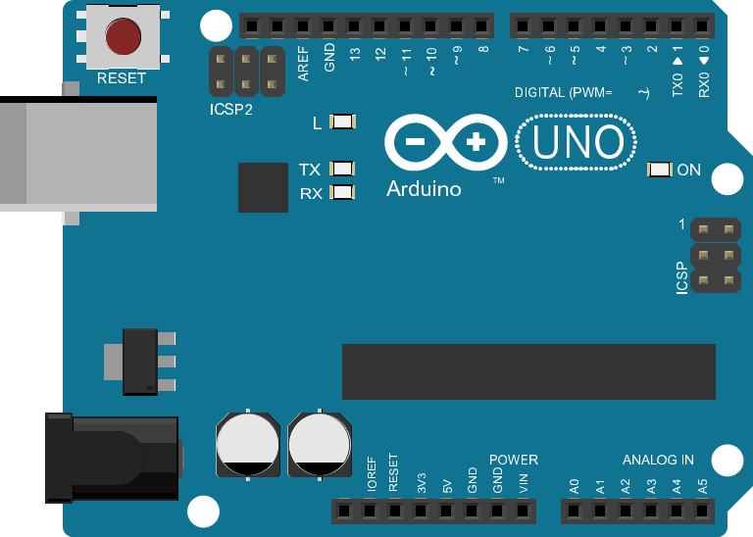
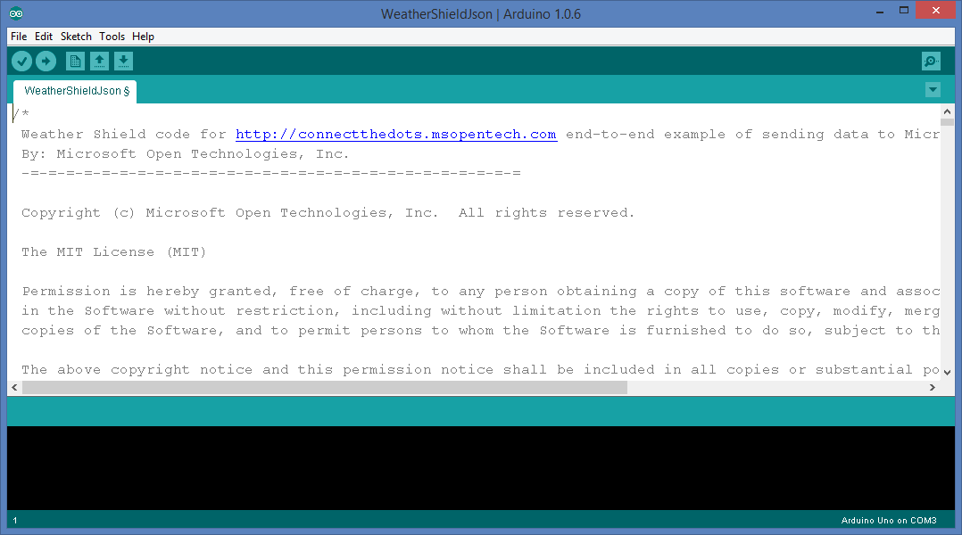


Slide 10
Computer
USB Cable
Arduino Uno
SparkFun Weather Shield

Slide 11
Computer
USB Cable
Arduino Uno
SparkFun Weather Shield

Slide 13
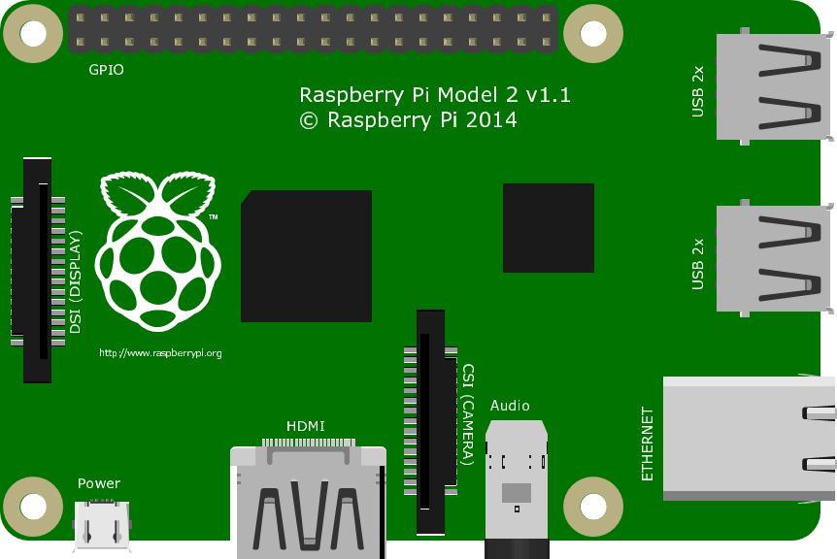
Raspberry Pi 2
USB Cable
Arduino Uno
SparkFun Weather Shield

Slide 14
Raspberry Pi 2
USB Cable
Arduino Uno
USB WiFi Adapter
SparkFun Weather Shield

Slide 15
Raspberry Pi 2
USB Cable
Arduino Uno
Micro SD Card
Inserted on Back
USB WiFi Adapter
SparkFun Weather Shield
Micro USB to Power

Slide 17
USB Cable to Computer
Slot 1 – USB Client
Ethernet Cable to Internet
Slot 7 - Ethernet
Slot 10 – LightSense
Slot 11 – TempHumid
FEZ Spider Mainboard

Slide 18
Connect the Dots Sample Web Site
Web App
<name>-ns Service Bus Namespace
LISTEN
LISTEN
SEND
“ehdevices”
Event Hub
“ehalerts”
Event Hub
SEND
LISTEN
SEND
LISTEN
SEND
“<name>Aggregates”
Stream Analytics Job
“<name>Alert”
“<name>LightSensor”
“<name>cg4pbi” Stream Analytics Jobs
LOGGING
LOGGING
“<name>storage”
Storage Account

Slide 19
Connect the Dots Sample Web Site
Web App
<name>-ns Service Bus Namespace
LISTEN
LISTEN
SEND
“ehdevices”
Event Hub
“ehalerts”
Event Hub
SEND
LISTEN
SEND
LISTEN
SEND
“<name>Aggregates”
Stream Analytics Job
“<name>Alert”
“<name>LightSensor”
“<name>cg4pbi” Stream Analytics Jobs
LOGGING
LOGGING
“<name>storage”
Storage Account

