Slide 1








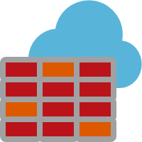




TF-REF-DEV-RG
TF-REF-QA-RG
TF-REF-PROD-RG
AKS-VNET
AKS-VNET
AKS-VNET
Azure Kubernetes Service Cluster
Azure Kubernetes Service Cluster
Azure Kubernetes Service Cluster
peering
peering
peering
BACKEND-VNET
MySQL w/
VNET integration
BACKEND-VNET
MySQL w/
VNET integration
BACKEND-VNET
MySQL w/
VNET integration
TF-REF-COMMON-RG
CI/CD TOOLING
Azure DevOps
Pipelines
MONITORING
Azure Container Registry
Azure Key Vault
Azure Firewall
Azure Monitor
Log Analytics

