Slide 1



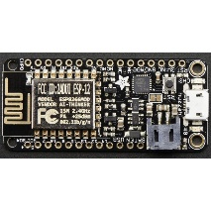
From Clicks to quarks: Composing an IOT APPLICATION with webhooks, “serverless” code, and messaging
Wordpress “Client”
Webhooks
Azure Functions Serverless Code
Azure IoT Hubs Secure Messaging Platform
Messages
via AMQPS
MQTTS HTTPS
Devices
Actuators and Sensors

Slide 2
From Clicks to quarks: Composing an IOT APPLICATION with webhooks, “serverless” code, and messaging
Wordpress “Client”
Webhooks
Azure Functions Serverless Code
Azure IoT Hubs Secure Messaging Platform
Messages
via AMQPS
MQTTS HTTPS
Devices
Actuators and Sensors

