Slide 1
Tutorial 01
Welcome to the Course / Review of Digital Logic
These tutorial slides review some important topics from courses on Digital Logic.

Slide 2
Welcome to the Course
During our tutorial sessions, we will examine the design and analysis of embedded microprocessor systems

Slide 3
Welcome to the Course
During our tutorial sessions, we will examine the design and analysis of embedded microprocessor systems
Each tutorial session will begin with a course update to help guide you through the course

Slide 4
Welcome to the Course
During our tutorial sessions, we will examine the design and analysis of embedded microprocessor systems
Each tutorial session will begin with a course update to help guide you through the course
Most tutorials will focus on assignment questions taken from previous examinations

Slide 5
Welcome to the Course
During our tutorial sessions, we will examine the design and analysis of embedded microprocessor systems
Each tutorial session will begin with a course update to help guide you through the course
Most tutorials will focus on assignment questions taken from previous examinations
To provide greater clarity, I will elaborate using slide annotations or the whiteboard, depending upon the mode of delivery

Slide 6
Course Update
By Friday, September 10th, you will have access to the first six micro lectures in the course:

Slide 7
Course Update
By Friday, September 10th, you will have access to the first six micro lectures in the course:
  Mondays thru Thursdays, a new micro lecture will appear in the course

Slide 8
Course Update
By Friday, September 10th, you will have access to the first six micro lectures in the course:
  Mondays thru Thursdays, a new micro lecture will appear in the course
  Two micro lectures will appear on Fridays to allow sufficient time for completion of the design project in the course

Slide 9
Course Update
By Friday, September 10th, you will have access to the first six micro lectures in the course:
  Mondays thru Thursdays, a new micro lecture will appear in the course
  Two micro lectures will appear on Fridays to allow sufficient time for completion of the design project in the course
Quiz #1 will appear next Wednesday at 9:00 am and will be due at 10:00 pm:

Slide 10
Course Update
By Friday, September 10th, you will have access to the first six micro lectures in the course:
  Mondays thru Thursdays, a new micro lecture will appear in the course
  Two micro lectures will appear on Fridays to allow sufficient time for completion of the design project in the course
Quiz #1 will appear next Wednesday at 9:00 am and will be due at 10:00 pm:
  The quiz will focus on material presented in the first six micro lectures and material presented in this tutorial session

Slide 11
Course Update
By Friday, September 10th, you will have access to the first six micro lectures in the course:
  Mondays thru Thursdays, a new micro lecture will appear in the course
  Two micro lectures will appear on Fridays to allow sufficient time for completion of the design project in the course
Quiz #1 will appear next Wednesday at 9:00 am and will be due at 10:00 pm:
  The quiz will focus on material presented in the first six micro lectures and material presented in this tutorial session
  The first quiz is the easiest

Slide 12
Course Update
By Friday, September 10th, you will have access to the first six micro lectures in the course:
  Mondays thru Thursdays, a new micro lecture will appear in the course
  Two micro lectures will appear on Fridays to allow sufficient time for completion of the design project in the course
Quiz #1 will appear next Wednesday at 9:00 am and will be due at 10:00 pm:
  The quiz will focus on material presented in the first six micro lectures and material presented in this tutorial session
  The first quiz is the easiest
  The quizzes will get more difficult as the course progresses

Slide 13
Tutorial Outline
Today, we will discuss the following:

Slide 14
Tutorial Outline
Today, we will discuss the following:
  Digital logic gates

Slide 15
Tutorial Outline
Today, we will discuss the following:
  Digital logic gates
  Output drivers

Slide 16
Tutorial Outline
Today, we will discuss the following:
  Digital logic gates
  Output drivers
  Signal notations

Slide 17
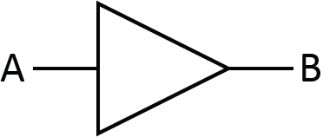
The Buffer
The buffer is the simplest digital logic gate:

Slide 18
The Buffer
The buffer is the simplest digital logic gate:
A | B
0 | 0
1 | 1
B = A

Slide 19
The Buffer
The buffer is the simplest digital logic gate:
It serves two possible purposes:
A | B
0 | 0
1 | 1
B = A

Slide 20
The Buffer
The buffer is the simplest digital logic gate:
It serves two possible purposes:
  It can be used to create an output signal B that is identical to signal A without placing a significant load on signal A
A | B
0 | 0
1 | 1
B = A

Slide 21
The Buffer
The buffer is the simplest digital logic gate:
It serves two possible purposes:
  It can be used to create an output signal B that is identical to signal A without placing a significant load on signal A
  It can be used as a delay element
A | B
0 | 0
1 | 1
B = A

Slide 22
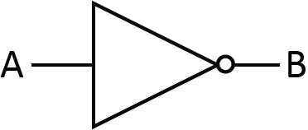
The Inverter
The inverter is another simple digital logic gate:

Slide 23
The Inverter
The inverter is another simple digital logic gate:
A | B
0 | 1
1 | 0
B = A’

Slide 24
The Inverter
The inverter is another simple digital logic gate:
This gate outputs a signal B that is the inverted value of signal A
A | B
0 | 1
1 | 0
B = A’

Slide 25
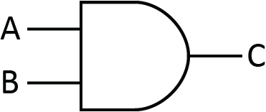
The AND Gate
The AND gate is a two-input digital logic gate:

Slide 26
The AND Gate
The AND gate is a two-input digital logic gate:
A | B | C
0 | 0 | 0
0 | 1 | 0
1 | 0 | 0
1 | 1 | 1
C = A ∙ B

Slide 27
The AND Gate
The AND gate is a two-input digital logic gate:
This gate outputs a signal C that is a value of 1 if and only if both inputs are 1
A | B | C
0 | 0 | 0
0 | 1 | 0
1 | 0 | 0
1 | 1 | 1
C = A ∙ B

Slide 28
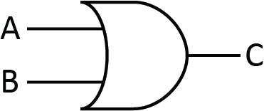
The OR Gate
The OR gate is another two-input digital logic gate:

Slide 29
The OR Gate
The OR gate is another two-input digital logic gate:
A | B | C
0 | 0 | 0
0 | 1 | 1
1 | 0 | 1
1 | 1 | 1
C = A + B

Slide 30
The OR Gate
The OR gate is another two-input digital logic gate:
This gate outputs a signal C that is a value of 1 if either input is 1
A | B | C
0 | 0 | 0
0 | 1 | 1
1 | 0 | 1
1 | 1 | 1
C = A + B

Slide 31
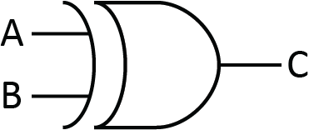
The XOR Gate
The XOR gate is another two-input digital logic gate:

Slide 32
The XOR Gate
The XOR gate is another two-input digital logic gate:
A | B | C
0 | 0 | 0
0 | 1 | 1
1 | 0 | 1
1 | 1 | 0
C = A ⊕ B

Slide 33
The XOR Gate
The XOR gate is another two-input digital logic gate:
This gate outputs a signal C that is a value of 1 if exactly one input (A or B) is a value of 1
A | B | C
0 | 0 | 0
0 | 1 | 1
1 | 0 | 1
1 | 1 | 0
C = A ⊕ B

Slide 34
Uses of the XOR Gate
The XOR Gate has some interesting uses:

Slide 35
Uses of the XOR Gate
The XOR Gate has some interesting uses:
  It can be used as an even parity bit generator by producing an output that will ensure the combination of input bits and output bits always has an even number of values of 1

Slide 36
Uses of the XOR Gate
The XOR Gate has some interesting uses:
  It can be used as an even parity bit generator by producing an output that will ensure the combination of input bits and output bits always has an even number of values of 1
  It can also be used as a controlled inversion which proves very useful in computer architecture:

Slide 37
Uses of the XOR Gate
The XOR Gate has some interesting uses:
  It can be used as an even parity bit generator by producing an output that will ensure the combination of input bits and output bits always has an even number of values of 1
  It can also be used as a controlled inversion which proves very useful in computer architecture:
A | B | C
0 | 0 | 0
0 | 1 | 1
1 | 0 | 1
1 | 1 | 0

Slide 38
Uses of the XOR Gate
The XOR Gate has some interesting uses:
  It can be used as an even parity bit generator by producing an output that will ensure the combination of input bits and output bits always has an even number of values of 1
  It can also be used as a controlled inversion which proves very useful in computer architecture:
A | B | C
0 | 0 | 0
0 | 1 | 1
1 | 0 | 1
1 | 1 | 0
B | C
0 | A
1 | A’

Slide 39
Totem Pole Output Drivers
All the digital logic gates presented so far use totem pole output drivers

Slide 40
Totem Pole Output Drivers
All the digital logic gates presented so far use totem pole output drivers
A totem pole output driver can only output one of two possible values (0 or 1)

Slide 41
Totem Pole Output Drivers
All the digital logic gates presented so far use totem pole output drivers
A totem pole output driver can only output one of two possible values (0 or 1)
Unless otherwise noted on a digital logic gate, the output is assumed to use a totem pole output driver

Slide 42
Open Drain Output Drivers
Any digital logic gate can be implemented with open drain output drivers

Slide 43
Open Drain Output Drivers
Any digital logic gate can be implemented with open drain output drivers
An open drain output driver can output either 0 or Z (a high impedance state)

Slide 44
Open Drain Output Drivers
Any digital logic gate can be implemented with open drain output drivers
An open drain output driver can output either 0 or Z (a high impedance state)
When the output is in a high impedance state, the output can be viewed as being unconnected

Slide 45
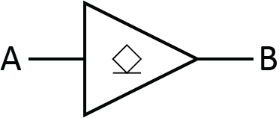
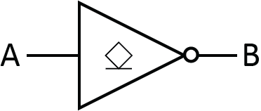
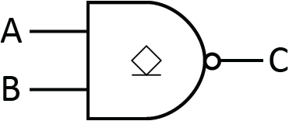
Open Drain Digital Logic Gate Examples
Open drain output drivers are denoted using the symbol shown on the digital logic gates below:

Slide 46
Open Drain Digital Logic Gate Examples
Open drain output drivers are denoted using the symbol shown on the digital logic gates below:
A | B
0 | 0
1 | Z

Slide 47
Open Drain Digital Logic Gate Examples
Open drain output drivers are denoted using the symbol shown on the digital logic gates below:
A | B
0 | 0
1 | Z
A | B
0 | Z
1 | 0

Slide 48
Open Drain Digital Logic Gate Examples
Open drain output drivers are denoted using the symbol shown on the digital logic gates below:
A | B
0 | 0
1 | Z
A | B
0 | Z
1 | 0
A | B | C
0 | 0 | Z
0 | 1 | Z
1 | 0 | Z
1 | 1 | 0

Slide 49
Open Drain Digital Logic Gate Examples
Open drain output drivers are denoted using the symbol shown on the digital logic gates below:
When producing the truth tables, you simply replace outputs of 1 with Z
A | B
0 | 0
1 | Z
A | B
0 | Z
1 | 0
A | B | C
0 | 0 | Z
0 | 1 | Z
1 | 0 | Z
1 | 1 | 0

Slide 50
Open Source Output Drivers
Any digital logic gate can be implemented with open source output drivers

Slide 51
Open Source Output Drivers
Any digital logic gate can be implemented with open source output drivers
An open source output driver can output either 1 or Z

Slide 52
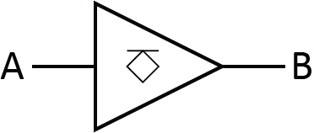
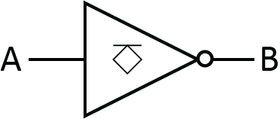
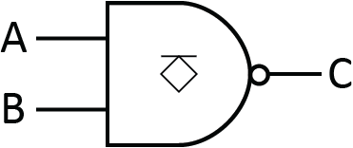
Open Source Digital Logic Gate Examples
Open source output drivers are denoted using the symbol shown on the digital logic gates below:

Slide 53
Open Source Digital Logic Gate Examples
Open source output drivers are denoted using the symbol shown on the digital logic gates below:
A | B
0 | Z
1 | 1

Slide 54
Open Source Digital Logic Gate Examples
Open source output drivers are denoted using the symbol shown on the digital logic gates below:
A | B
0 | Z
1 | 1
A | B
0 | 1
1 | Z

Slide 55
Open Source Digital Logic Gate Examples
Open source output drivers are denoted using the symbol shown on the digital logic gates below:
A | B
0 | Z
1 | 1
A | B
0 | 1
1 | Z
A | B | C
0 | 0 | 1
0 | 1 | 1
1 | 0 | 1
1 | 1 | Z

Slide 56
Open Source Digital Logic Gate Examples
Open source output drivers are denoted using the symbol shown on the digital logic gates below:
When producing the truth tables, you simply replace outputs of 0 with Z
A | B
0 | Z
1 | 1
A | B
0 | 1
1 | Z
A | B | C
0 | 0 | 1
0 | 1 | 1
1 | 0 | 1
1 | 1 | Z

Slide 57
Tri-State Output Drivers
A tri-state output driver can be used to implement three possible output values (0, 1, or Z)

Slide 58
Tri-State Output Drivers
A tri-state output driver can be used to implement three possible output values (0, 1, or Z)
Most often, tri-state output drivers are implemented on buffers but they can be implemented on any digital logic gate

Slide 59
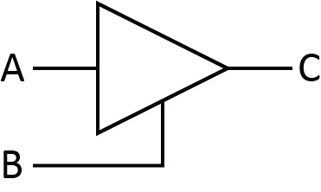
Tri-State Output Drivers
A tri-state output driver can be used to implement three possible output values (0, 1, or Z)
Most often, tri-state output drivers are implemented on buffers but they can be implemented on any digital logic gate
A control input entering the bottom of the gate is typically a sign that the gate uses a tri-state output (but not always)

Slide 60
Tri-State Output Drivers
A tri-state output driver can be used to implement three possible output values (0, 1, or Z)
Most often, tri-state output drivers are implemented on buffers but they can be implemented on any digital logic gate
A control input entering the bottom of the gate is typically a sign that the gate uses a tri-state output (but not always)
A | B | C
0 | 0 | Z
0 | 1 | 0
1 | 0 | Z
1 | 1 | 1

Slide 61
Tri-State Output Drivers
A tri-state output driver can be used to implement three possible output values (0, 1, or Z)
Most often, tri-state output drivers are implemented on buffers but they can be implemented on any digital logic gate
A control input entering the bottom of the gate is typically a sign that the gate uses a tri-state output (but not always)
A | B | C
0 | 0 | Z
0 | 1 | 0
1 | 0 | Z
1 | 1 | 1
A | B | C
- | 0 | Z
0 | 1 | 0
1 | 1 | 1

Slide 62
Tri-State Output Drivers
A tri-state output driver can be used to implement three possible output values (0, 1, or Z)
Most often, tri-state output drivers are implemented on buffers but they can be implemented on any digital logic gate
A control input entering the bottom of the gate is typically a sign that the gate uses a tri-state output (but not always)
A | B | C
0 | 0 | Z
0 | 1 | 0
1 | 0 | Z
1 | 1 | 1
A | B | C
- | 0 | Z
0 | 1 | 0
1 | 1 | 1
A | B | C
- | 0 | Z
- | 1 | A

Slide 63
Signal Notations for Inversion
There are many different signal notations that exist for indicating the inversion of a signal

Slide 64
Signal Notations for Inversion
There are many different signal notations that exist for indicating the inversion of a signal
What are some of the possible ways of indicating an inversion of a CLK signal?

Slide 65
Signal Notations for Inversion
There are many different signal notations that exist for indicating the inversion of a signal
What are some of the possible ways of indicating an inversion of a CLK signal?
Some notations we can use for inverting a CLK signal are the following:
CLK’ | /CLK
!CLK | ~CLK
CLK_n | CLK

