Slide 1
WOMEN AND TECH
BRETIUS MUSTAPHAT

Slide 2
TABLE OF CONTENTS
Description
Data Acquisition And cleaning
Methodologie
Problem
Result
Conclusion and future directions

Slide 3
Description
The project consists in gathering the profiles of people on the inkedIn their training specifically in the field of technology do the analysis on the quantity of girls who are in this field and a comparison with men to see which training is the most recommended.

Slide 4
Data Acquisition And cleaning
Obtained using web scraping on LinkedIn
Using the Beautifulsoup and Selenium

Slide 5
METHODOLOGIE
I collected the data by doing web scraping on LinkedIn using beautifulsoup and selenium. The dataset has name, title, profile, location.

Slide 6
PROBLEM
The field of technology has always attracted my attention and as a woman I have often noticed that there are fewer women in my career, that's why I wanted to make a comparison between men and women to see where the real problem lies. I will use web scraping or Foursquare in order to retrieve data about my subject.
I have noticed that ICT interests men more than women so I would like to make a comparison with those who have already entered the field in order to see what interests women as much.
Women also have their place in ICT and businesses need them. For some time now, there have been more men in the field of technology than women, so it is essential to raise awareness of this subject among more women, since it is a field that dominates the world today.

Slide 7
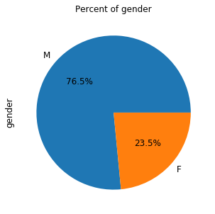
Percent of gender

Slide 8
In this analysis there are 76.5 percent boys and 23.5 percent girls which gives us in majority more boys who have training, which gives a total of 1040 Boys out of 319 females, this analysis shows that boys have more education than girls which made me curious to find out why girls are few in number, especially in ICT.

Slide 9
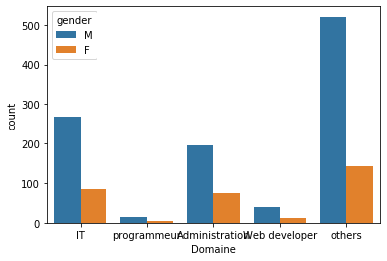
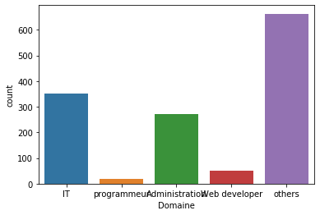
skill category and gender training category

Slide 11
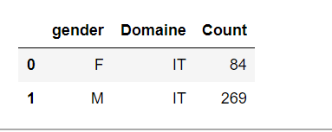
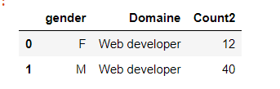
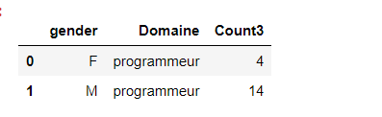
counts from gender the domains of each profile

Slide 12
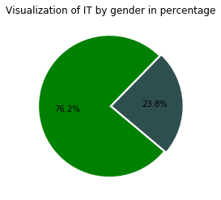
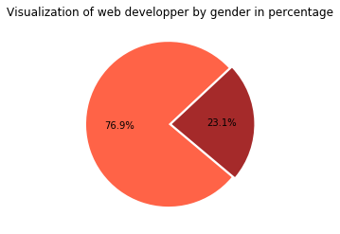
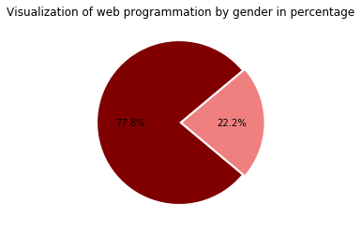
VISUALIZATION

Slide 14
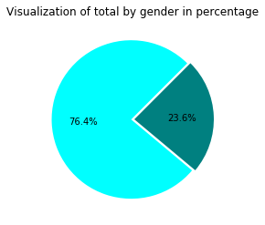
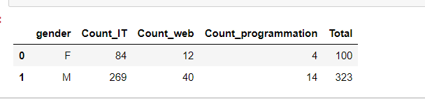
RESULT

Slide 15
I have grouped the skills by category such as web developer, programmer and IT his trainings are part in the field of technology according to gender as you can see in all the categories there are more boys with skills than girls this poses a big problem of education for the female community. With a total of 423 representing 76.4 percent boys and 23.6 per cent girls, this poses a big educational problem for the female community.

Slide 16
Conclusion and future directions

