Slide 1





EBS Pacific cod
Steven J. Barbeaux, Lewis Barnett, Jason Connor, Julie Nielson, S. Kalei Shotwell, Elizabeth Siddon, and Ingrid Spies
December, 2022

Slide 2
Thanks to the many contributors to this assessment
Caitlin Allen-Akselrud, Kerim Aydin, Mathew Callahan, Curry Cunningham, Lucas DeFilippo, Bridget Ferriss, Ben Fissel, Madison Hall, Kirstin Holsman, Tom Hurst, Kelly Kearney, Ben Laurel, Cecilia A. O’Leary, Beth Matta, Susanne McDermott, Sandi Neidetcher, Jens Nielsen, Kimberly Rand, Patrick Ressler, Heather Renner, Sean Rohan, Katie Sweeney, Grant Thompson, James Thorson, Muyin Wang, Jordan Watson, Sarah Wise, and Stephani Zador
Notes:
Table filled out using author recommended model

Slide 3
Teams or SSC Comments
Given that an ensemble model structure has been endorsed by the SSC in 2021, representing a fairly large change in the assessment process, if the new authors choose to propose an ensemble in the future it may be prudent to minimize changes to the suite of models comprising the ensemble so that the potential benefits of a stable ensemble can be realized.
The authors presented a series of minor changes to the model this year. The Plan Team and SSC endorsed removing of the weight-at-length adjustments and the aging bias for post-2007. These model changes resulted in very minimal changes to the resulting model and are described below.
If model ensembles are brought forward in the future, the authors should work with the BSAI GPT to define a process whereby GPT members themselves assign model scores based on the same, or an updated set, of scoring criteria. This would allow for future development of ensemble member weightings based upon independent review, and the SSC believes this would address one of the concerns highlighted in public comment.
In light of the above recommendation, model changes were kept to a minimum and the weighting criteria used for this year’s ensemble were judged to rate the same as the weights generated by the CIE and endorsed by the SSC in 2021.
The SSC recommends that inclusion of [fishery age composition data] be fully explored in a later assessment cycle, either within a single model or multiple ensemble members, highlighting that it views this as a top priority for future research.
Given the already monumental task of taking this stock over from Dr. Thompson, the authors chose not to investigate the use of fishery age composition data. This also in light of the SSCs recommendation to minimize changes to the suite of models comprising the ensemble. The authors intend to investigate the use of fishery age composition data in the future.
Notes:
PT/SSC comments being addressed IN THIS PRESENTATION ONLY

Slide 4
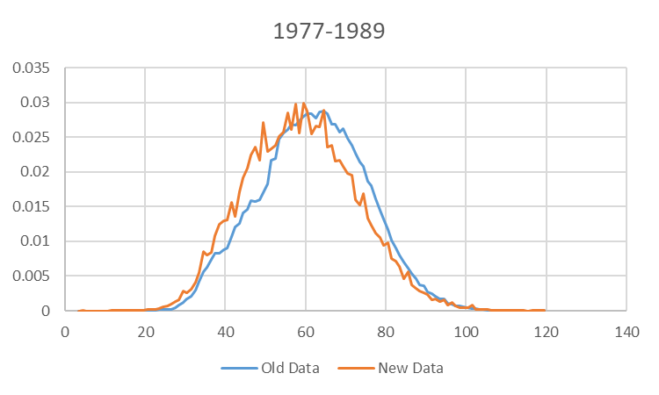
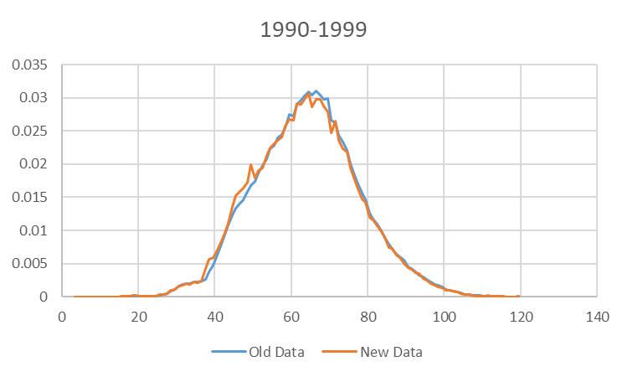
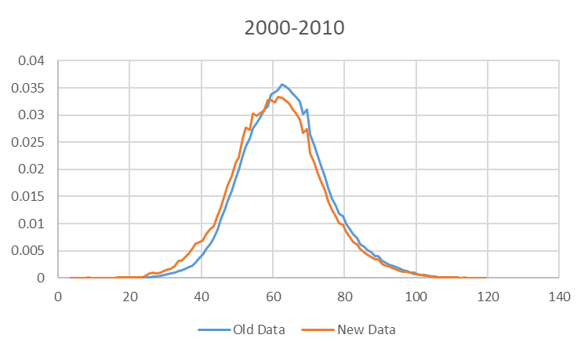
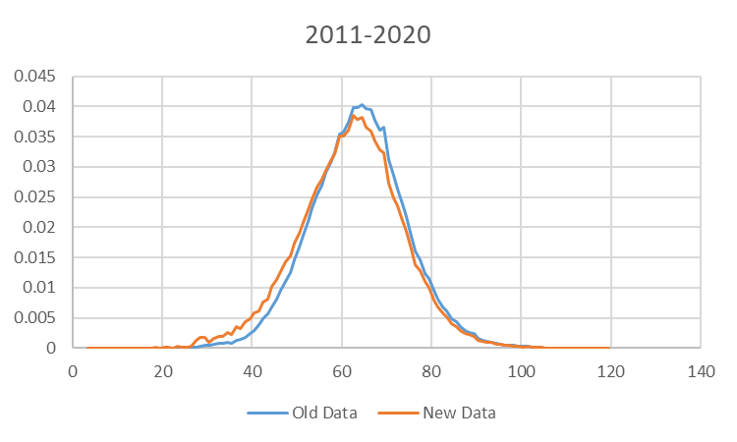
Data changes Fishery Length Composition
New algorithm for constructing fishery length composition (described in September)
Data weighted by haul, vessel, gear, month, NMFS area, and year
Resulted in shift to more small fish in distribution

Slide 5
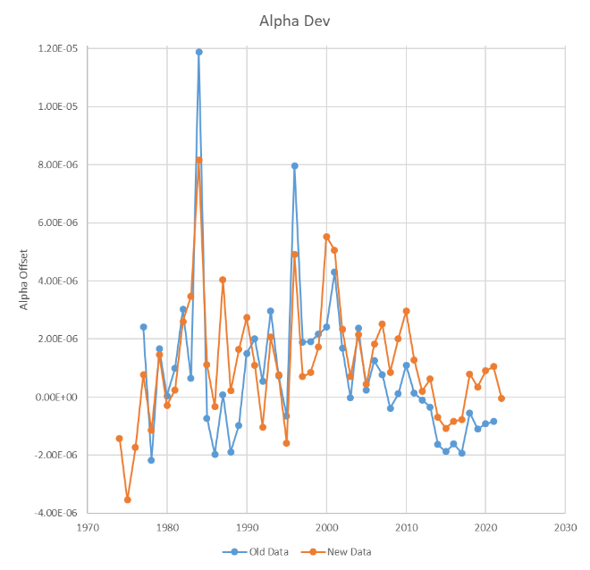
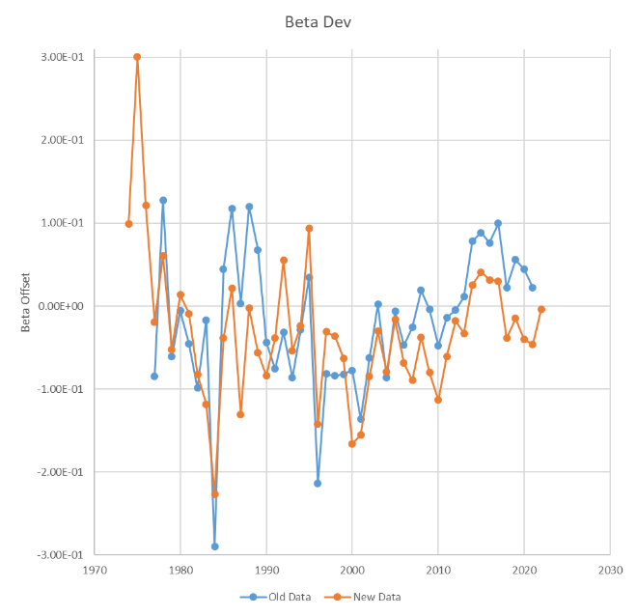
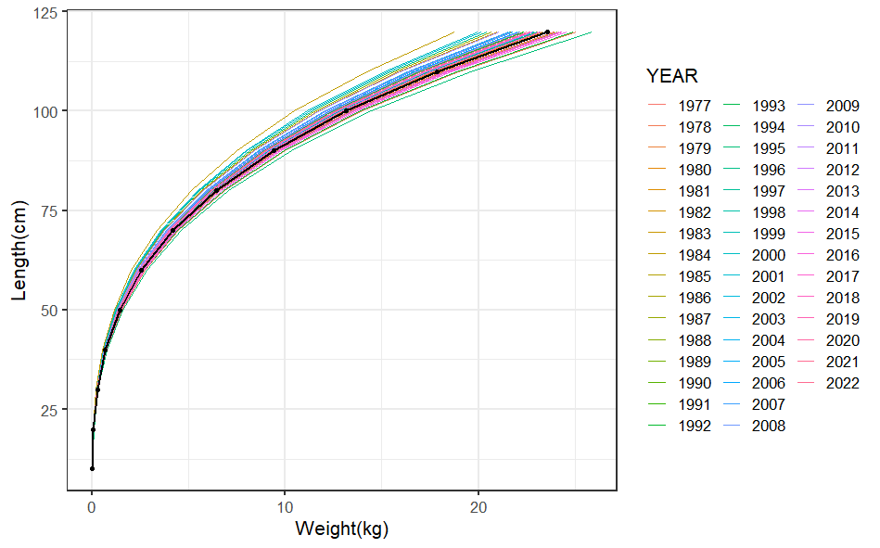
Data changes – Annual Weight-at-Length Adjustments
Switch from linear Mathcad algorithm to GAM in R mgcv library (described in September)
Similar resulting trend in adjustments

Slide 6
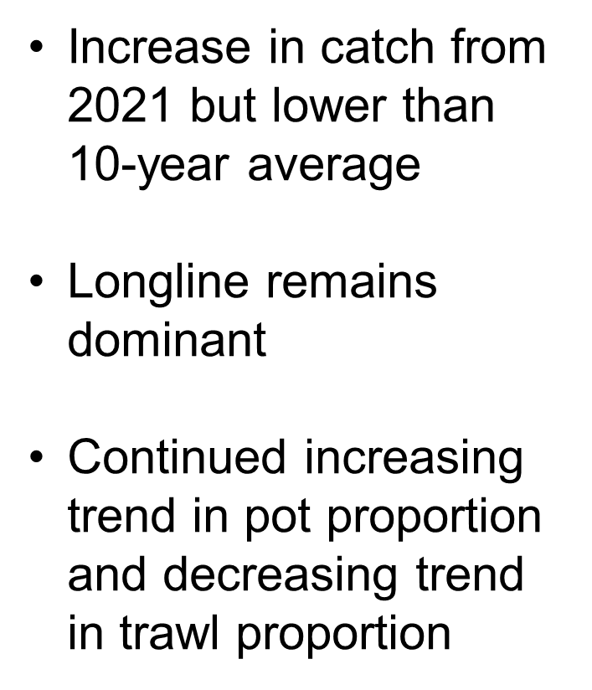
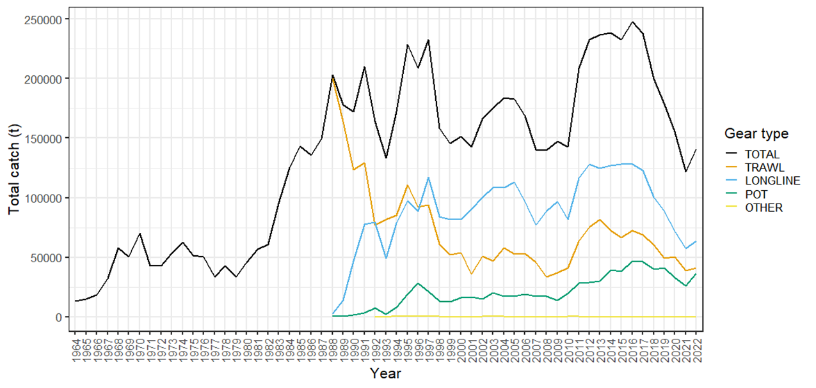
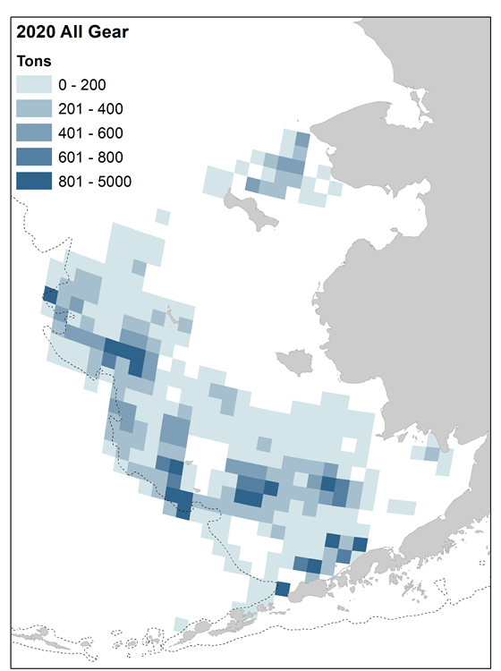
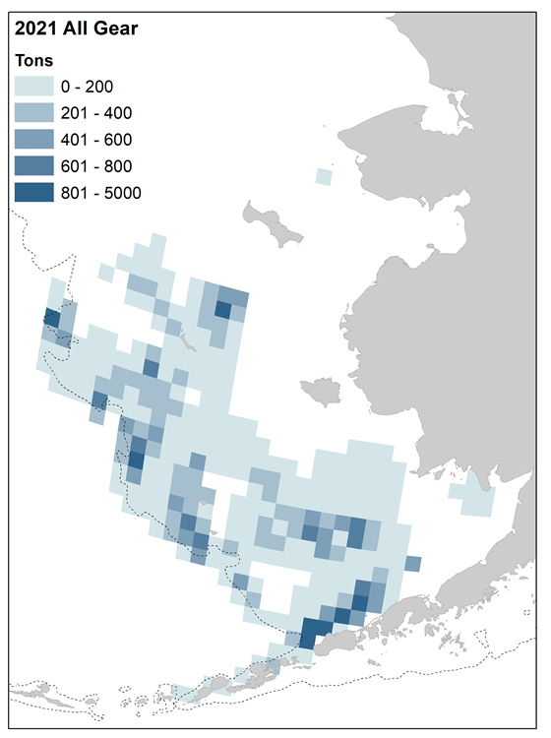
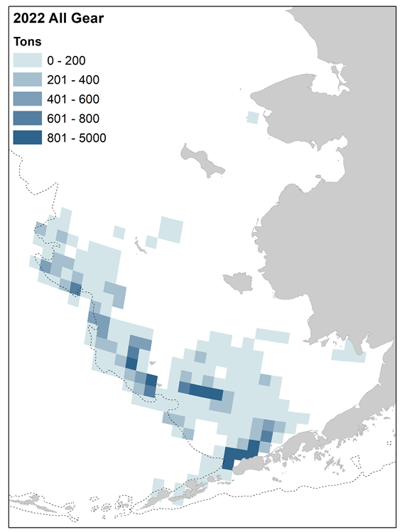
Catch – Fishery Sector
Southwestward shift in center of gravity
Low level of fishing in NBS

Slide 7
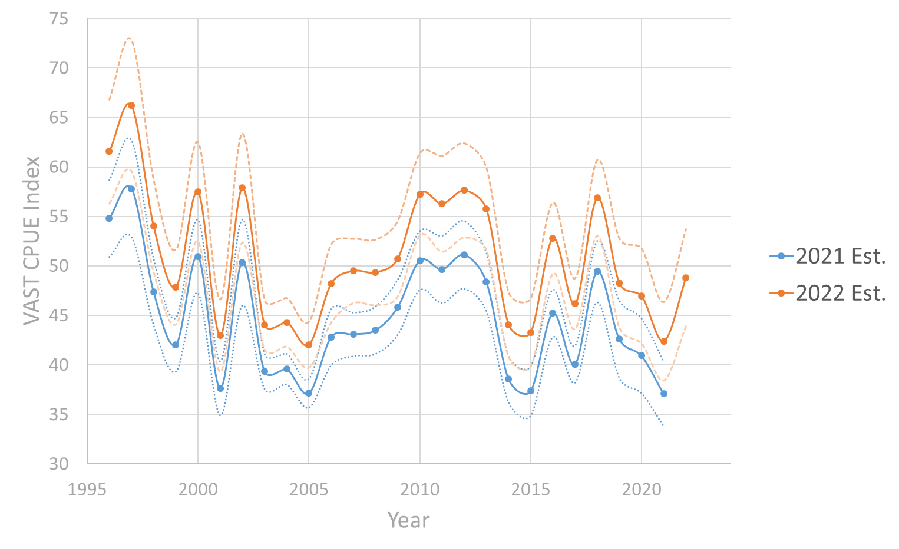
VAST CPUE Index – Jan.-Feb. Longline Fishery
Difference in spatial extent resulted in overall inflation of index
Trend remains the same with high correlation between indices
15% Increase in 2022 from 2021

Slide 8
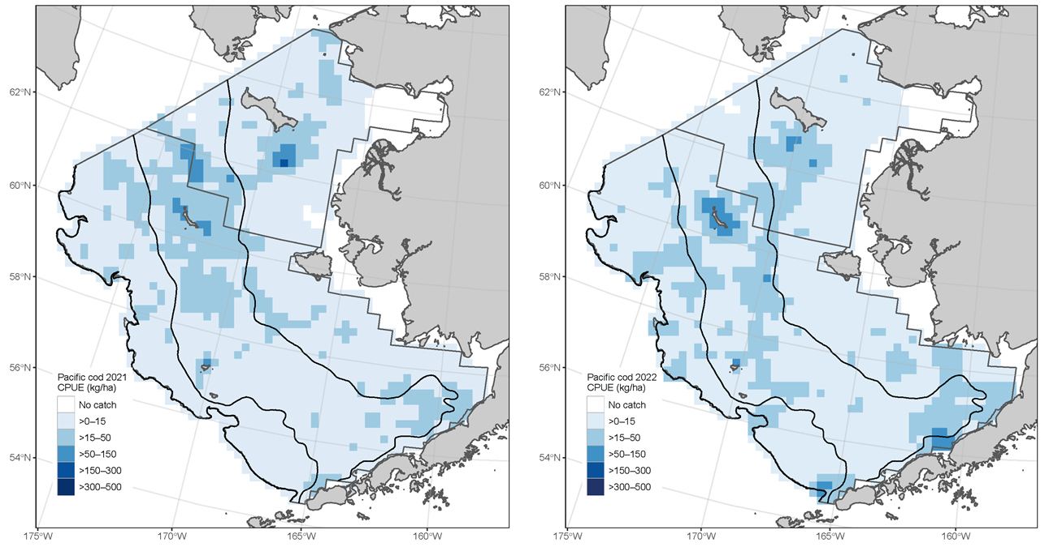
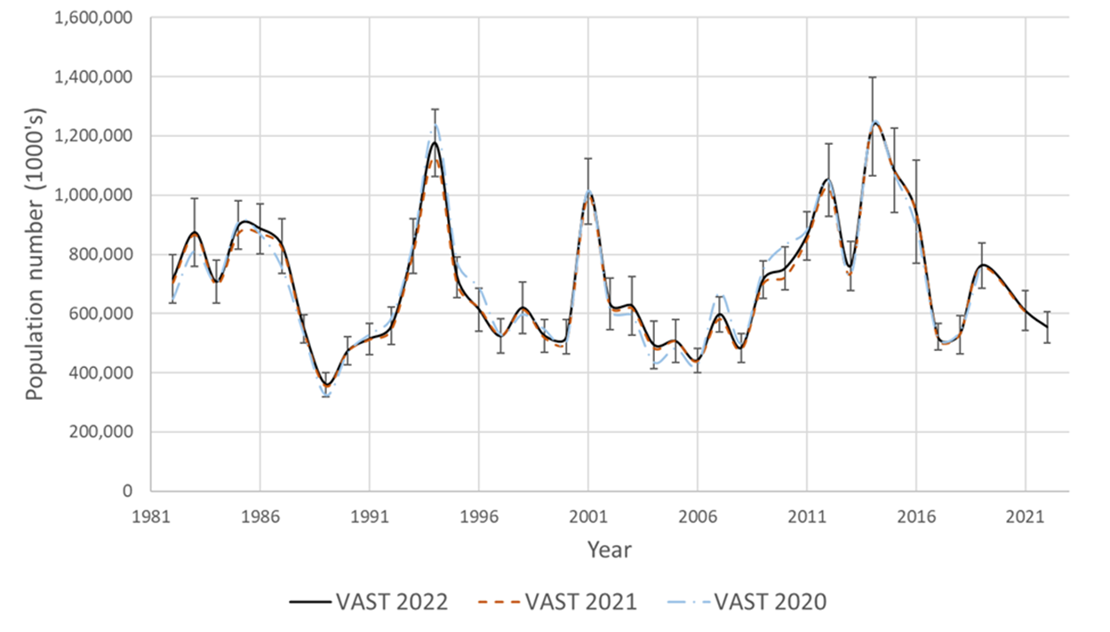
VAST Survey Index – Bering Sea Shelf Bottom Trawl
Southeastward shift in center of gravity
Small changes in time series from previous years
Overall drop in abundance (VAST -8.9% from 2021)

Slide 9
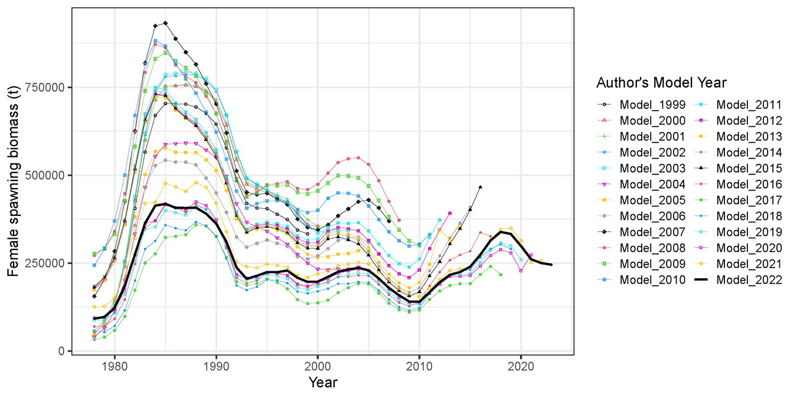
Stock Assessment Models
Diverse set of models over the past 22 years
Current base model is an ensemble of 4 models

Slide 10
Model configurations
Thompson Series models | M 19.12 | M 19.12A | M 21.1 | M 21.2
New Series models | M 22.1 | M 22.2 | M 22.3 | M 22.4
Feature 1: Allow catchability to vary? | YES | NO | NO | NO
Feature 2: Allow domed survey selectivity? | NO | NO | YES | NO
Feature 3: Use fishery CPUE? | NO | NO | NO | YES
New Series models - Same as Thompson Series models except
Seasonally corrected annual weight-at-length adjustments removed
Post-2007 aging bias block removed
Although minor model changes, substantial changes in data processing resulting in model name changes for this year.

Slide 11
Model weighting (same as last year)
Feature |  | M 19.12 M 22.1 | M 19.12A M 22.2 | M 21.1 M 22.3 | M 21.2 M 22.4
Feature 1: Allow catchability to vary? |  | yes | no | no | no
Feature 2: Allow domed survey selectivity? |  | no | no | yes | no
Feature 3: Use fishery CPUE? |  | no | no | no | yes
Criterion | Emph. | M 19.12 M 22.1 | M 19.12A M 22.2 | M 21.1 M 22.3 | M 21.2 M 22.4
General plausibility of the model | 3 | 1 | 2 | 0.6667 | 1
Acceptable retrospective bias | 3 | 2 | 2 | 1.3333 | 1
Uses properly vetted data | 3 | 2 | 2 | 2 | 0
Acceptable residual patterns | 3 | 2 | 2 | 2 | 2
Comparable complexity | 2 | 1 | 2 | 1 | 2
Fits consistent with variances | 2 | 2 | 1 | 1 | 0
Average emphasis: |  | 1.6875 | 1.875 | 1.375 | 1
Model weight: |  | 0.2842 | 0.3158 | 0.2316 | 0.1684

Slide 12
Model Fits
Exploration of individual models and their fits can be found at the link provided
Model fits and results were nearly identical between the Thompson and New Series models
Largest difference was the fit to the age composition data with a degraded fit due to the removal of the post-2007 aging bias
https://afsc-assessments.github.io/EBS_PCOD/2022_ASSESSMENT/NOVEMBER_MODELS/

Slide 13
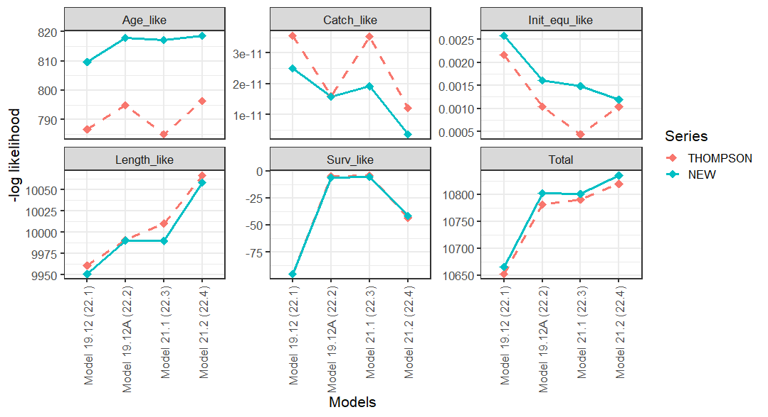
Models – Objective function
Can not compare across models in a series, but can look at between models across series
Largest difference between series is the fit to the age composition

Slide 14
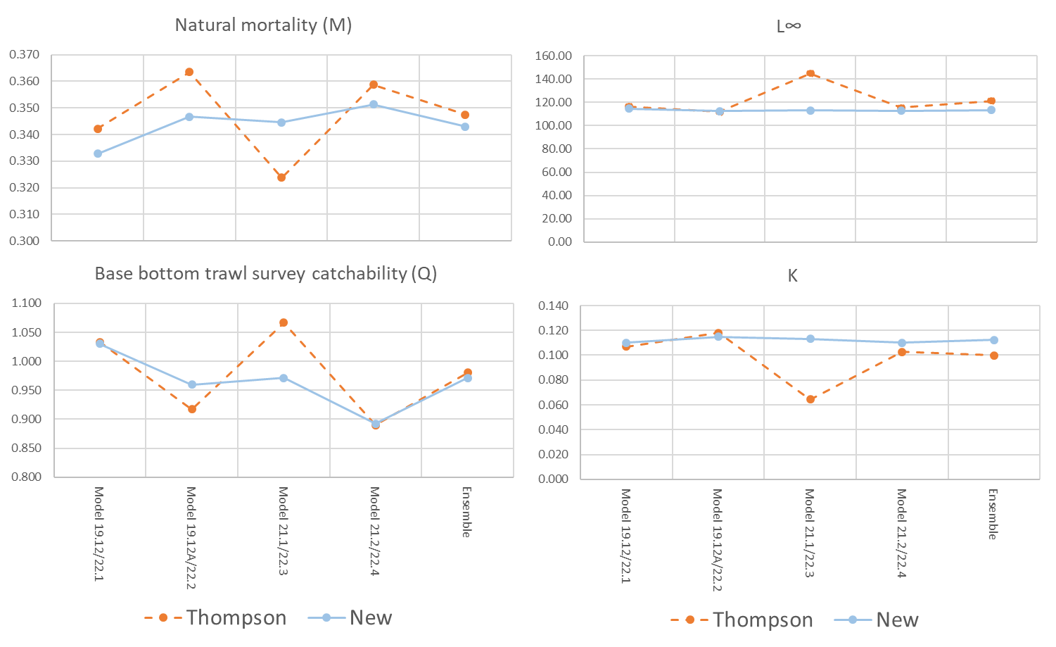
Models – Parameters
Similar values between the ensembles
Higher variability in parameters from the individual Thompson Series models

Slide 15
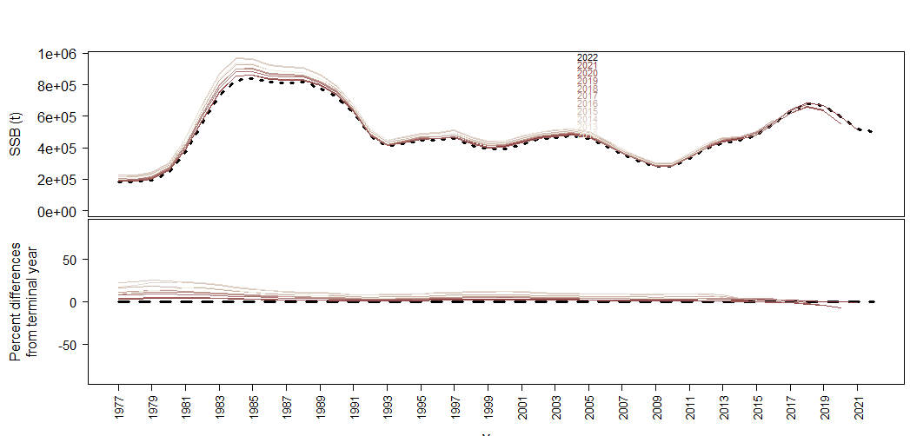
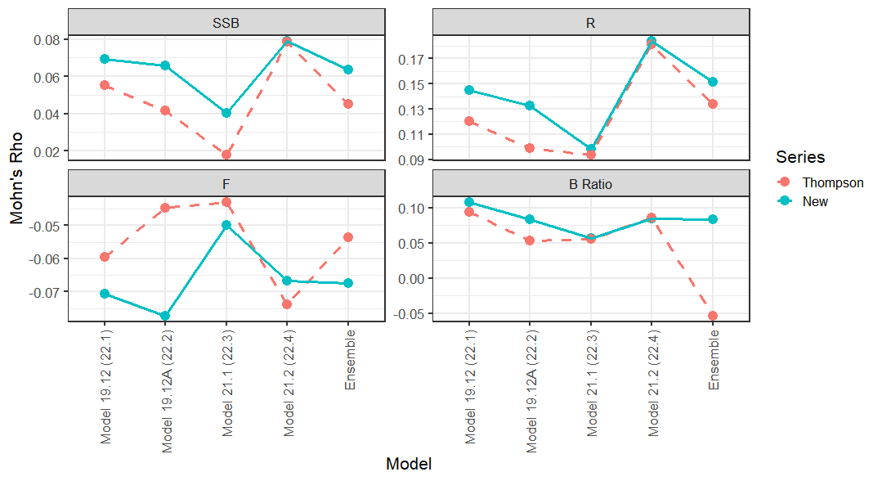
Models – Retrospective analysis
Consistently low positive bias on Mohn’s ρ for SSB from both series
Ensemble retrospective analysis

Slide 16
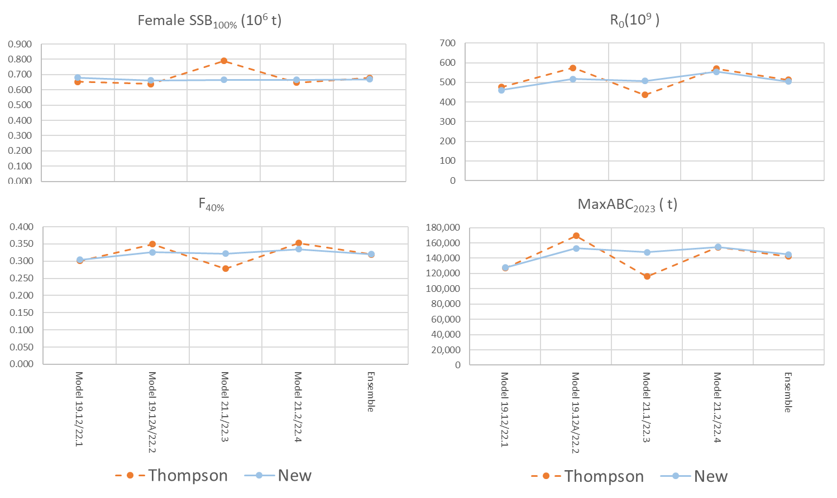
Models – Derived quantities
As with the parameters the derived quantities are similar, but less variable for the New Series.
Ensemble values are very similar.

Slide 17
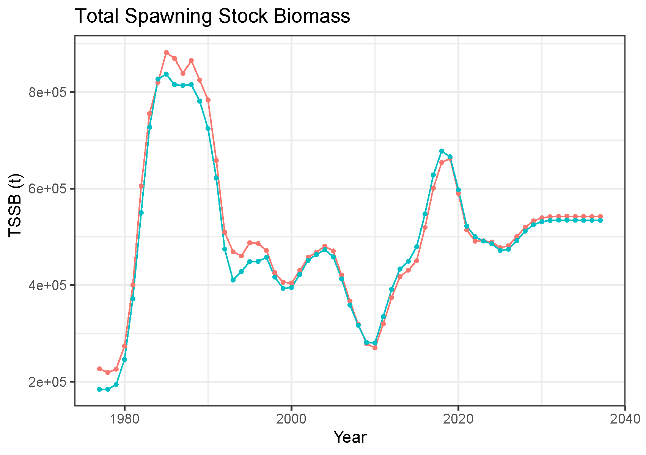
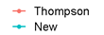
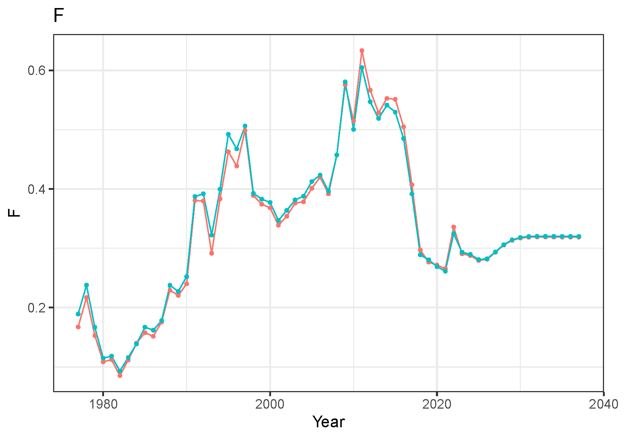
Models – Derived quantities
Spawning biomass slightly higher in early part for Thompson Series
Higher variability in fishing mortality in Thompson Series

Slide 18
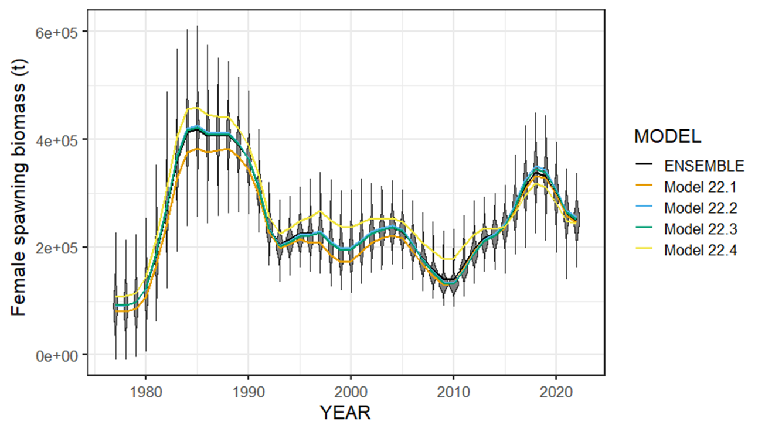
New Series Results – Female spawning biomass
All four models show reduction from 2018 high point.
Model 22.4 with CPUE index indicates higher SSB earlier in the time series and lower in most recent

Slide 19
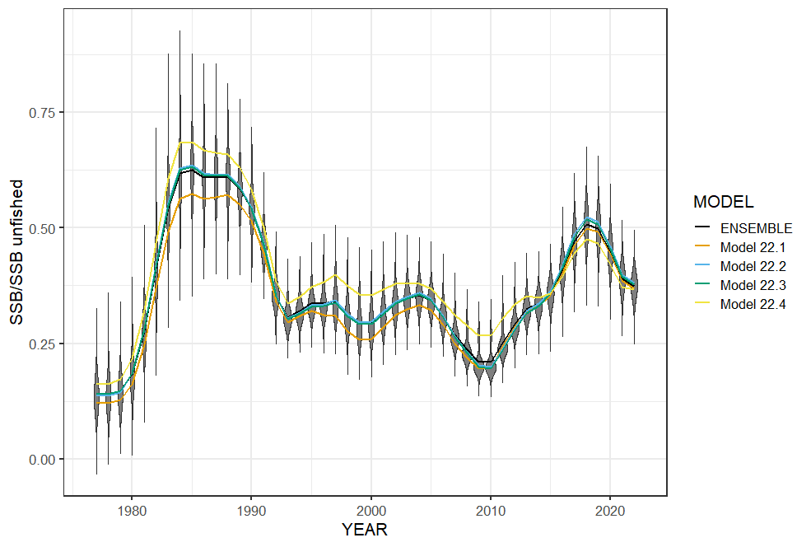
New Series Results – Female spawning biomass
High point in the mid to late 1980s
Low point in 2010 at B_{21%}
Currently below B_{40%}

Slide 20
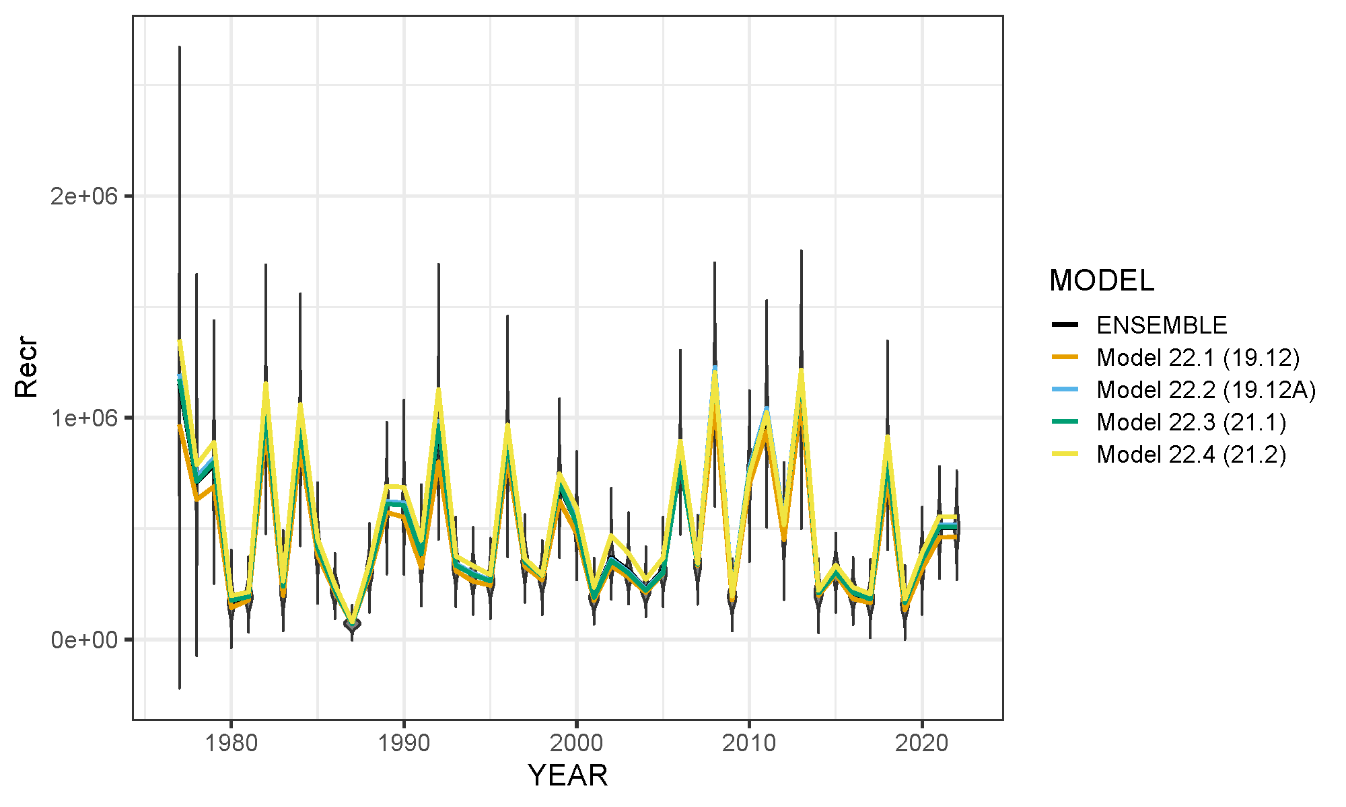
New Series Results – Age-0 recruitment
Large 2018 year class
2014-2017, 2019, and 2020 estimated to be below average
2021 and 2022 set at ~R₀ as not yet well defined in the data.

Slide 21
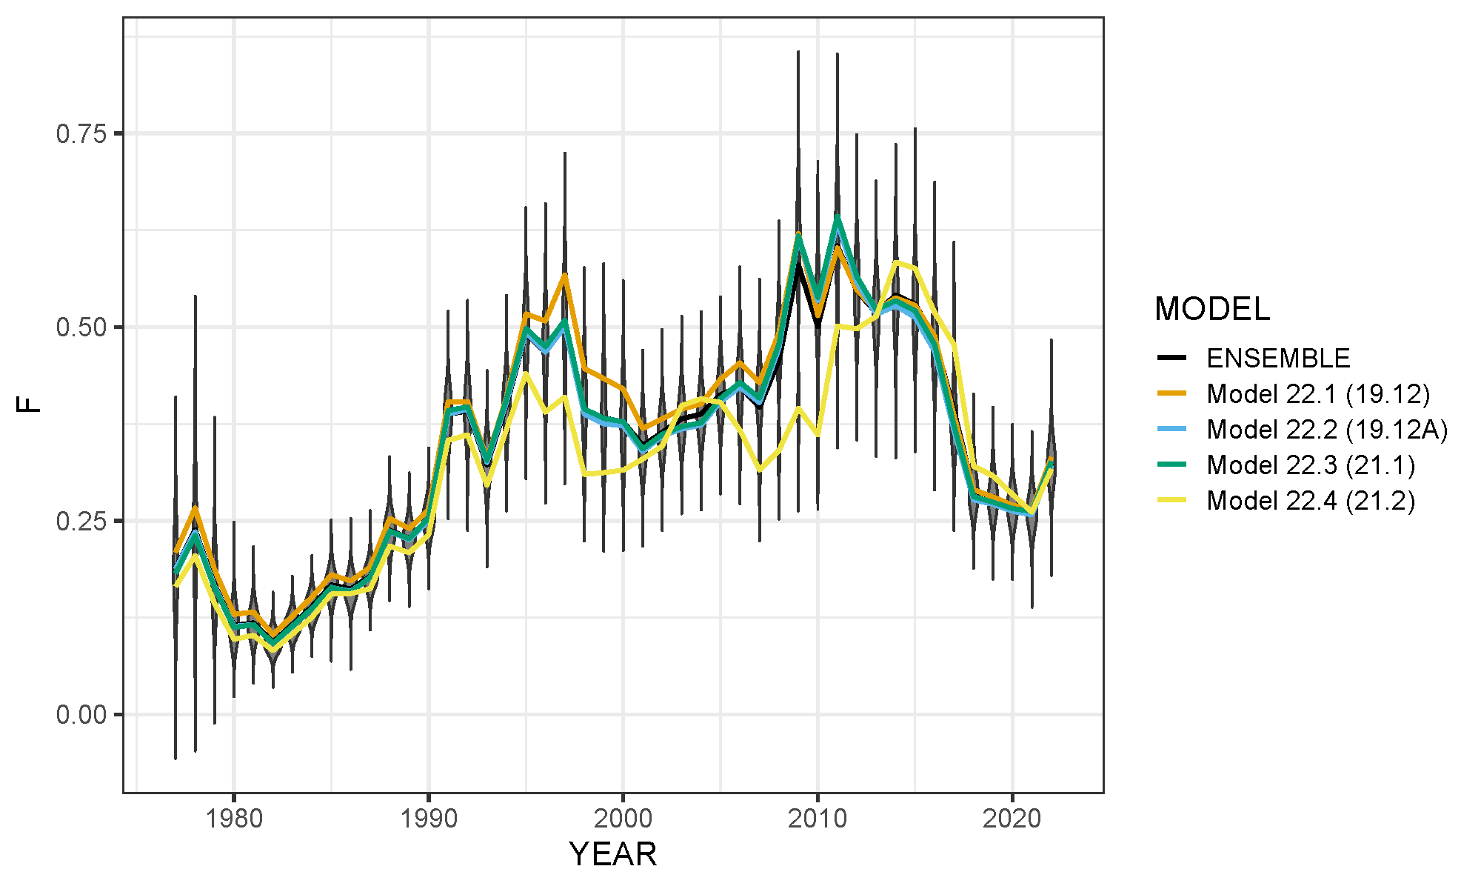
New Series Results – Apical fishing mortality
High fishing mortality from 2008-2016 with dome-shaped survey selectivity
Drop in F 2017-2021 change to asymptotic survey selectivity.
Increase in 2022 due again to change in model with ensemble

Slide 22
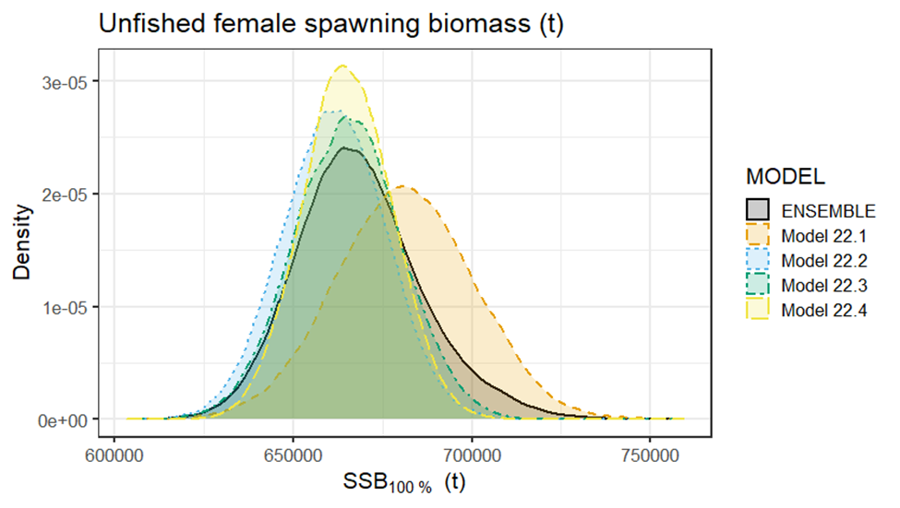
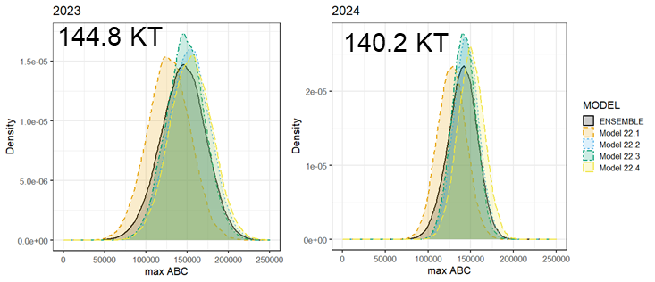
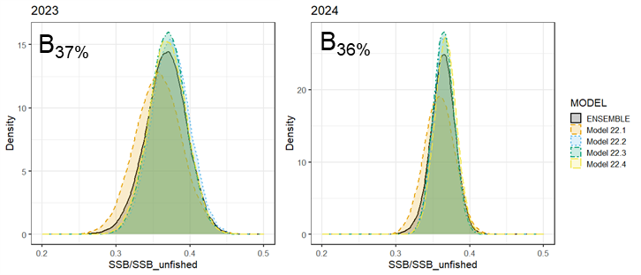
Harvest Recommendation – New Series Ensemble
Year | Quantity | Last Year | New Series | Change
 | B_{100%} | 686,761 | 668,477 | -2.70%
2023 | Tot Biom Age 0+ | 848,615 | 844,578 | -0.50%
2023 | B₂₀₂₃ | 254,585 | 245,594 | -3.50%
2023 | B% | 0.370 | 0.367 | -0.80%
2023 | maxF_{ABC} | 0.310 | 0.293 | -5.50%
2023 | maxABC | 151,709 | 144,834 | -4.50%
2024 | Tot biom Age 0+ |  | 831,566
2024 | B₂₀₂₄ |  | 242,911
2024 | B% |  | 0.364
2024 | maxF_{ABC} |  | 0.29
2024 | maxABC |  | 140,159
Unfished SSB (t)
ABC
Bratio

