Slide 1

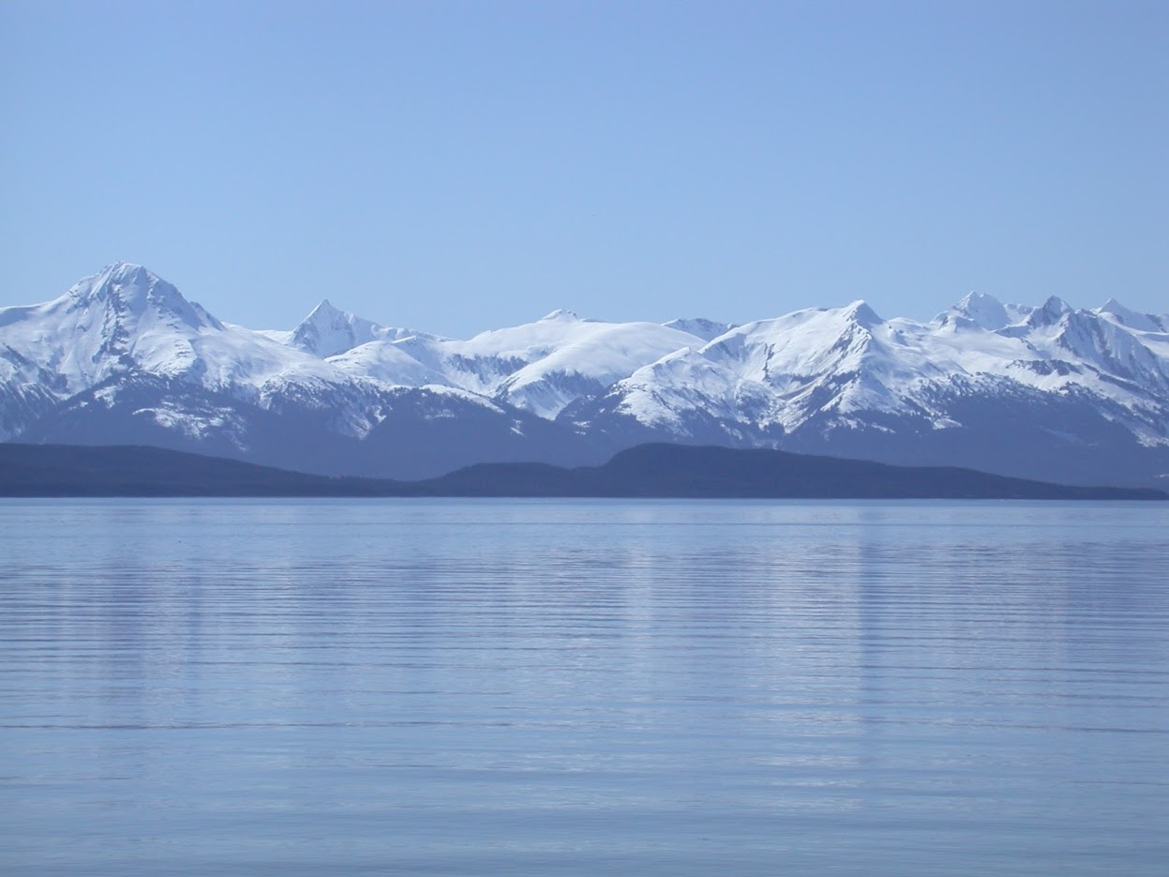
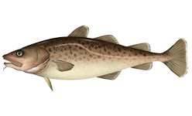


EBS Pacific cod
Steven J. Barbeaux, Lewis Barnett, Jason Connor, Julie Nielson, S. Kalei Shotwell, Elizabeth Siddon, and Ingrid Spies
May 8, 2023

Slide 2
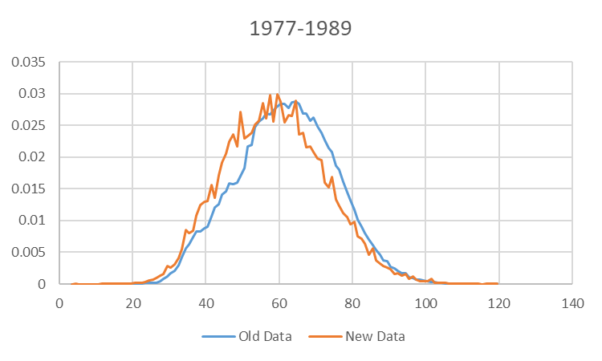
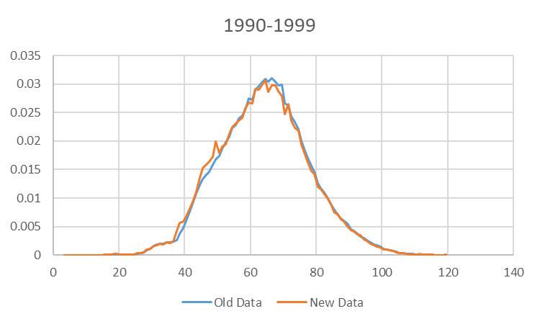
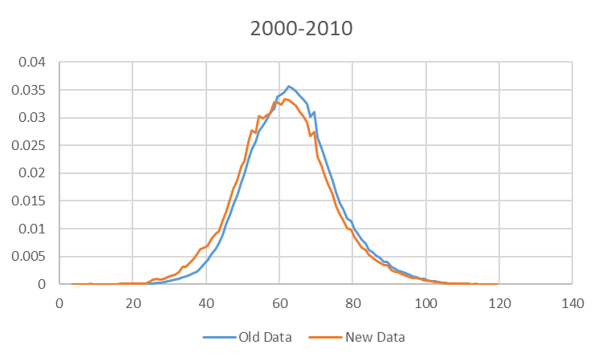
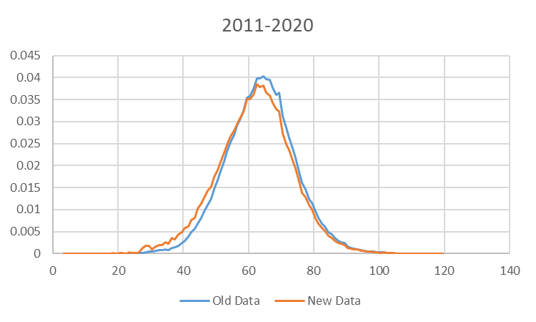
Data changes Fishery Length Composition
New algorithm for constructing fishery length composition (described in September)
Data weighted by haul, vessel, gear, month, NMFS area, and year
Resulted in shift to more small fish in distribution

Slide 3
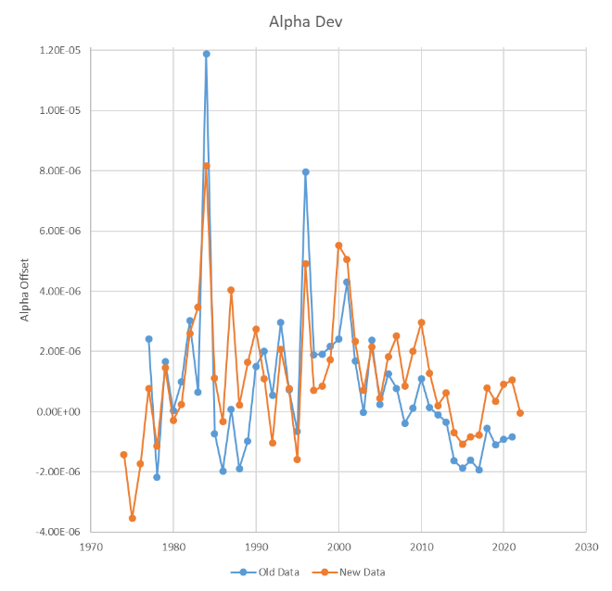
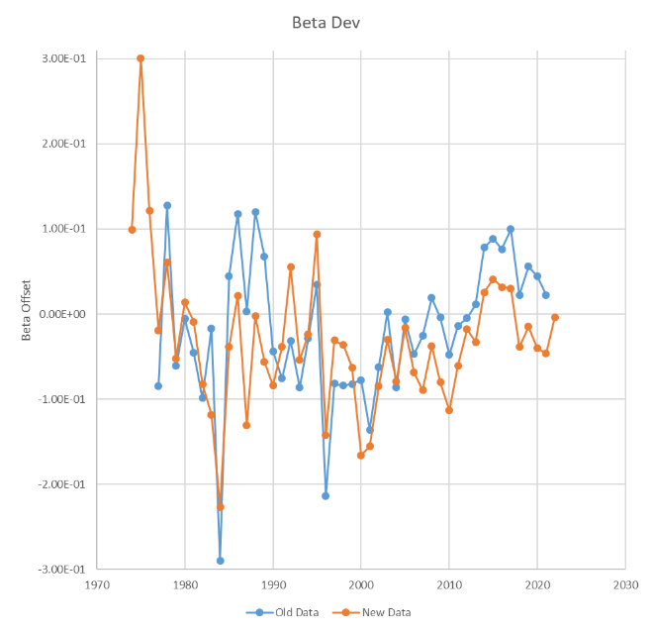
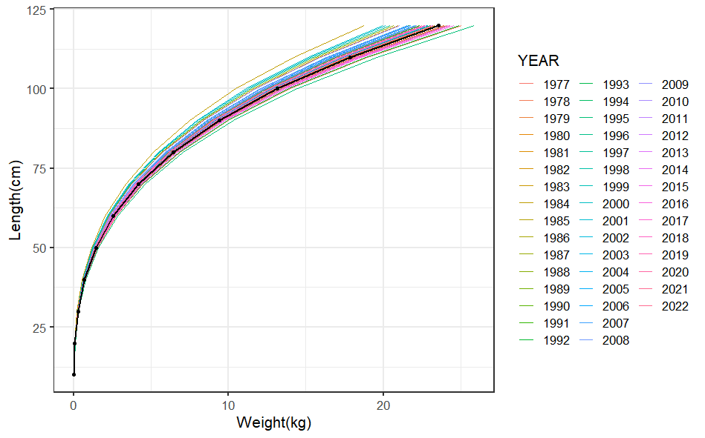
Data changes – Annual Weight-at-Length Adjustments
Switch from linear Mathcad algorithm to GAM in R mgcv library (described in September)
Similar resulting trend in adjustments

Slide 4
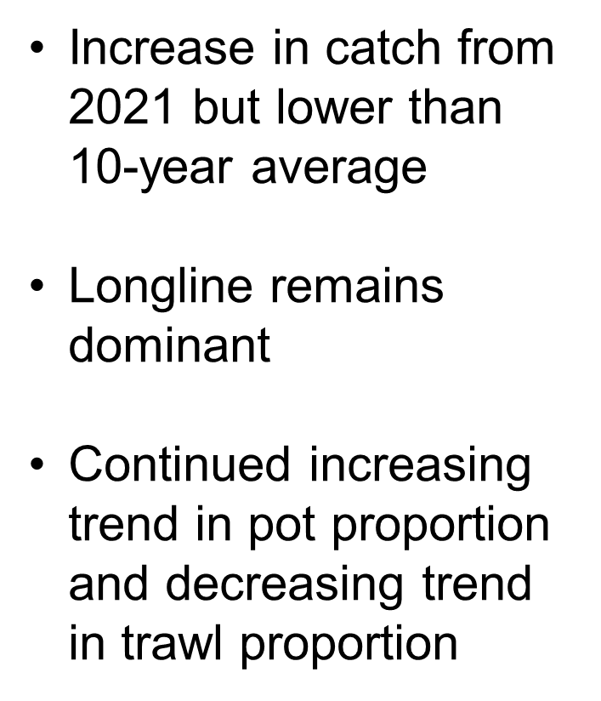
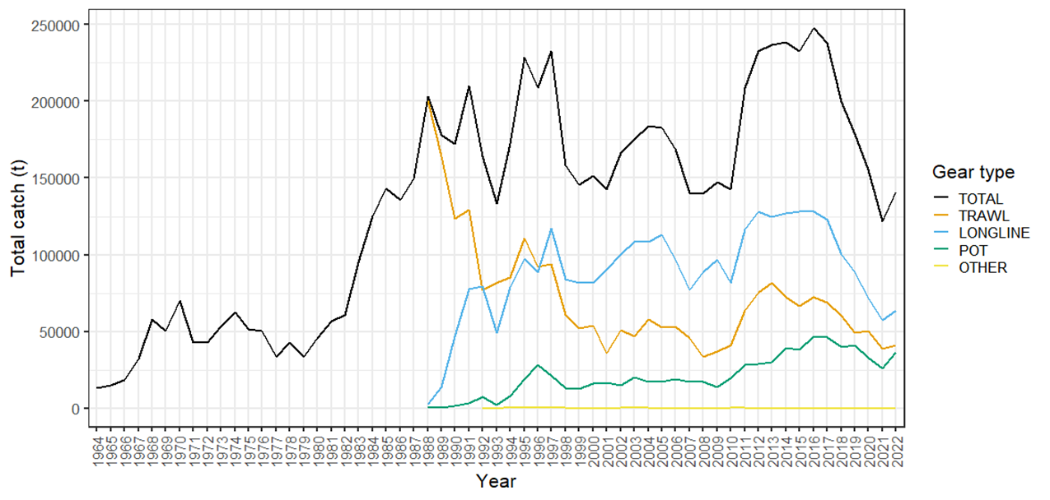
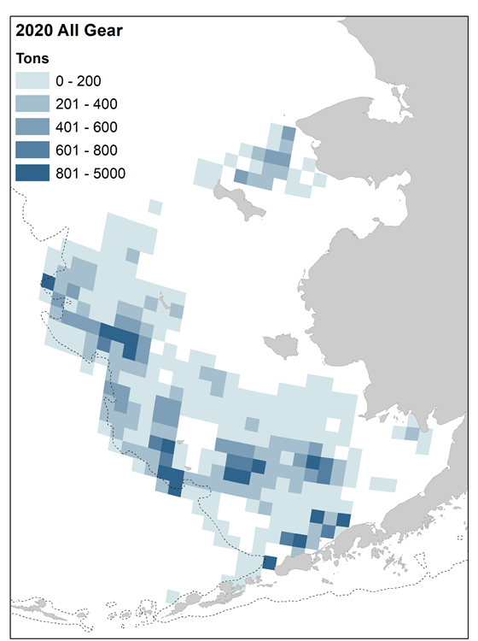
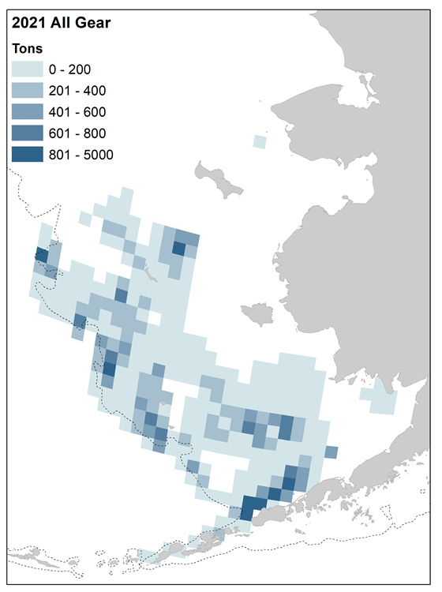
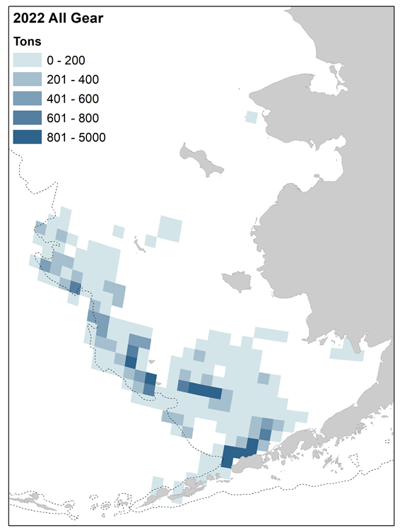
Catch – Fishery Sector
Southwestward shift in center of gravity
Low level of fishing in NBS

Slide 5
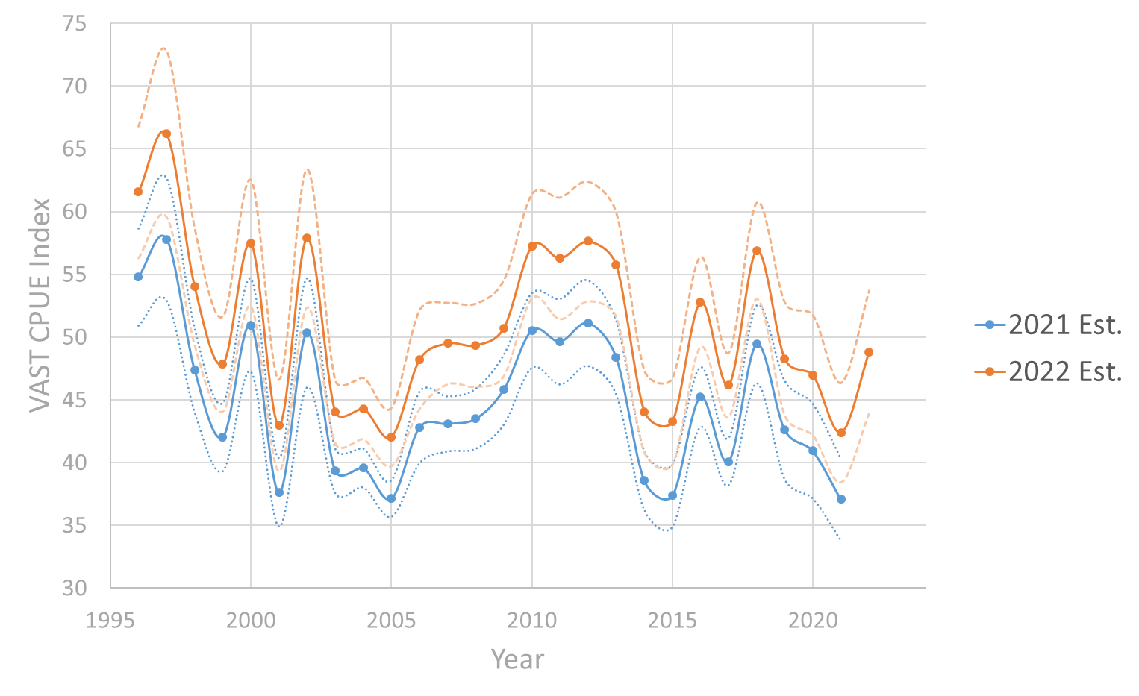
VAST CPUE Index – Jan.-Feb. Longline Fishery
Difference in spatial extent resulted in overall inflation of index
Trend remains the same with high correlation between indices
15% Increase in 2022 from 2021

Slide 6
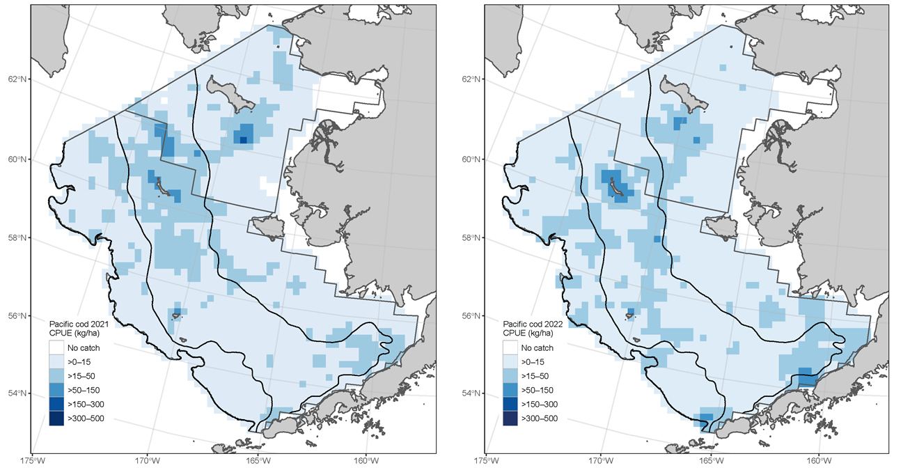
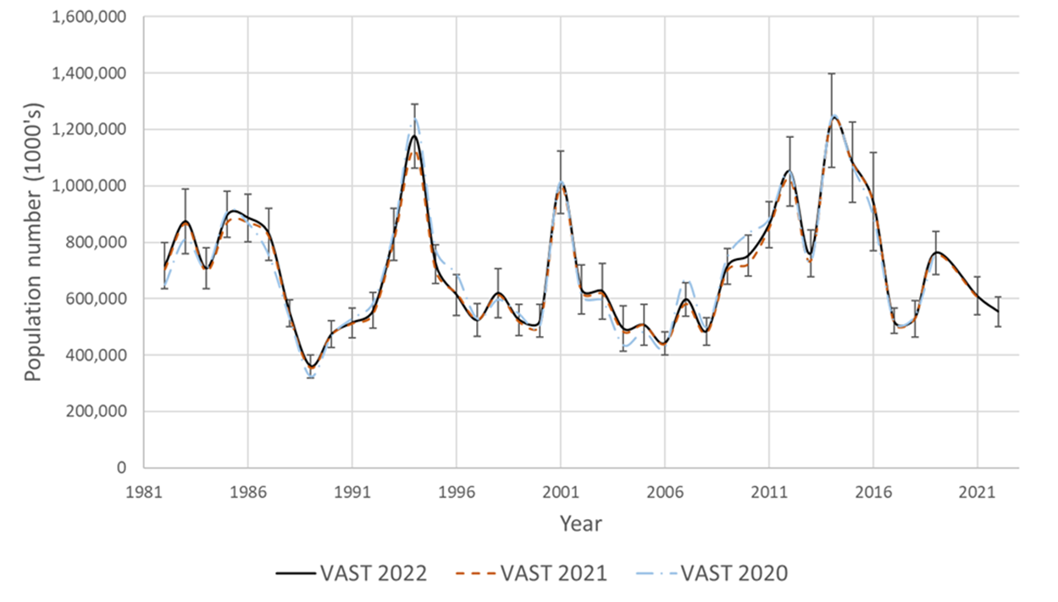
VAST Survey Index – Bering Sea Shelf Bottom Trawl
Southeastward shift in center of gravity
Small changes in time series from previous years
Overall drop in abundance (VAST -8.9% from 2021)

Slide 7
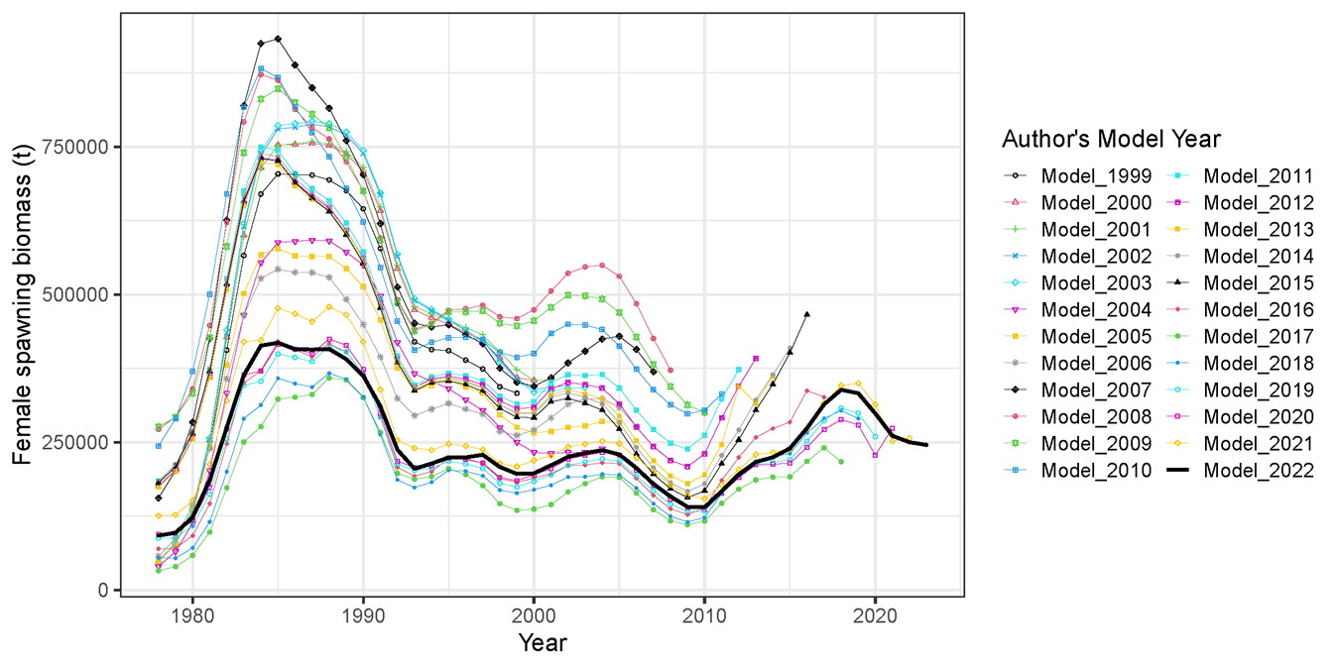
Stock Assessment Models
Diverse set of models over the past 22 years
Current base model is an ensemble of 4 models

Slide 8
Model configurations
Thompson Series models | M 19.12 | M 19.12A | M 21.1 | M 21.2
New Series models | M 22.1 | M 22.2 | M 22.3 | M 22.4
Feature 1: Allow catchability to vary? | YES | NO | NO | NO
Feature 2: Allow domed survey selectivity? | NO | NO | YES | NO
Feature 3: Use fishery CPUE? | NO | NO | NO | YES
New Series models - Same as Thompson Series models except
Seasonally corrected annual weight-at-length adjustments removed
Post-2007 aging bias block removed
Although minor model changes, substantial changes in data processing resulting in model name changes for this year.

Slide 9
Model Fits
Exploration of individual models and their fits can be found at the link provided
Model fits and results were nearly identical between the Thompson and New Series models
Largest difference was the fit to the age composition data with a degraded fit due to the removal of the post-2007 aging bias
https://afsc-assessments.github.io/EBS_PCOD/2022_ASSESSMENT/NOVEMBER_MODELS/

Slide 10
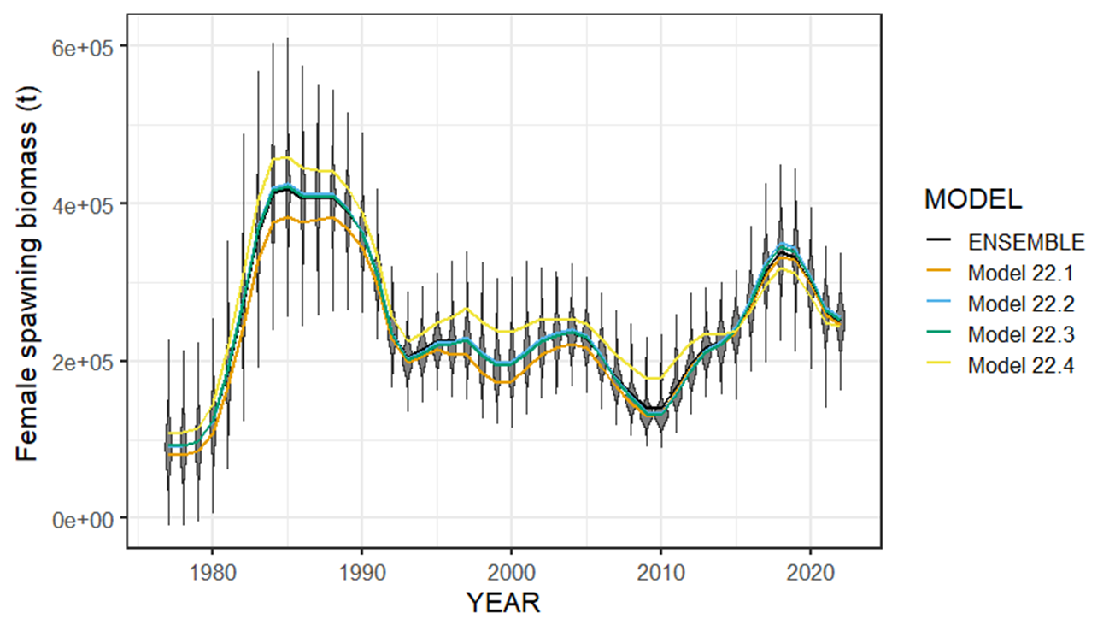
New Series Results – Female spawning biomass
All four models show reduction from 2018 high point.
Model 22.4 with CPUE index indicates higher SSB earlier in the time series and lower in most recent

Slide 11
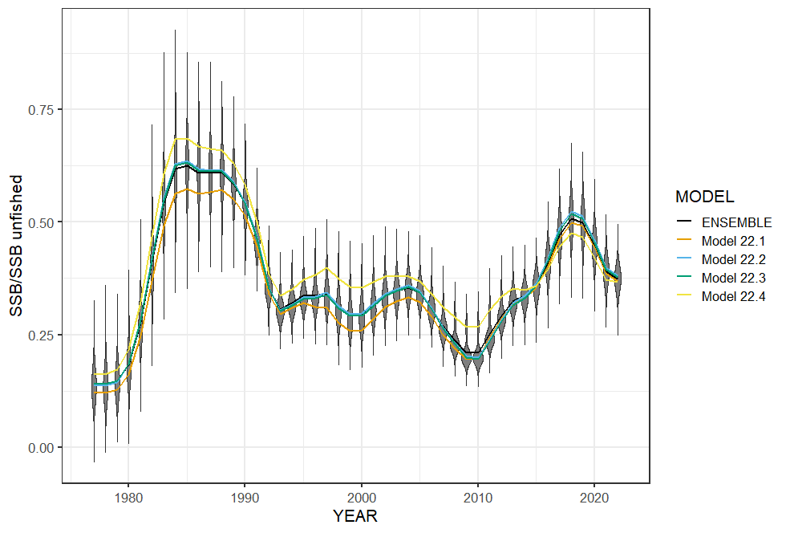
New Series Results – Female spawning biomass
High point in the mid to late 1980s
Low point in 2010 at B_{21%}
Currently below B_{40%}

Slide 12
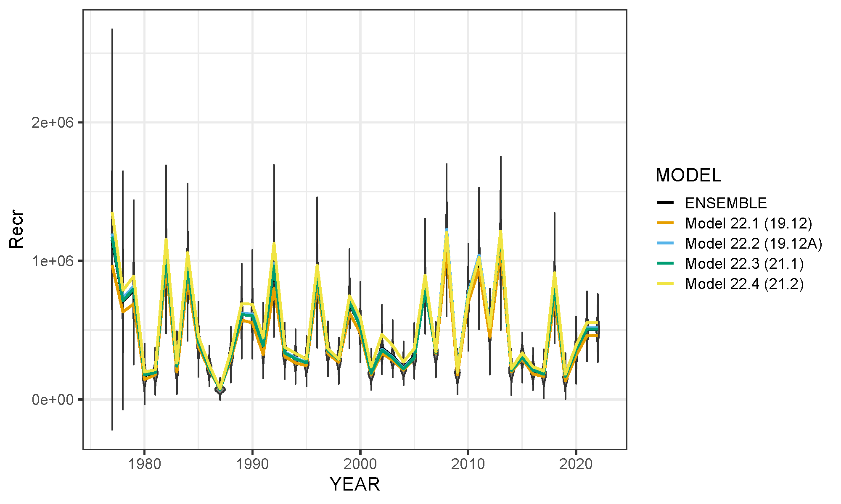
New Series Results – Age-0 recruitment
Large 2018 year class
2014-2017, 2019, and 2020 estimated to be below average
2021 and 2022 set at ~R₀ as not yet well defined in the data.

Slide 13
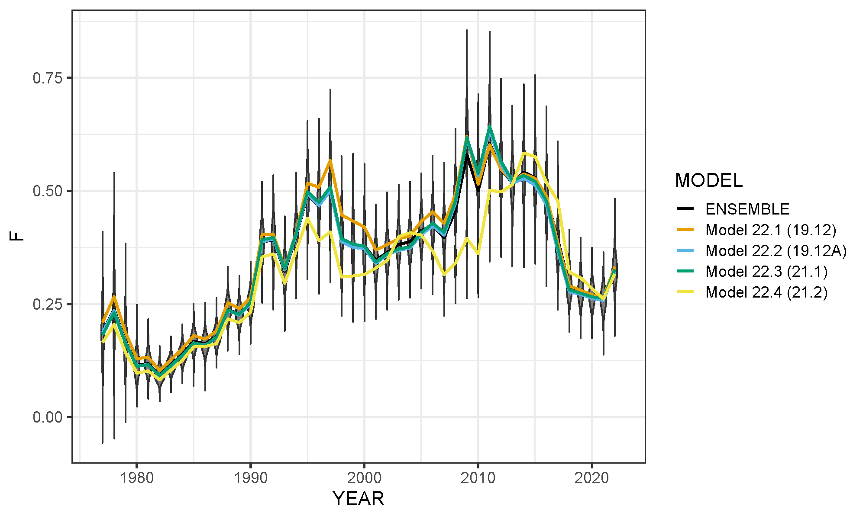
New Series Results – Apical fishing mortality
High fishing mortality from 2008-2016 with dome-shaped survey selectivity
Drop in F 2017-2021 change to asymptotic survey selectivity.
Increase in 2022 due again to change in model with ensemble

Slide 14
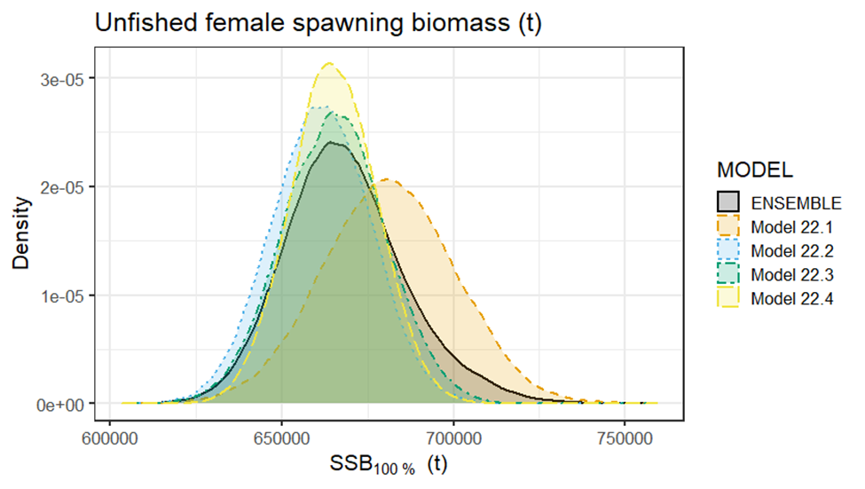
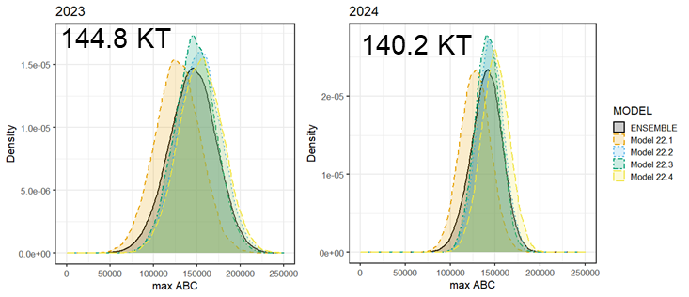
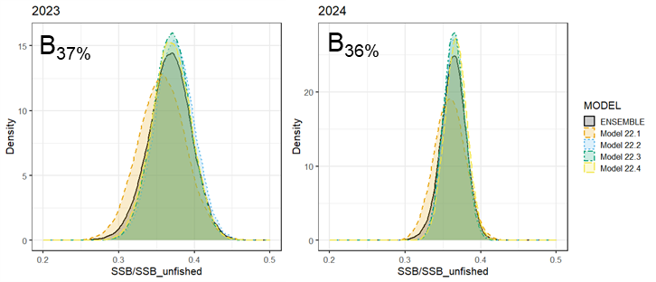
Harvest Recommendation – New Series Ensemble
Year | Quantity | Last Year | New Series | Change
 | B_{100%} | 686,761 | 668,477 | -2.70%
2023 | Tot Biom Age 0+ | 848,615 | 844,578 | -0.50%
2023 | B₂₀₂₃ | 254,585 | 245,594 | -3.50%
2023 | B% | 0.370 | 0.367 | -0.80%
2023 | maxF_{ABC} | 0.310 | 0.293 | -5.50%
2023 | maxABC | 151,709 | 144,834 | -4.50%
2024 | Tot biom Age 0+ |  | 831,566
2024 | B₂₀₂₄ |  | 242,911
2024 | B% |  | 0.364
2024 | maxF_{ABC} |  | 0.29
2024 | maxABC |  | 140,159
Unfished SSB (t)
ABC
Bratio

Slide 15
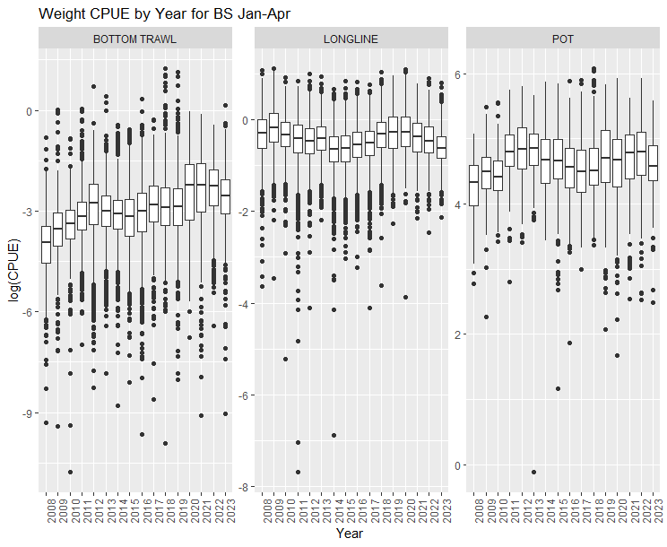
RAW CPUE – Jan.-Mar. All Fisheries
Drop from 2022 for all gear types

Slide 16
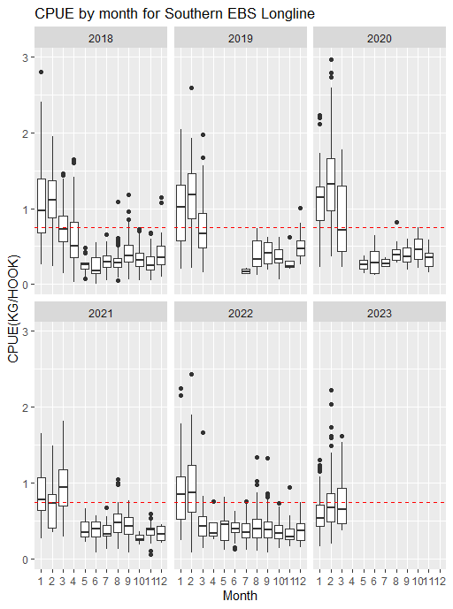
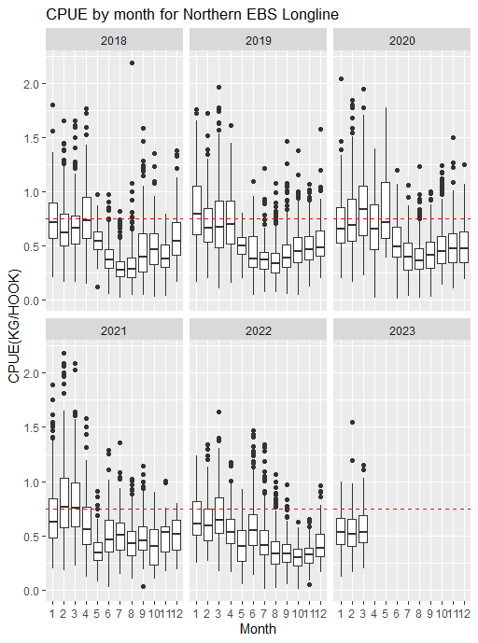
RAW CPUE – Longline Fishery
Drop in longline CPUE for both the Southern and Northern Bering Sea

Slide 17
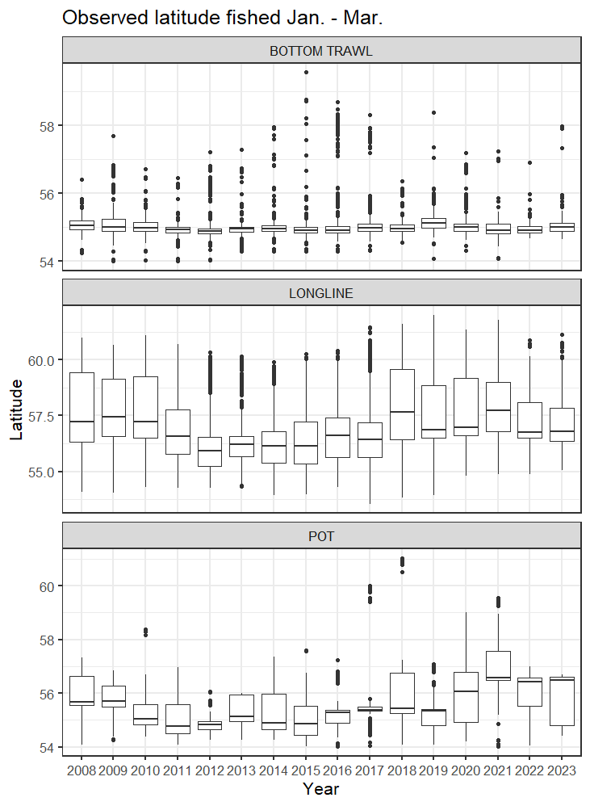
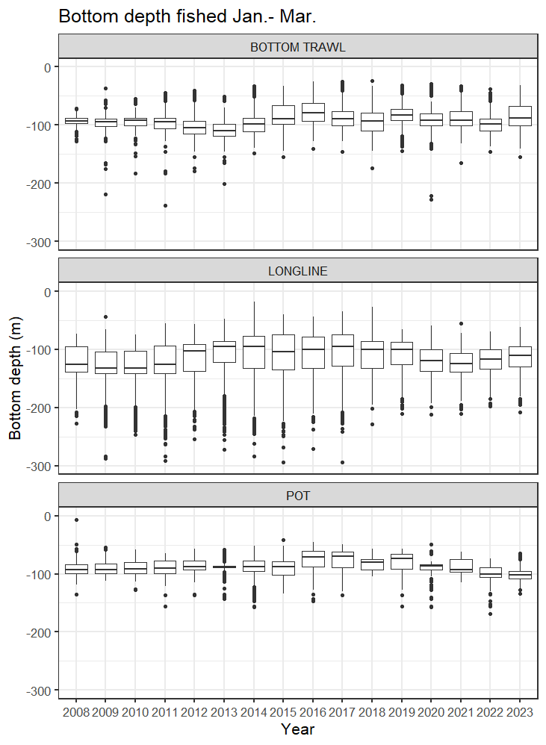
RAW CPUE – Longline Fishery
Longline shifting southward
Trawl and pot remaining the same
Lower variability in depth for longline in recent years.

Slide 18
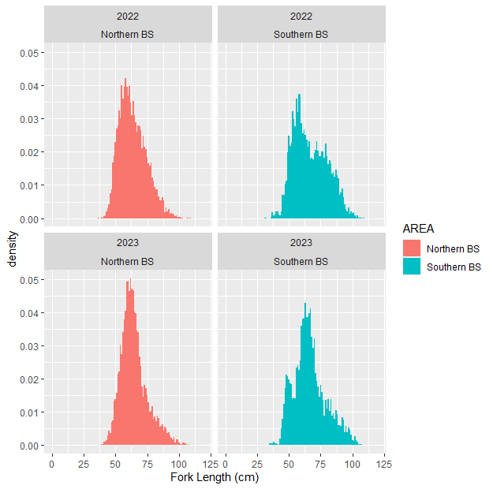
Length Composition– Longline Fishery
Northern Bering Sea looks similar between years
Small fish showing up on longline in southern Bering Sea

Slide 19
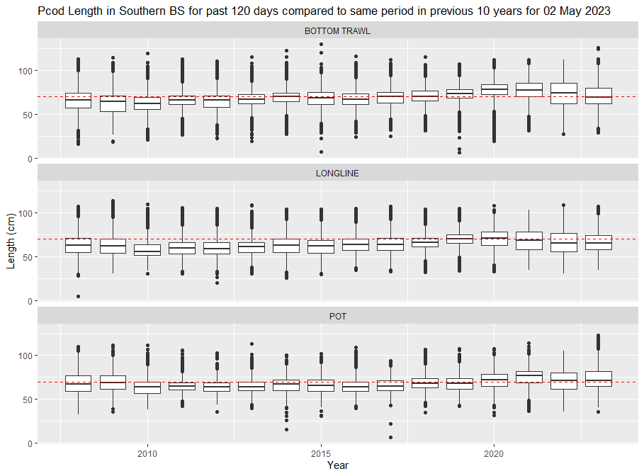
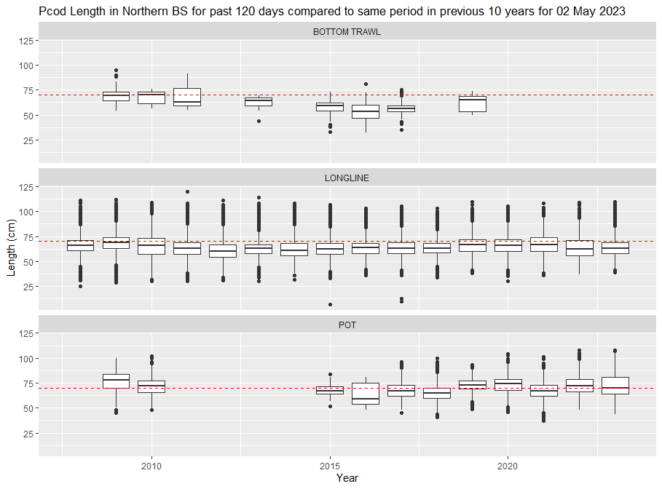
Length Composition– Longline Fishery
Slightly smaller fish than previous 5 years in longline and trawl fisheries, relatively stable for the pot fishery

