Slide 1
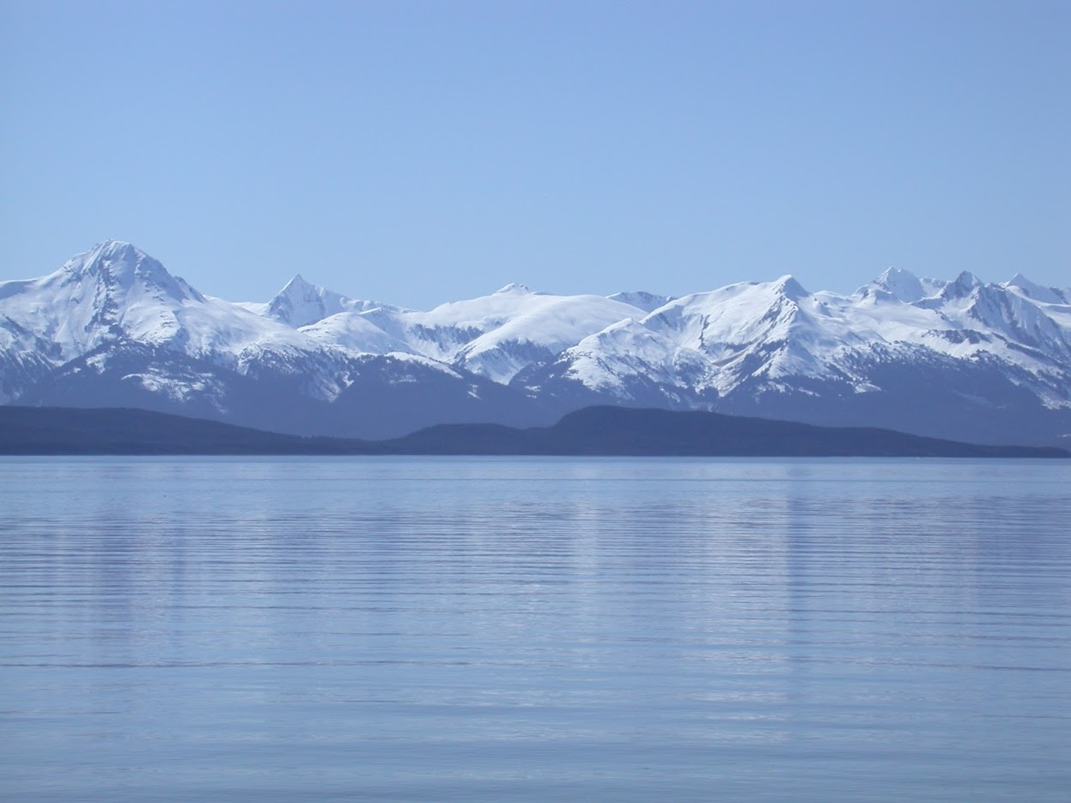
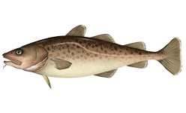

Explorations of alternative stock assessment models for Eastern Bering Sea Pacific cod BSAI Groundfish Plan Team
Steven J. Barbeaux, Pete Hulson, Ingrid Spies, and James Thorson
September, 2023

Slide 2
Summary of analyses
asdf

Slide 3
Summary

Slide 4
Summary

Slide 5
Summary

Slide 6
Summary

Slide 7
Summary

Slide 8
Summary

Slide 9
Summary

Slide 10
QUESTIONS?

