Slide 1
October 2021
Take Home Case
Brett Bartol
MS Business Analytics Student, The University of Texas at Austin

Slide 2
Contents of Presentation:
Patterns within the Data
High Value Neighborhoods
Predicting New House Prices
Recommendations and Conclusion

Slide 3
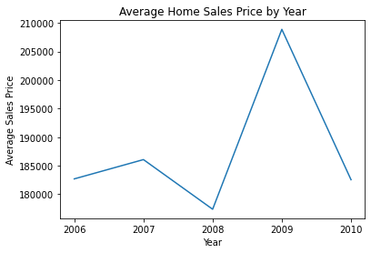
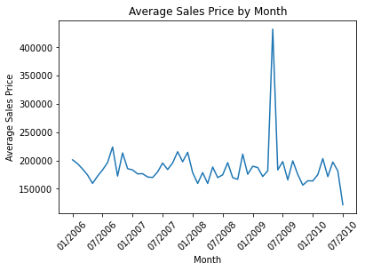
Patterns In the Data
Monthly and Yearly Home Sales

Slide 4
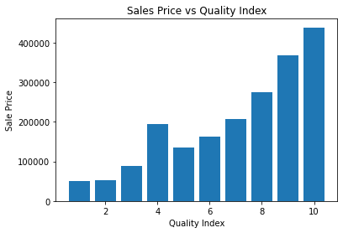
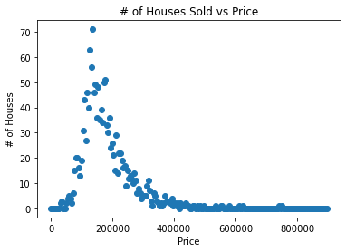
Patterns In the Data CONTD.
Effect of Quality on Price and Distribution of Sales Prices

Slide 5
High Value Neighborhoods

Slide 6
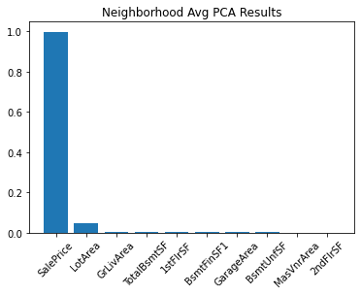
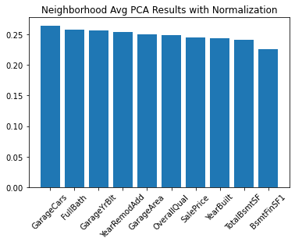
High Value Neighborhoods
Looking at Most Important Predictor with PCA and Housing Price

Slide 7
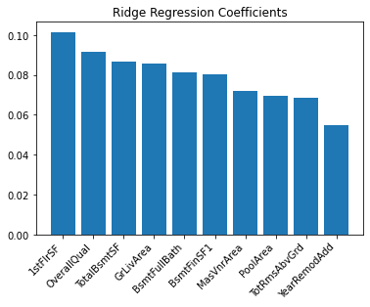
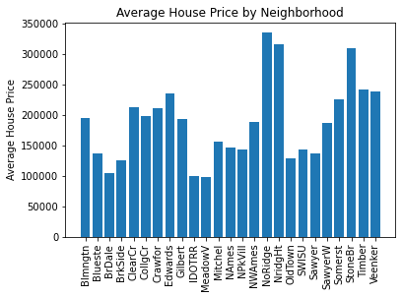
High Value Neighborhoods
Finding Other Important Values Predicting House Values with Ridge Regression

Slide 8
Predicting New Housing Values

Slide 9
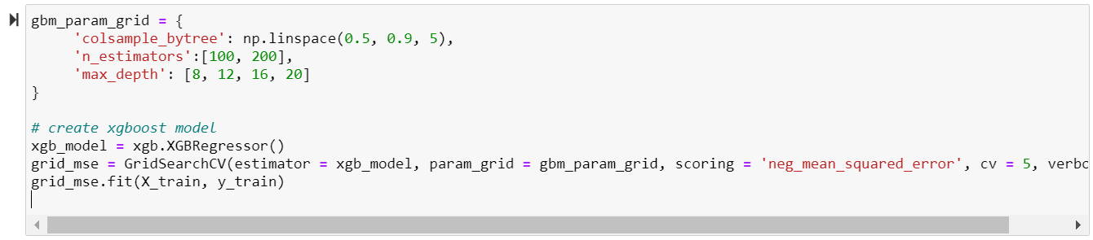
Predicting New Values
Creating House Price Predictions with XGBoost & Cross Validation

Slide 10
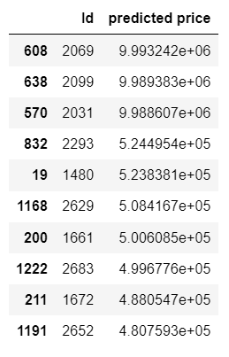
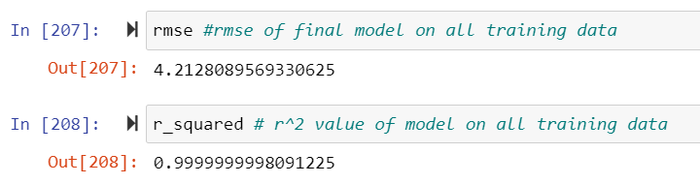
Predicting New Values
RMSE, R^2, and Top 10 Predicted House Values

Slide 11
Conclusions:
House Price Trend over Time
Most Important NH Predictors
Top 10 NEW House Prices

