Slide 1

ATC COMMUNICATION INTELLIGENCE
Speech Recognition and Information Extraction for Aviation Safety
PROGRESS UPDATE · EDA COMPLETE · MACHINE LEARNING IN PROGRESS
Brett Allen | DATA 606 Capstone Progress Update | UMBC, Fall 2026
Advisor: Dr. Jay Wang

Slide 2
Agenda
Project Recap
EDA Results
01
02
Pipeline overview & research questions
Complete: key findings & data readiness
ML Pipeline Tooling
ASR Prototype Findings
03
04
What’s been built so far
Baseline vs. domain-adapted vs. our fine-tune
Remaining ML Work
What’s Next
05
06
Three efforts still ahead
Streamlit app & overall timeline
Brett Allen | DATA 606 Capstone Progress Update | UMBC, Fall 2026
2

Slide 3




01. Project Recap
Goal: a prototype tool (Streamlit app) that transcribes real ATC audio and extracts structured operational information for pilots and controllers, not just a transcript.
→
→
→
ATC Audio
Speech Recognition
Aviation Info Extraction
Communication Analysis
Real + simulated
controller/pilot speech
Whisper-family ASR
(baseline, adapted, fine-tuned)
Callsigns, commands,
altitudes, headings (NER)
WER vs. acoustic/linguistic
characteristics
Research Questions: RQ1 ASR accuracy · RQ2 aviation information extraction · RQ3 what drives transcription error
Brett Allen | DATA 606 Capstone Progress Update | UMBC, Fall 2026
3

Slide 4




02. EDA Results: Complete
17,681
17.9 hrs
2
0
Utterances combined
across both corpora
Of ATC audio,
resampled to 16kHz
Sources: real (ATC-ASR-
Dataset) + simulated (ATCOSIM)
Data-quality issues:
no missing/duplicate rows
Full ingestion → cleaning → feature-derivation pipeline is reusable (src/preprocessing/) and already exposed as a standalone CLI script (see slide 07).
Brett Allen | DATA 606 Capstone Progress Update | UMBC, Fall 2026
4

Slide 5
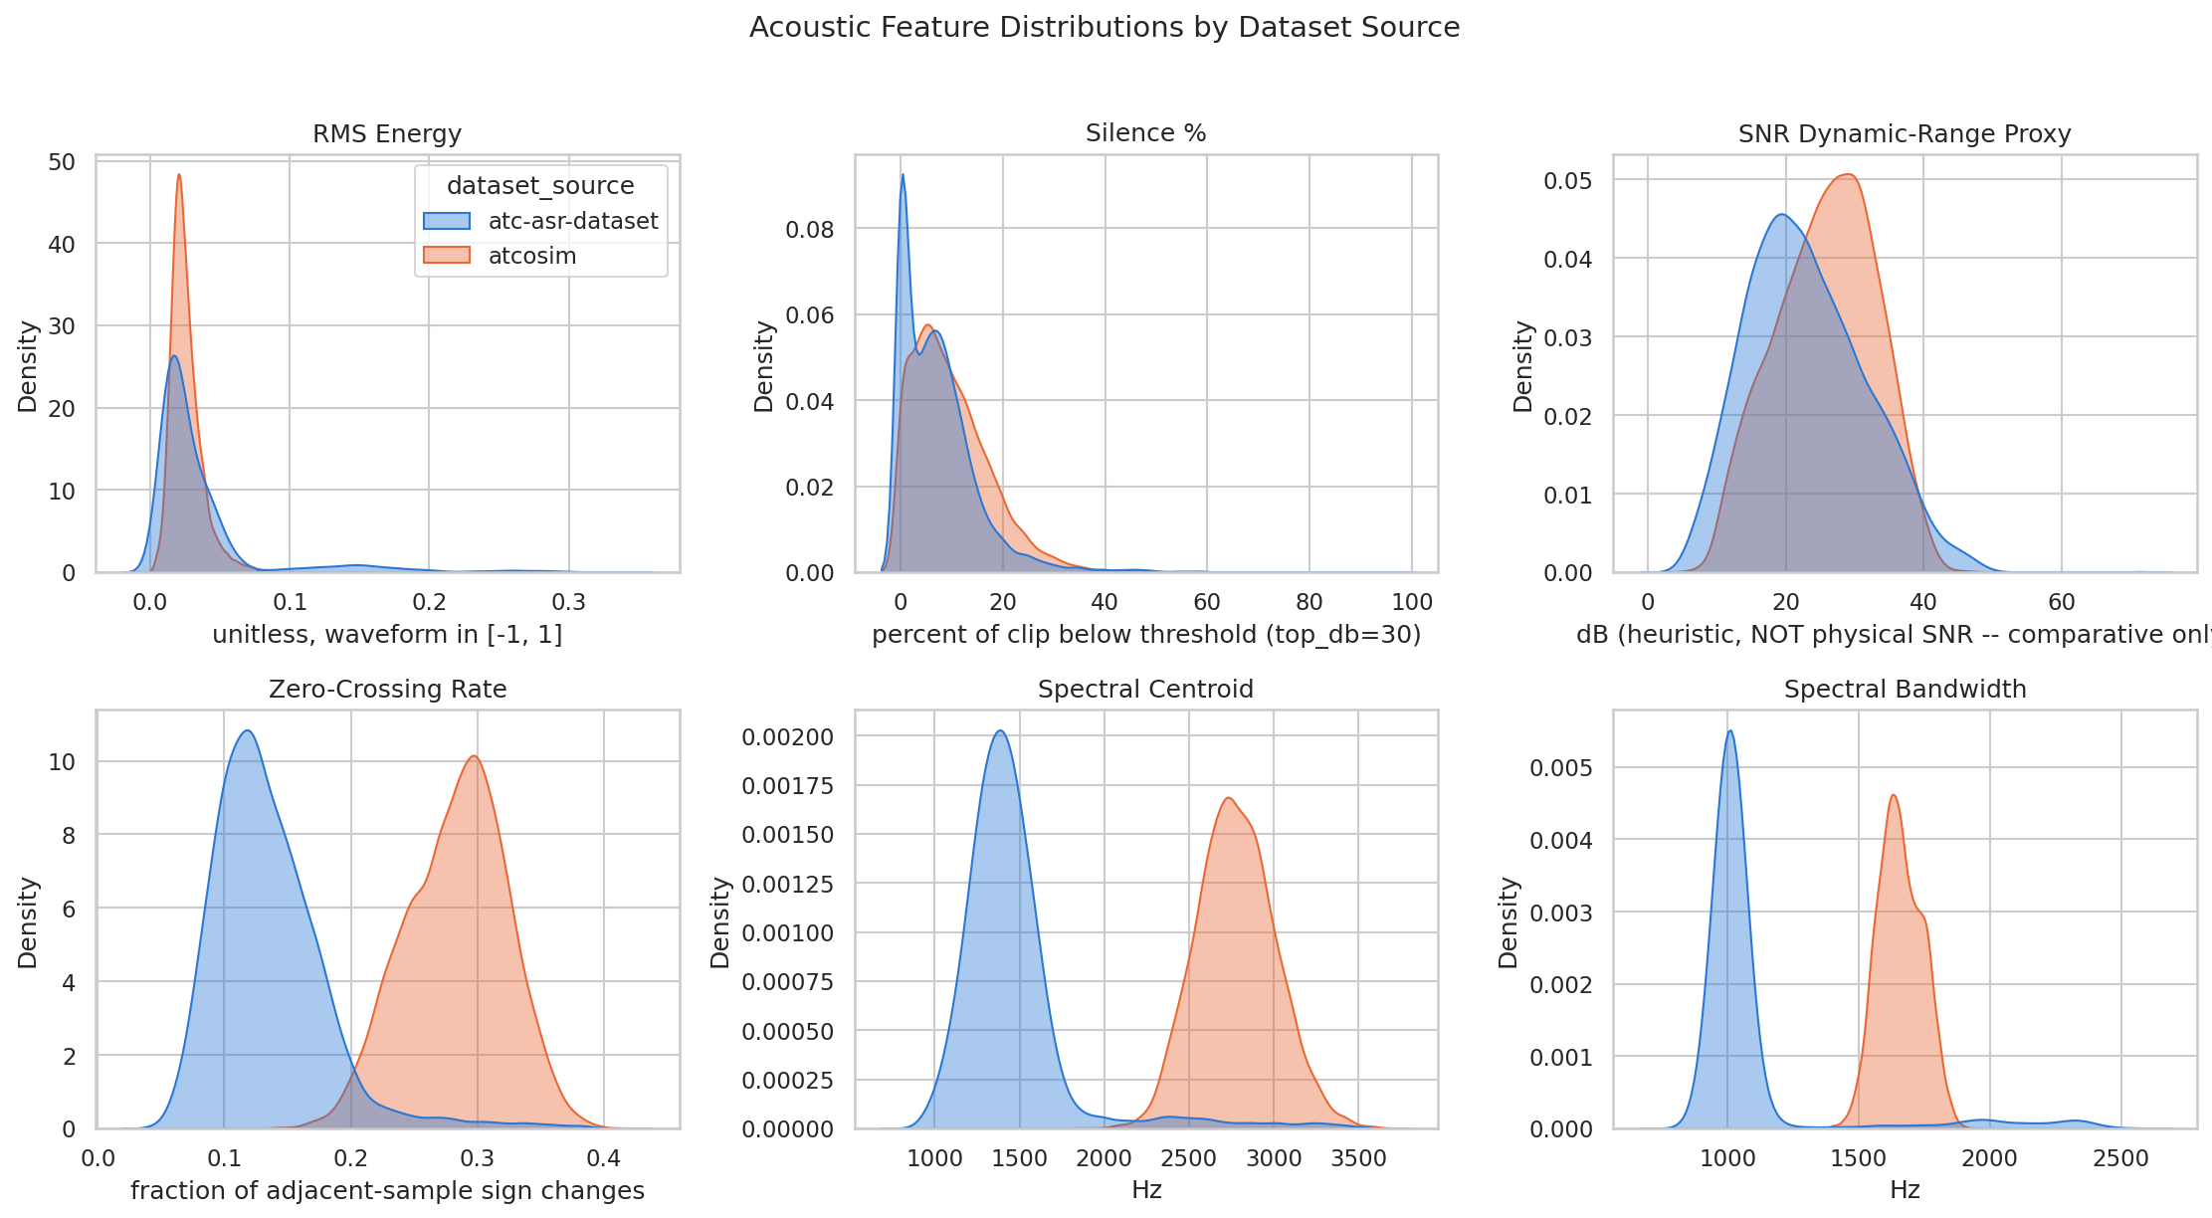
02. Key Finding: The Acoustic Domain Gap
Real ATC audio is measurably narrower-band than simulated audio, the acoustic fingerprint of a VHF radio channel and a domain gap any model must account for.
Brett Allen | DATA 606 Capstone Progress Update | UMBC, Fall 2026
5

Slide 6
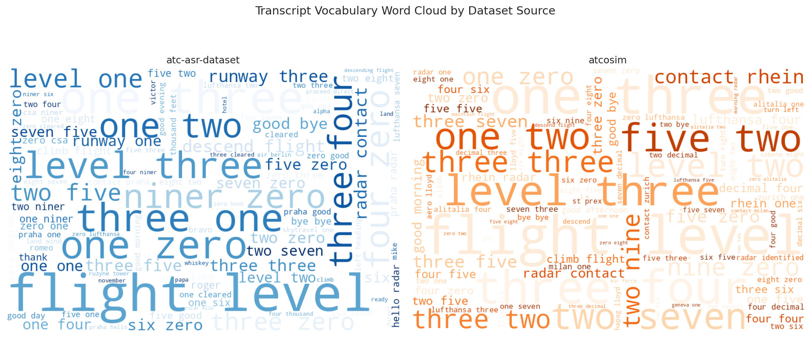
02. Key Finding: Vocabulary & Phraseology
Real-world traffic is lexically richer (nearly 2x the vocabulary type-token ratio) despite fewer total words; simulated ATCOSIM leans on a smaller, more repeated set of scripted phraseology (31.6% vs. 8.2% repeated-transcript rate).
Brett Allen | DATA 606 Capstone Progress Update | UMBC, Fall 2026
6

Slide 7


03. ML Progress: Pipeline Tooling
Built so the full data-curation step no longer requires running the EDA notebook end to end.
scripts/run_ingest.py
DONE
Standalone CLI for data curation/ingest, with no notebook memory overhead
--purge-raw flag
DONE
Optional post-process purge of large raw downloads to reclaim disk space
run-pipeline.sh
INGEST READY
Interactive driver meant to orchestrate ingest → train → infer; asks per-stage questions
Brett Allen | DATA 606 Capstone Progress Update | UMBC, Fall 2026
7

Slide 8
04. ASR Prototype Results
Three conditions on the same 100-utterance held-out test set: openai/whisper-medium.en (baseline), jacktol’s fine-tuned medium.en (comparison), and our own whisper-small.en fine-tune.
*Baseline’s real-audio WER is dominated by two runaway-generation (hallucination) outliers (see next slide).
†Our Fine-Tune’s figures are approximate: exact WER shifts by a few tenths of a point each time it’s retrained (GPU non-determinism).
Brett Allen | DATA 606 Capstone Progress Update | UMBC, Fall 2026
8

Slide 9



04. ASR Prototype: Key Takeaways
Fine-tuning beats raw size
A real failure mode, caught
Our small.en fine-tune (244M params, 1,000 training rows) beat the medium.en baseline (769M params) in both domains.
The generic baseline repeats itself into a 150-word loop on some real-audio clips, a documented Whisper hallucination pattern, not a bug in our code.
An engineering lesson
Disclosed, not hidden
Full batch_size=8 fine-tuning pinned this GPU at 98% VRAM and thrashed; batch_size=4 (same effective batch via gradient accumulation) fixed it.
jacktol’s real-audio numbers carry an unverified train/test-overlap risk, flagged explicitly rather than presented as a clean win.
Brett Allen | DATA 606 Capstone Progress Update | UMBC, Fall 2026
9

Slide 10
05. Remaining ML Work
1
2
3
ASR Standalone Pipeline
Aviation Information Extraction
NER Standalone Pipeline
Promote the notebook’s training + evaluation loop into a reusable script, following the same pattern as the data-ingest CLI.
Use an LLM to help curate aviation entity labels (callsigns, commands, altitudes, headings, frequencies), then train a NER model on them.
Build a reusable training/evaluation pipeline for the NER model, mirroring the ASR and data-ingest pipelines.
Brett Allen | DATA 606 Capstone Progress Update | UMBC, Fall 2026
10

Slide 11



06. What’s Next
Once the ASR and aviation-NER pipelines are complete, the final milestone is a Streamlit prototype for real-time ATC audio analysis.
EDA
ASR Prototype
ASR Pipeline
Aviation NER
NER Pipeline
Streamlit App
Milestones ahead: ASR pipeline → LLM-assisted entity labeling + NER training → NER pipeline → Streamlit integration & demo.
Brett Allen | DATA 606 Capstone Progress Update | UMBC, Fall 2026
11

Slide 12
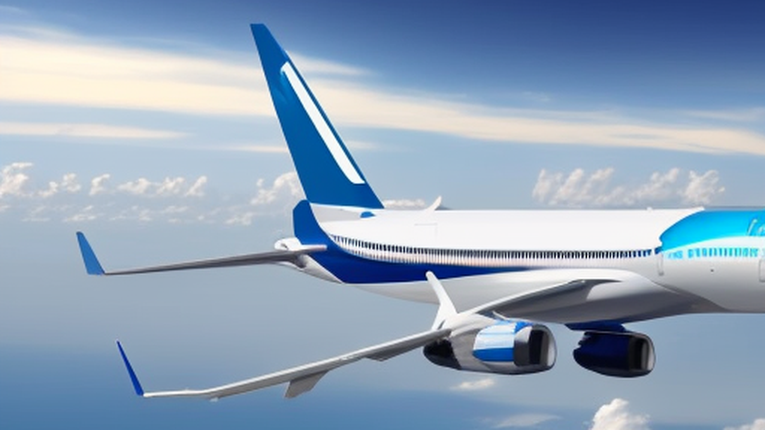
Thank You
Questions & Discussion
Brett Allen | DATA 606 Capstone Progress Update | UMBC, Fall 2026

