Slide 1
ATC COMMUNICATION INTELLIGENCE
Speech Recognition and Information Extraction for Aviation Safety
FINAL PRESENTATION · HEAR → UNDERSTAND → COMPARE → ASSIST
Brett Allen | DATA 606 Capstone | UMBC, Fall 2026
Advisor: Dr. Jay Wang
Notes:
[~0:30] Introduce yourself and the project in one sentence: I built and evaluated a pipeline that turns air traffic control radio audio into text and then into structured clearance information, and wrapped it in a prototype application. The talk follows four verbs: HEAR the audio, UNDERSTAND the text, COMPARE the models, ASSIST with an application.

Slide 2




From radio audio to a usable clearance
THE STORY
HEAR
UNDERSTAND
COMPARE
ASSIST
Fine-tune Whisper to transcribe real ATC radio
Extract nine aviation entity types from the transcript
Judge models by aviation entities, not only WER
ClearanceIQ: a CPU-only research prototype
RQ1
RQ2
RQ3
How accurately can domain-adapted ASR transcribe ATC speech?
Can NLP reliably extract operational information from transcripts?
Which acoustic and linguistic traits are linked to ASR errors?
Notes:
[~1:30] Walk the four stages left to right, then the three research questions. Key framing: ATC is safety critical, and a transcript that looks 'mostly right' can still get a callsign or an altitude digit wrong, which is why this project evaluates by aviation entities as well as WER.
Transition: 'Let's start with what we are listening to: the data.'

Slide 3




Two corpora, one leakage-safe test set
HEAR · THE DATA
17,681
17.9 hrs
2
1,909
utterances across both corpora
of ATC audio, resampled to 16 kHz
sources: real radio (8,122) and simulated (9,559)
held-out test utterances, scored once per model
Real = ATC-ASR-Dataset (UWB corpus + ATCO2 test subset). Simulated = ATCOSIM. An overlapping ATCO2 mirror was dropped and ATCOSIM was split by recording session, so no session or recording crosses a split.
Notes:
[~1:30] Two corpora on purpose: real radio audio is the hard, operationally relevant target; simulated audio supplies training volume. Emphasize the leakage decision: the first real source overlapped with the second, so it was replaced, and ATCOSIM was re-split by recording session. The test set is 1,909 utterances, scored once per model.
Transition: 'Before modeling, EDA asked how different those two worlds really are.'

Slide 4
Real ATC audio is narrowband radio speech
HEAR · EDA FINDING 1
0.135 vs 0.283
zero-crossing rate, real vs. simulated (see note)
0.045 vs 0.011
RMS-energy spread: uncontrolled real recordings
300–3,400 Hz
traditional VHF voice band that filters out high frequencies
A model trained mostly on simulated audio meets a different signal in deployment.
Spectral centroid = the average frequency of the sound (its “brightness”); bandwidth = how widely the frequencies spread. Zero-crossing rate = how often the waveform flips sign, a noisiness proxy.
Notes:
[~1:30] Finding 1 of 3. Real audio is much narrower-band: mean spectral centroid is 1,460 Hz versus 2,777 Hz, consistent with the VHF radio channel. Real recordings also vary far more in energy. Modeling implication: always report real and simulated performance separately, because aggregating them hides the domain gap.

Slide 5
Real traffic varies; simulation is scripted
HEAR · EDA FINDINGS 2 AND 3
0.0141 vs 0.0077
type-token ratio (distinct ÷ total words); real is ~2x richer
1,167 vs 830
distinct word types, real vs. simulated
Simulation leans on a small set of standard instructions. Real traffic mixes short acknowledgements with a wider vocabulary, so it is the better test.
Notes:
[~1:15] Findings 2 and 3. Simulated audio repeats its phraseology (31.6% of rows have a repeated transcript versus 8.2% for real) and almost always contains a command verb. Real traffic has nearly twice the type-token ratio. Together with the acoustics, all angles agree: real audio is the harder, more varied target.
Transition: 'So how well can a model hear the real thing?'

Slide 6
Fine-tuning cut real-audio WER to 7.5%
HEAR · ASR RESULTS
3.8%
overall WER (95% CI 3.4–4.3), 1.2% on simulated audio
−1.5 pts
vs. the off-the-shelf ATC model on real audio (CI −2.4 to −0.6)
That model may have seen part of the test audio during its own training, so its number carries a leakage caveat.
WER (word error rate) = the share of words the model gets wrong; lower is better. CI = 95% confidence interval, the plausible range.
Notes:
[~1:30] This is the headline ASR result. Zero-shot medium.en is at 53.6% WER on real audio; the selected medium.en + LoRA model, trained on the full train split, reaches 7.5% real and 3.8% overall, scored once on all 1,909 test utterances. It beats the off-the-shelf ATC model on real audio by 1.5 points with a paired confidence interval that excludes zero. Be upfront about the caveat: that model's real-audio number may be inflated by train/test overlap that cannot be verified.
Transition: 'A transcript is only useful if we can pull the operational facts out of it, so next, UNDERSTAND.'

Slide 7




An LLM teaches a small, fast model
UNDERSTAND · ENTITY EXTRACTION
LLM teacher
Curate
Verify
Student
Qwen3.5-9B labeled 15,083 utterances: 42,915 spans in 12.5 h
33% of labels were flagged as doubtful and held out of training
Humans adjudicated disagreements to build a frozen held-out set
spaCy NER: about 4 MB and 3,700 utterances/s on a CPU
NINE LABELS
CALLSIGN
COMMAND
FACILITY
ALTITUDE
HEADING
FREQUENCY
WAYPOINT
RUNWAY
SQUAWK
Notes:
[~1:30] The datasets have no entity labels, so labels were produced in stages. An LLM teacher labeled the whole corpus; cheap signals flagged the doubtful third, which was kept out of training; humans adjudicated the disagreements between two annotators to make a frozen held-out set; and a small spaCy student was trained on the curated labels so the app can run entity extraction on a CPU in about a millisecond. Nine labels: callsign, command, facility, altitude, heading, frequency, waypoint, runway, squawk.

Slide 8
NER is strong on structure, weaker on ambiguity
UNDERSTAND · NER RESULTS
SPAN F1 SCORE · 0 TO 1, HIGHER IS BETTER
0.861 vs 0.878
spaCy student vs. LLM teacher on 100 human-verified utterances. F1 balances precision and recall; a span counts only if label and exact text match. The gap is within noise (CI −0.047 to +0.013).
WHERE IT SLIPS
FREQUENCY: digit-only shorthand is missed (61% found)
COMMAND / FACILITY: ambiguous boundaries; annotators agreed exactly on only 60–62%
HEADING, SQUAWK: too few held-out spans to score
Notes:
[~1:30] Held-out F1 for the LLM teacher is 0.878 overall; per label, runway, altitude, command and callsign are above 0.9. The spaCy student chosen for the app scores 0.861, within noise of the teacher. Error examples: frequencies spoken as bare digit strings are missed; command and facility boundaries are genuinely ambiguous, so even two independent annotators agreed exactly on only about 60% of utterances. Heading and squawk have too few held-out spans to say anything about.
Transition: 'Now let's put all the ASR models side by side.'

Slide 9
Medium + LoRA wins on every accuracy metric
COMPARE · MODEL COMPARISON
Model | Overall WER | Real WER | Simulated WER | Entity F1 | Callsign recall | Train time
small.en, zero-shot | 42.2% | 61.3% | 28.8% | 0.445 | 0.231 | n/a
medium.en, zero-shot | 35.7% | 53.6% | 23.1% | 0.513 | 0.286 | n/a
Off-the-shelf ATC medium.en | 12.4% | 9.1%* | 14.8% | 0.754 | 0.557 | n/a
small.en fine-tuned, 3 epochs | 5.4% | 10.9% | 1.5% | 0.908 | 0.847 | 57 min
small.en fine-tuned, 8 epochs | 4.9% | 9.7% | 1.4% | 0.918 | 0.860 | 154 min
medium.en + LoRA (selected) | 3.8% | 7.5% | 1.2% | 0.935 | 0.886 | 239 min
Test split: 1,909 utterances (813 real, 1,096 simulated), each model scored once. WER = share of words wrong (lower is better). Entity F1 and callsign recall (0 to 1, higher is better) = how many reference entities or callsigns survive in the transcript, matched on label and exact text. * May have overlapped the test audio in its own training.
Notes:
[~1:30] One table, six models. Read it top to bottom: zero-shot models are poor on real audio; the off-the-shelf ATC model is good on real audio but weak on simulated and on entities; fine-tuning on the full train split removes most error; medium.en with LoRA adapters (4.3% of parameters trained) is best on every accuracy column, at the cost of 239 minutes of training on an 8 GB laptop GPU. Point to the entity F1 and callsign columns as the lead-in to the next slide.

Slide 10
WER hides where the errors fall
COMPARE · AVIATION-SPECIFIC ERRORS
9.1% vs 7.5%
real-audio WER: nearly the same...
0.754 vs 0.935
...entity F1 (0 to 1, higher is better): very different
Callsigns are the weakest entity for every fine-tuned model (recall 0.886 for the selected one): airline names and spelled registrations are the hardest words.
Entity recall = the share of the reference transcript's entities (same label, same text) that also appear in the model's transcript.
Notes:
[~1:30] This is the slide that justifies the project's premise. The off-the-shelf ATC model and the selected model are close on real-audio WER (9.1% vs 7.5%), yet entity F1 is 0.754 versus 0.935; callsign recall is 0.557 versus 0.886 and waypoint recall is 0.252 versus 0.928. A callsign or a waypoint is exactly the kind of word an operator cannot afford to lose. Caveat to mention if asked: the reference entities come from the NER model itself, so a systematic NER bias would not show up here.

Slide 11



When ASR slips, NER inherits the error
COMPARE · ERROR ANALYSIS
Hallucination
ASR → NLP PROPAGATION
A degraded 3.75 s clip ending 'descend flight level one zero zero' came out as 'If you have any questions, please contact the flight control team'.
7.5% → 0.856
Callsign garbling
real-audio WER becomes entity F1 (0 to 1, higher is better): one wrong word breaks a whole entity.
'eight juliett echo' became 'athria degol' in the small fine-tuned model.
NER cannot tell a wrong digit from a right one: “six thousand” heard for “five thousand” is still a clean ALTITUDE tag.
Number conventions
'niner' versus 'nine' is a scoring artifact that inflates WER without a real recognition error.
Notes:
[~1:30] Left: three failure modes from the error taxonomy. Hallucination is a documented Whisper failure that persisted after fine-tuning; callsign garbling is the most operationally costly; the niner/nine issue is a scoring artifact rather than a recognition error. Right: error propagation. The NER was trained on clean reference text but in the app receives ASR output, so a 7.5% word error rate on real audio becomes 0.856 entity F1, and the NER will confidently tag a wrong digit. This is why the app presents results as research output, not as authoritative clearances.

Slide 12
Short real-audio clips are the hardest
COMPARE · RESEARCH QUESTION 3
|ρ| ≤ 0.17
Spearman correlation of WER with each trait (0 = no link, 1 = perfect): all weak
14.5% vs 5–6%
real-audio WER with 0–1 entities vs. 3 or more
−0.32 → −0.05
Spearman ρ of WER with clip duration: zero-shot vs. fine-tuned
Exploratory and correlational. SNR proxy = a rough dynamic-range estimate, not true signal-to-noise.
Notes:
[~1:15] RQ3. Recording origin matters most (7.5% vs 1.2%), and within real audio the shortest clips are hardest: 14.6% under two seconds versus about 6% beyond three. Entity-dense transmissions are actually easier, mostly because they are longer and give the model more context. Per-utterance correlations are weak (|rho| at most 0.17), and fine-tuning weakened the dependence on length. Label this as exploratory: it is correlational and relies on heuristic features like the SNR proxy.
Transition: 'Now, how do we put all of this in someone's hands? ASSIST.'

Slide 13
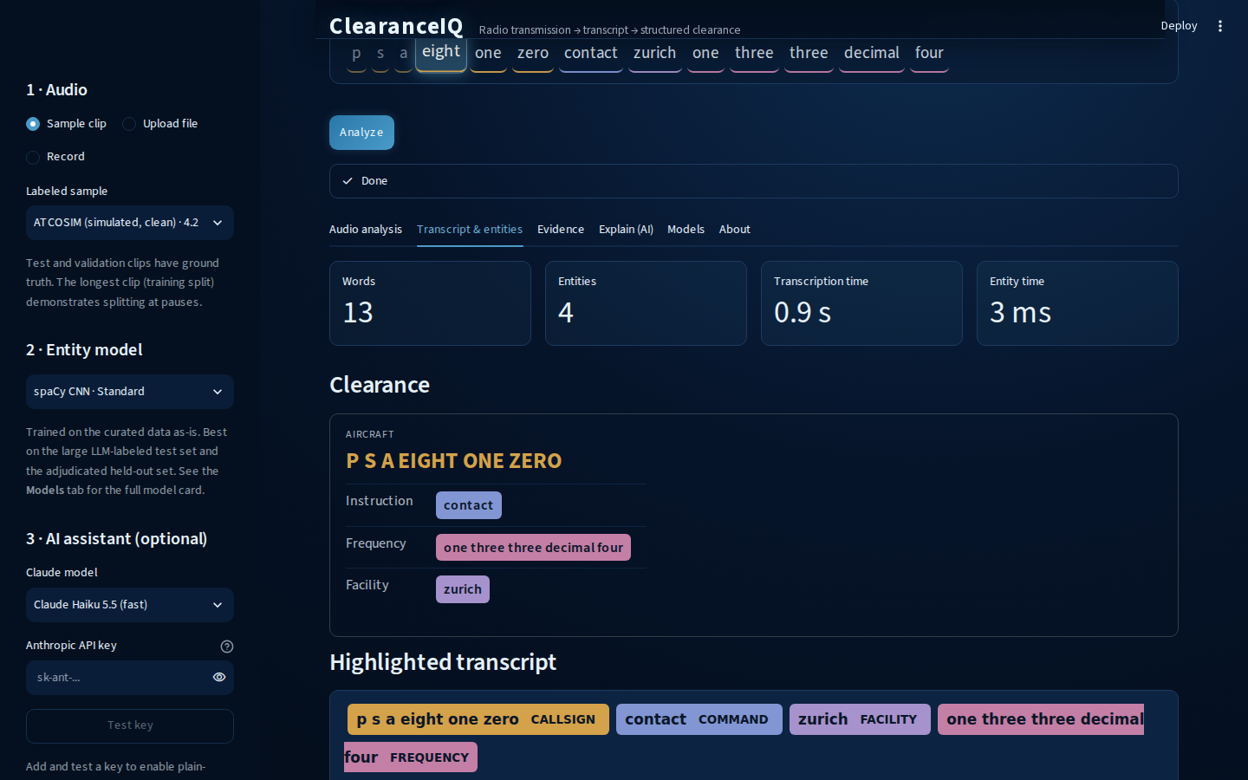


ClearanceIQ runs on a laptop CPU
ASSIST · CLEARANCEIQ
0.7 s
per utterance on CPU: real-time factor 0.2, about 5x faster than real time
2.2 GB
RAM; no GPU, PyTorch or transformers needed
~1 ms
for nine-label entity extraction
Audio → Whisper (CTranslate2 int8) → spaCy NER → clearance card. Optional: Claude explanation, Kokoro voice read-back.
Notes:
[~1:30 + LIVE DEMO ~3:00] Key engineering result: CTranslate2 int8 with dynamic encoder windows is about 3.6x faster than a fixed 30 s window and showed no measurable accuracy loss on 300 paired utterances (-0.25 points, CI -0.70 to +0.22), so the app runs the medium model at about 0.7 s per clip on a CPU in 2.2 GB. Then switch to the live demo: pick a labeled sample clip, press Analyze, show the live word-synchronized transcript, the clearance card with entities, the Evidence tab (WER and entity F1 against ground truth) and the Models tab. If the demo fails, advance to the hidden backup slide (next) that has the screenshots.

Slide 14
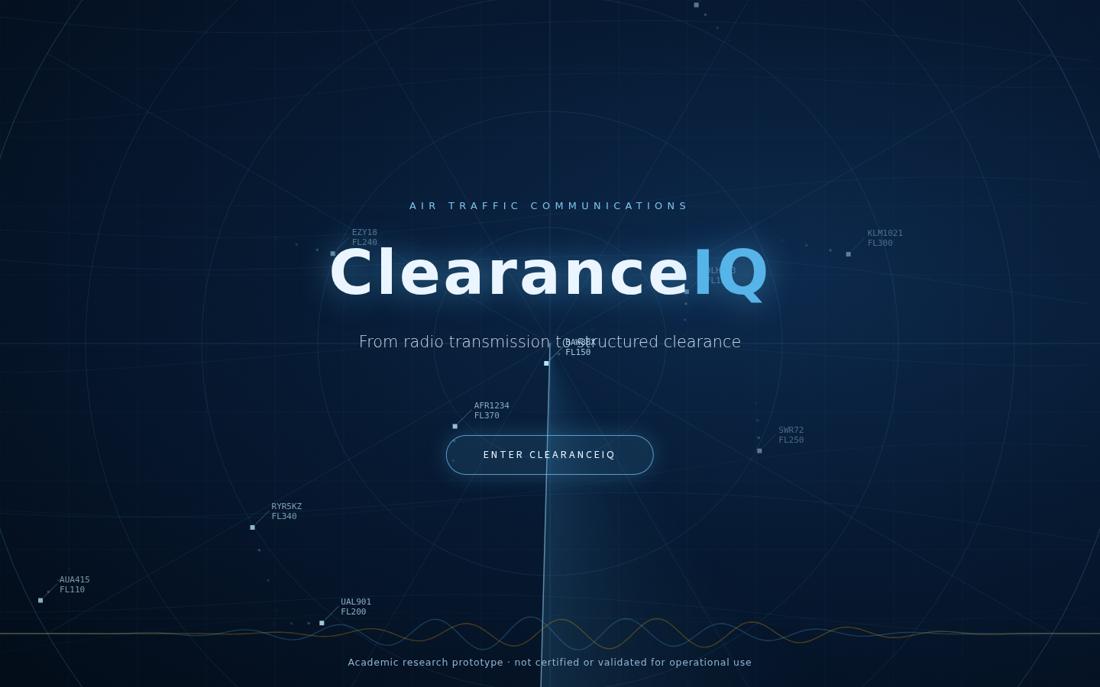
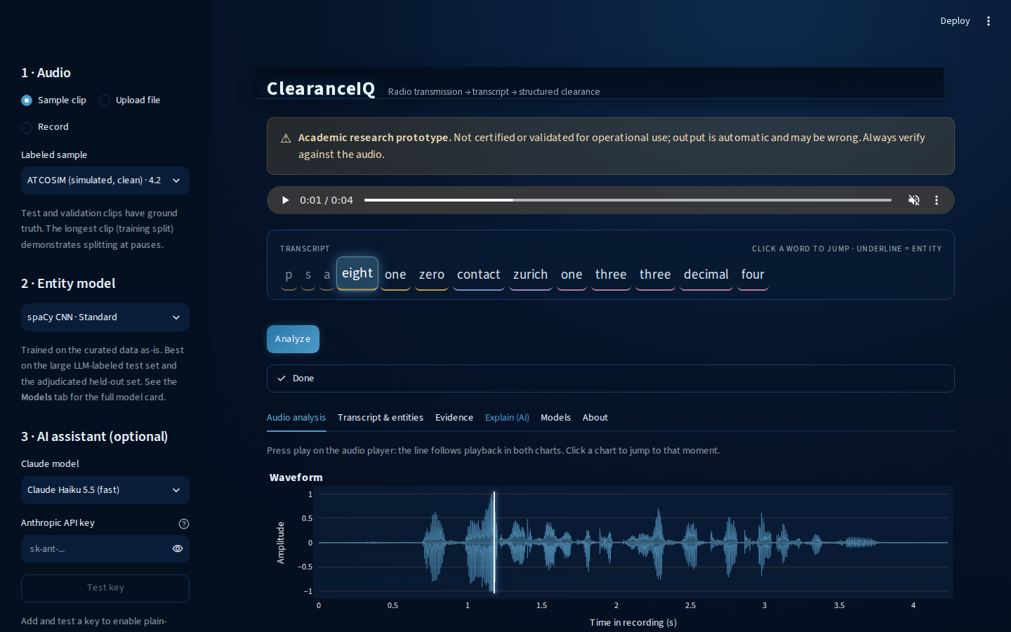
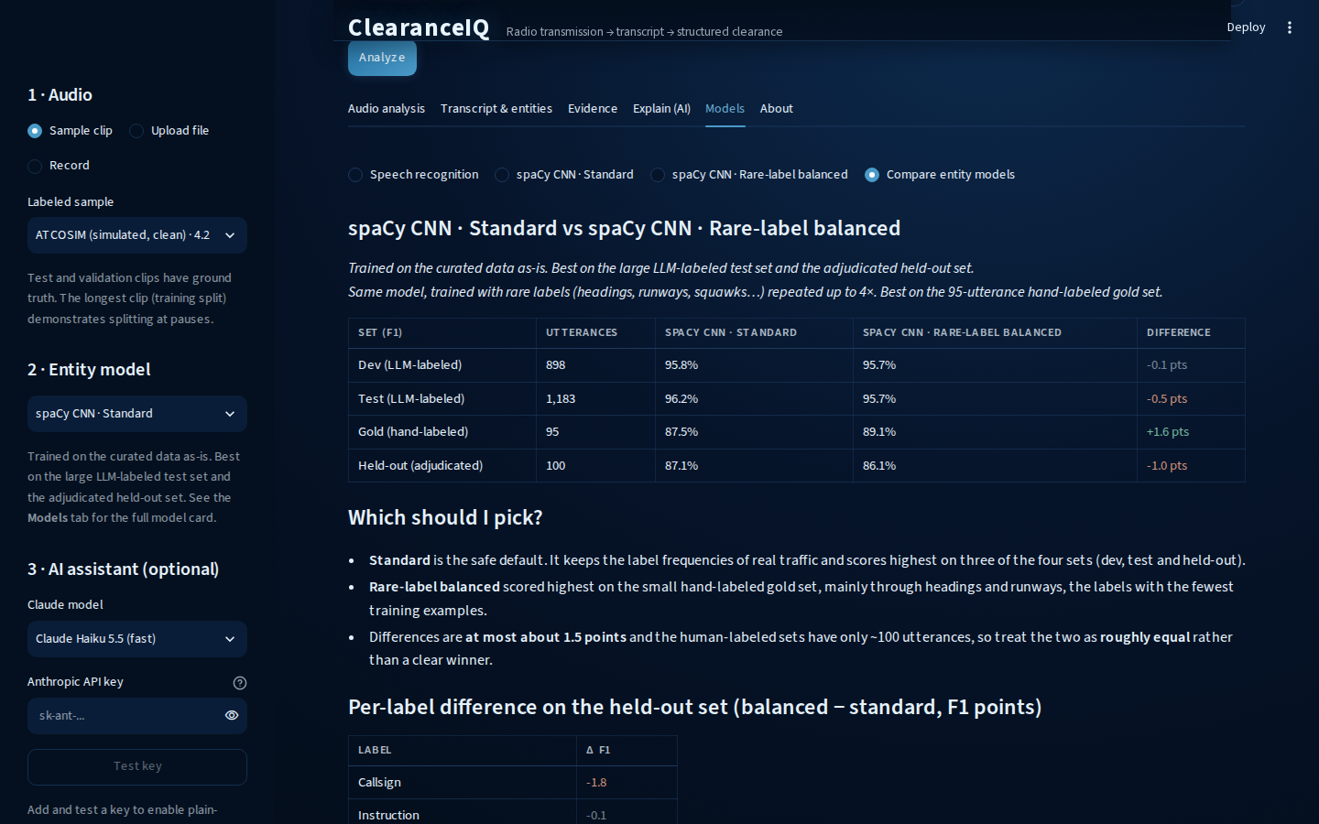
Demo backup: ClearanceIQ screenshots
ASSIST · BACKUP
Splash and research-prototype disclaimer
Audio analysis: waveform and Mel spectrogram
Transcript, clearance card and entities
Model cards with scores and limitations
Notes:
HIDDEN BACKUP SLIDE. Use only if the live demo fails. Narrate the same path: choose a sample, analyze, read the transcript and clearance card, then show the Evidence and Models tabs and the research-prototype disclaimer. In slideshow mode this slide is skipped; press the slide number then Enter, or unhide it, to jump here.

Slide 15
Metric glossary: how to read the numbers
BACKUP
Metric | Plain-English meaning
WER (word error rate) | Share of words the model gets wrong (substitutions, deletions, insertions). Lower is better; can exceed 100% on runaway output.
Precision / recall | Precision: of the entities found, how many are right. Recall: of the true entities, how many were found.
F1 (span F1, entity F1) | One score from 0 to 1 that balances precision and recall; higher is better. A span counts only if label and exact text match.
Entity recall | Share of the reference transcript's entities that also appear in the model's transcript.
95% confidence interval | The plausible range for a number given the finite test set; if a difference's interval includes zero, there is no clear gap.
Spearman ρ | How consistently two measures rise and fall together: 0 is no link, ±1 is perfect. Values under 0.2 are weak.
Real-time factor (RTF) | Processing time divided by audio length; below 1 is faster than real time.
Type-token ratio | Distinct words divided by total words; a measure of vocabulary variety.
SNR proxy | A rough dynamic-range estimate of audio clarity, not a physical signal-to-noise measurement.
Notes:
HIDDEN BACKUP SLIDE. Use if someone asks what a metric means. Plain-English definitions of every metric used in the deck.

Slide 16

What the project showed
CONCLUSIONS
RQ1 · ASR
RQ2 · NER
RQ3 · Errors
Domain adaptation works
Reliable on structured labels
Source and clip length matter most
3.8% word error rate overall and 7.5% on real audio, down from 35.7% and 53.6% zero-shot.
F1 of 0.861–0.878 on human-verified data (0 to 1, higher is better); weaker on frequencies and waypoints.
Real audio is harder than simulated; every other link is weak (correlation at most 0.17).
Notes:
[~1:00] Answer each research question in one sentence, explicitly. RQ1: yes, once adapted to the domain. RQ2: yes for well-structured labels, less so for ambiguous ones. RQ3: recording origin and very short clips matter most; the rest is weak and exploratory.
Transition: 'Which brings me to what this does not show.'

Slide 17



Limits and responsible use
LIMITS AND NEXT STEPS
Representativeness
About 7.4 h of real audio from limited airspace, 813 real test utterances, no accent or speaker metadata. The 7.5% is an estimate for these corpora.
OPERATIONAL USE
ClearanceIQ is a research prototype.
Error propagation
NER was trained on clean text but reads ASR output, and nothing yet passes ASR confidence to the entity stage.
It is not validated, certified or intended for operational use, has not been tested with controllers or pilots, and must not inform any safety decision.
Next steps
Accent-stratified evaluation, NER trained on ASR output, a controller and pilot user study, and speech-arousal (sentiment) analysis against WER and SNR.
Notes:
[~1:15] Be direct about limits. Representativeness: two corpora, limited airspace, no accent or speaker labels, so accent effects are untested rather than measured. Error propagation: entities amplify word errors and the NER cannot detect them. And the clear statement: ClearanceIQ is an academic prototype, not validated or intended for operational use.

Slide 18
Thank You
Questions & Discussion
github.com/BrettFX/UMBC-DATA606-Capstone · linkedin.com/in/brett-allen-586ba4121
Brett Allen | DATA 606 Capstone Final Presentation | UMBC, Fall 2026
Notes:
[Q&A] See docs/final_presentation_prep.md for prepared answers on scope, bias, leakage, metrics and operational limitations.

