Slide 1


ATC Communication Intelligence
Speech Recognition and Information Extraction for Aviation Safety
Brett Allen | DATA 606 Capstone Proposal | UMBC, Fall 2026
Dr. Jay Wang

Slide 2
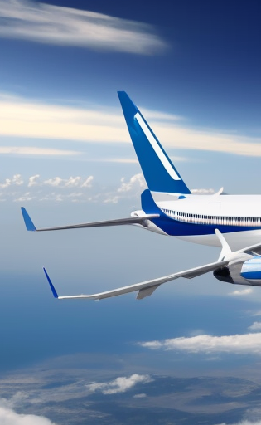
Proposal Contents
01
02
03
04
05
Why This Matters
Research Questions
The Data
Preliminary EDA
Modeling Plan & Next Steps
Brett Allen | DATA 606 Capstone Proposal | UMBC, Fall 2026

Slide 3
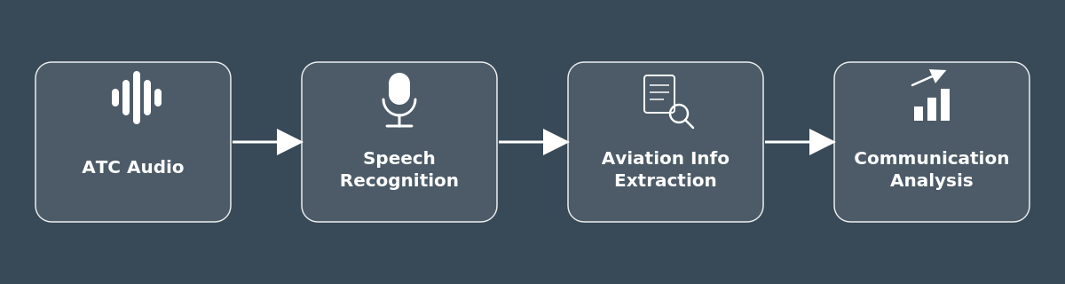
01. Why This Matters
Domain Challenge: Air Traffic Control (ATC) requires safety-critical communication that standard Automatic Speech Recognition (ASR) frequently misinterprets (e.g., callsigns, altitudes, headings, speeds, etc.).
Operational Risk: Traditional Word Error Rate (WER) metrics are insufficient. Minor transcript errors can lead to critical operational failures.
Goal: Develop a prototype tool (e.g., Streamlit app) designed to analyze real-time ATC audio for pilots and controllers.
Brett Allen | DATA 606 Capstone Proposal | UMBC, Fall 2026

Slide 4
02. Research Questions
Research Question 1: Automatic Speech Recognition (ASR) How accurately can general-purpose vs. aviation-adapted (pre-trained and/or fine-tuned) models transcribe ATC audio? (WER, CER, callsign/numeric/command recognition accuracy)
Research Question 2: Aviation Information Extraction Can NLP techniques reliably identify operational aviation information from ATC transcripts? None of the datasets inspected so far provides token-level entity labels, so the plan is to take a rule-based approach first, then possibly LLM-assisted annotation curation to train a spaCy NER model, evaluated against a small manually annotated subset. May be able to find and use a pre-trained NER model.
Research Question 3: Communication Characteristics and Model Performance Do acoustic properties (e.g., duration, speech rate, noise) or linguistic ones (e.g., word/content density) have an influence on model accuracy? Core features (e.g., duration, word/char count, speech rate, recording origin) are already computed as part of the preliminary EDA work.
Brett Allen | DATA 606 Capstone Proposal | UMBC, Fall 2026

Slide 5
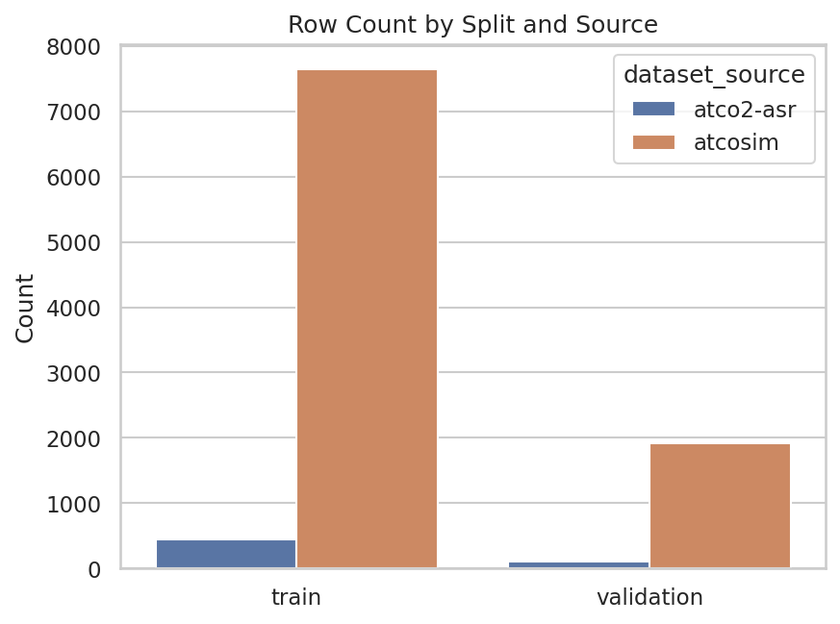
03. The Data
 | ATCO2-ASR (real) | ATCOSIM (simulated)
Utterances | 559 (446 train / 113 val) | 9,559 (7,646 train / 1,913 val)
Audio hours | ~1.10 | ~10.46
Native sample rate | 16kHz | 32kHz (resampled to 16kHz)
Avg. duration / words | 7.06s / 19.1 words | 3.94s / 11.3 words
Extra metadata | Airport, waypoints, callsigns (info) | None beyond audio + transcript
Combined via a reusable DataIngestPipeline: 10,118 utterances, ~11.55 hours, unified to 16kHz, with derived metadata (duration_sec, word_count, speech_rate_wpm, recorded_at, etc.).
ATCO2-ASR is the harder, real-world evaluation target while the ATCOSIM dataset is planned for training volume.
Sources: ATCO2 (atco2.org), accessed via the Hugging Face mirror jlvdoorn/atco2-asr; ATCOSIM (Jzuluaga/atcosim_corpus), accessed via the Hugging Face mirror jlvdoorn/atcosim.
Brett Allen | DATA 606 Capstone Proposal | UMBC, Fall 2026

Slide 6
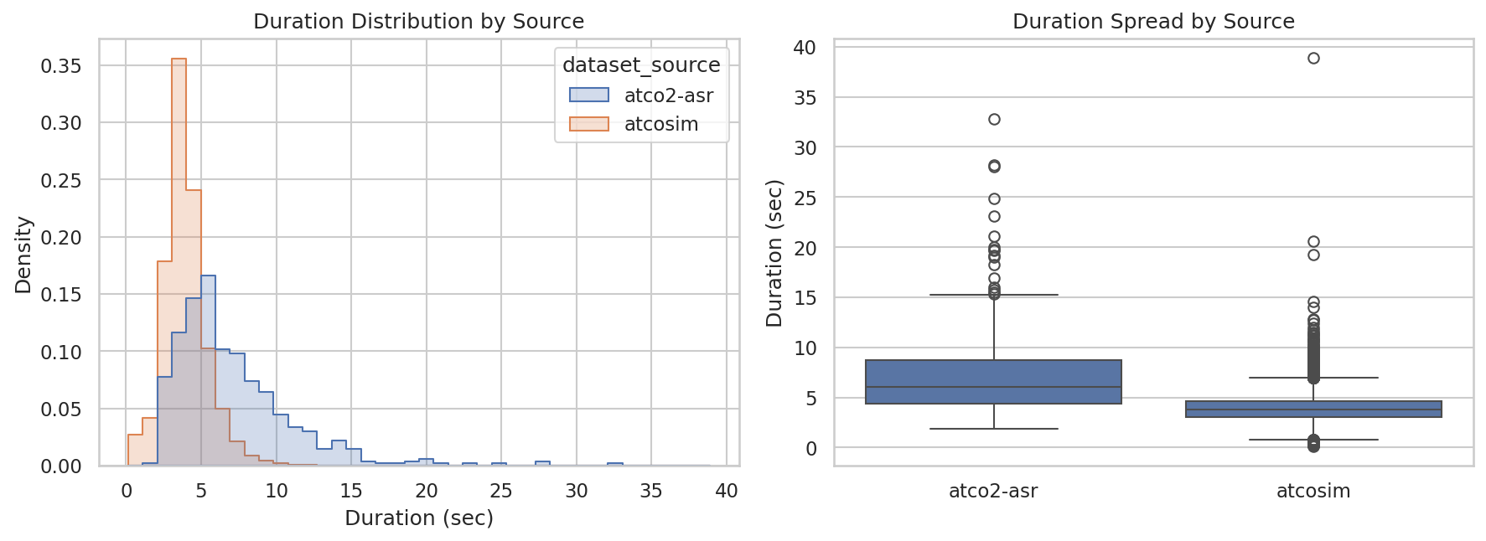
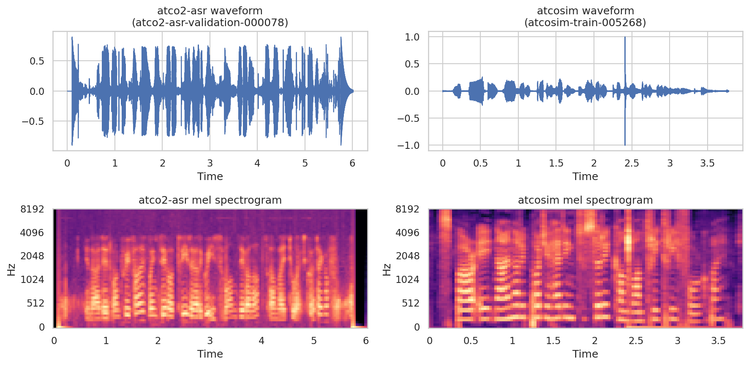
04. Preliminary EDA
Data Integrity: No missing transcripts, empty audio, or duplicates.
Severe Imbalance: Training split heavily skewed toward ATCOSIM (~17:1 vs. ATCO2-ASR) which will require separate evaluation per source.
Duration vs. Speed: ATCO2-ASR utterances are ~1.8x longer with ~1.7x more words but maintain a comparable speech rate (~168 vs. 174 wpm) which indicates higher information density.
Corpus Composition: ATCO2-ASR spans two collection periods (Oct 2020, Apr-May 2021) across seven non-US airports (non-American accents).
Manual Validation: Qualitative review revealed feedback (click) noise in an ATOCSIM sample when visualized as a waveform (otherwise undetectable by automated checks).
Brett Allen | DATA 606 Capstone Proposal | UMBC, Fall 2026

Slide 7
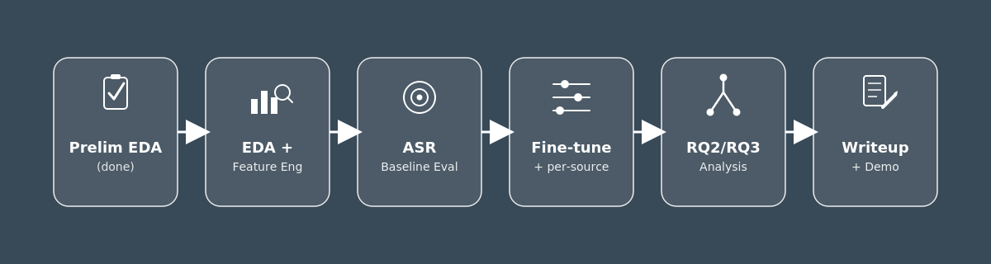
05. Modeling Plan & Next Steps
Evaluation: Split WER/CER by dataset source to ensure ATCOSIM volume doesn't mask poor performance on challenging ATCO2-ASR audio.
Workflow: Establish zero-shot baseline (e.g., Whisper/Wav2Vec2 at 16kHz), then fine-tune on ATCOSIM and adapt to ATCO2-ASR.
Data Prep: Filter/flag sub-0.5s clips and perform a corpus-wide clipping-artifact scan (in addition to further feature engineering).
Parallel Tasks: Develop rule-based NER baseline (RQ2) and conduct WER-vs-characteristics analysis (RQ3).
Milestones: Baseline eval, fine-tuning, RQ2/RQ3 analysis, and final writeup/prototype demo.
Brett Allen | DATA 606 Capstone Proposal | UMBC, Fall 2026

Slide 8

Thanks!
Brett Allen | DATA 606 Capstone Proposal | UMBC, Fall 2026

