Slide 1
ATC COMMUNICATION INTELLIGENCE
Speech Recognition and Information Extraction for Aviation Safety
HEAR, UNDERSTAND, COMPARE, ASSIST
Brett Allen | DATA 606 Capstone Executive Summary | UMBC, Fall 2026
Dr. Jay Wang
Notes:
[~0:15] One sentence: I built and evaluated a pipeline that turns air traffic control radio audio into text, then into structured clearance information, and wrapped it in a prototype app that runs on a laptop CPU. I'll cover the results in about four and a half minutes, then spend the rest of the video in the live demo.

Slide 2




From radio audio to a usable clearance
THE STORY
HEAR
UNDERSTAND
COMPARE
ASSIST
Fine-tune OpenAI Whisper model to transcribe real ATC radio
Extract aviation entities from the transcript
Judge models by aviation entities in addition to WER
CPU-based frontend application driven by Streamlit (ClearanceIQ)
RQ1
RQ2
RQ3
How accurately can domain-adapted ASR transcribe ATC speech?
Can NLP reliably extract operational information from transcripts?
Which acoustic and linguistic traits are linked to ASR errors?
Notes:
[~0:40] ATC is safety critical, and a transcript that is 'mostly right' can still get a callsign or an altitude digit wrong. So the project does four things: HEAR (fine-tune Whisper on real ATC radio), UNDERSTAND (extract nine aviation entities), COMPARE (judge models by entities, not just word error rate) and ASSIST (the ClearanceIQ app). Data in one breath: 17,681 utterances, about 17.9 hours, from one real-radio corpus and one simulated corpus, with a leakage-safe 1,909-utterance test set. Three research questions, answered at the end.
Transition: 'First, how well can a model hear ATC radio?'

Slide 3
Fine-tuning cut real-audio WER from 53.6% to 7.5%
HEAR · ASR RESULTS
3.8%
overall WER (95% CI: 3.4% to 4.3%), 1.2% on simulated audio
1.5 pts lower
vs. the jacktol/whisper-medium.en-fine-tuned-for-ATC off-the-shelf ATC model on real audio (95% CI: −2.4 to −0.6)
NOTE: The jacktol model may have seen part of the test audio during its own training, so it’s possible there was leakage.
WER: Word error rate; the share of words the model gets wrong; lower is better.
CI: Confidence interval; the range the true value likely falls in.
Notes:
[~0:40] Headline ASR result. Off-the-shelf Whisper medium is at 53.6% word error rate on real radio audio. After domain fine-tuning (LoRA), the selected model reaches 7.5% on real audio and 3.8% overall, scored once on all 1,909 test utterances. It beats an off-the-shelf ATC model on real audio by 1.5 points; mention briefly that model may have seen part of the test audio, so treat that comparison with care.
Transition: 'A transcript is only useful if we can pull the operational facts out of it.'

Slide 4




An LLM teaches a small, fast model
UNDERSTAND · ENTITY EXTRACTION (NER)
LLM teacher
Curate
Verify
Student
Qwen3.5-9B LLM labeled 15,083 utterances: 42,915 entity spans in 12.5 h
33% of labels were flagged as doubtful and held out of training
Ran remaining disagreements through custom NER labeling tool to build a final gold held-out set
spaCy NER: about 4 MB and 3,700 utterances/s on a CPU vs. 0.33 utterances/s using the LLM (3.03 seconds per utterance). Student is ~11,000x faster.
NINE LABELS
CALLSIGN
COMMAND
FACILITY
ALTITUDE
HEADING
FREQUENCY
WAYPOINT
RUNWAY
SQUAWK
Notes:
[~0:30] The datasets have no entity labels, so I made them in stages: an LLM teacher labeled 15,083 utterances, doubtful labels were held out, humans verified a gold evaluation set, and a small spaCy student model was trained on the result. Student scores 0.861 F1 versus 0.878 for the LLM teacher, but is about 11,000x faster and only 4 MB, which is what lets the app run on a CPU. Nine labels shown on the slide. Don't read them all.
Transition: 'Now the key insight of the project.'

Slide 5
WER hides the actual meaning of errors
COMPARE · AVIATION-SPECIFIC ERRORS
9.1% vs 7.5%
real-audio WER: nearly the same
0.754 vs 0.935
entity F1 is very different
NOTE: Callsigns are the weakest entity for both fine-tuned models (recall 0.886 for the medium.en + LoRA model). Airline names and spelled registrations are the hardest words (e.g., “alpha bravo charlie one niner six seven”).
Entity recall = the share of the reference transcript's entities (same label, same text) that also appear in the model's transcript.
Notes:
[~0:40] This is the slide that justifies the project's premise. Two ATC models look similar on word error rate (9.1% vs 7.5% on real audio), yet entity F1 is 0.754 versus 0.935, and callsign recall is 0.557 versus 0.886. WER hides which words are wrong, and in aviation a callsign or an altitude is exactly the word you cannot lose. That is why I evaluate by entities.
Transition: 'So let me show you what this looks like in practice.'

Slide 6
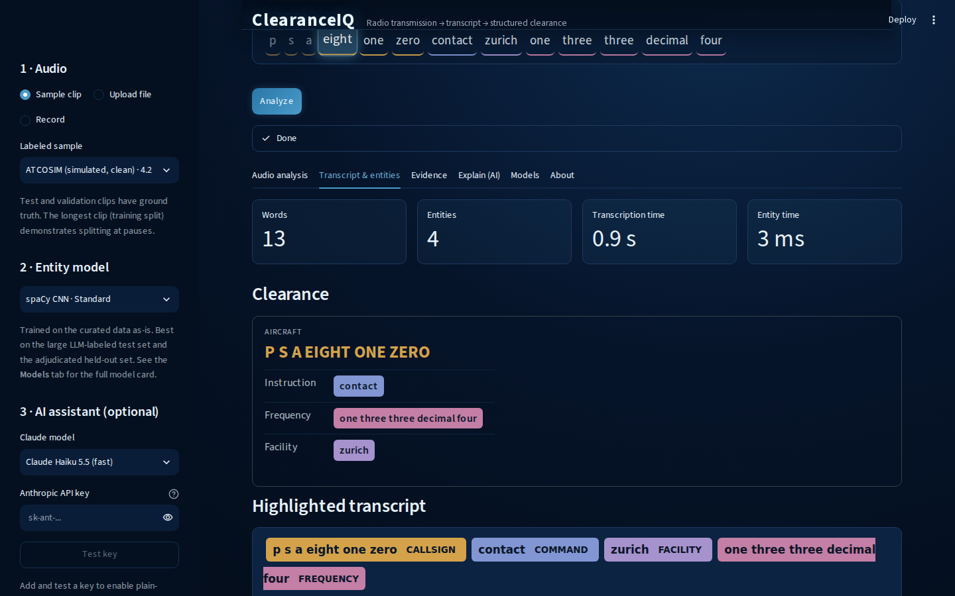


Streamlit app (ClearanceIQ) runs on a laptop CPU
ASSIST · CLEARANCEIQ
0.7 s
per utterance on CPU: real-time factor of 0.2, which is about 5x faster than real time
2.2 GB CPU RAM
No special prerequisite installations required (e.g., PyTorch, transformers, etc.)
~1 ms
for nine-label entity extraction
Features: Audio → Whisper (CTranslate2 int8) → spaCy NER → clearance card.
Optional: Claude explanation, Kokoro voice read-back.
Notes:
[~0:25 then LIVE DEMO, 5:00+] One line of context: the app runs the medium model at about 0.7 s per clip, about 5x faster than real time, on a laptop CPU in 2.2 GB, with about 1 ms for entity extraction. Now switch to the Streamlit app and follow the DEMO SCRIPT (script saved separately as DEMO_SCRIPT.md). If the demo fails, advance to the hidden backup slide (screenshots).

Slide 7
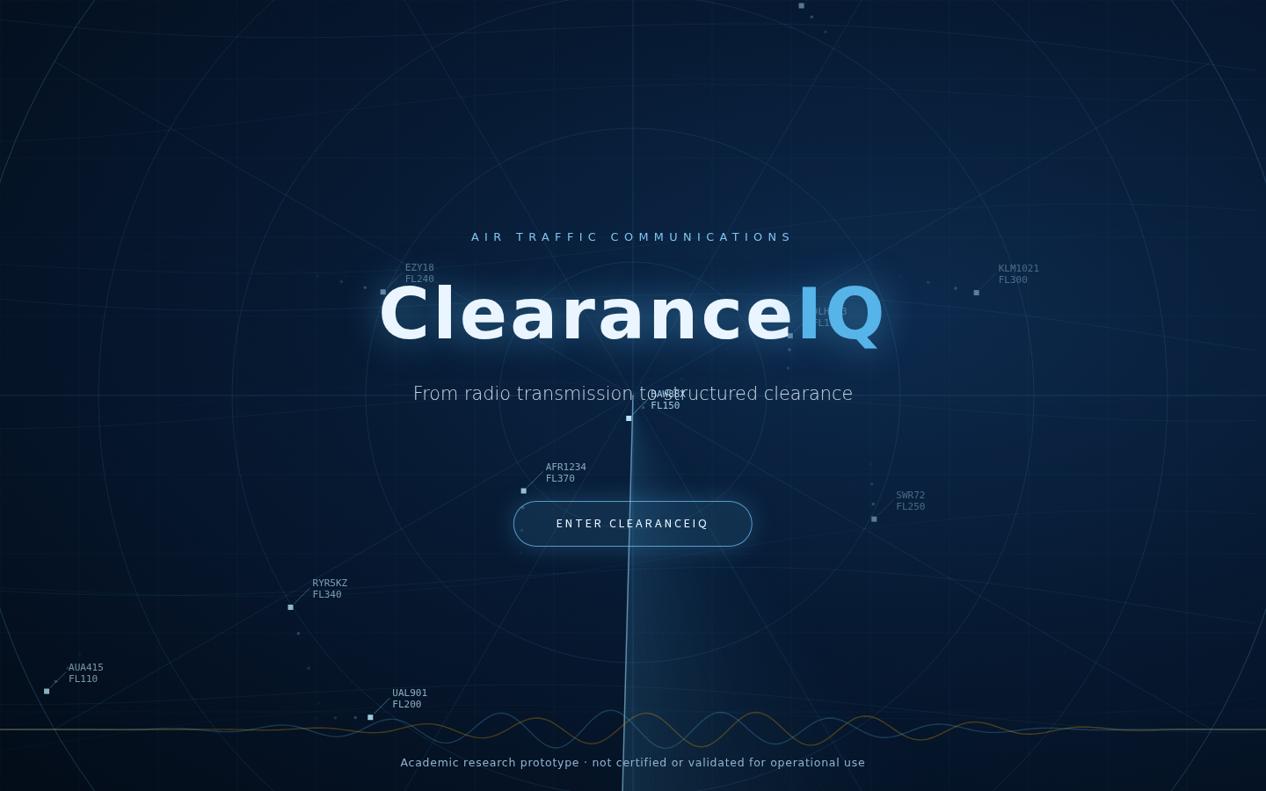
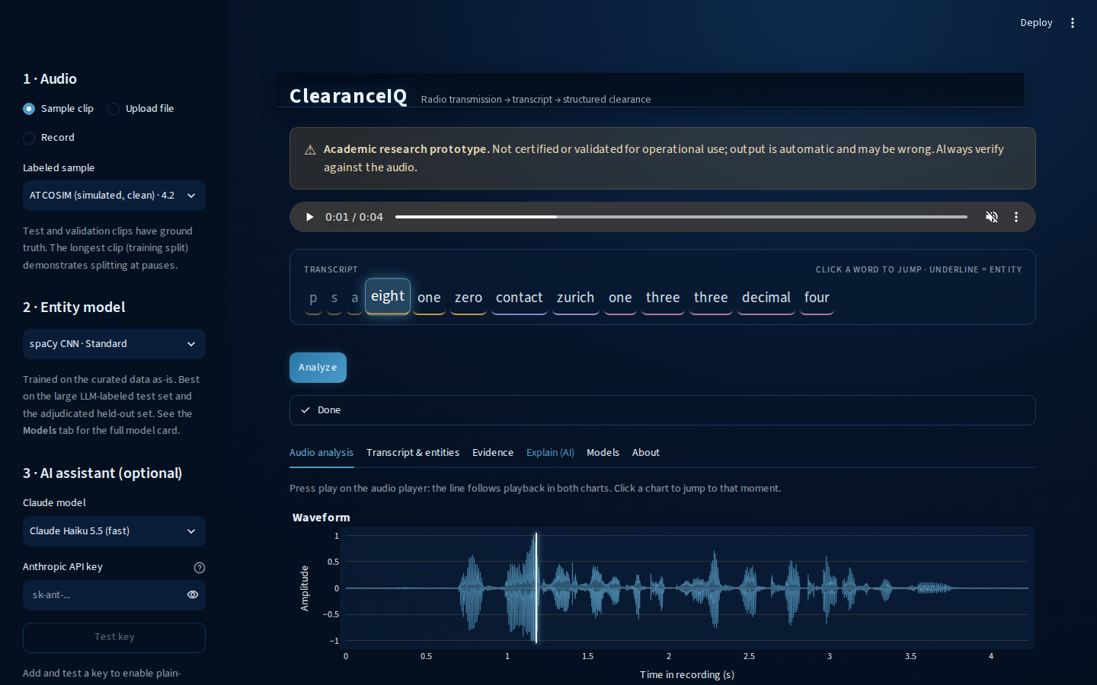
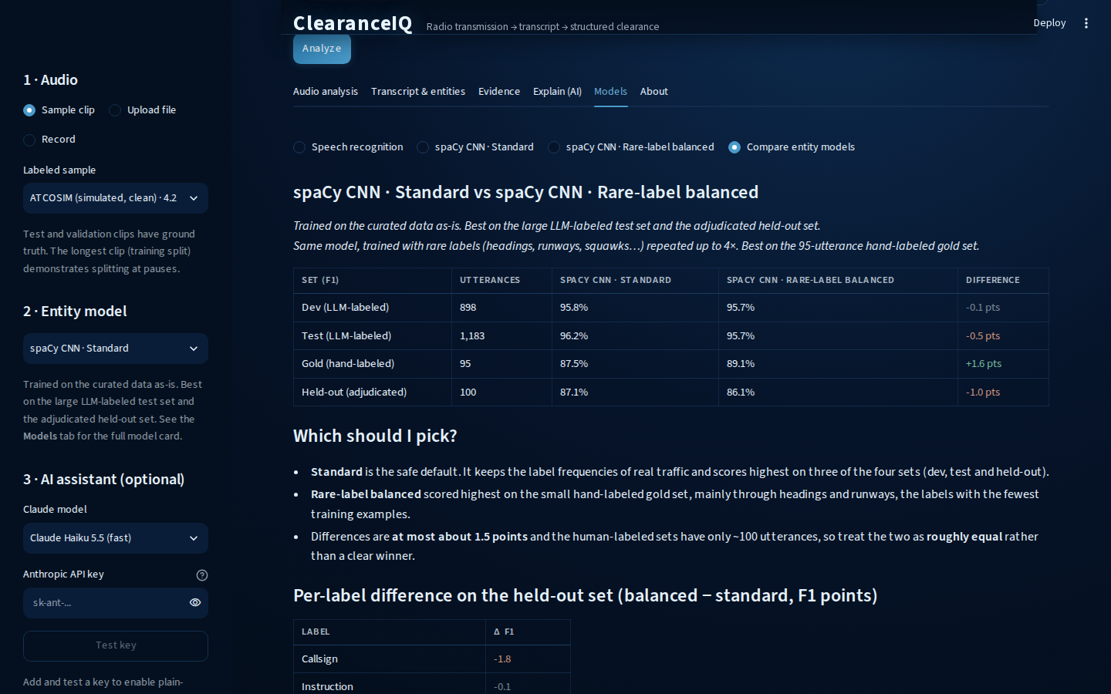
Demo backup: ClearanceIQ screenshots
ASSIST · BACKUP
Splash and research-prototype disclaimer
Audio analysis: waveform and Mel spectrogram
Transcript, clearance card and entities
Model cards with scores and limitations
Notes:
[BACKUP, hidden] Only use if the live demo fails. Walk through the screenshots instead.

Slide 8

Lessons Learned & Key Takeaways
CONCLUSIONS
RQ1 · ASR
RQ2 · NER
RQ3 · Errors
Domain adaptation works
Reliable on structured labels
Source and clip length matter most
Fine-tuning cut word error rate from 35.7% to 3.8% overall, and from 53.6% to 7.5% when looking at just real radio audio.
The spaCy model scores 0.861 F1 on human-verified held-out data (teacher at 0.878 F1). Weakest labels are waypoints (0.74 span F1) and frequencies (0.76 span F1).
Real audio is harder than simulated; every other link is weak (correlation at most 0.17).
Notes:
[~0:40] Answer each research question in one sentence. RQ1: very accurately once adapted to the domain (35.7% to 3.8% WER overall, 53.6% to 7.5% on real audio). RQ2: yes for well-structured labels such as runway, altitude, command and callsign; weaker for waypoints and frequencies. RQ3: real versus simulated audio and very short clips matter most; every other link is weak.
Transition: 'And the honest limits.'

Slide 9



Limits and responsible use
LIMITS AND NEXT STEPS
Representativeness
About 7.4 h of real audio from limited airspace, 813 real test utterances, no accent or speaker metadata. The 7.5% is an estimate for these corpora.
OPERATIONAL USE
ClearanceIQ is a research prototype.
Error propagation
NER was trained on clean text but reads ASR output, and nothing currently passes ASR confidence to the entity stage.
It is not validated, certified or intended for operational use, has not been tested with controllers or pilots, and must not inform any safety decision.
Next steps
Accent-stratified evaluation, NER trained on ASR output, a controller and pilot user study, and speech-arousal (sentiment) analysis against WER and SNR.
Notes:
[~0:30] Be direct. Two corpora and limited airspace, so accent effects are untested. Errors propagate: NER cannot tell a wrong digit from a right one. Say clearly: ClearanceIQ is an academic prototype, not validated or intended for operational use, and must not inform any safety decision.

Slide 10
Thank You
Questions & Discussion
github.com/BrettFX/UMBC-DATA606-Capstone · linkedin.com/in/brett-allen-586ba4121
Brett Allen | DATA 606 Capstone Executive Summary | UMBC, Fall 2026
Notes:
[~0:10] Thank the audience. Repo and LinkedIn are on the slide. Full report and the complete 21-slide deck are in the repo's docs folder.

